Slide 1

Git

Slide 2

What is version control
Version control allows you to manage your application overtime
With version control you can track any changes or added features to you application
Download git from https://git-scm.com/
To check that installation was successful type the following command

Slide 3
Exploring Git
add command
commit command
Untracked File
Unstaged File
Staged File
Commits
app.js
app.js
0a13
app.js
Features.js
app.js
0a12
Features.js

Slide 4
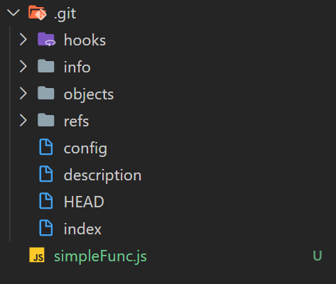
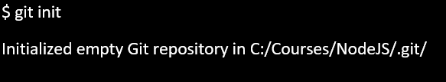
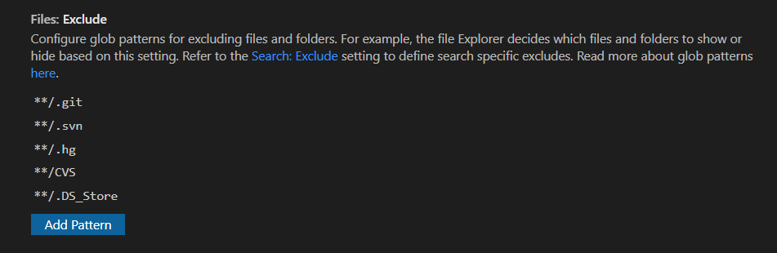
Initializing git
Initializing git

Slide 5
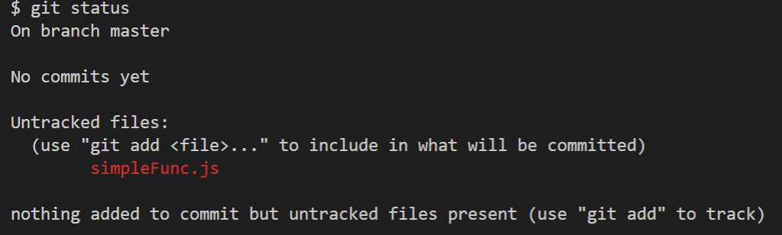
Git status

Slide 6
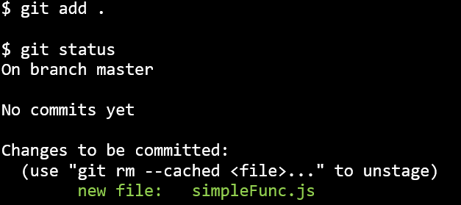
Git add

Slide 7
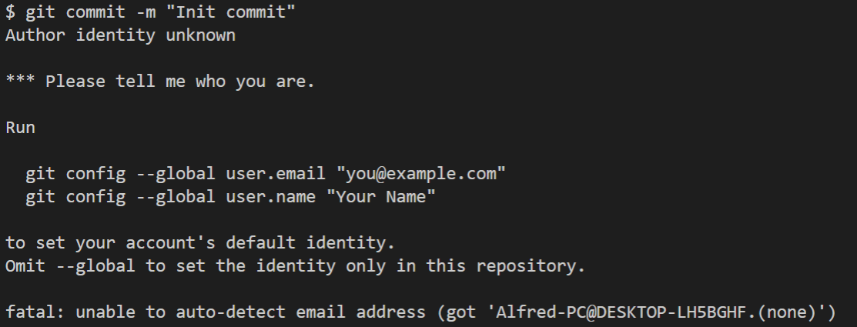
Git commit

Slide 8
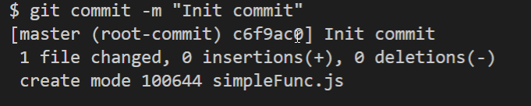
Git commit

Slide 9
Check if you have ssh

Slide 10
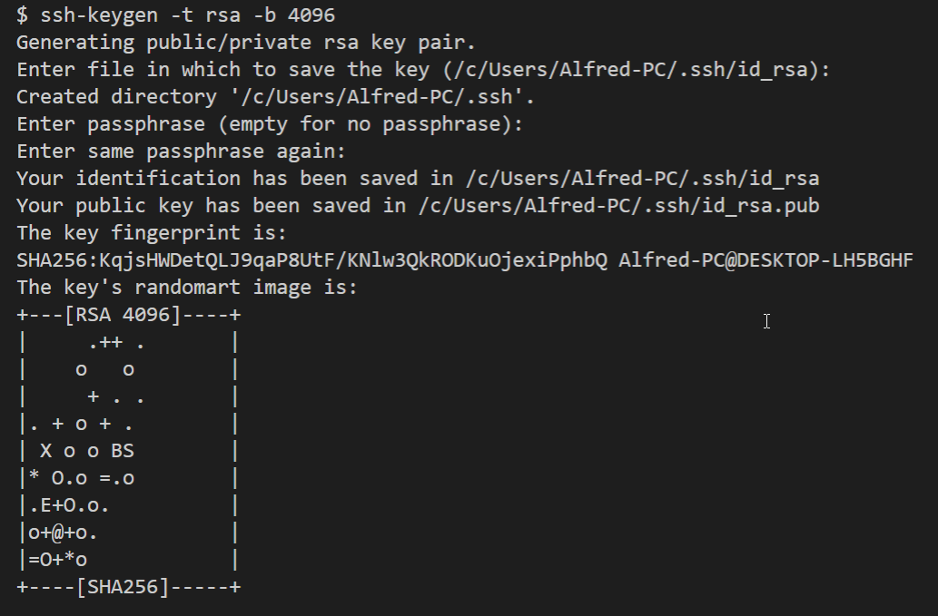
Create an SSH Key

Slide 11
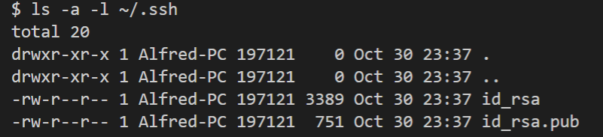
SSH Files

Slide 12
For more info about ssh key
https://docs.github.com/en/github/authenticating-to-github/generating-a-new-ssh-key-and-adding-it-to-the-ssh-agent

