Slide 1
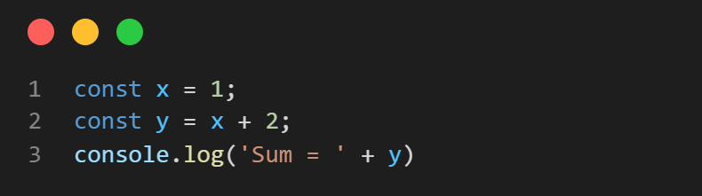
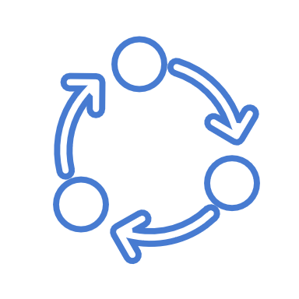
Asynchronous Node.js
Call Stack
Node APIs
Event Loop
Callback Queue

Slide 2
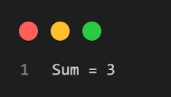
Asynchronous Node.js
Call Stack
Node APIs
Console.log(‘Sum= 3’)
Event Loop
Callback Queue

Slide 3
Asynchronous Node.js
Call Stack
Node APIs
Event Loop
Callback Queue

Slide 4
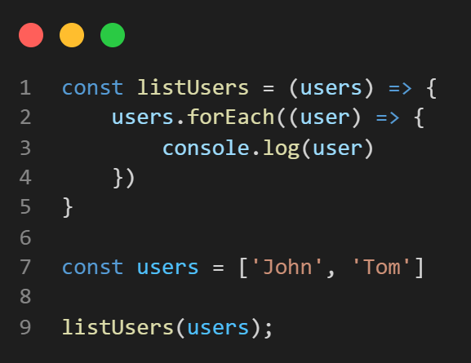
Asynchronous Node.js
Call Stack
Node APIs
Event Loop
Callback Queue

Slide 5
Asynchronous Node.js
Call Stack
Node APIs
listUsers([ . . . ])
Event Loop
Callback Queue

Slide 6
Asynchronous Node.js
Call Stack
Node APIs
forEach(…)
listUsers([ . . . ])
Event Loop
Callback Queue

Slide 7
Asynchronous Node.js
Call Stack
Node APIs
anonymous(‘John’)
forEach(…)
listUsers([ . . . ])
Event Loop
Callback Queue

Slide 8
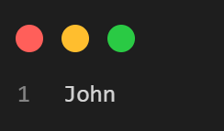
Asynchronous Node.js
Call Stack
Node APIs
console.log(‘John’)
anonymous(‘John’)
forEach(…)
listUsers([ . . . ])
Event Loop
Callback Queue

Slide 9
Asynchronous Node.js
Call Stack
Node APIs
anonymous(‘John’)
forEach(…)
listUsers([ . . . ])
Event Loop
Callback Queue

Slide 10
Asynchronous Node.js
Call Stack
Node APIs
forEach(…)
listUsers([ . . . ])
Event Loop
Callback Queue

Slide 11
Asynchronous Node.js
Call Stack
Node APIs
anonymous(‘Tom’)
forEach(…)
listUsers([ . . . ])
Event Loop
Callback Queue

Slide 12
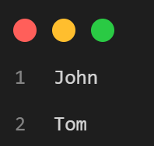
Asynchronous Node.js
Call Stack
Node APIs
console.log(‘Tom’)
anonymous(‘Tom’)
forEach(…)
listUsers([ . . . ])
Event Loop
Callback Queue

Slide 13
Asynchronous Node.js
Call Stack
Node APIs
anonymous(‘Tom’)
forEach(…)
listUsers([ . . . ])
Event Loop
Callback Queue

Slide 14
Asynchronous Node.js
Call Stack
Node APIs
forEach(…)
listUsers([ . . . ])
Event Loop
Callback Queue

Slide 15
Asynchronous Node.js
Call Stack
Node APIs
listUsers([ . . . ])
Event Loop
Callback Queue

Slide 16
Asynchronous Node.js
Call Stack
Node APIs
Event Loop
Callback Queue

Slide 17
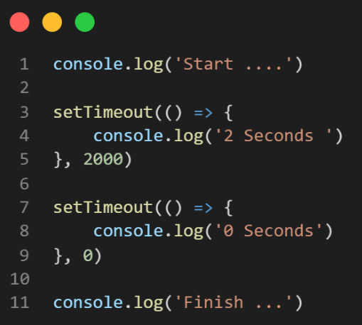
Asynchronous Node.js
Call Stack
Node APIs
Event Loop
Callback Queue

Slide 18
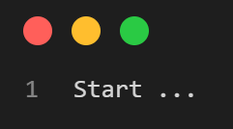
Asynchronous Node.js
Call Stack
Node APIs
Console.log(‘Start . . .’)
Event Loop
Callback Queue

Slide 19
Asynchronous Node.js
Call Stack
Node APIs
setTimeout(…, 2000)
Event Loop
Callback Queue

Slide 20
Asynchronous Node.js
Call Stack
Node APIs
setTimeout(…, 2000)
Event Loop
Callback Queue

Slide 21
Asynchronous Node.js
Call Stack
Node APIs
setTimeout(…, 2000)
setTimeout(…, 0)
Event Loop
Callback Queue

Slide 22
Asynchronous Node.js
Call Stack
Node APIs
setTimeout(…, 2000)
Event Loop
Callback Queue
setTimeout(…, 0)

Slide 23
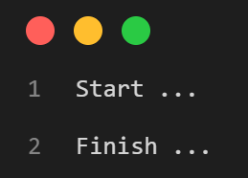
Asynchronous Node.js
Call Stack
Node APIs
setTimeout(…, 2000)
Console.log(‘Finish . . .’)
Event Loop
Callback Queue
Callback(0 sec)

Slide 24
Asynchronous Node.js
Call Stack
Node APIs
setTimeout(…, 2000)
Event Loop
Callback Queue
Callback(0 sec)

Slide 25
Asynchronous Node.js
Call Stack
Node APIs
setTimeout(…, 2000)
Callback(0 sec)
Event Loop
Callback Queue

Slide 26
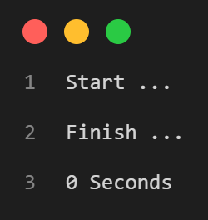
Asynchronous Node.js
Call Stack
Node APIs
setTimeout(…, 2000)
console.log(0 Seconds)
Callback(0 sec)
Event Loop
Callback Queue

Slide 27
Asynchronous Node.js
Call Stack
Node APIs
setTimeout(…, 2000)
Callback(0 sec)
Event Loop
Callback Queue

Slide 28
Asynchronous Node.js
Call Stack
Node APIs
setTimeout(…, 2000)
Event Loop
Callback Queue

Slide 29
Asynchronous Node.js
Call Stack
Node APIs
Event Loop
Callback Queue
setTimeout(…, 2000)

Slide 30
Asynchronous Node.js
Call Stack
Node APIs
Callback(2 sec)
Event Loop
Callback Queue

Slide 31
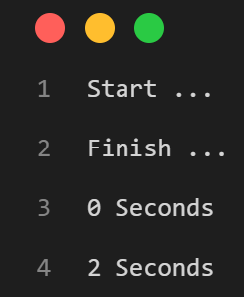
Asynchronous Node.js
Call Stack
Node APIs
console.log(2 Seconds)
Callback(2 sec)
Event Loop
Callback Queue

Slide 32
Asynchronous Node.js
Call Stack
Node APIs
Callback(2 sec)
Event Loop
Callback Queue

Slide 33
Asynchronous Node.js
Call Stack
Node APIs
Event Loop
Callback Queue

