Slide 1

Sign Language Recognition System with Machine Learning
DEPERTMENT OF COMPUTER SCIENCE & ENGINEERING
BIRBHUM INSTITUTE OF ENGINEERING & TECHNOLOY, SURI, BIRBHUM
Presented by
Under Guidance of
Akash Murmu (11800119010)
Samrat Biswas (11800119005)
Dr. Debasri Chakraborty
Nilim Sarkar

Slide 2
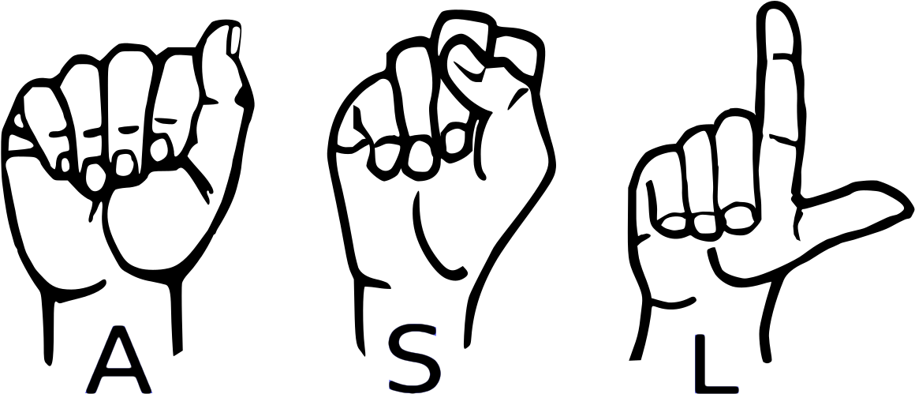
Agenda_
What is Sign Language & Why It’s Important?
Motivation;
Problem Statements;
System Requirements;
System Implementation;
Result;
What Next?
Conclusion.

Slide 3

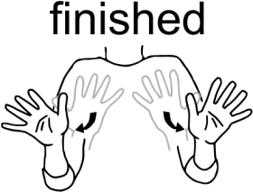
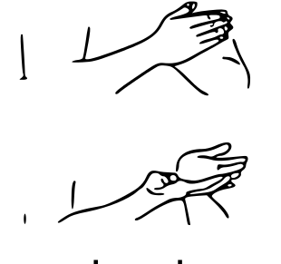
What is Sign Language?
01
Sign language is a way of communication using hand gestures and movements, body language and facial expressions, instead of spoken words.
Open
Finished
Book

Slide 4
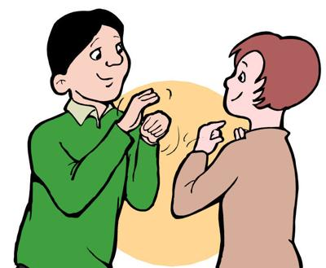
Importance Sign Language?
02
Sign Language is the only way to communicate with Deaf & Dumb people.
It gives deaf children the opportunity to educate themselves.
It also makes deaf people’s lives easier.

Slide 5
Motivation
03
Usually, Sign Language is learned by deaf & dumb people, it is not known to normal people.
It‘s a challenge to communicate with deaf & dumb people for normal people.
Our project aim is to take the basic step in bridging the communication gap between normal people and deaf and dumb people using American sign language.

Slide 6
Problem Statements
04
Realtime Hand detection;
Understanding the exact context of symbolic expression;
Recognize the hand sign and tracking the accuracy of hand gesture;
In addition, there are also sum problems like, background noise of image, high computation cost, large-scale of data.

Slide 7
System Requirements
05
Hardware Requirements (min):
Processor: Intel core i3 / AMD Ryzen 3
RAM: 4GB
Storage: 5GB
Graphic Card: Integrated graphics
Capture Device: External Webcam (if don’t have in-built camera)

Slide 8
System Requirements
06
Software Requirements (min):
Python 3.10
Operating System: Windows 7-11/ Linux / MAC OS
IDE: VSCode / PyCharm / any other IDE

Slide 9
System Requirements
07
Other Requirements:
Python Modules
TensorFlow (2.11.0)
Keras (2.11.0)
MediaPipe (0.9.0)
Scikit-learn (1.1.3)
Pandas (1.5.1)
Numpy (1.23.1)

Slide 10

System Implementation
08
Data Collection: As it is a vision based approach our data is images.
First of all we detect & captured the images from the camera feed.
Then all the images are stored as following structure of directories.
Root dir
data
Storing Images
A
Capture Image
B
…
Z

Slide 11

System Implementation
09
Image Processing: In order to process the image data some steps are followed. They are showing in diagram bellow:
Captured Image
Captured Image
Captured Image
Cropped Hand Sign
Convert into Grayscale
Further Per-process
(64, 64, 3)
(64, 64, 1)
Data is perfect to use in Training
Flatten Array
Dataset

Slide 12
System Implementation
10
Training Model:
Load and separate train-test data.
In order to train the model we used 23400 sample data. Every sample data has 4096 attributes (pixel values).
3 Dense Layers and 1 Dropout Layer are used to train to CNN model.
Activation Function: ReLU & Softmax.
Loss Function: Sparse Categorical Crossentropy
Splitting Train & Test Data
Dataset
Training Machine Learning Model

Slide 13
System Implementation
11
Testing Model:
Getting Test Dataset
Dataset
Train Machine Learning Model
Test Data
Fine-tune the Architecture & Hyper Parameters of Model
Get Desired Accuracy?
Classification Using Machine Learning Model
False
True
Output

Slide 14
System Implementation
12
Real-time Testing:
Capturing image from camera feed.
Process image same as done during training model.
Feed image array to the trained model.
Getting output.
Capture Image
Process Image
Feeding to the Trained Model
Predicting Class
Output

Slide 15
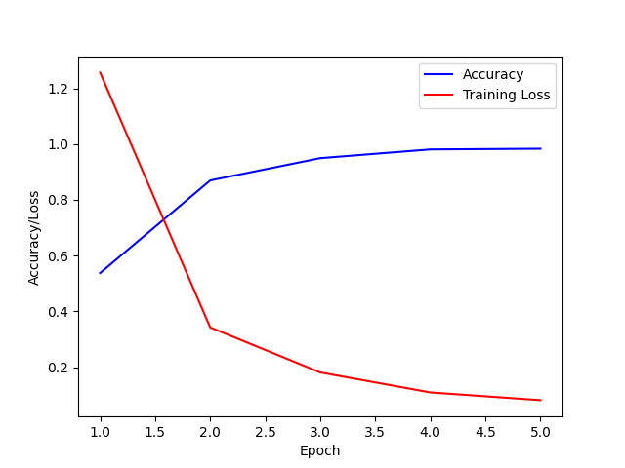
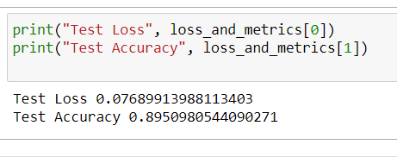
Result
13
Train Result
Accuracy:
Training Accuracy: 96.3%
Test Accuracy: 89.5%
Loss:
Training Loss: .0644%
Test Loss: .0768%
Train Result

Slide 16
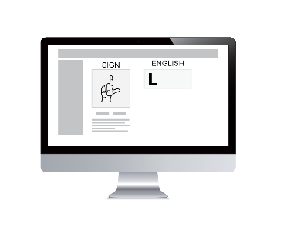
What Next?
14
Recognize other gestures like- Number, Words, Instructions etc.
Also recognize dynamic signs.
Implement speak functionality.
Finally implement a beautiful User Interface.

Slide 17
Conclusion
15
In this project we proposed an idea for feasible communication between deaf & dumb and normal people by using Machine Learning & Image Processing.
Our proposed project ensure accuracy of 96.3%.
But there is some problem with real time testing.

Slide 18
Thank You !
Any Question?
Notes:
© Samrat Biswas

