Slide 1
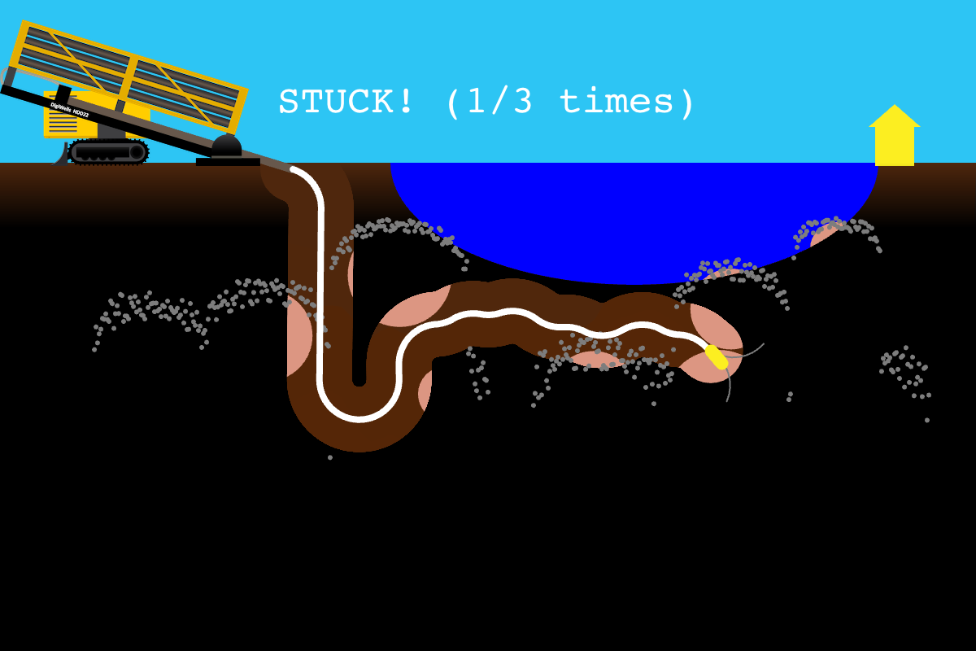

Slide 2
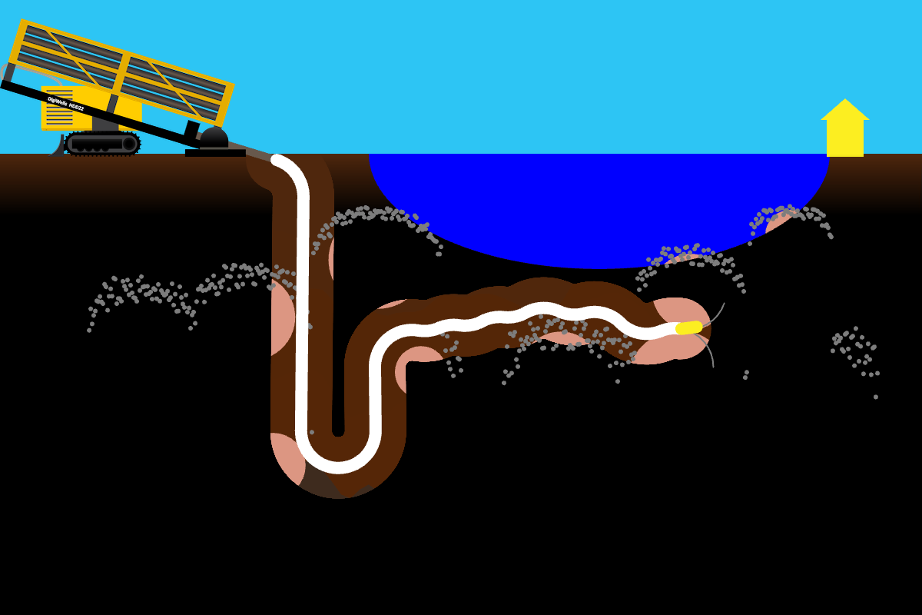
bore
nder

Slide 3
nder
bore

