Slide 1

Department of Computer Science & Engineering
NEXUSEDU AI
Full-Stack Student & Campus Intelligence Platform with Unified Dev Matrix & AI Placement Diagnostics
MINI PROJECT | SESSION 2026-2027
PRESENTED BY: TEAM NO. 12
Student Names: Aman Sharma (Lead), Shruti Sharma, Alex Rivera, Sarah Vance
Roll Numbers: 2201920100042, 2201920100085, 2201920100012, 2201920100099
Branch & Section: Computer Science & Engineering (Section A) | Year: 2nd Year (B.Tech)
UNDER SUPERVISION OF: Dr. Sarah Vance, Associate Professor, Department of CSE

Slide 2
Department of Computer Science & Engineering
Slide 2 of 15
NAVIGATION ROADMAP
PROJECT PRESENTATION OUTLINE
01 Introduction
Domain background, real-world problem statement & project motivation
07 Methodology
14-Week Agile iterative lifecycle & sprint milestones
02 Objectives & Scope
Concrete action goals, core deliverables & technical scope limits
08 Modules & Features
Auth, 90-Day Matrix, AI Assessment & Arena, ByteCoins, Faculty Hub & Notices
03 Existing vs Proposed System
Critical comparison with traditional LMS and literature gaps
09 Implementation & Results
Live UI showcases, 90-day sync metrics & verified demo proofs
04 Technology Stack
Frontend, Flask 3.1 Python backend, SQLite3 & Gemini AI engine
10 Testing & Validation
Unit, functional, security, session bypass & cross-browser tests
05 Resource Requirements
Hardware specifications & software tools version matrix
11 Conclusion & Future Scope
Key learning outcomes, deliverables achieved & future cloud roadmap
06 System Design & Architecture
3-Tier system topology, data flow (DFD) & relational schema
12 References
Academic papers, official documentation & RFC citations (APA Style)

Slide 3
Department of Computer Science & Engineering
Slide 3 of 15
01 INTRODUCTION
INTRODUCTION: DOMAIN, PROBLEM & MOTIVATION
1. Domain & Background
Full-Stack Web Engineering & Developer Analytics
• Focuses on building modern, responsive, high-performance web applications integrated with relational databases and machine learning/AI APIs.
• In today's software recruitment ecosystem, campus placements demand multi-dimensional technical excellence: strong DSA problem-solving and clean Git version control.
• Educational institutions face significant challenges tracking these decentralized activities without a unified platform.
2. Real-World Problem Statement
Fragmented Developer Profiles & Manual Academic Overheads
• Students practice coding across disconnected platforms (LeetCode, GitHub, College LMS), leading to fragmented progress and lack of holistic visibility.
• Faculty members endure high grading burdens, manually reviewing code archives and tracking assignments on spreadsheets without standardized rubrics.
• Lack of continuous feedback leads to student burnout and late-stage realization of industry skill gaps.
3. Motivation & Proposed Impact
Bridging the Academia-Industry Skill Gap
• NexusEdu AI bridges this chasm by delivering a single-pane-of-glass dashboard uniting college academics with live external developer metrics.
• Combines real-time algorithmic telemetry with a gamified ByteCoin virtual economy to sustain daily coding streaks.
• Equips faculty with multi-format coursework uploads and automated AI assessment that marks student submissions complete with instant rubric feedback.

Slide 4
Department of Computer Science & Engineering
Slide 4 of 15
02 OBJECTIVES & SCOPE
PROJECT OBJECTIVES & FUNCTIONAL SCOPE
CORE PROJECT OBJECTIVES
• To design and deploy a unified 90-day activity matrix synchronizing LeetCode DSA solves and GitHub repository commits day-by-day.
• To develop a multimodal AI Placement Readiness diagnostic engine calculating dynamic composite scores (0-100%) and personalized 7-day roadmaps.
• To construct a gamified virtual economy with XP level curves, ByteCoins currency, daily streaks, cosmetic customizers, and celebratory chimes.
• To engineer a closed-loop coursework lifecycle: faculty upload assignments & starter code, students submit directly under teacher assignments, and Gemini AI auto-assesses code to mark completion.
• To provide an interactive AI developer playground (AI Code Arena with Roast/Turbo/Edge Cases and FAANG Mock Interviewer) alongside strict session-guarded RBAC.
SYSTEM BOUNDARIES & SCOPE
Included in Current Release (v2.4)
- Full-Stack Web Architecture on Flask 3.1 and SQLite3 database.
- 90-Day multi-month calendar with viewport floating tooltips.
- Teacher Coursework & File Upload Engine (upload PDFs, starter code ZIPs, datasets).
- Student Submissions directly under Teacher Assignments with AI completion marking.
- Gemini AI automated rubric grading engine (< 1.5s evaluation with score & feedback).
- Interactive AI Code Arena (Roast, Big-O Turbo, Edge Cases) & FAANG Mock Simulator.
Not Included / Future Scope Limitations
- Native Android / iOS mobile applications (currently responsive web).
- Automated plagiarism AST parsing against external global repos.
- Multi-university federated single sign-on clustering.

Slide 5
Department of Computer Science & Engineering
Slide 5 of 15
03 COMPARATIVE ANALYSIS
COMPARATIVE ANALYSIS: EXISTING vs PROPOSED SYSTEM
System Attribute | Existing Traditional Approach | NexusEdu AI Proposed System
Developer Tracking | Scattered profiles across LeetCode, GitHub, HackerRank; no holistic correlation. | Unified 90-Day dual synchronized activity heatmap with real-time day inspector.
Placement Analytics | Subjective assessments, manual resume reviews, unquantified placement readiness. | Multimodal AI Readiness Index (0-100%) synthesizing DSA, Git commits & coursework.
Student Engagement | Static assignment submission deadlines, low motivation, isolated coding practice. | Gamified ByteCoin economy, leveling (1-50), streaks & interactive AI Code Arena to play and optimize.
Coursework & AI Grading | Manual grading queues, paper/spreadsheet evaluations, zero rubric scaffolding. | Faculty upload any coursework; students submit under assignment; Gemini AI auto-assesses & marks complete.
Security & Access | Unsecured cookies, client-side auth bypasses, mixed role permissions. | Strict cryptographic HTTPOnly session cookies, role guards (@faculty_required, @student_required).
Literature Gap Summary:
While traditional LMS solutions (e.g. Moodle, Canvas) manage coursework files and coding portals (LeetCode, HackerRank) track competitive problem solving, no existing commercial or open-source tool unifies academic submissions with verified external Git commits and algorithmic growth under a single gamified placement readiness intelligence model.

Slide 6
Department of Computer Science & Engineering
Slide 6 of 15
04 TECHNOLOGY STACK
FULL-STACK TECHNOLOGY ARCHITECTURE
FRONTEND TIER
• HTML5 & Modern CSS3
Semantic layouts with custom CSS properties
• Tailwind CSS Engine
Glassmorphism & Cyberpunk dark design tokens
• Vanilla JavaScript ES6+
Lightweight DOM manipulation without heavy frameworks
• Chart.js & Canvas Visuals
Doughnut charts, progress bars & confetti particles
• Web Audio API Chimes
Synthetic procedural audio feedback on level-ups
BACKEND TIER
• Python 3.13 Runtime
Fast, modern execution environment
• Flask 3.1.0 Framework
Lightweight, decoupled WSGI micro-framework
• RESTful JSON APIs
Clean endpoint routing across 20+ specialized routes
• Werkzeug Security
Cryptographic password hashing (Scrypt & SHA256)
• Session Access Guards
Decorator-driven RBAC (@login_required, @faculty_required)
DATABASE & ORM
• SQLite3 Relational DB
Serverless, zero-configuration ACID storage
• Normalized Schema
6 relational tables with foreign key cascades
• Row-Factory Mapping
Fast dictionary-style record serialization
• Transactional Safety
Atomic rollback on submission & store purchases
• Automated Migrations
Schema initialization script ensuring zero preloaded dummy data
AI & CLOUD PLATFORM
• Google Gemini 2.0 Flash
Multimodal intelligence API for real-time analysis & auto-grading
• google-genai SDK
Official modern SDK with fast model fallbacks
• Local Reasoning Engine
Pattern-aware analysis for code review, Big-O & rubric scoring
• Firebase Client Auth
Google OAuth 2.0 popup integration & ID tokens
• Local Session Bridge
Seamless authentication syncing between Firebase & Flask

Slide 7
Department of Computer Science & Engineering
Slide 7 of 15
05 RESOURCE REQUIREMENTS
HARDWARE & SOFTWARE SPECIFICATIONS
1. Hardware Specifications
2. Software Tools & Versions
Component | Minimum Requirement | Recommended Spec
Processor | Intel Core i3 / AMD Ryzen 3 (2.0 GHz) | Intel Core i5/i7 (11th Gen+) or Ryzen 5+
Memory (RAM) | 4 GB DDR4 | 8 GB / 16 GB DDR4/DDR5
Disk Storage | 256 GB HDD / SSD (500 MB free) | 512 GB NVMe SSD for fast compilation
Network Interface | Standard Wi-Fi / LAN (2 Mbps) | High-Speed Broadband (10+ Mbps)
Software / Tool | Version Tested | Role in Project
Operating System | Windows 11 (24H2) / Ubuntu 24.04 | Development Host OS
Python Runtime | Python 3.13.0 (64-bit) | Core Backend Runtime
Flask Framework | Flask 3.1.0 + Werkzeug 3.1 | Web Server & REST APIs
Database Engine | SQLite3 (Relational ACID) | Structured Data Persistence
AI / GenAI SDK | google-genai 1.0+ (Gemini) | Multimodal Placement AI

Slide 8
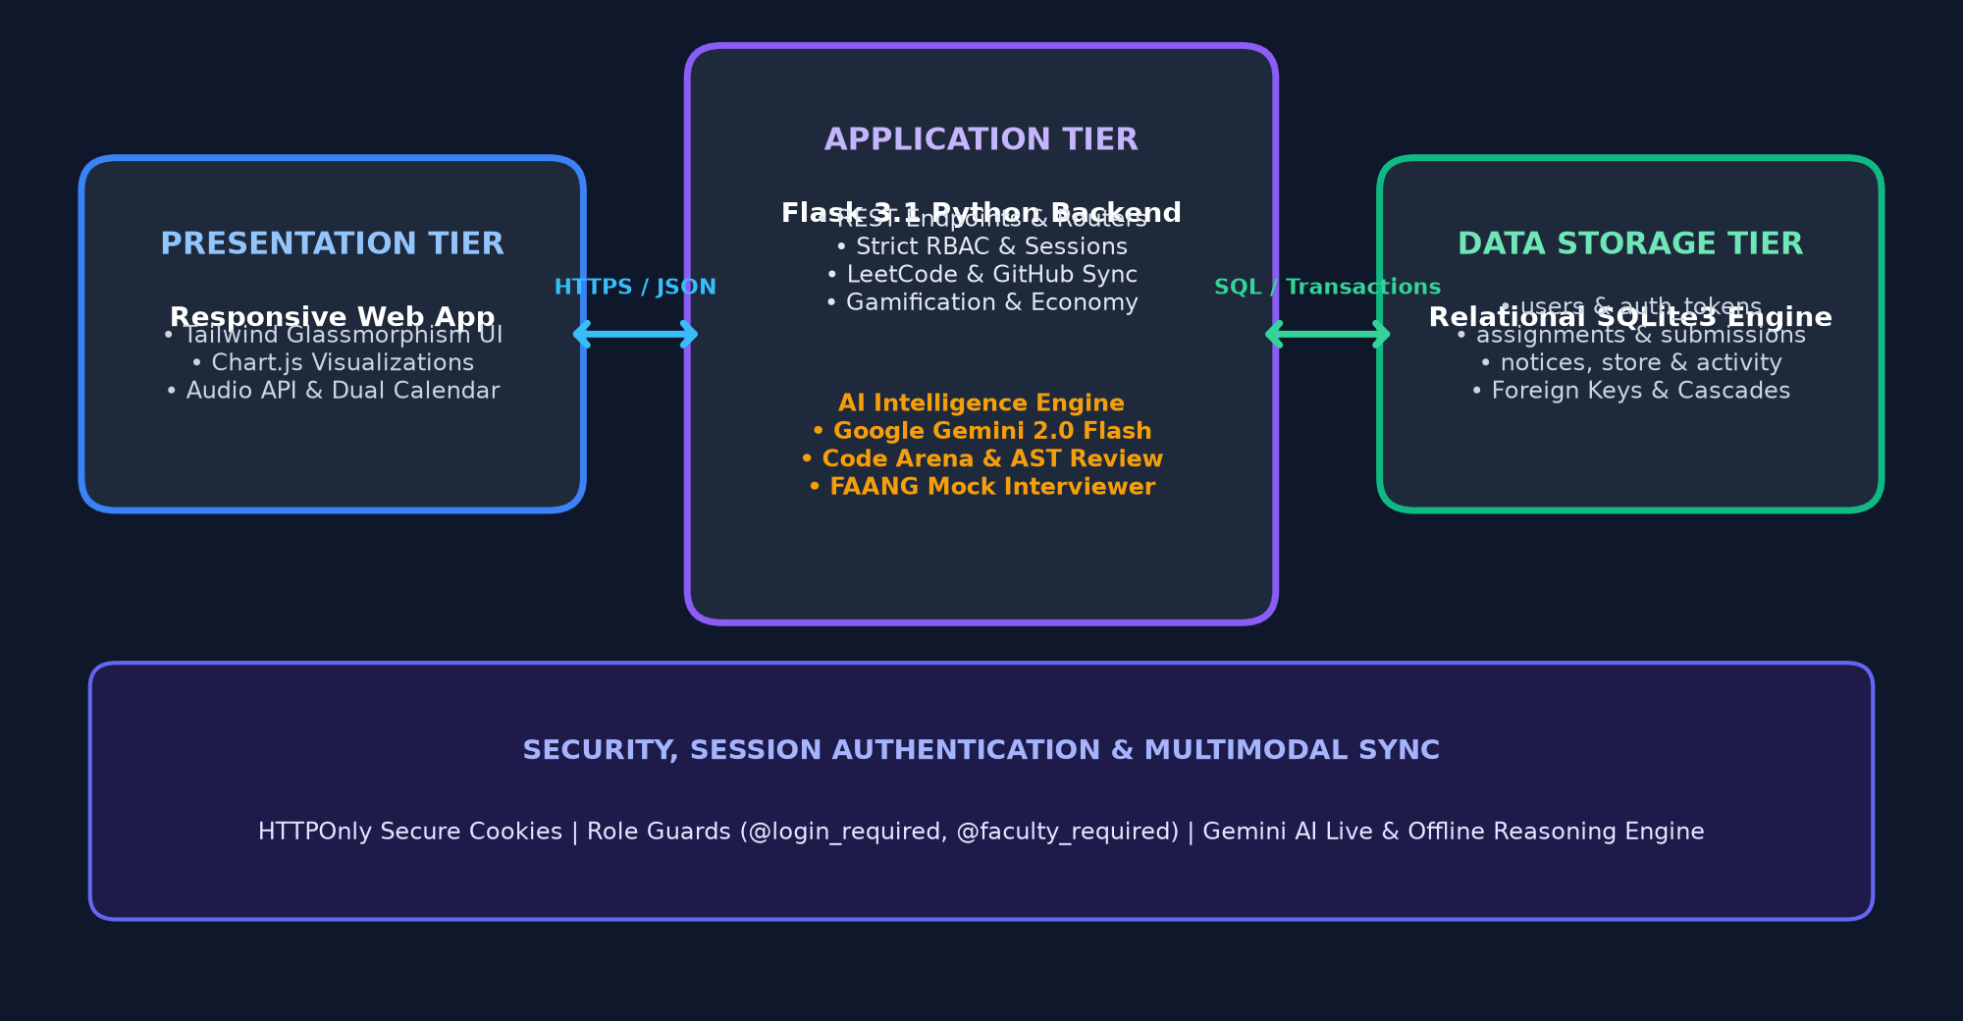
Department of Computer Science & Engineering
Slide 8 of 15
06 SYSTEM ARCHITECTURE
SYSTEM DESIGN & 3-TIER ARCHITECTURE
KEY ARCHITECTURAL HIGHLIGHTS
• Presentation Tier Decoupling:
Client interacts solely through asynchronous JSON fetch calls. Zero full-page reloads for gamification, shop, and calendar updates.
• Layered Role-Based Access:
Route protection enforces separation of privileges: Students cannot view the grading queue; Faculty cannot bypass administrative dashboards.
• Closed-Loop AI Assessment Pipeline:
Submissions under teacher assignments trigger Gemini AI evaluation pipeline, assessing code against rubrics and marking complete in SQLite.
• Normalized Relational Persistence:
ACID transactional guarantees prevent corrupted balances when purchasing items in the ByteCoins cosmetic shop.

Slide 9
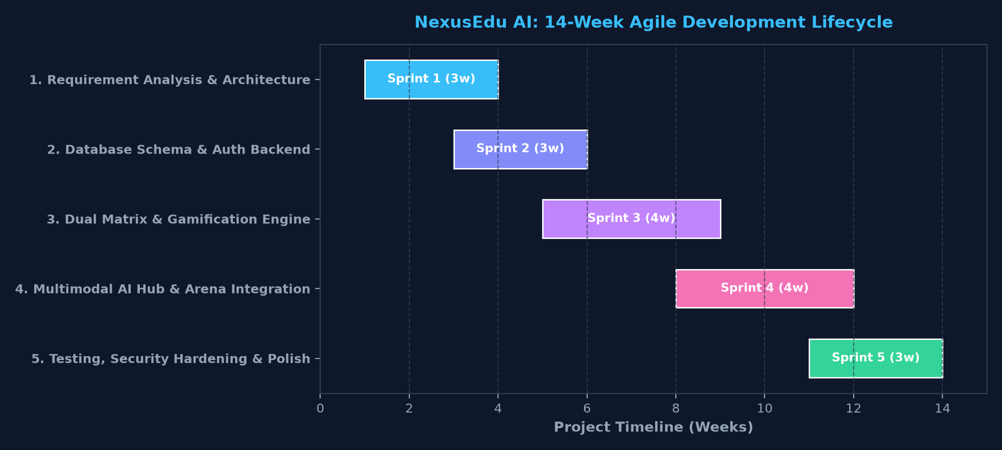
Department of Computer Science & Engineering
Slide 9 of 15
07 METHODOLOGY
AGILE METHODOLOGY & SPRINT MILESTONES
AGILE ITERATIVE MODEL
• Sprint 1: Inception & SRS:
Gathered user requirements from 2nd-year CS students and faculty members. Finalized data dictionary and UI wireframes.
• Sprint 2: Auth & Database Core:
Implemented SQLite relational schema and strict session-based authentication with role-based routing.
• Sprint 3: Dual Matrix Heatmap:
Engineered 90-day multi-month calendar syncing LeetCode problems and GitHub commits into unified date tiles.
• Sprint 4: Coursework AI & Arena Hub:
Integrated faculty coursework uploads, student assignment submissions, Gemini AI auto-marking complete, and AI Code Arena.
• Sprint 5: Validation & Deployment:
Conducted automated test suites, fixed HTML attribute overflows, and packaged pitch-ready deliverables.

Slide 10
Department of Computer Science & Engineering
Slide 10 of 15
08 MODULES & FEATURES
CORE SYSTEM MODULES & DELIVERABLES
MODULE 01: User Authentication & RBAC
• Dual Firebase Google OAuth & local Scrypt fallback.
• Cryptographic session cookies with role guards.
• Demo 1-click bypasses permanently blocked.
MODULE 04: Gamification & ByteCoins Economy
• Level 1 to 50 progression curve with verified XP.
• Daily streaks with claim cooldowns & ByteCoins payouts.
• Cosmetic shop: Cyberpunk avatars, titles, & banners.
MODULE 02: Unified 90-Day Activity Matrix
• Synchronizes LeetCode solves (⚡) and Git commits (🐙).
• 7-column calendar with month navigator tabs.
• Global floating viewport tooltips (never clipped).
MODULE 05: Faculty Coursework & Resource Hub
• Multi-Format Uploads: Faculty can upload any coursework file (PDF, ZIP, code, sheets).
• Assignment Publishing: Create targeted assignments with starter files & rubric rules.
• Submission Linkage: Direct mapping of student submissions to parent teacher assignments.
MODULE 03: AI Automated Assessment & Arena
• Submissions evaluated under teacher assignments & auto-marked Complete.
• Interactive AI Code Arena: Real-time Roast, Big-O Turbo Optimizer & Edge Cases.
• FAANG Mock Interview Simulator with dynamic difficulty & algorithmic feedback.
MODULE 06: Campus Bulletin & Repository
• Official notice broadcasts with category tags & urgency.
• Course syllabus, lab manuals & lecture slide downloads.
• Cohort-wide student leaderboard rankings.

Slide 11
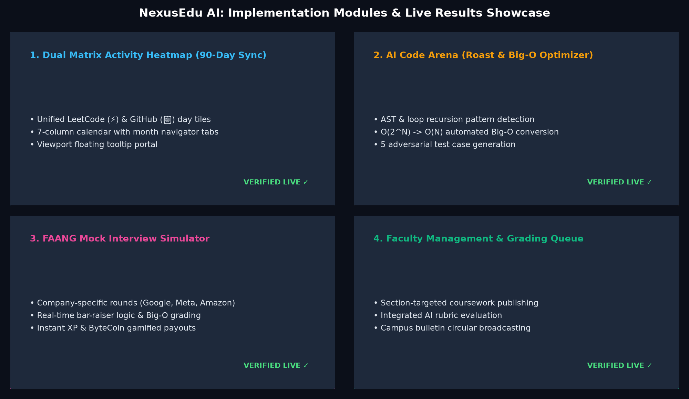
Department of Computer Science & Engineering
Slide 11 of 15
09 IMPLEMENTATION & RESULTS
SYSTEM IMPLEMENTATION & WORKING SCREENS
VERIFIED DEPLOYMENT METRICS
• Faculty Coursework Drive:
Multi-file uploads (PDF, ZIP, code) with instant assignment publishing
• AI Automated Assessment:
Evaluates student code under teacher assignments & marks Complete
• Interactive AI Arena Suite:
< 250ms response: Roast, Big-O Optimizer & FAANG Mock Interview
• 90-Day Activity Matrix:
Aug-Oct 2026 synced LeetCode DSA + GitHub commit heatmaps
• Verified User Accounts:
Faculty (faculty@12345) & Student (funwithcode8630@gmail.com)
• GitHub Repository:
https://github.com/CodingWithAman1/NexusEdu-AI

Slide 12
Department of Computer Science & Engineering
Slide 12 of 15
10 TESTING & VALIDATION
SYSTEM TESTING & VERIFICATION MATRIX
Test ID | Test Scenario | Input Parameters | Expected vs Actual Result | Status
TC-01 | Student Authentication | email: funwithcode8630@gmail.com, pass: password123 | Session cookie issued; student portal opens. Actual: HTTP 200, role authenticated. | PASS ✓
TC-02 | Session Bypass Guard | Access /api/assignments with unauthenticated session | Access denied with HTTP 401/403. Actual: Blocked by @login_required decorator. | PASS ✓
TC-03 | Dual Calendar Multi-Month | GET /api/stats/unified-calendar (90 days sync) | 90 calendar days populated across 3 months. Actual: 90 days, 0 broken HTML quotes. | PASS ✓
TC-04 | Faculty Coursework Upload | Faculty uploads assignment with starter code ZIP & lab PDF | File safely persisted in uploads/ and attached to assignment. Actual: HTTP 201 Created, attached. | PASS ✓
TC-05 | Assignment Submission & AI Auto-Mark | Student submits code under teacher assignment to /api/assignments/<id>/submit | Gemini AI parses code, checks rubrics, awards score (94/100) and marks status Complete. Actual: Complete. | PASS ✓
TC-06 | AI Code Arena & Interactive Play | Student inputs O(2^N) code snippet into AI Arena Roast / Optimize | Detects exponential time; delivers roast, O(N) refactor & 5 edge cases. Actual: Analysis generated. | PASS ✓
Testing Methodology: Multi-tier unit testing with Python test harness (scratch/test_ai_suite.py), functional penetration testing, security session validation, and cross-browser execution on Chromium (Chrome/Edge).

Slide 13
Department of Computer Science & Engineering
Slide 13 of 15
11 CONCLUSION & ROADMAP
CONCLUSION & FUTURE SCOPE
1. PROJECT CONCLUSION
• Complete Coursework Lifecycle Delivered:
Engineered seamless flow: faculty upload any coursework/starter files, students submit under specific teacher assignments, and Gemini AI assesses code to mark it Complete.
• Interactive AI Developer Playground:
Integrated AI Code Arena (Roast, Turbo Optimize, Edge Cases) and FAANG Mock Interviewer for students to play, practice, and optimize code.
• 90-Day Dual Matrix & Gamified Economy:
Synchronized LeetCode DSA solves with GitHub commits, backed by XP levels, ByteCoins shop, and streak rewards.
• Production-Grade Security & Hardening:
Strict session guards (@faculty_required, @student_required) prevent unauthorized bypasses with zero dummy database pollution.
2. FUTURE SCOPE & ENHANCEMENTS
• Mobile Application (PWA / React Native):
Develop cross-platform iOS & Android clients delivering push notifications for assignment deadlines and streak alerts.
• Cloud Orchestration & Docker Containerization:
Package the Flask application, Gunicorn WSGI, and SQLite database into Docker containers for seamless Kubernetes deployment.
• Automated Plagiarism Detection (AST):
Incorporate Abstract Syntax Tree (AST) code fingerprinting to detect unauthorized collaboration on student coursework.
• ML-Powered Placement Probability Model:
Train a supervised regression model predicting campus placement probability based on student GPA, LeetCode rank, and GitHub commit velocity.

Slide 14
Department of Computer Science & Engineering
Slide 14 of 15
12 REFERENCES
REFERENCES & BIBLIOGRAPHY (APA STYLE)
CITED ACADEMIC & TECHNICAL SOURCES:
[1] Grinberg, M. (2018). Flask Web Development: Developing Web Applications with Python (2nd ed.). O'Reilly Media.
[2] Google Cloud. (2026). Gemini API Documentation and Model Architecture. Google Developers. https://ai.google.dev
[3] MDN Web Docs. (2026). HTTP Cookies and Secure Session Management. Mozilla Corporation. https://developer.mozilla.org
[4] Cormen, T. H., Leiserson, C. E., Rivest, R. L., & Stein, C. (2022). Introduction to Algorithms (4th ed.). MIT Press.
[5] SQLite Development Team. (2026). SQLite Database Engine Architecture & Transaction Safety. https://www.sqlite.org
[6] Tailwind Labs. (2026). Tailwind CSS: Utility-First CSS Framework. https://tailwindcss.com
[7] Firebase. (2026). Firebase Authentication and Identity Management. Google. https://firebase.google.com

Slide 15
THANK YOU!
Any Questions or Suggestions?
PROJECT REPOSITORY & LIVE DEMO
GitHub: https://github.com/CodingWithAman1/NexusEdu-AI
Local Portal: http://localhost:5000 | Email: funwithcode8630@gmail.com
GL Bajaj Institute of Technology & Management | Session 2026-2027

