Slide 1
A NEW .NET SPA FRAMEWORK
David Gallivan
@CodingWithDavid
Notes:
Welcome everyone
Thanks for taking time out of your Saturday
Introduction
Who
Why
Could be mowing the yard, told wife to edge
Note since it is a code camp, there is a lot of code
Who has heard of Blazor
Who have built the sample template app
History
Started as a demo at NDC
Community demanded they make it a product
This session is just dealing with the basics

Slide 2










https://...
JS
Notes:
Todays web app architecture is:
Server
Client – Insert framework of the week
Client side written in JS or something that is trans piled into JS
There is nothing wrong with using JS foe your web applications, we have been building then like this for a long time.

Slide 3
https://...
Notes:
We now have a couple of different configuration models that we can choose to allow us to run C# with in the Blazor with in the browser with out plug ins.
Blazor just gives us another tool to put in our toolbox

Slide 4
BLAZOR BASICS
Notes:
Show basic template
Counter
Weather
Explain:
Razor Files
Counter
Page director
HTML
CSS
C#
Show counter as a compoonent
Forecast Page
Inject
HTTP Request
Edit Forecast
Average Temperature
Input bind type = number
Calculate the TempF
Describe the average temp by using a ling @forecasts?.Average(f =>f.TemperatureF) degrees
Just showed the basics of coding a blazor app
Page Directive
Inject Service
Add HTML
Included a C# expression
Control flow
Using binding
C# code
Server Request
Custom Types

Slide 5
PAGE DIRECTION
SERVER REQUEST
INJECT SERVICE
CUSTOM TYPES
ADDED HTML
Data WAY BINDING
C# EXPRESSIONS
C# CODE
CONTROL FLOW
COMPONENT PACKAGES
What did we see?
Notes:
With our simple demo, we have already show all these thing Blazor can do

Slide 6
BLAZOR Hosting Models

Slide 7

https://...
DOM
Server-side
Notes:
Uses SignalR to handle UI render changes
Uses Virtual Dom
Publish to an Azure App service
Gives you full .Net framework feature set
GA with .Net Core 3.0

Slide 8

https://...
DOM
Client-side
Notes:
Client Side
Uses Web Assembly to run a WASM Mono run time
Downloads your dlls
Runs in the Browser sandbox
Is limited to the browser's capability
GA with May 2020ish

Slide 9
Notes:
Why and What is Web Assembly
Stack of 3 technologies

Slide 10
Notes:
Web Assemblies – byte code – 2 years
https://webassembly.studio/ - Cool to play with

Slide 11
Notes:
.Net runtime to WASM
Not compiling .Net to WASM
Mono Portable runtime – make change
2. With .Net 5, Mono maybe replaces

Slide 12
Notes:
UI programming model - Component Model (KEY TAKE AWAY)
Show in Browser Network tab
Show download
Show how to debug
Created a debug to run in the browser
Still a progress in work
Since this all in static files we can host in Azure Blog or even as a CDN

Slide 13
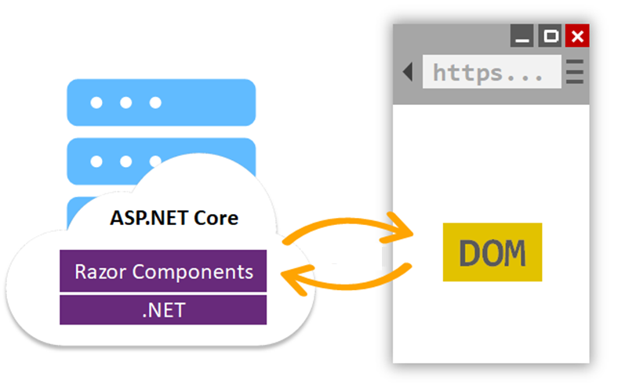
Notes:
Mixture of the other 2 models
Runs on Web Assembly
More traditional arch
Does allow sharing data objects
Show project format
Client – WASM client
Server – ASP.Net Core, Web API
Shared Project

Slide 14
Choosing the right hosting model
Server?
Client?
Asp.Net Core?
Notes:
So with all these different hosting models, which one is the right one. As with most decisions in our profession, it depends.

Slide 15
Server-side
Pros
> Thin client
Full .Net runtime
Code Never Leaves Server
Simpler arch.
All Browser Support
Cons
> No offline
> Latency
Server resources
Scaling
https://...
DOM

Slide 16
Client
Pros
True SPA
Supports offline, static files, PWA
All processing on the client
Allows Server–less
DOM updates local
Cons
Only support modern browsers
Requires Web Assembly
Larger Downloads
Debug tools not mature
Limited to Browser
https://...
DOM

Slide 17
ASP.Net Core Client
Pros
Processes on the client and the server
Allow offline mode
Full .Net Runtime
Shared data objects
Cons
Only support modern browsers
Larger Downloads
Debug tools not mature
Limited to Browser
Notes:
Your need wiil drive which hoisting option is the best solution for you

Slide 18
DEPENDENCY INJECTION
SERVER-SIDE RENDERING
COMPONENT MODEL
FORMS & VALIDATION
DEBUGGING
PUBLISHING
ROUTING
LAYOUTS
UNIT TESTING
AUTO REBUILD
ASSEMBLY TRIMMING
JAVASCRIPT INTEROP
INTELLISENSE & TOOLING
COMPONENT PACKAGES
Notes:
These are just some of the features that Blazor has to offer. But it does show that Blazor is a very flexible

Slide 19

Future of BLAZOR on the Client

Slide 20






So many platforms, so little time…
?

Slide 21
Web
Blazor Server
Web app
Every interaction handled on server
Prerendered HTML (optional)
Blazor WebAssembly
Web app with client-side execution
Loaded from web server
Can work offline via Service Worker
Desktop
+ Mobile

Slide 22
Web
Blazor Server
Web app
Every interaction handled on server
Prerendered HTML (optional)
Blazor WebAssembly
Web app with client-side execution
Loaded from web server
Can work offline via Service Worker
Blazor PWA – OS installed
Appears as native app (own window)
Works offline or online
Desktop
+ Mobile

Slide 23
What is a PWA?
Progress Web App (PWA): A web app that users modern web standards to provide a closer-to-native user experience.
Works offline
Push notifications
Fast & responsive
OS installable

Slide 24
Web
Blazor Server
Web app
Every interaction handled on server
Prerendered HTML (optional)
Blazor WebAssembly
Web app with client-side execution
Loaded from web server
Can work offline via Service Worker
Blazor PWA – OS installed
Appears as native app (own window)
Works offline or online
Native .NET renders to Electron / WebView
Appears as native app (own window)
Works offline or online
Blazor Hybrid
Desktop
+ Mobile

Slide 25
Web
Blazor Server
Web app
Every interaction handled on server
Prerendered HTML (optional)
Blazor WebAssembly
Web app with client-side execution
Loaded from web server
Can work offline via Service Worker
Blazor PWA – OS installed
Appears as native app (own window)
Works offline or online
Blazor Hybrid
Native .NET renders to Electron / WebView
Appears as native app (own window)
Works offline or online
Desktop
+ Mobile
Blazor Native
Same programming model, but
rendering non-HTML UI

Slide 26
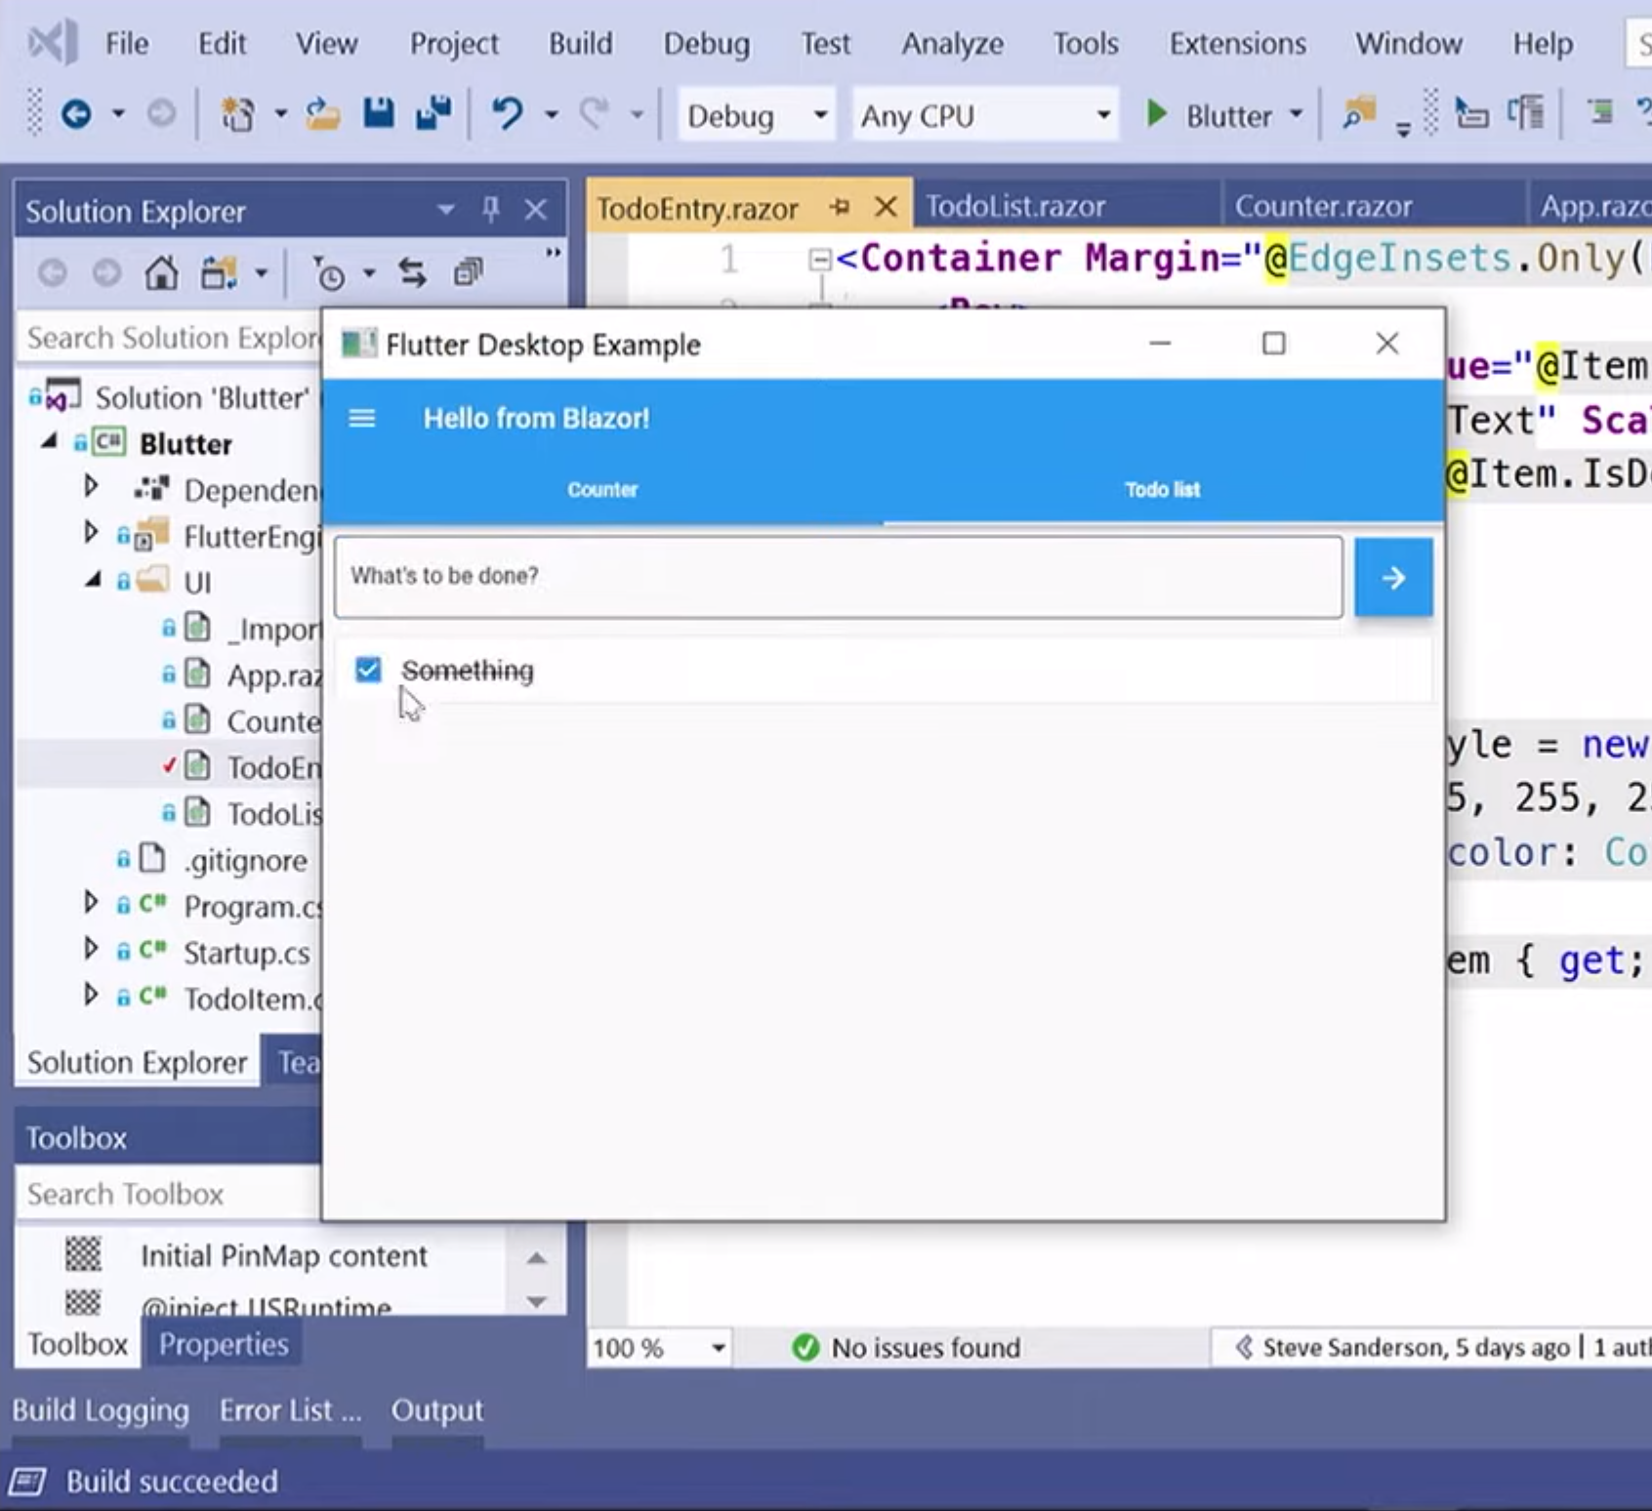
Blazor Native
By default, Blazor renders to HTML
But the rendering layer is replaceable
Possible to render to native controls instead
Currently exploring different options
https://aka.ms/blutter

Slide 27
Blazor roadmap
Blazor Server – Shipped with .NET Core 3.0!
Blazor WebAssembly – May 2020
Blazor PWA & Electron – Previews with .NET 5
Blazor Native – Under investigation

Slide 28
DOWNLOAD & LEARN MORE
Blazor.Net
CODE & SLIDES FROM THIS TALK
Put Github Link Here
Details go here if any
David Gallivan
@CodingWithDavid

Slide 29
Try Blazor today!
Blazor: https://blazor.net
Docs: https://blazor.net/docs
.NET Core 3.0: https://dot.net/get-core3
Visual Studio: https://visualstudio.com/
Workshop: https://aka.ms/blazorworkshop
Community: https://aka.ms/awesomeblazor
David Gallivan
@CodingWithDavid

