Slide 1
Life after the introduction Demo
David Gallivan
@CodingWithDavid
Notes:
Welcome everyone
Thanks for taking time out of your Saturday
Introduction
Who - Me
Why
Could be mowing the yard, told wife to edge
Note since it is a code camp, there is a lot of code
Who has heard of Blazor
Who have built the sample template app
This session is dealing with more advance topics of working with Blazor

Slide 2
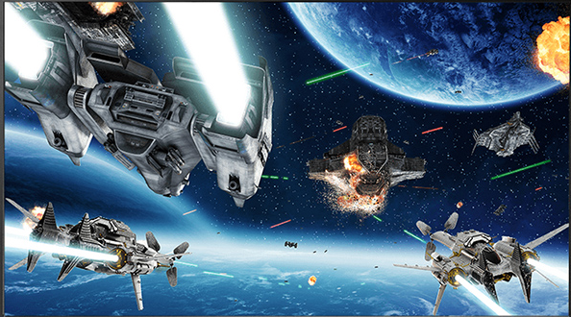
Notes:
We all have seen the great “Demo” of a new technology. We see how cool it is, how “easy” it is to use it.
Like a really cool Virtual reality tech

Slide 3
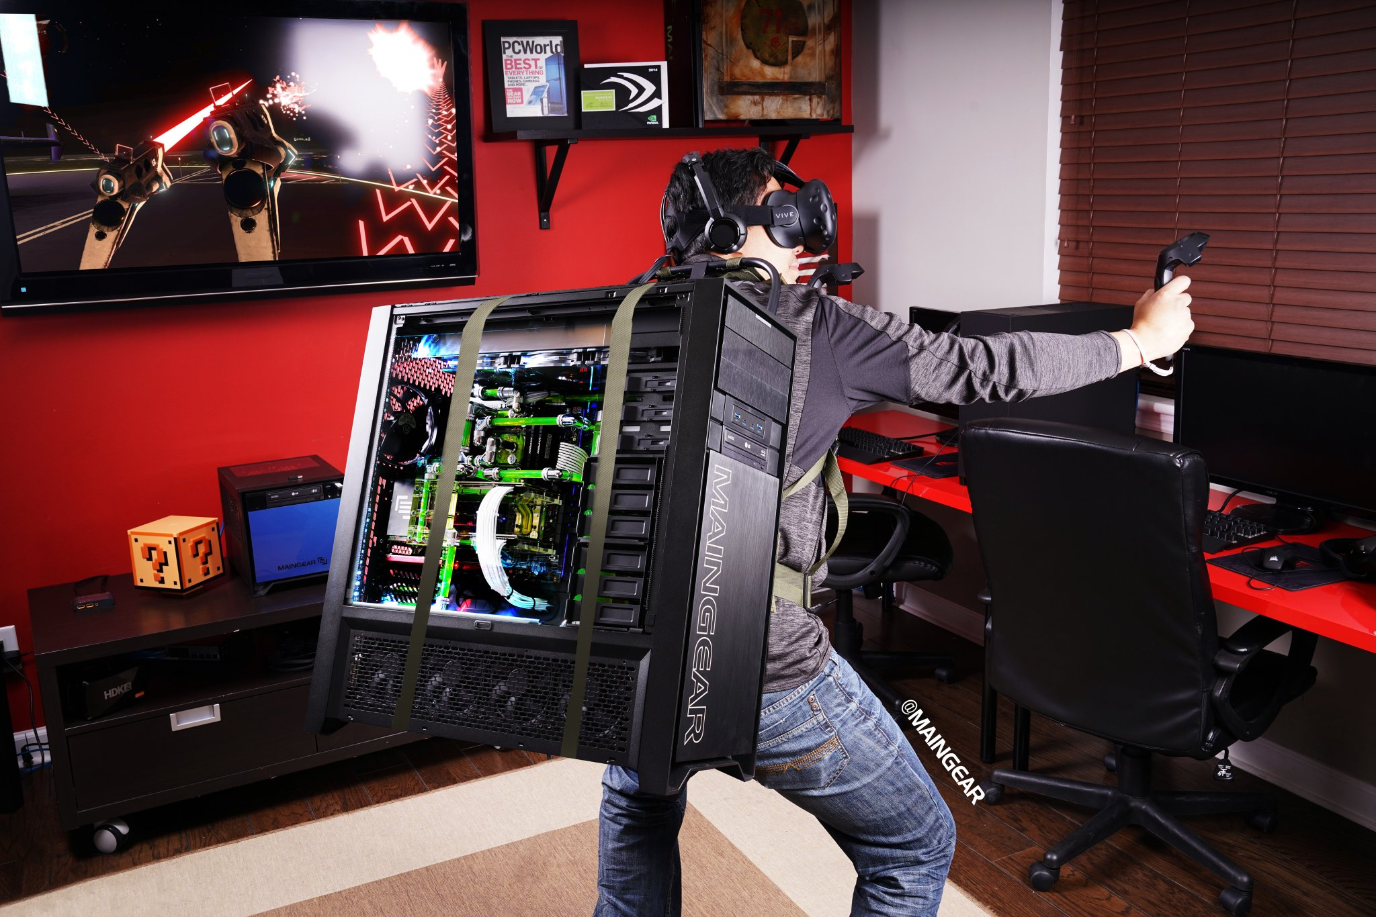
Notes:
And then there is reality!
Maybe the tech is not fully backed, tools are not ready, you have to jump through hoops to get even the demo app to run.

Slide 4

Web UI framework
Notes:
We are here today to see that this does not apply to Blazor!
And why is that – The Blazor Community!

Slide 5
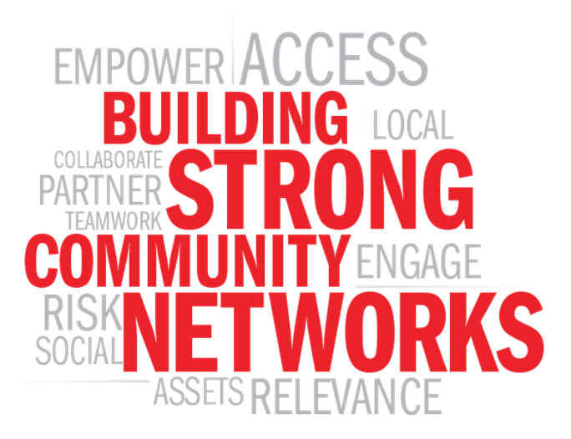
Notes:
A Strong Community
Blazor is an open-source framework and is a part of the .NET development platform that has a strong community of over 60,000 contributors from more than 3,700 companies. And counting…
The community has self-organized itself into a great group of people helping each other and promoting it through their experiments. Adrien Torris has done a magnificent job of collating resources in an aptly named Awesome Blazor collection.

Slide 6
Features to Review
Providing User Feedback
Spinner
Toast Message
Notifications
Modal Dialogs
File Upload and displaying an Image
Authentication
CSS Frameworks
Notes:
So today we are going to take an honest look at Blazor by doing some “normal” functionality that most applications do. And we will see how Blazor can handle it

Slide 7

User Feedback
Provide feedback
Long running process
Calling API
Retrieving Data
Messages
Info
Warn
Error
Notes:
All applications need to keep their users posted as it does work in the back ground, on the server or if the user themselves messed up. I know we all know users don’t mess things up.
Let’s look at some examples of user feedback we can provide.

Slide 8

User Feedback Demo
Notes:
What did we see?
How to use a spinner
We found a Toast component and how to use it
We found a Modal dialog component and how to use it

Slide 9
Modal Dialogs
Data Entry
User Confirmation
Wizards
Notes:
Modal dialogs found their life in desktop applications. They can provide a nice user experience for several different input types. We will be looking at a more complex use of the Modal component for this one.

Slide 10

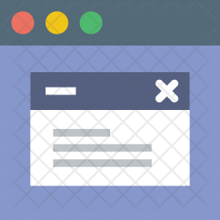
Notes:
We saw
Another use of the modal component
EditForm component
Page navigation from code

Slide 11
File Upload
Upload files
Display files
Store file on the server
Read or import data from them
Present in an Editor
No Separate API Endpoint
Provides access to the file data via regular .Net Stream
Works independently of SignalR Message size limits
Near native HTTP transfer speeds
Notes:
I first thought this was going to be a complicated task, but as I have learned working with Blazor, it turns out to be pretty easy. Because “There is a component for that”. I am using the InputFile componenet from Steve Sanderson

Slide 12

File Upload Demo
Notes:
What did we see
We can use a component to upload files into Blazor
Once the file is read into a stream we can use the C# stream functions to process the file
We can only save directly to the server when we are using Blazor server configuration.
We can us JavaScript interop to access our favorite JS libraries or the browsers APIs directly.

Slide 13
Authentication
Blazor handles the UI part of user access
ASP.Net Core handles the “security” part
Tokens
Cookies
Active Directory
3rd party
Notes:
Authorization for Blazor point of view is to allow you to control the UI from an user access point of view.

Slide 14

Authentication Demo
Notes:
In Summary, We Saw
Blazor provides a object to allow you to control what the user sees dependent on if they are logged in or their role or policy
You can use the AuthenticationStateProvider to get the users information
You can use @attribute [Authorize] at the page level to control if the page can be accessed
You can use <AuthorizeView> to control access to any part of the page.

Slide 15
UI Frameworks
Free ones
Brazorise
Bootstrap
Bulma
Material
Radzen
Package ones
Telerik
DevExpress
Syncfusion

Slide 16
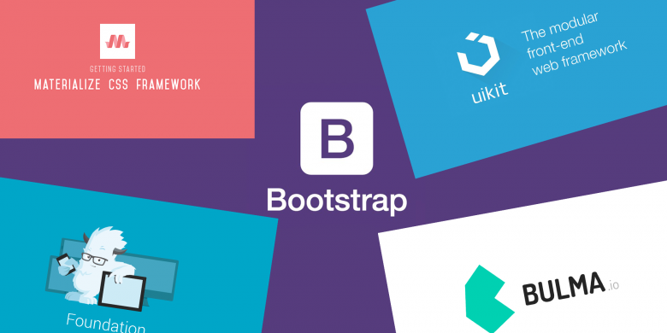
UI Frameworks Demo
Notes:
What did we learn
The UI frameworks are just Blazor components, that is how they were able to be produce already
You can mix and match from different UI components
You can create your own library of your own

Slide 17
DOWNLOAD & LEARN MORE
Put URLs here
CODE & SLIDES FROM THIS TALK
Put Github Link Here
Details go here if any
David Gallivan
@CodingWithDavid
Notes:
I have been working with Blazor for almost a year now and it is amazing how much and how quickly it was matured. The community has a lot to do with that, but I think the value Blazor brings is the main reason.

