Slide 1


JavaScript FullStack(MEAN/ MERN)
Summer Of Code B-ll
University of Engeenring and Technology Lahore

Slide 2
JavaScript
JavaScript is a high-level, browser side programming language used to make web pages interactive. It is lightweight, dynamic, and event-driven, enabling functionalities like animations, form validation, API requests, and real-time updates in web applications.

Slide 3
JavaScript Syntax
JavaScript syntax is the set of rules, how JavaScript programs are constructed.
In HTML, JavaScript code is inserted between <script> and </script> tags.
Scripts can be placed in the <body>, or in the <head> section of an HTML page, or in both.
<script>
//any code
</script>

Slide 4
JS Output
JavaScript can "display" data in different ways:
Writing into an HTML element, using innerHTML.
Writing into the HTML output using document.write().
Writing into an alert box, using window.alert().
Writing into the browser console, using console.log().

Slide 5
JS Comments
JavaScript comments can be used to explain JavaScript code, and to make it more readable.
JavaScript comments can also be used to prevent execution, when testing alternative code.
Single line comments start with //.
Multi-line comments start with /* and end with */.

Slide 6
Variables
Variables are the names you give to computer memory locations which are used to store values in a computer program.
For example, assume you want to store two values 10 and 20 in your program and at a later stage, you want to use these two values.
Let's see how you will do it. Here are the following three simple steps.

Slide 7
STEP-1
Creating
variable
Variables
STEP-2
Store value
in variable
Creating variables is also called declaring variables in C programming. e.g int a, b;
Store value in variable a = 10;
value stored in a variable accessed by using some print statement or output statement
STEP-3
Access stored values in variables

Slide 8
Variables in JS
JavaScript Variables can be declared in 4 ways:
Automatically
Using var
Using let
Using const

Slide 9
Data Types
A data type is a classification of data which tells the compiler or interpreter how the programmer intends to use the data. Most programming languages support various types of data, including integer, real, character or string, and Boolean.
In javaScript String ,Number,Bigint,Boolean,Undefined, Null, Symbol,Object are some data Types.

Slide 10
Variable Scope
A scope is a region of the program and broadly speaking there are three places, where variables can be declared:
Inside a function or a block which is called local variables,
In the definition of function parameters which is called formal parameters.
Outside of all functions which is called global variables.

Slide 11
Variable Name
A variable can have a short name (like x and y) or a more descriptive name (age, price, carname, etc.).
Rules for variable name
A variable name must start with a letter or an underscore character (_)
A variable name cannot start with a digit
A variable name can only contain alpha-numeric characters and underscores (a-z, A-Z, 0-9, and _ )
Variable names are case-sensitive (age, Age and AGE are three different variables)
There is no limit on the length of the variable name
A variable name cannot contain spaces
The variable name cannot be any Go keywords

Slide 12
What is an operator
An operator in a programming language is a symbol that tells the compiler or interpreter to perform specific mathematical, relational or logical operation and produce final result.
Types of Operators
Arithmetic Operators
Comparison Operators
Logical Operators
Bitwise Operators
Assignment Operators

Slide 13
Arithmetic Operator
Arithmetic operators are used to perform common mathematical operations.
operator | Name | Example
+ | Addition | x+y
- | Subtraction | x-y
* | Multiplication | x*y
/ | Division | x/y
% | Modulas | x%y
++ | Increment | x++
-- | Decrement | x--

Slide 14
Comparison Operator
Comparison operators are used to compare two values.
Note: The return value of a comparison is either true (1) or false (0).
operator | Name | Example
== | Equal to | x==y
!= | Not equal | x!=y
> | Greater than | x>y
< | Less than | x<y
>= | Greater than and eqqual to | x>=y
<= | Less than and equal to | x<=y

Slide 15
Logical Operator
Logical operators are used to determine the logic between variables or values:
operator | Name | Description | Example
&& | Logical AND | Returns true if both statements are true | x < 5 && x < 10
|| | Logical OR | Return true if one of the statement is true | x < 5 || x < 4
! | Logical NOT | Reverse the result, returns false if the result is true. | !(x < 5 && x < 10)

Slide 16
Bitwise Operator
Bitwise operators are used on (binary) numbers:
operator | Name | Description | Example
& | AND | Sets each bit to 1 if both bits are 1 | x&y
| | OR | Sets each bit to 1 if one of two bits is 1 | x|y
^ | XOR | Sets each bit to 1 if only one of two bits is 1 | x^y
>> | Zero fill right shift | iShift right by pushing copies of the leftmost bit in from the left, and let the rightmost bits fall off | x>>2
<< | Zero fill left shift | Shift left by pushing zeros in from the right | x<<3

Slide 17
Assignment Operator
Assignment operators are used to assign values to variables.
operator | Example | Same as
= | x=5 | x=5
+= | x+=3 | x=x+3
-= | x-=5 | x=x-5
*= | x*=5 | x=x*5
/= | x/=5 | x=x/5
%= | x%=5 | x=x%5
&= | x&=3 | x=x&3

Slide 18
Programing language
What is program
Main Parts of programing language
Variables
Operators
Inputs
Output Statement
Control structure
Sequential
Selection(conditionals)
Iteration (Loops)
Function
Arrays

Slide 19
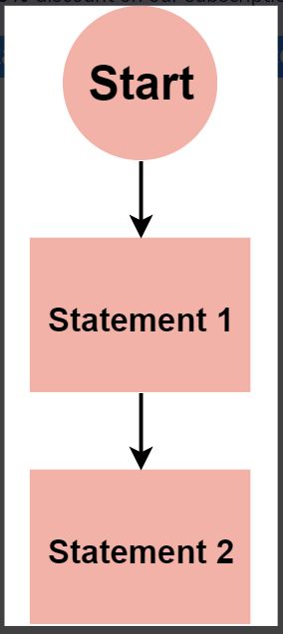
Sequential
The most basic control flow is sequential control flow. It involves the execution of code statements one after the other. A real-world example is following a cooking recipe.

Slide 20
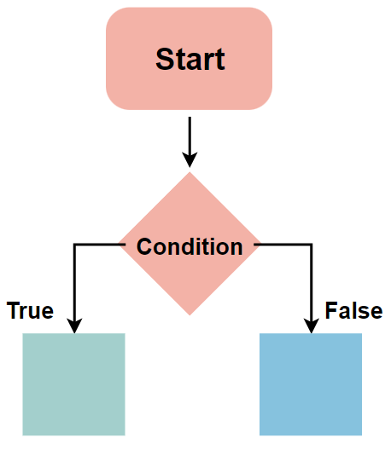
Selection (conditionals)
In the condition statement Execute the statement or set of statement on the base of condition .If the condition is true control move the first side and execute the first statement otherwise it move second side and execute other side statements
If
Ifelse
Multiple ifelse
Nested ifelse
Switch

Slide 21
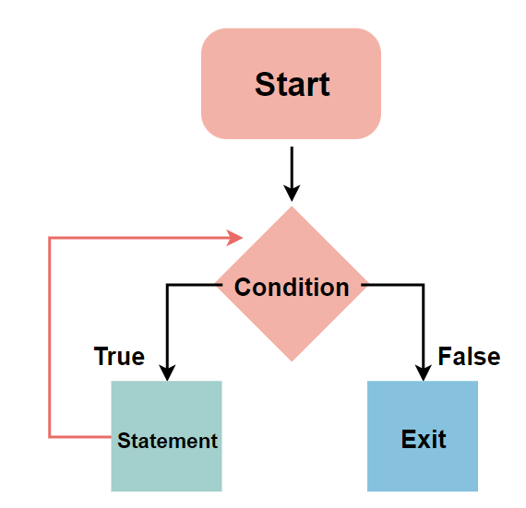
Iteration (Loops)
A loop is a programming structure that allows a statement or block of code to be run repeatedly until a specified condition is remain true.
For loop
While loop
Do while loop

Slide 22
Functions
A function is a block of organized, reusable code that is used to perform a single, related action.
Advantage
It makes our code short .
Reusable.
Time saving.
function to sum of two numbers
<script> function sum(a, b) { return a + b; } let total = sum(4, 5); document.write("The sum is: " + total); </script>

Slide 23
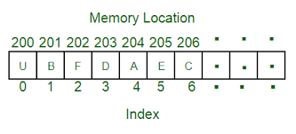
What is Array
An array is a collection of elements of the same type placed in contiguous memory locations that can be individually referenced by using an index to a unique identifier.
<script> let numbers = [4, 6, 9, 12, 54]; // Accessing first element console.log("The first element of array is: " + numbers[0]); // Printing full array console.log("Full array is: ", numbers); </script>

Slide 24
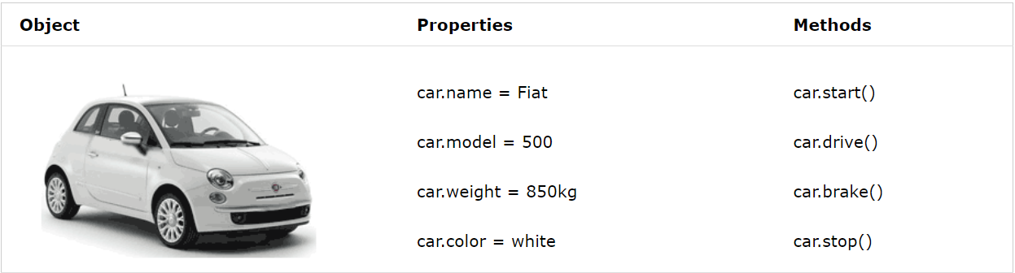
What is Object
Object is any thing about which we collect data .
Example. Ali, car, home

Slide 25
THANK YOU

