Slide 1
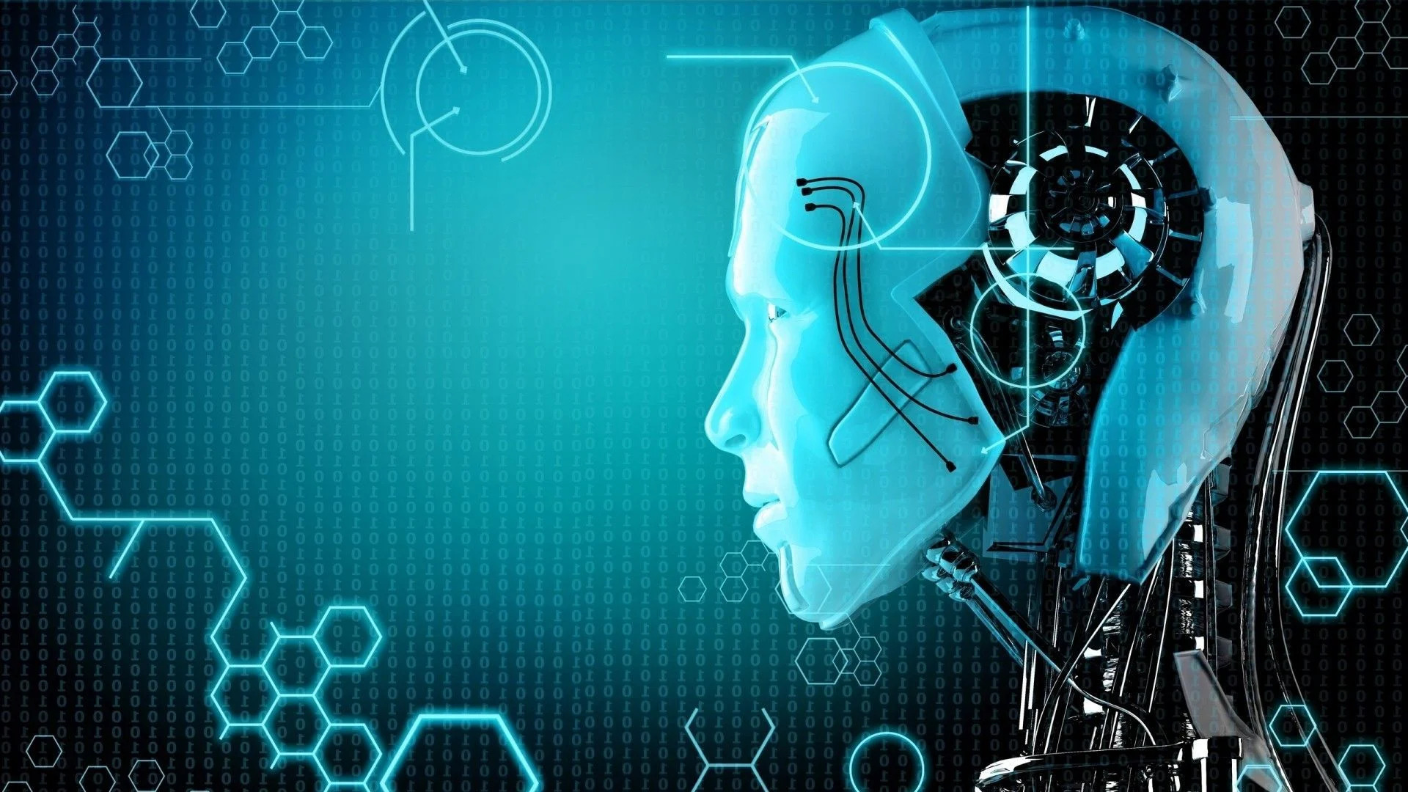
Artificial Intelligence

Slide 2
What is Artificial Intelligence ?
Artificial Intelligence is basically making a computer machine intelligent to perform one or more than one functions like a Human .

Slide 3
How Does AI Actually Work?
AI systems work by combining large sets of data with intelligent, iterative processing algorithms to learn from patterns and features in the data that they analyze.

Slide 4
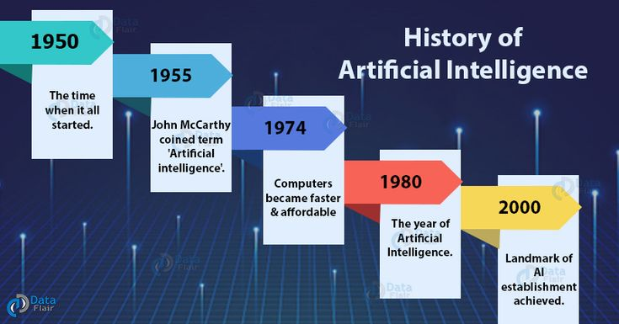

Slide 5
Year 1943: The first work which is now recognized as AI was done by Warren McCulloch and Walter pits in 1943. They proposed a model of artificial neurons.
An artificial neuron is a mathematical function receives one or more inputs and sums them to produce an output.

Slide 6
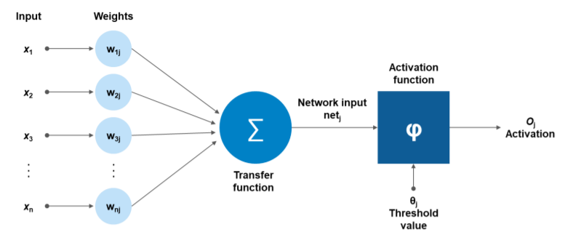
Artificial neurons

Slide 7
The first AI winter (1974-1980)
The duration between years 1974 to 1980 was the first AI winter duration. AI winter refers to the time period where computer scientist dealt with a severe shortage of funding from government for AI researches.
During AI winters, an interest of publicity on artificial intelligence was decreased.

Slide 8
Boom of AI (1980-1987)
AI came back with "Expert System". Expert systems were programmed that emulate the decision-making ability of a human expert.
In the Year 1980, the first national conference of the American Association of Artificial Intelligence was held at Stanford University.

Slide 9
Emergence of intelligent agents (1993-2011)
.
.
IBM Deep Blue beats world chess champion, Gary Kasparov, and became the first computer to beat a world chess champion.

Slide 10
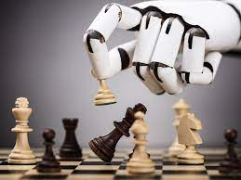

Slide 11
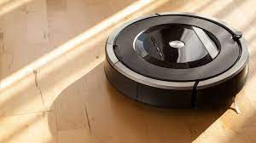
Year 2002: for the first time, AI entered the home in the form of Roomba, a vacuum cleaner.
Roomba
Vaccum Cleaner

Slide 12

LET UNDERSTAND MORE ABOUT AI THROUGH SOME FAMOUS AI PROGRAMS

Slide 13
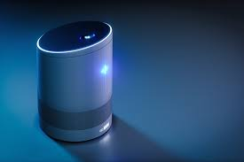
ALEXA
AI is used for voice recognition in Alexa

Slide 14


Slide 15
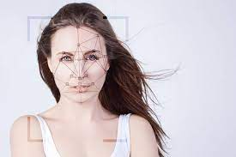
Face Recognition Technology

Slide 16
Conclusion
So this is how we have discussed about Artificial Intelligence may be your knowledge had grown about AI .
AI is now growing more and have bright scope in future.

Slide 17
Thank You

