Slide 1
Project Overview
Team Name: Renaissance
Team members: Aishwar Bhatnagar, Himanshu Mohanty, Jay Methani, Shreya Raj
Challenge: Embiggen Your eyes

Slide 2
The PROBLEM
Huge Dataset Sizes: MRO/CTX images and other NASA datasets are massive. So, downloading and storing them locally is slow, storage-intensive, and sometimes impractical.
Complex Data Formats: The raw data often comes in PDS or IMG formats, which are not directly viewable or usable without conversion tools.
Limited Accessibility: Researchers, students, and enthusiasts without high-end computing resources struggle to process or visualize these datasets.
Manual Processing Bottlenecks: Existing workflows require multiple manual steps (download, convert, preprocess) which are error-prone and time-consuming.

Slide 3
Our SOLUTION
Automated Data Access: Users provide NASA dataset URLs, and the system automatically downloads the files.
Format Conversion: Raw planetary data in complex formats (PDS/IMG) is converted into standard, usable formats like GeoTIFF or PNG using GDAL.
Efficient Processing: The pipeline handles large datasets and supports batch processing, minimizing manual intervention.
Immediate Usability: Converted images are ready for visualization and analysis without high-end computing resources.
User-Friendly: Provides a pipeline accessible to researchers and enthusiasts, even with limited computing resources.
Streamlined Workflow: The solution removes bottlenecks, making Mars imagery more accessible to researchers, students, and enthusiasts.

Slide 4
DATA & TECHNOLOGY
Data Acquisition & Processing: Python, Pandas, NumPy, APIs, JSON/SQLite
AI / ML Core: PyTorch/TensorFlow, predictive modeling, GPU-accelerated training
Automation & Integration: Prefect/Airflow pipelines, scheduled Python scripts
User Interaction: Streamlit/Flask, responsive UI, real-time API updates
Storage & Data Management: SQLite/PostgreSQL, cloud/local storage, efficient retrieval
Visualization & Insights: Matplotlib, Seaborn, Plotly, automated dashboards
Continuous Improvement: Logging, monitoring, automated model retraining

Slide 5
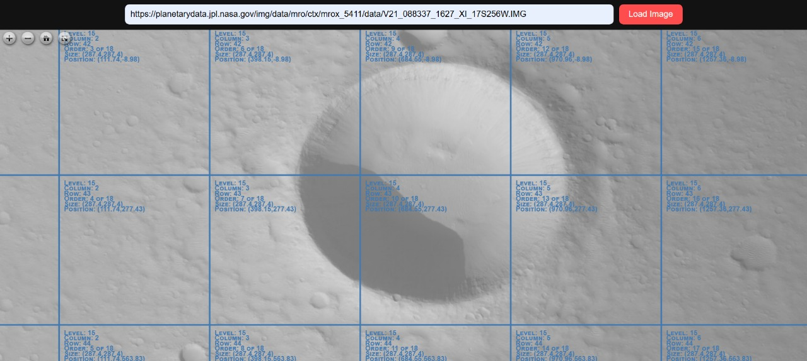
Technical WORKFLOW

Slide 6
IMPACT & FUTURE
Enhanced Efficiency: Automated workflows reduce manual effort and processing time.
Data-Driven Decisions: AI/ML models provide accurate predictions and actionable insights.
Seamless & Personalized User Experience: Real-time interaction, adaptive UI, and responsive design improve engagement.
Scalable & Reliable System: Secure storage ensures fast retrieval and robust performance.
Continuous Improvement & Advanced AI Integration: Feedback loops and more sophisticated ML/DL models optimize performance over time.
Multi-Platform & Automation Expansion: Support for web/mobile platforms and fully automated pipelines for real-time updates.
Data Expansion for Richer Insights: Integration of additional external sources enhances predictive and analytical capabilities.

Slide 7
THANK YOU
GitHub Link:https://github.com/Codingwalibilli/NASA.git

