Slide 1
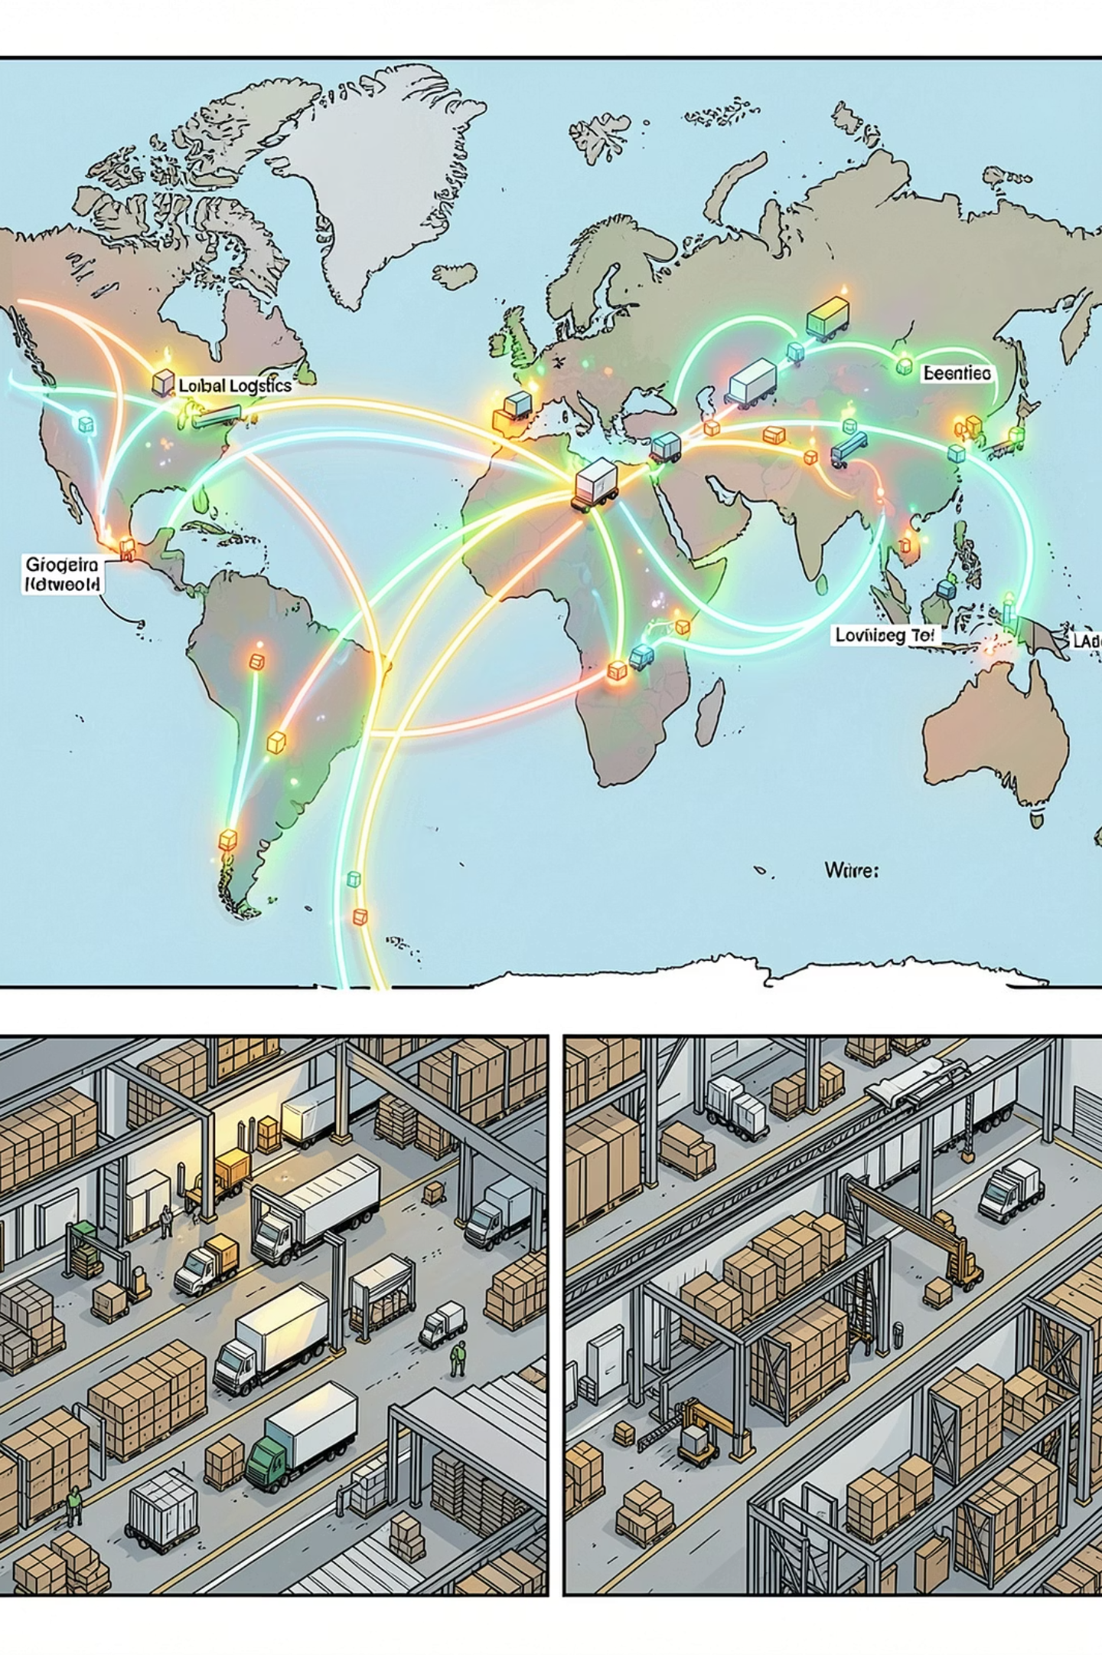
Delivery Operations & Profitability Analysis
Root-Cause Analysis of Late Deliveries and Their Financial Impact, Jan 2015 – Jan 2018
GLOBAL E-COMMERCE ORDER FULFILLMENT
1,72,765 ORDERS
OPERATIONS & SUPPLY CHAIN ANALYTICS

Slide 2
EXECUTIVE SUMMARY
The Headline: More Than Half of All Orders Arrive Late
This report analyzes 1,72,765 orders spanning January 2015 through January 2018 across a global e-commerce platform. The findings are striking: 54.71% of all orders are delivered late, costing the business an estimated $2.1M in eroded profitability on delayed orders alone. While total profit across fulfilled orders reached $7.5M, the persistent late-delivery problem represents both a significant financial drain and a major customer-experience risk.
1,72,765
54.71%
Total Orders Analyzed
Late Delivery Rate
94,523 orders delivered late
$7.5M
$2.1M
Total Profit
Profit at Risk
Across all profitable orders
On delayed orders alone

Slide 3
BUSINESS CONTEXT
Business Context & Analytical Objectives
The Core Problem
Analytical Objectives
The company operates a global e-commerce platform selling sporting goods, fitness equipment, outdoor gear, footwear, and apparel. Actual shipping times frequently deviate from scheduled delivery windows, eroding customer trust, reducing order profitability, and undermining the ability to make reliable delivery commitments at the point of purchase.
Understand delivery performance across region, shipping mode, time, and customer segment
Quantify the financial impact of delays on order profitability
Identify primary operational bottlenecks driving late deliveries
Build a predictive model to flag high-risk orders before shipment
Deliver actionable recommendations to improve on-time delivery and profitability

Slide 4

KPIS
Key Performance Indicators
Metric
Value
Total Orders Analyzed
1,72,765
Late Deliveries
94,523
Late Delivery Rate
54.71%
On-Time Delivery Rate
45.29%
Total Profit (Profitable Orders)
$7.5M
Profit at Risk (Delayed Orders)
$2.1M
90th Percentile Delay
3 days
Average Order Profit
$22.03
54.71% Late Delivery Rate
$2.1M Profit at Risk
90th Percentile Delay: 3 Days
More than half of all orders arrive late — this is not an edge case. It represents the default experience for the majority of customers.
Delayed orders collectively generated $2.1M in profit that remains under constant pressure from operational deterioration.
Even the most extreme cases are contained within 3 days of lateness — the problem is systemic and process-driven, not caused by rare outliers.

Slide 5
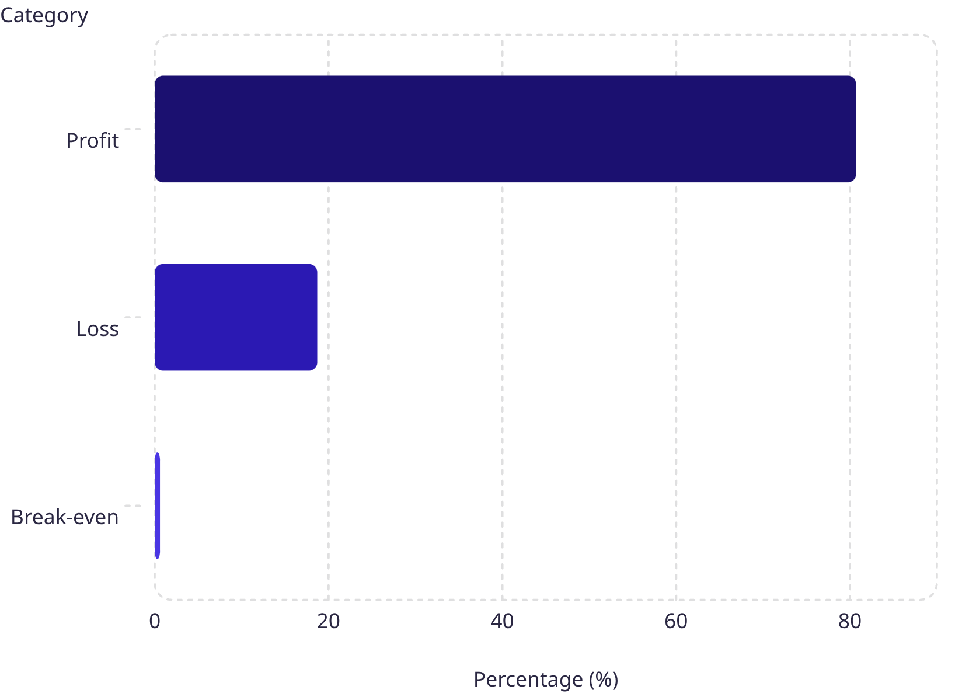

PROFITABILITY ANALYSIS
Profit Distribution: 80.7% Profitable, 18.7% Loss-Making
Order-level profitability was classified into three tiers. While 80.7% of orders are profitable, the 18.7% loss-making share represents a meaningful drag on the business — one disproportionately concentrated among delayed shipments.
The loss-making share warrants a separate pricing and discount review. Cross-reference with delay analysis to determine whether discounted orders are disproportionately late, compounding the margin problem.

Slide 6
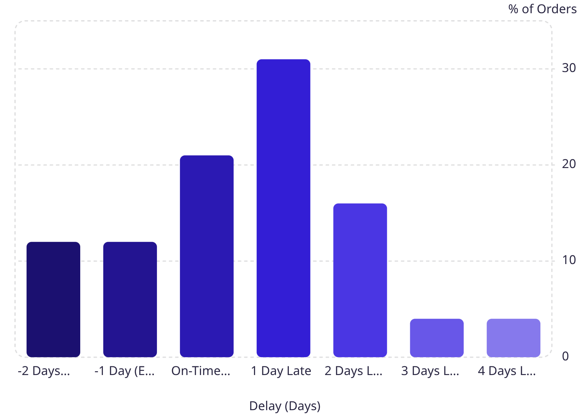
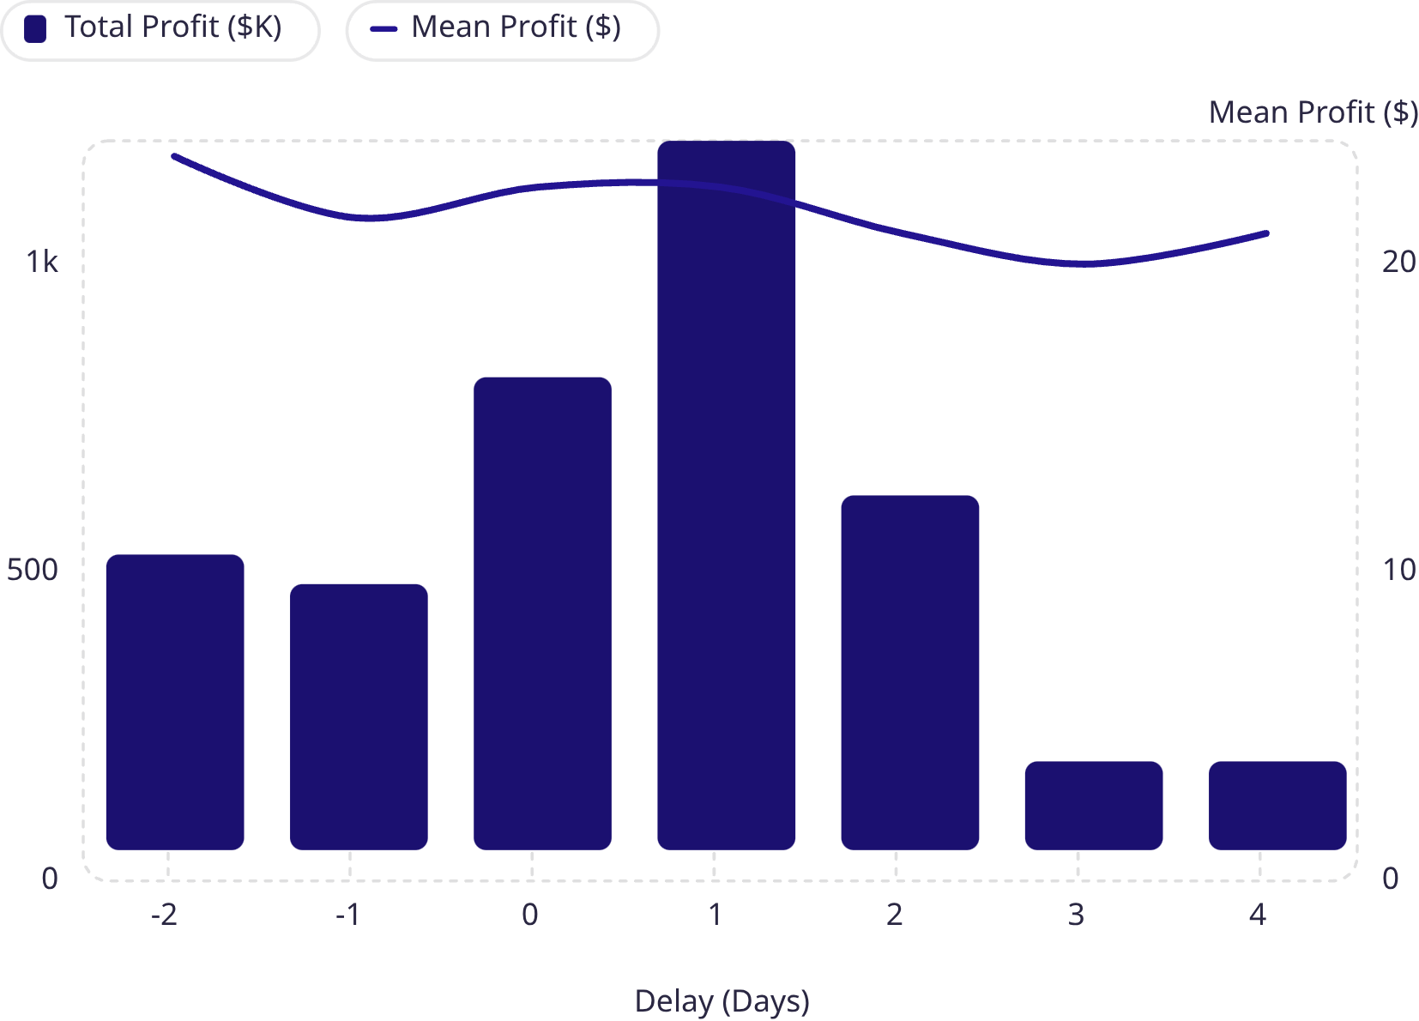
PROFITABILITY ANALYSIS
Delay Distribution & Profit by Delay Days
31% of all orders arrive exactly one day late — the single largest cohort. Combined, orders delayed 1–4 days account for 54.7% of total volume, directly mapping to the overall late-delivery rate. Critically, mean profit per order remains stable at ~$20–$23 across all delay levels. The profitability problem is driven by the volume of delayed orders, not the economics of individual orders — making systemic throughput improvement the highest-leverage intervention.

Slide 7

BOTTLENECK DETECTION
Delay Percentage by Operational Dimension
Delay percentage was computed across six key operational dimensions, revealing where the fulfillment process breaks down most severely.
🚚 Shipping Mode — #1 Lever
🌍 Order Region — Narrow Spread
First Class: 100% delay rate. Second Class: 79.8%. Standard Class: 39.8%. Same Day: 0%. Shipping-mode assignment logic is the single most impactful variable to fix.
Central Africa leads at 58.7%, but all regions cluster within a 55–59% band. This rules out a localized failure and confirms a company-wide systemic issue.
👥 Customer Segment — No Preference
📦 Department — Marginal Variance
Home Office (55.4%), Consumer (54.6%), and Corporate (54.5%) all experience nearly identical delay rates — no segment receives preferential service.
Health & Beauty (56.9%) and Pet Shop (56.6%) lead by department, warranting an inventory and carrier audit for these product categories.

Slide 8
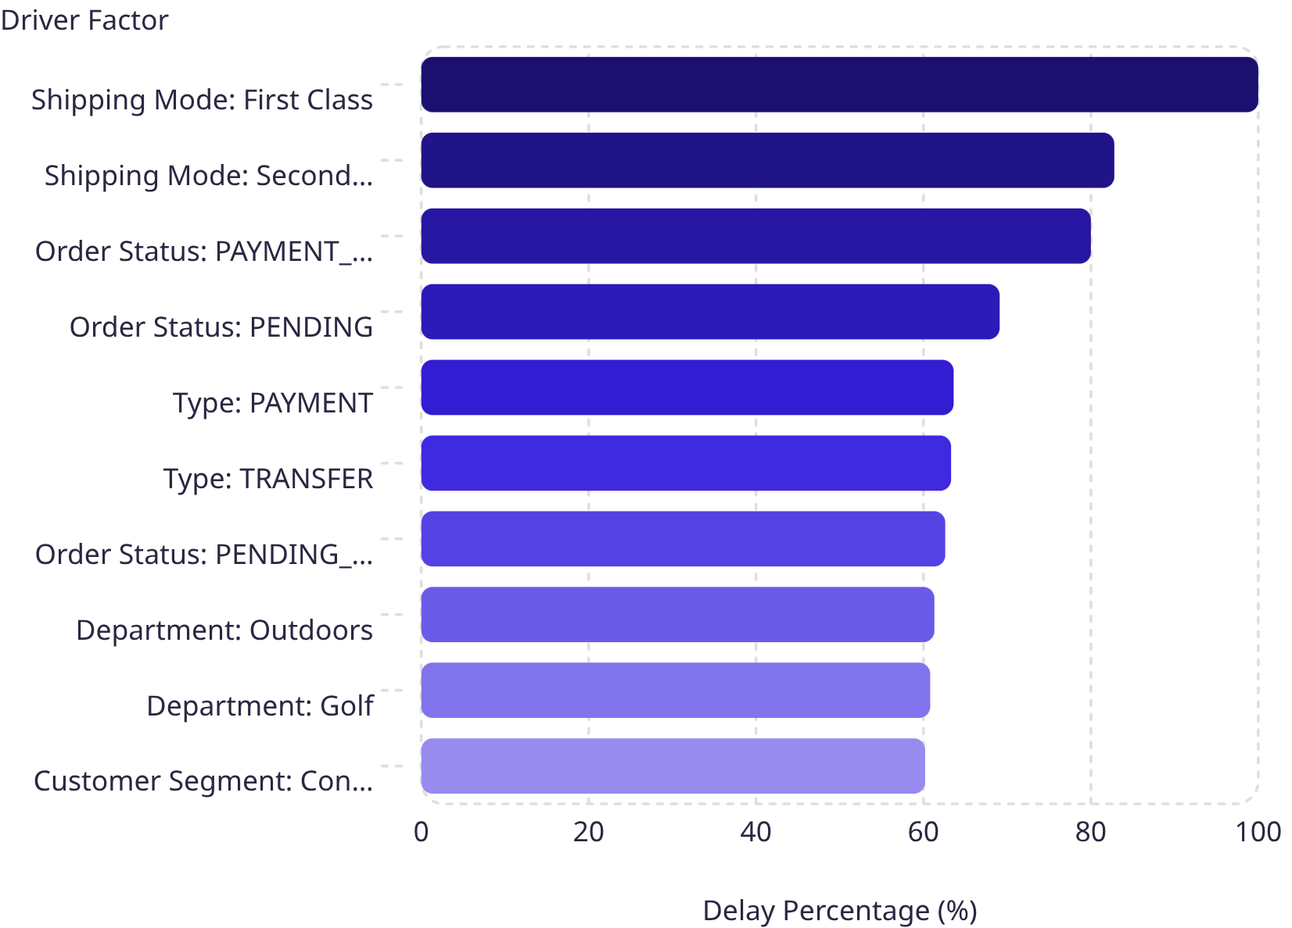

ROOT CAUSE ANALYSIS
Deep Dive: Top 10 Drivers of Late Delivery in Central Africa
Central Africa was selected for deep-dive analysis as the highest-delay region (58.7%). The pattern mirrors — and amplifies — company-wide findings.
First Class shipping reaches 100% delay rate; Second Class hits 82.8%. Orders held in PAYMENT_REVIEW status are delayed 80.0% of the time. Outdoors (61.3%) and Golf (60.8%) departments rank among top drivers, indicating a region-specific inventory and carrier issue layered on top of systemic shipping-mode and payment-processing problems.
The three dominant root causes are: (1) Shipping-mode misconfiguration, (2) Payment-processing friction, and (3) Regional inventory/carrier gaps.

Slide 9
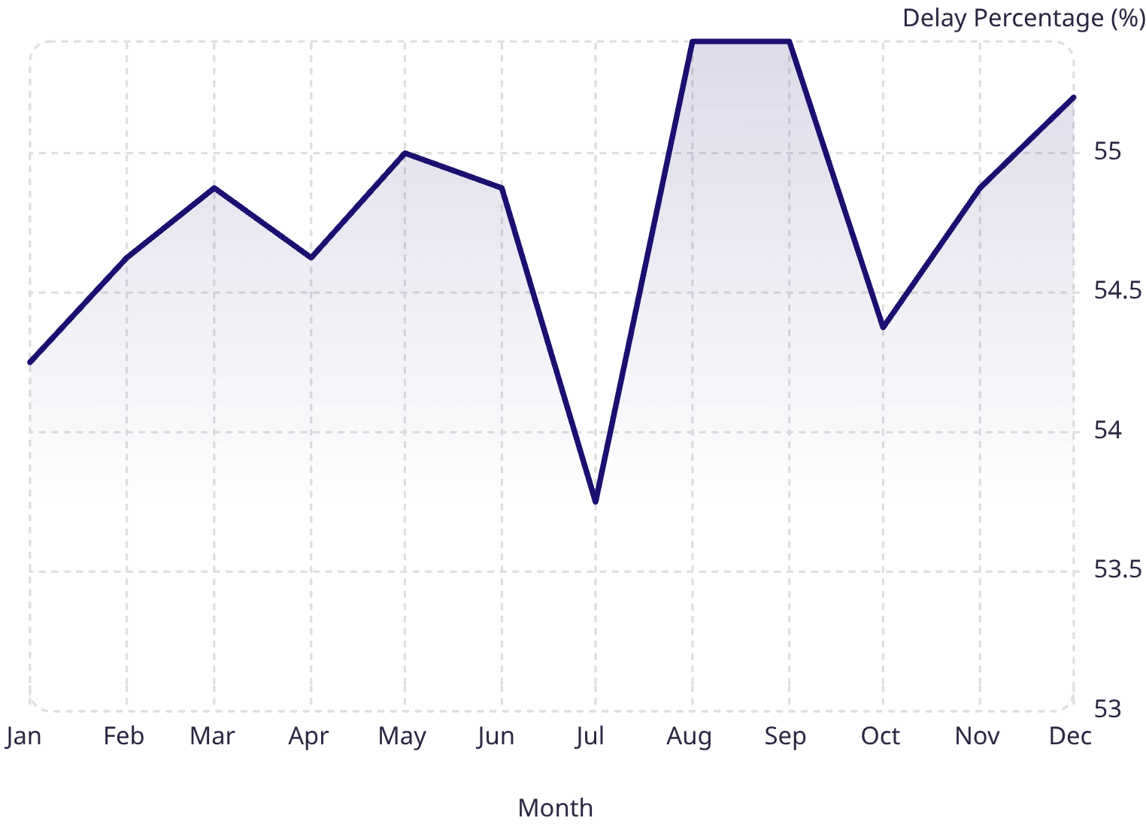
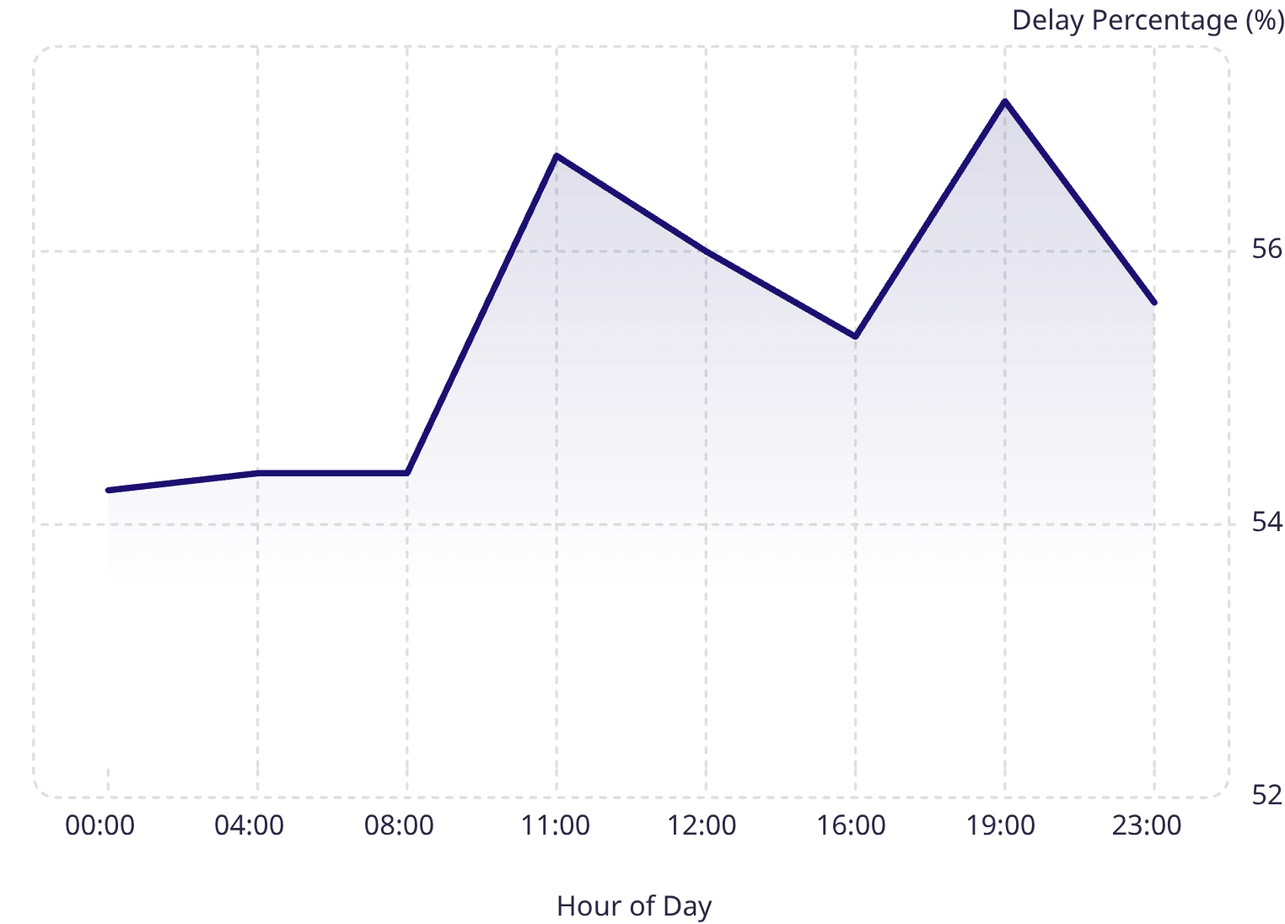
TIME-BASED ANALYSIS
Delay Rates by Month, Day of Week & Hour of Day
Peak Months
Day of Week
Intra-Day Peaks
August & September (55.4%) and December (55.2%) reflect mid-year promotions and Q4 holiday surges. July is a notable low (53.7%), confirming seasonal variation is predictable and plannable.
Monday (55.5%) and Sunday (55.2%) are peak days, but spread is under one percentage point. Day of week is not a meaningful lever for intervention.
Hour 21 (57.1%), Hour 11 (56.7%), Hour 12 (56.0%) — late-evening orders likely hit processing cutoffs; midday peaks reflect high-volume bottlenecks.

Slide 10
RECOMMENDATIONS & CONCLUSION
Strategic Recommendations
#
Priority
Action
Rationale
1
Critical
Audit First & Second Class shipping capacity
First Class: 100% delay; Second Class: 79.8%. Commission carrier SLA audit; consider suspending First Class and repricing both modes.
2
High
Resolve payment-processing bottlenecks
PAYMENT_REVIEW (80% delay in Central Africa) and PENDING_PAYMENT (55%) show elevated rates. Introduce automated escalation for reviews stalled beyond 2 hours.
3
Medium
Build seasonal surge-capacity plans
August, September (55.4%) and December (55.2%) are peak delay months. Establish pre-season capacity plans and inventory pre-positioning.
4
Medium
Default eligible orders to Standard Class
Standard Class delivers a markedly lower 39.8% delay rate. Re-evaluate shipping-mode assignment logic, particularly in underperforming regions.
5
Medium
Audit Outdoors and Golf in Central Africa
Outdoors (61.3%) and Golf (60.8%) show significantly elevated delay rates. Conduct warehouse-level audit of stock, pick-and-pack times, and carrier assignment.
6
Low
Reduce the loss-making order share (18.7%)
These orders warrant a separate pricing and discount review. Cross-reference with delay analysis to determine whether discounted orders are disproportionately late.
Addressing shipping-mode assignment and payment-review escalation alone has the potential to materially reduce the 54.71% late-delivery rate and protect the $2.1M of profit currently at risk, while seasonal capacity planning and targeted departmental audits offer further incremental gains.

