Slide 1



HackOrbit 2025
Codomania-Legends

Slide 2




PROBLEM STATEMENT
Miscommunication
Time management issues
Participation experience
Colleges frequently face challenges in coordinating and managing events efficiently, resulting in miscommunication, resource conflicts, and logistical issues. These difficulties often stem from fragmented communication channels, unorganized data handling, and poor time management, leading to chaotic event execution and unsatisfactory experiences for participants.

Slide 3

SOLUTION OVERVIEW
Our app simplifies event management with seamless organizer meetups, offline access to event details, smart scheduling, real-time attendee tracking, and automated reminders—ensuring smooth coordination and engagement. 🚀

Slide 4
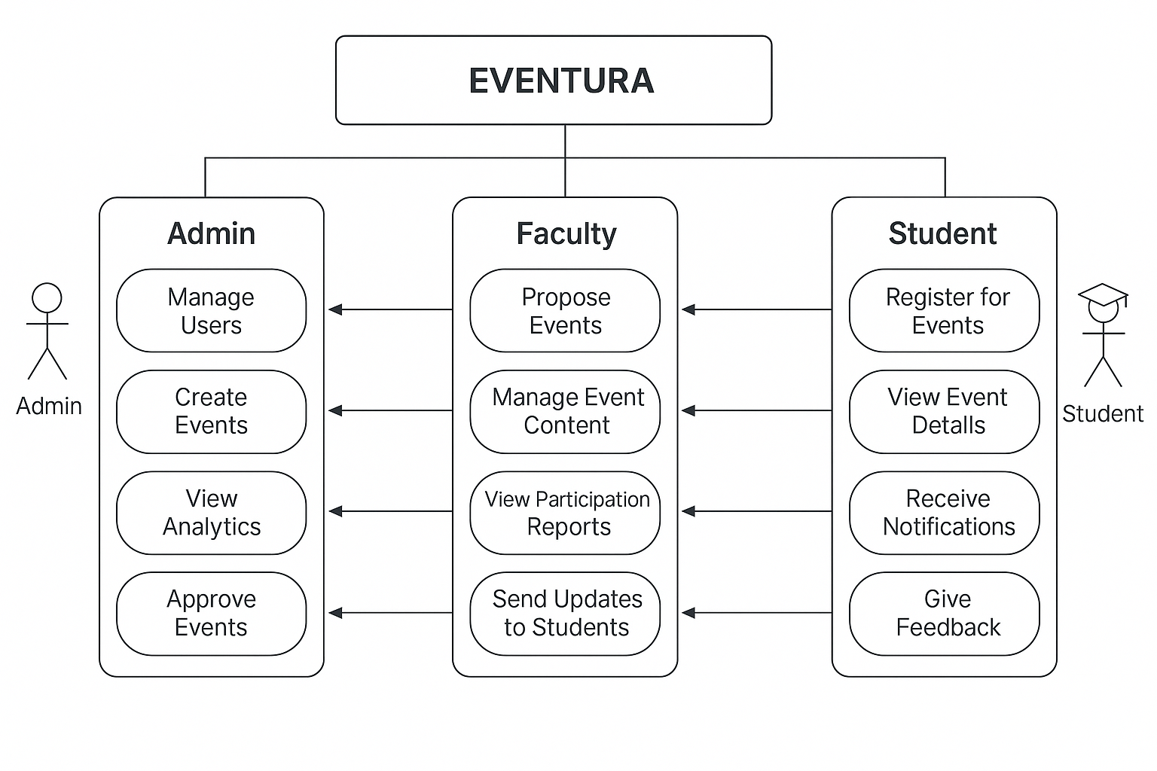
USE-CASE DIAGRAM

Slide 5

KEY FEATURES
1️⃣ Organizer & Volunteer Meetups –
Effortless coordination for smooth event planning.
2️⃣ Offline Event Access –
View schedules, dates, and details anytime.
3️⃣ Smart Scheduling –
Plan events with optimal date suggestions.
4️⃣ Live Attendee Tracking –
Real-time registration and participation updates.
5️⃣ Timely Reminders –
Never miss an event with smart notifications.

Slide 6

DRAWBACK AND SHOWSTOPPERS
1. Fragmented Communication Channels
Event details are shared via WhatsApp, emails, or verbal announcements — causing confusion, missed updates, and zero traceability.
2. No Role-Based System
There’s no separation of powers. Anyone can make changes or access everything — leading to security risks and mismanagement.
3. Lack of Automation & Reporting
Manual attendance, no real-time tracking, and no analytics. This creates unnecessary workload and zero insights for future events.

Slide 7


TEAM MEMBERS
Codomania-Legends
Anshul Vishwakarma
Vidhi Agarwal
anshulkb123456@gmail.com
github.com/AnshulVishwa
vidhiagrawal2205@gmail.com
github.com/VidhiAgrawa

Slide 8

Thank you

