Slide 1



Fashion Trends Analysis
By – S . Girade

Slide 2

Price Segmentation Analysis

Slide 3
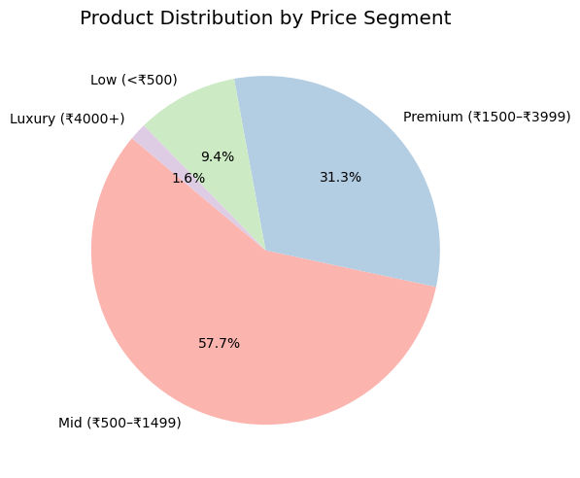
Product Distribution by Price Segment
Key Insights :
1. Dominance of Mid-Priced Products:
57.7% of all products (18,237 items) fall into the Mid (₹500–₹1499) range.
This indicates a strong focus on affordable fashion aimed at the largest consumer base.
Brands are likely prioritizing volume sales through competitive pricing.
2. Premium Segment Is Also Strong:
31.3% of products (9,872 items) are in the Premium (₹1500–₹3999) segment.
This suggests a substantial offering for consumers seeking brand value, better quality, or exclusive designs.
3. Low & Luxury Are Niche Segments:
9.4% (2,972 items) fall under the Low (<₹500) category.
Possibly represents budget collections, flash sales, or off-season items.
Only 1.6% (501 items) are in the Luxury (₹4000+) tier.
Indicates either a selective inventory strategy or limited luxury demand in the dataset.
4. Strategic Price Positioning:
The data reflects how brands are targeting mass affordability (Mid) while keeping Premium attractive.
This dual pricing strategy may help maintain market coverage while boosting average order values.
5. Market Opportunity:
Luxury and Low tiers are underrepresented.
There’s potential for emerging brands to explore:
Luxury-focused collections

Slide 4
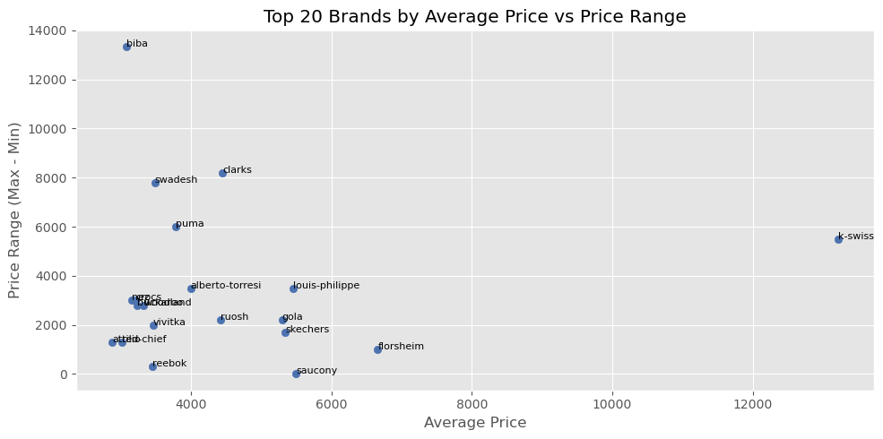
20 Brands by Average Price vs Price Range
Key Insights
1. High-End Premium Brands Stand Out
K-Swiss shows the highest average price among all brands, indicating a luxury positioning in the market.
2. Wide Price Range Suggests Diverse Product Lines
Clarks and Swadesh have a large price spread, indicating that they cater to both budget and premium segments.
These brands may be targeting a broader customer base by offering products at various price points.
3. Affordable Brands with Low Range
Reebok, Attic, and Campus cluster around the lower average price with a narrow price range, likely representing budget-focused or mass-market offerings.
4. Balanced Brands
Brands like Puma, Roush, and Sketchers strike a balance with mid-range average prices and moderate price spreads, appealing to value-conscious yet style-driven consumers.

Slide 5
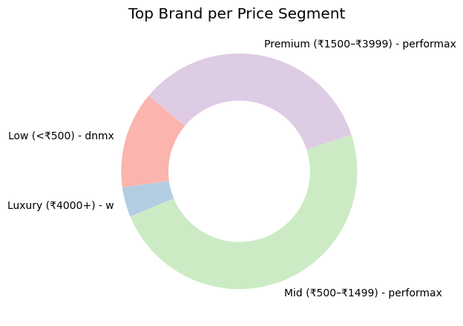
Top Brands by Price Segment
Key Insights
1. Mid-Range Market Dominance
Performax is the top brand in both Mid (₹500–₹1499) and Premium (₹1500–₹3999) segments.
It captures a large share in the market with 1657 (Mid) and 1153 (Premium) products — indicating broad appeal across middle-income buyers.
2. Affordable Fashion
DNMX leads the Low (<₹500) price tier with 453 products.
The brand caters well to budget-conscious shoppers looking for value at the lowest price point.
3. Luxury Segment
W stands out in the Luxury (₹4000+) category with 139 products.
Though smaller in volume, the brand targets premium customers with high-end offerings.

Slide 6
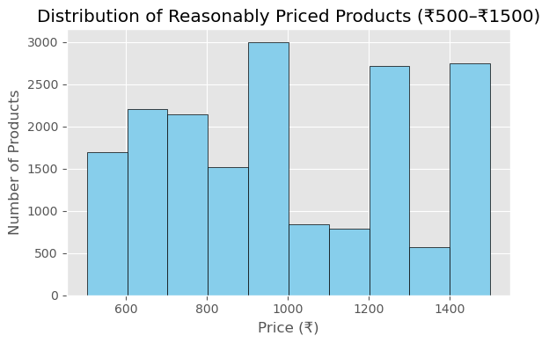
Price Distribution in Mid-Range Segment (₹500–₹1500
Key Insights:
1. Mid-range is Highly Crowded
Most products fall between ₹900 and ₹1500, showing a strong preference for upper-mid price points within this tier.
Price clusters suggest bulk pricing strategies by brands.
2. Popular Product Types
Crew-Neck T-shirts dominate this segment with multiple entries around ₹549–₹699.
Track Pants and Joggers are frequent and consistently priced around ₹1299, showing pricing consistency.
3. High-End of Mid Segment
Products like Sports Shoes reach the top of this tier at ₹1499, signaling the boundary between mid and premium offerings.

Slide 7

Discount Strategies Analysis

Slide 8
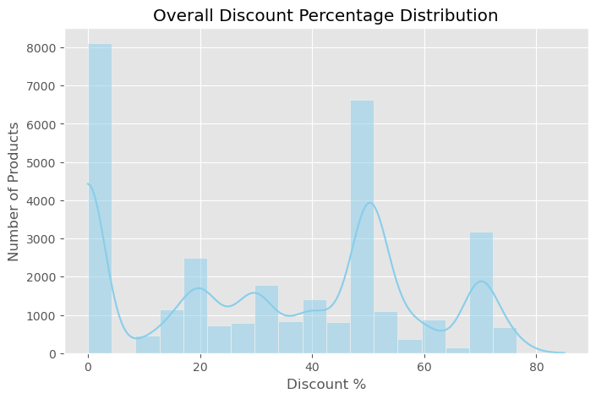
Overall Discount Trends
Key Insights:
1. Zero Discount Dominates
Over 8,000+ products have no discount at all — this is the largest group, indicating a significant portion of the catalog is offered at full price.
2. Popular Discount Bands
High concentrations are found around 20%, 40–50%, and 70% discounts.
These are likely marketing-driven sweet spots, showing strategic pricing thresholds that attract buyers.
3. Discount Sweet Spot
40–50% discounts see a sharp spike, making it the most aggressive and attractive discount range used by sellers.
4.Minimal Deep Discounts
Discounts beyond 70% are rare, suggesting that deep clearance pricing is not a common strategy.

Slide 9
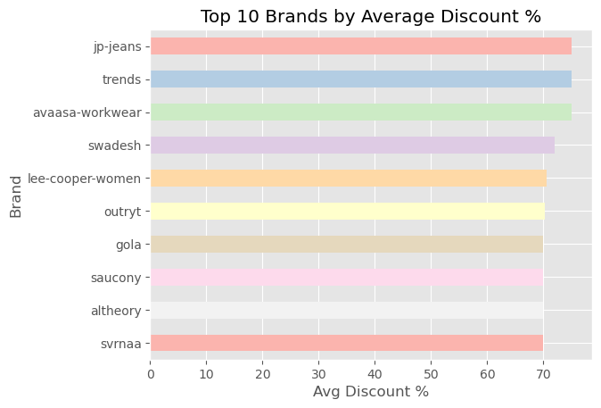
Top Brands Offering Deep Discounts
Key Insights:
1. Aggressive Discounting
All top 10 brands offer average discounts >69%, signaling a strong strategy to attract budget-conscious shoppers.
2. Leaders in Discount
JP-Jeans, Trends, and Avaasa Workwear top the chart with discounts nearly touching 75% — these are the most value-driven brands.
3. Consistent Strategy
The remaining brands (like Swadesh, Lee-Cooper-Women, and Svrnaa) maintain discounts around 70%, suggesting a consistent promotional pricing strategy across products.
4. Price-First Positioning
These brands likely appeal to price-sensitive segments, using discounts as their primary competitive edge.

Slide 10
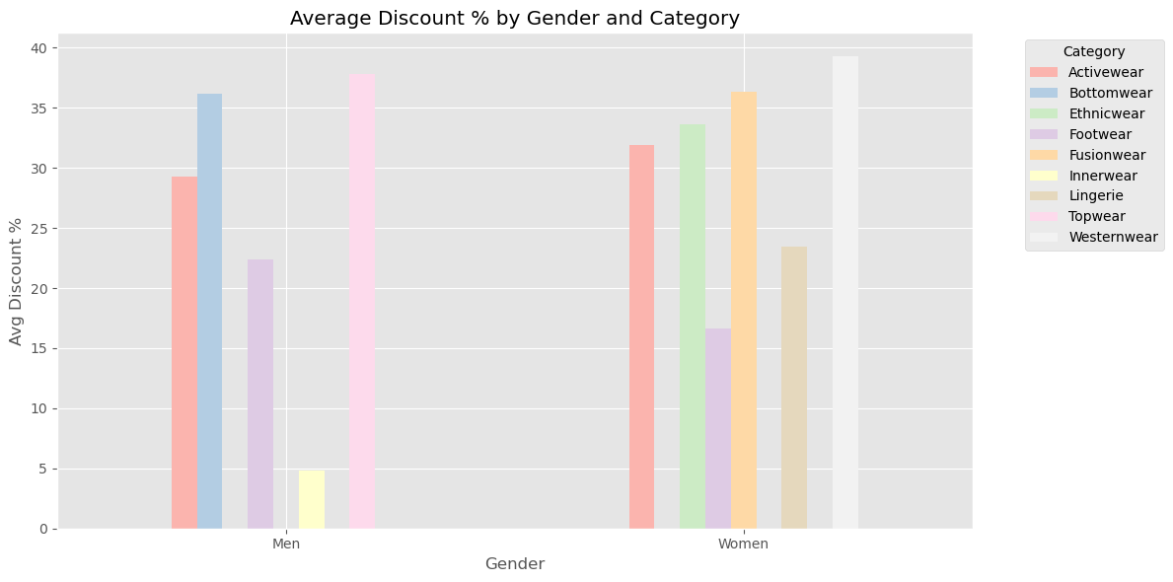
Discounts by Category and Gender
Key Insights:
1. Gender-Based Discount Trends
Women’s categories consistently receive higher average discounts compared to men’s, indicating targeted promotional efforts.
2. High-Discount Categories for Women
Westernwear (39.27%), Fusionwear (36.37%), and Ethnicwear (33.61%) top the list, showing retailers’ push to attract women shoppers in these segments.
Lingerie (23.46%) also receives strong discounts, likely tied to competitive pricing and seasonal promotions.
3. Top Discounted Categories for Men
Topwear (37.82%) and Bottomwear (36.14%) have the highest discounts for men, suggesting these are core drivers for male shoppers.
Innerwear (4.83%) has the lowest discount, indicating either stable demand or low-margin category.
4. Category Gaps
Certain categories like Ethnicwear, Fusionwear, Lingerie, and Westernwear are exclusive to women in this analysis.
Topwear is the only category with significant discounts across both genders, with men slightly higher.

Slide 11
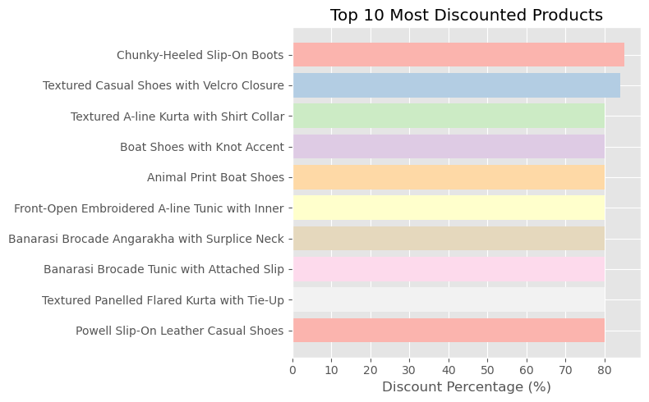
Top 10 Most Discounted Products
Key Insights:
1. Extreme Discounting
All top 10 products are offered at ≥80% discount, with Catwalk's Chunky-Heeled Slip-On Boots leading at 85% — highlighting highly aggressive markdowns.
2. Brand Dominance
Catwalk (footwear) and Swadesh (ethnic wear) dominate the list with 4 and 5 products respectively, showing a brand-level push in discount strategy.
Buckaroo appears once with Powell Slip-On Leather Casual Shoes.
3. Product Category Mix
Products include both footwear (e.g., boat shoes, boots) and ethnic wear (e.g., kurtas, tunics), showing discounts are not limited to a single segment.
4. Strategic Implications
These heavy discounts likely target inventory clearance or seasonal promotions, but may raise concerns on brand positioning and profit margins if used extensively.

Slide 12
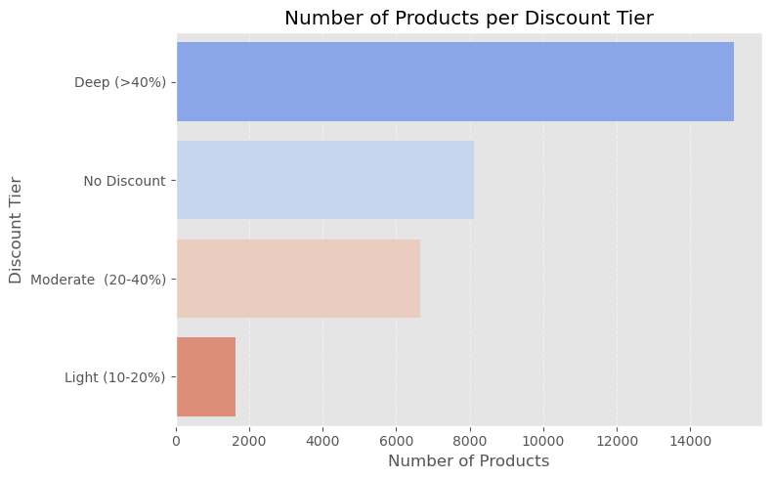
Product Discount Distribution Analysis by Tier
Key Insights:
1. Majority Deeply Discounted
The highest count of products (15,194) falls under the Deep Discount tier (>40%), indicating aggressive promotional pricing across a large inventory share.
2. Minimal Light Discounts
Only 1,621 products have light discounts (10–20%), showing a sharp contrast in pricing strategy — most products are either highly discounted or not at all.
3. Balanced Mid-Range Strategy Missing
Moderate discounts (20–40%) cover 6,660 products, but are significantly fewer than deeply discounted items, suggesting limited use of mid-range discounting as a pricing tactic.
4. Substantial No-Discount Segment
Despite heavy discounting trends, 8,107 products are sold at full price — this may include premium or new arrivals.
5. Strategic Implication
The bimodal pattern (either deep discounts or no discount) suggests a binary pricing strategy that may impact perceived value and customer expectations.

Slide 13

Gender Focus Trend Analysis

Slide 14
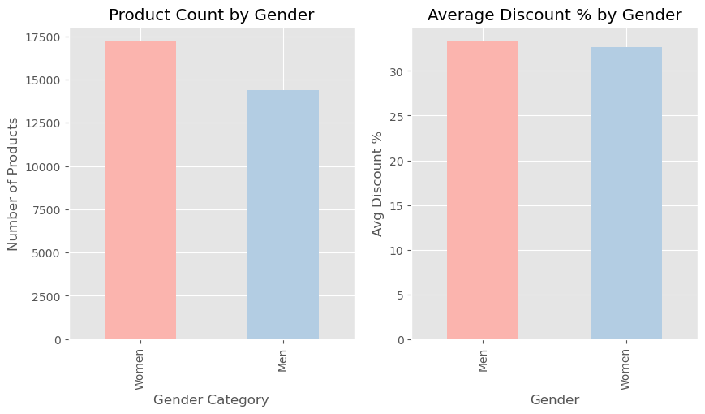
Gender-Based Analysis of Product Count and Discount Trends
Key Insights
1. Higher Product Count for Women
There are more products for women (17,207) than for men (14,375), indicating a stronger market focus on women’s fashion or consumer demand.
2. Slightly Higher Discounts for Men’s Products
The average discount for men’s products is 33.32%, slightly higher than women’s products at 32.69%.
This ~0.63% difference suggests relatively more aggressive discounting in men's categories, possibly to boost sales or clear inventory.
3. Balanced Discount Strategy
Although women’s products are more in number, the discount rates are fairly balanced across genders, indicating consistent pricing strategies.

Slide 15
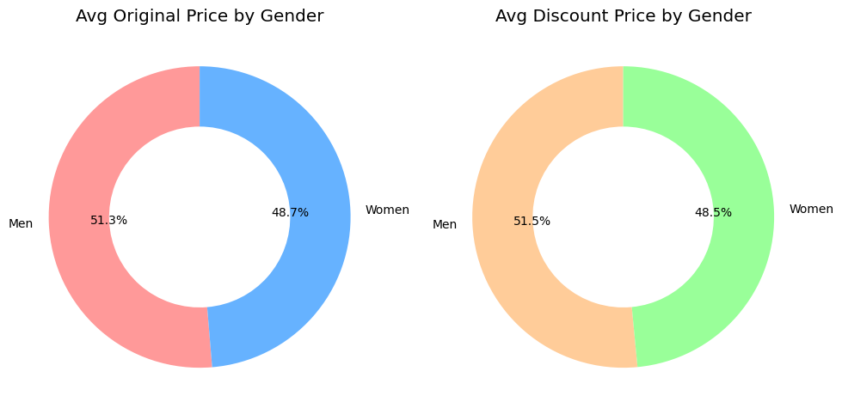
Gender-wise Product Pricing Analysis
Key Insight:
Men’s products are priced higher than women’s on average — both before and after discounts.
Original Price:
Men: ₹1459.13
Women: ₹1383.82
Discounted Price:
Men: ₹960.51
Women: ₹904.07
Percentage Share in Spending:
Men’s products account for ~51.5% of both original and discounted price averages, indicating a slightly higher consumer spend or premium pricing in men’s segments.

Slide 16
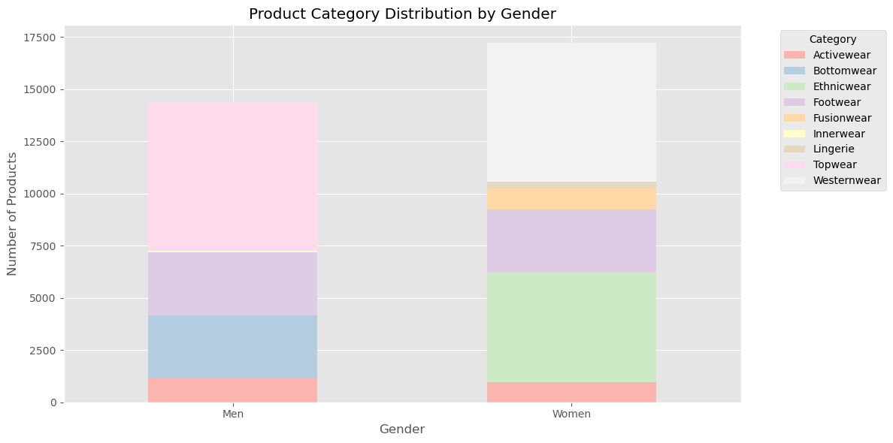
Gender-Based Product Category Distribution Analysis
Key Insights:
Men’s Product Portfolio:
Highly concentrated in Topwear (7,110), Bottomwear (2,984), and Footwear (3,015).
Completely lacks presence in Ethnicwear, Fusionwear, Lingerie, and Westernwear, indicating a narrower product focus.
Women’s Product Portfolio:
Significantly more diverse, with strong representation in Ethnicwear (5,265) and Westernwear (6,641).
Also includes Fusionwear (997), Lingerie (325), and Innerwear, highlighting greater variety in category offerings.
No products listed under Topwear or Bottomwear, possibly due to category naming differences for women’s clothing.
Women’s fashion offerings span a wider and more varied range of categories, while men's products are concentrated in a few key segments. This reflects differing marketing strategies and consumer demands across genders.

Slide 17
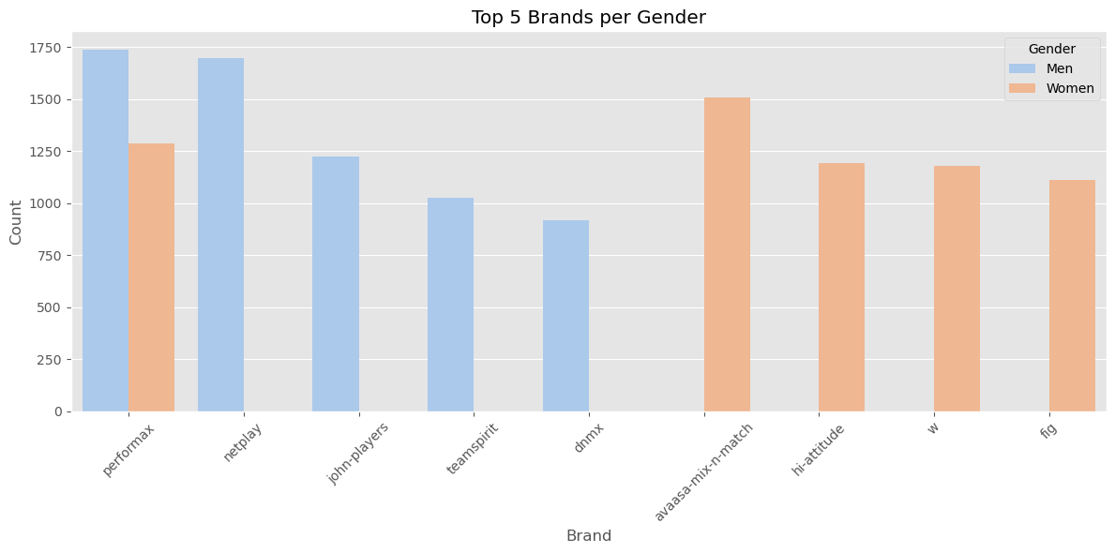
Top 5 Brands by Gender Preference
Key Insights:
Men’s Top Brands:
Dominated by Performax (1,740) and Netplay (1,698).
Also popular: John Players (1,224), Teamspirit (1,028), and DNMX (917).
These brands mostly focus on casual and formal menswear.
Women’s Top Brands:
Avaasa-Mix-n-Match (1,507) leads the list.
Performax (1,289) also performs strongly among women.
Other notable brands: Hi-Attitude (1,191), W (1,179), and Fig (1,110) — generally offering ethnic, fusion, and casual wear.
Common Brand:
Performax is a strong performer across both genders, indicating a broad unisex appeal, possibly in categories like activewear or essentials.

Slide 18

Brand-Level Strategy

Slide 19
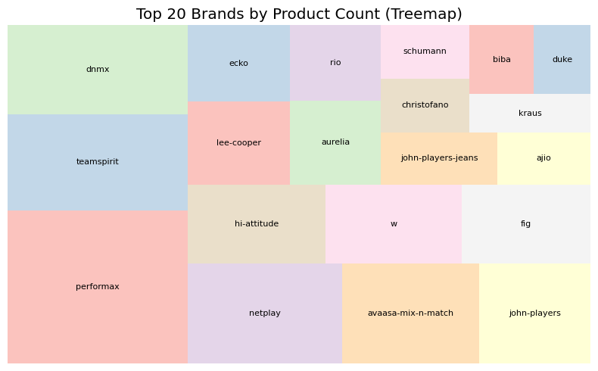
Top 20 Fashion Brands by Product Count (Treemap Analysis)
Key Insights:
Top Brands:
Performax dominates the chart with the highest product count (3,029).
Teamspirit (1,908) and DNMX (1,757) also hold significant product shares.
Mid-Tier Popular Brands:
Netplay (1,698) and Avaasa Mix-n-Match (1,507) show strong presence in the market.
Others like John Players (1,224), Hi-Attitude (1,191), and W (1,179) are also prominent.
Limited Presence:
Several brands such as Duke (429), Biba (485), Schumann (516), and Kraus (510) have comparatively fewer products, indicating niche or limited stock strategies.
Brand Strategy Inference:
Larger brands (e.g., Performax, Teamspirit) may cater to a wide range of categories or emphasize fast-moving essentials.
Smaller brands could be focusing on premium, niche, or exclusive lines

Slide 20
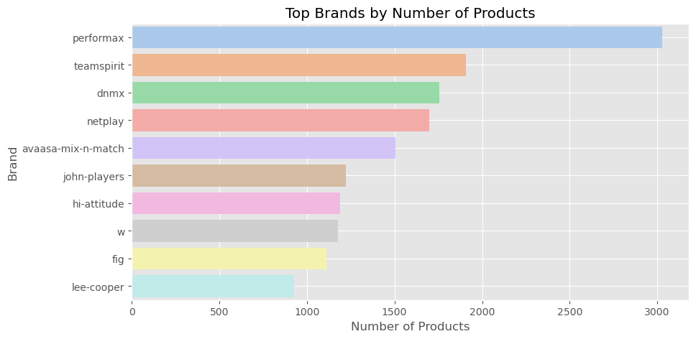
Top Brands by Product Volume, Price & Discount Strategy
Key Insights:
1. Most Prolific Brand
Performax leads with 3,029 products, focused on Men’s Activewear.
Offers an attractive ~39% average discount, making it both high-volume and budget-friendly.
2. Dominant Segment: Men’s Fashion
Brands like Teamspirit, DNMX, Netplay, and John Players dominate in Men’s Westernwear & Topwear.
These brands maintain moderate pricing (₹750–₹1,600) with ~30–47% discounts, striking a balance between value and style.
3. Women’s Fashion Focus
Avaasa Mix-n-Match and W lead for women:
Avaasa is affordable ethnicwear (~₹896 original, ~₹514 discounted).
W is a premium ethnicwear brand with the highest average price (₹2,605) and ~42% discount, signaling a high-end strategy with seasonal pricing cuts.
Hi-Attitude and FIG also serve women but at lower average prices (₹800–₹830).
4. Discount Trends
John Players offers the steepest average discount (~47%), hinting at aggressive pricing or seasonal clearance tactics.
Hi-Attitude has the lowest average discount (17%) among top brands, possibly reflecting limited-time offers or newer arrivals.

Slide 21
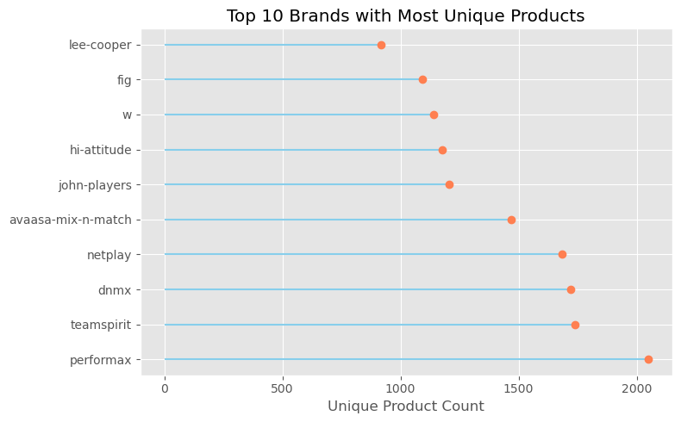
Top Brands by Unique Product Variety
Key Insights:
1. Leaders in Product Diversity
Performax tops with 2,049 unique products, showcasing broad assortment capabilities, especially in Men's Activewear.
Teamspirit (1,740), DNMX (1,719), and Netplay (1,684) also offer extensive variety, reinforcing their strong brand presence in casual menswear.
2. Women's Fashion with Depth
Avaasa Mix-n-Match (1,470) and W (1,141) reflect rich diversity in ethnicwear for women, catering to a wide range of preferences, designs, and occasions.
3. Mid-Tier Brand Differentiation
John Players, Hi-Attitude, FIG, and Lee Cooper range between 900–1,200 unique items, striking a balance between depth and specialization.

Slide 22
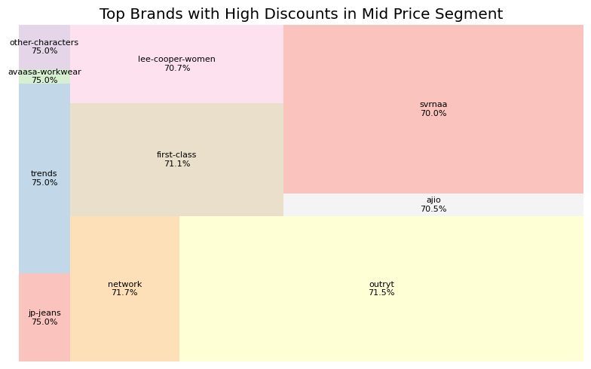
Top Brands Offering Deep Discounts in the Mid-Price Segment
Key Insights:
1. Exceptional Discounting Strategy
Brands like JP Jeans, Trends, Avaasa Workwear, and Other Characters consistently offer steep discounts of ~75%, making them high-value options for price-sensitive customers in the mid-price range.
2. Focus on Women’s Fashion
Lee-Cooper Women (70.7%), Ajio (70.5%), and Svrnaa (70%) target the women's segment while maintaining significant markdowns, hinting at competitive positioning or overstock clearance strategies.
3. Balanced Volume with Discounts
Outryt (71.5%) and Network (71.7%) strike a balance between decent product variety (38 & 21 items) and aggressive discounting, potentially indicating inventory push or seasonal clearance tactics.

Slide 23

Category Deep Dive

Slide 24
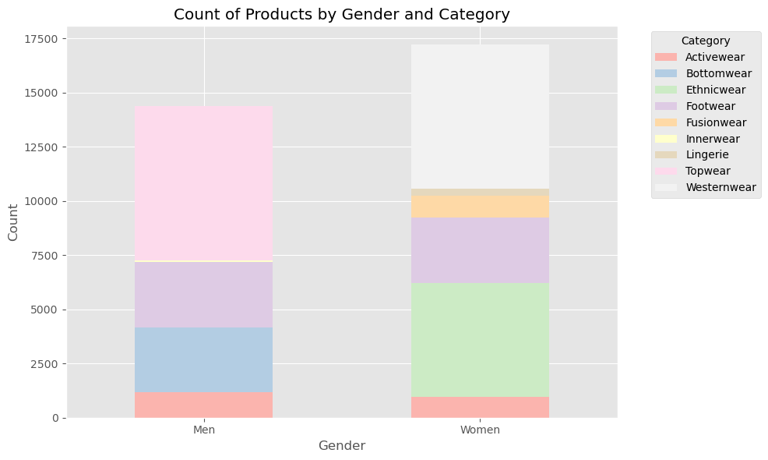
Product Category Preferences by Gender
Key Insights:
Men’s Shopping Preferences
Topwear (7,110) leads men's product categories, followed by Footwear (3,015) and Bottomwear (2,984).
Negligible or no products are listed under categories like Ethnicwear, Fusionwear, Lingerie, or Westernwear, highlighting a narrower category distribution.
Women’s Category Dominance
Women’s top categories are Westernwear (6,641) and Ethnicwear (5,265), showing a strong demand for varied apparel styles.
Women also have exclusive categories like Lingerie (325), Fusionwear (997), and Innerwear (0 listed but assumed niche).
Women’s product range appears more diverse, suggesting wider targeting opportunities.
Overlap and Parity
Footwear (3,015 each) and Activewear (Men: 1,170 | Women: 964) show balanced engagement, making them strong gender-neutral categories.

Slide 25
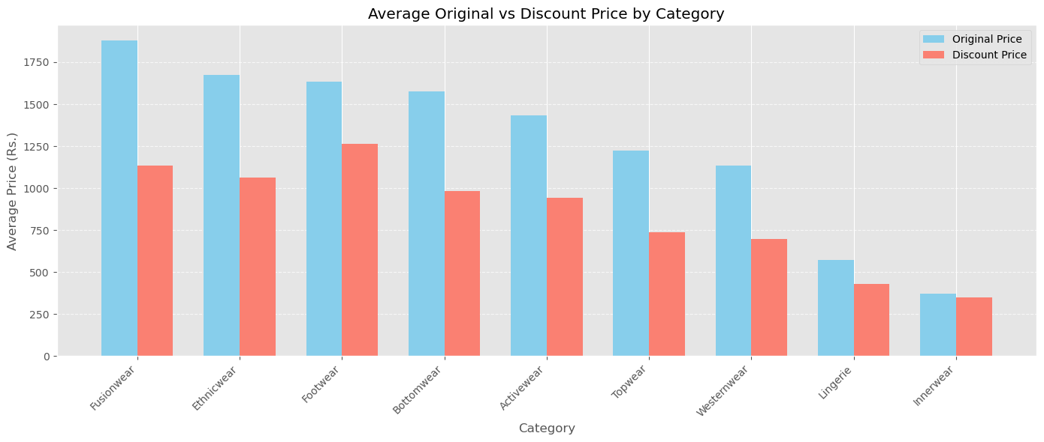
Average Original vs Discounted Prices by Product Category
Key Insights:
Premium Categories
Fusionwear tops the chart with an average original price of ₹1877 and a discounted price of ₹1134.
Ethnicwear (₹1674) and Footwear (₹1636) follow, showing strong perceived value and price elasticity.
Budget-Friendly Segments
Innerwear (₹370) and Lingerie (₹572) are the lowest-priced categories, catering to basic or essential needs.
These categories show smaller gaps between original and discount prices, likely due to tighter margins.
High Discounts, Mid-Tier Pricing
Topwear and Westernwear are priced in the mid to low range (₹1136–₹1225) but show significant price reductions, signaling:
Aggressive discount strategies
High competition in these segments
Value per Rupee
Categories like Footwear offer relatively high value post-discount (~₹1266), making them attractive buys even in premium brackets.

Slide 26
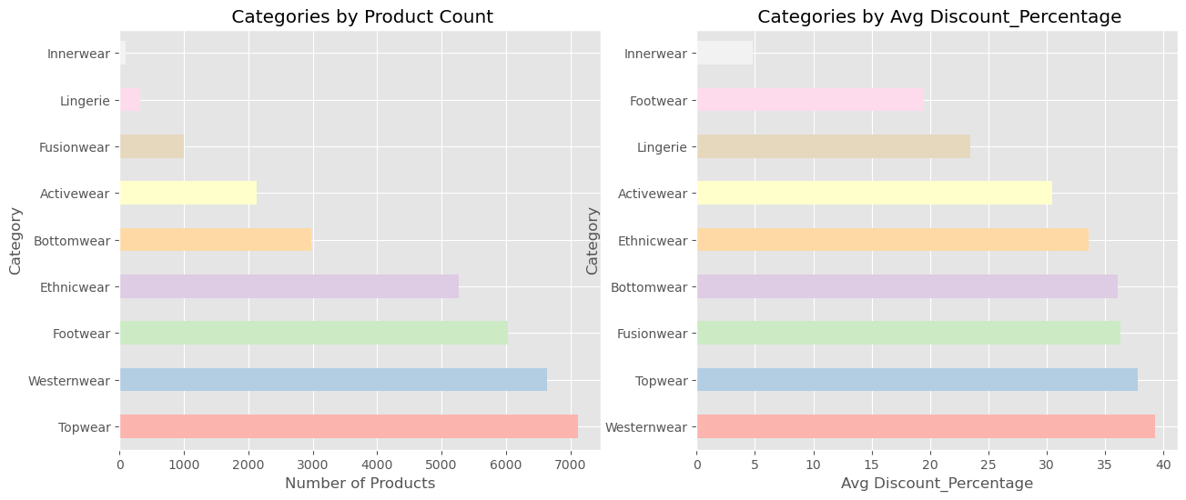
Product Distribution and Discount Strategy by Category
Key Insights:
Product Volume Leaders
Topwear (7110) and Westernwear (6641) dominate in product count.
Footwear (6030) and Ethnicwear (5265) also represent large collections.
Innerwear (96) and Lingerie (325) are niche or minimally stocked categories.
Average Discount Percentage
Westernwear (39.3%) and Topwear (37.8%) not only have the highest stock but also the largest discounts, indicating:
Competitive space
Potential overstock clearance
Fusionwear (36.4%) and Bottomwear (36.1%) offer strong markdowns despite moderate inventory, possibly to boost visibility or adoption.
Innerwear (4.8%) and Footwear (19.5%) receive minimal discounts, reflecting:
Steady demand
Lower price sensitivity
Possibly essentials-driven pricing

Slide 27
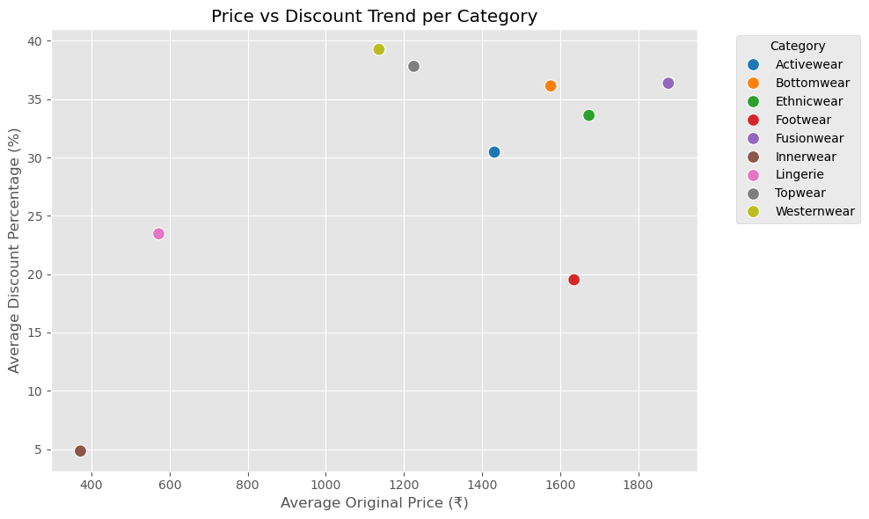
Average Price vs Discount Strategy Analysis by Category
Key Insight:
Westernwear and Topwear offer the highest discounts (~38–39%) despite lower average prices, suggesting a focus on mass-market appeal.
Fusionwear and Bottomwear are premium categories with strong discounts (~36%), indicating a push to drive sales in high-value segments.
Footwear has a moderate price point but receives lower discounting (~20%), likely due to consistent demand or lower markdown policies.
Innerwear, with the lowest average price, also has the least discount (~5%), indicating a stable, low-margin category.
Ethnicwear and Activewear maintain a balanced strategy, with premium pricing and moderate discounts (30–33%).

Slide 28

Product-Level Analysis

Slide 29
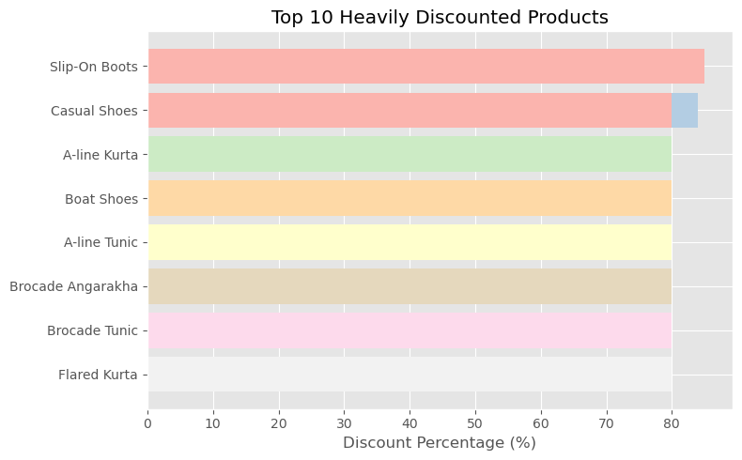
Top 10 Heavily Discounted Products
Key Insight:
1. Deep Discount Strategy
Discounts range from 80% to 85%, placing all products in the Deep Discount Tier (>40%).
Signals aggressive clearance on select styles, likely to push unsold inventory or boost sales volume rapidly.
2. Category Concentration
Footwear leads with 5 out of 10 top discounted products, primarily from Catwalk.
Ethnicwear and Fusionwear from Swadesh dominate the rest — suggesting discount focus on traditional and occasion wear.
3. High-Value Focus
Majority of products fall in Premium (₹1500–₹3999) and Luxury (₹4000+) price segments.
Implies strategic discounting on high-ticket items to drive conversion and stock turnover.
4. Brand-wise Dominance
Catwalk targets premium footwear with steep markdowns — possibly to maintain market share.
Swadesh applies heavy discounts on ethnic styles — likely to clear seasonal collections or reposition in a crowded market.

Slide 30
Top Premium Products with Zero Discounts
Top 10 Full-Price Premium Products
 | Product_Name | Brand | Original_Price
19423 | Flared Kurta | w | 16999
6997 | Casual Shoes | k-swiss | 14999
6734 | Casual Shoes | k-swiss | 14999
6966 | Casual Shoes | k-swiss | 14999
24459 | Embellished Gown | w | 14999
7012 | Casual Shoes | k-swiss | 12999
7027 | Casual Shoes | k-swiss | 12499
7007 | Casual Shoes | k-swiss | 12499
24162 | Lehenga-Choli Set | w | 11999
20134 | Kurta Set | w | 9999
Key Insights:
1. No Discount Strategy
All listed products have a 0% discount, suggesting no promotional pricing is applied — they are sold at full price.
2. Brand-Specific Premium Pricing
K-Swiss, a men’s footwear brand, dominates the list with Casual Shoes priced between ₹12,499 and ₹14,999.
Indicates a premium positioning strategy with no reliance on discounts.
3. High-End Women’s Wear
Products like Flared Kurta, Lehenga-Choli Set, Embellished Gown, and Kurta Set reflect premium ethnic and fusionwear, primarily from brand “W”.
These likely target occasion wear segments with steady demand.
4. Price Band Focus
All products fall within the ₹9,999–₹16,999 range, indicating a mid-to-high luxury segment.
Suggests these items are either new arrivals, flagship pieces, or core products not intended for discounting.

Slide 31
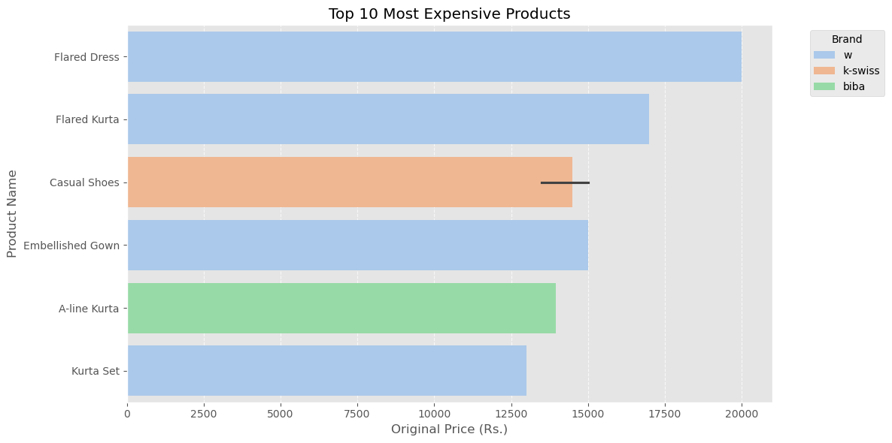
Top 10 Most Expensive Products
Key Insights:
1. Luxury Pricing Range: Prices span from ₹12,999 to ₹19,999 — reflecting a premium, full-price luxury segment with no discounts applied.
2. Category Concentration: Most products belong to Ethnicwear (Kurta, Kurta Sets) and Footwear (Casual Shoes), with a few Fusionwear items (Flared Dress, Embellished Gown) also represented.
3. Brand Dominance: Brands like W, K-Swiss, and Biba lead in the high-price bracket, with W offering a variety of premium ethnic and fusion items.
4. Product Type Variety: Includes Embroidered and Embellished pieces, indicating that detailed craftsmanship and occasion-wear aesthetics contribute to high pricing.

Slide 32
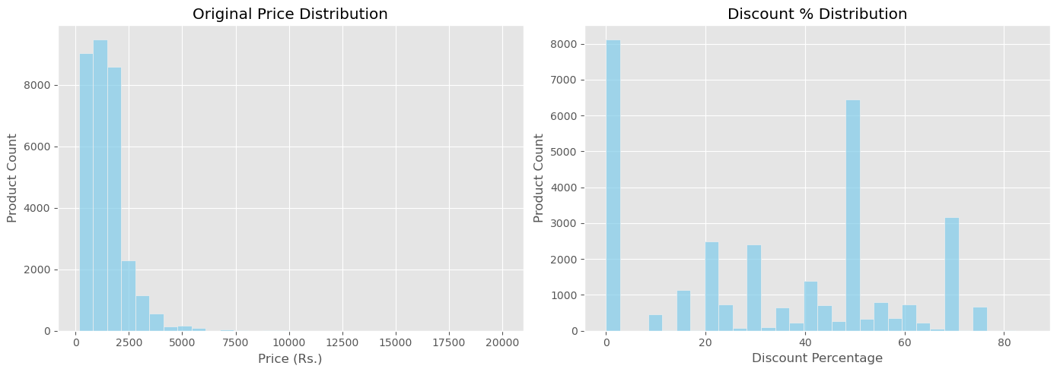
Distribution Analysis of Product Prices and Discounts
Key Insights:
1. Majority of Products Are Affordable:
Most items priced below ₹2500.
Luxury items (₹5000+) are very limited.
2. High Concentration in Mid & Premium Range:
Aligns with ₹500–₹3999 focus seen earlier.
3. No Discount Is Common:
Many products sold at full price, showing pricing confidence.
4. Heavy Discounts (50–70%) Also Used:
Likely for clearance or promotional boosts.
5. Dual Strategy Observed:
Brands use both full-price sales and deep discounts to target different buyers.

Slide 33
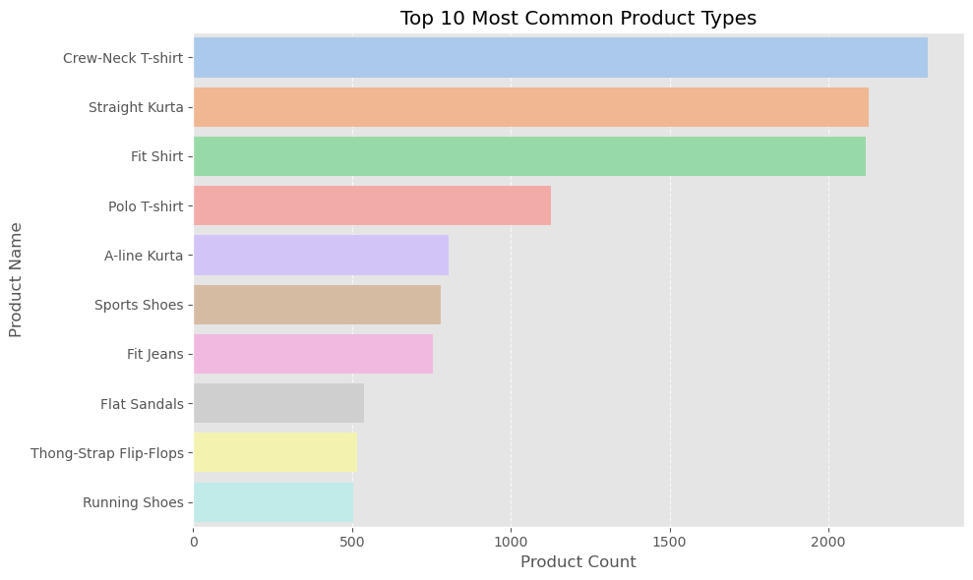
Top 10 Most Listed Product Types
Key Insights:
Crew-Neck T-shirt is the most listed product, with 2312 items, indicating strong demand for casual essentials.
Straight Kurta (2126 items) and Fit Shirt (2117 items) are also highly common, showing a balance between ethnic and formal styles.
Polo T-shirt, A-line Kurta, and Fit Jeans reflect a focus on versatile wardrobe basics that cater to both daily wear and semi-formal occasions.
Footwear is well-represented, with Sports Shoes, Running Shoes, Flat Sandals, and Flip-Flops, highlighting the importance of active and casual footwear in the catalog.
The overall distribution indicates a broad appeal strategy, covering casual wear, ethnic fashion, and footwear, likely targeting young and style-conscious consumers.

