Slide 1
Google search
DSC340
Mike Pangburn

Slide 2
Agenda
Performing your own Google searches
Google conversions
Gaining insights (e.g., marketing related) from others’ Google searches

Slide 3
The Google query language
One recent study indicates that white-collar workers in business spend about 1/3 of their day searching for information.
You can likely become significantly better at searching with Google if you understand its search operators
Reference: the “Ultimate Google Guide” @ mapelli.info

Slide 4
Google.com searches 101
Search keywords are not case sensitive: searching for Oregon Ducks (7.5M hits) is the same as oregon ducks
Short common words (e.g.,“I” , “the”, “me”) are largely ignored by Google
avoid such words in your searches!
search operators are case sensitive: searching for oregon OR ducks football uses OR as the Google operator (325M hits), while oregon or ducks football does not (17M hits)

Slide 5
Finding Better Results : OR
Google.com searches 101
Increasing the Number of Results
car OR vehicle OR automobile inspections
retrieves web pages containing:
car AND inspections
vehicle AND inspections
automobile AND inspections

Slide 6
Google.com searches 101
Try this
Search for information on post high-school education in Oregon
Search for information on singer Taio Cruz but you’re not sure about the spelling of the first name
Answer: university OR college OR postsecondary “Oregon”
Answer: tieo OR taio cruz

Slide 7
Other basic Google operators
- exclude word oregon ducks –football (~7M hits)
“ ” find particular phrase
“oregon ducks” football (~9M hits)
~ look for synonyms of word as well
oregon ducks ~football (~30M hits)

Slide 8
Google’s basic operators
You need a buying guide for computers (Hint: what are some other terms for “computer”?)
Answer: ~computer “buying guide”
What is the #1 result that appears? It may not be about “computers”

Slide 9
Other basic Google operators
* wildcard “oregon ducks * bowl game” (~3M hits)
.. accept range of #’s “oregon ducks” football “60..80 points” (~0.1M hits)

Slide 10
Advanced Google operators
daterange:
Returns documents modified in the given time interval. Dates should be entered in julian format
E.g., Using "oregon ducks" football "60..80 points" daterange:2455805-2455926 you can filter our prior results to pages dated between 9/01/2011 and 12/31/2011
2455805 is the Julian calendar date for Sep. 1, 2011
2455926 is the Julian calendar date for Dec. 31, 2011

Slide 11
Advanced Google operators
filetype:
returns links to documents with the given file type.
E.g., For example searching for "oregon ducks" football "60..80 points" daterange:2455805-2455926 filetype:pdf will filter our prior results to find only .pdf pages. (returns 3 hits)

Slide 12
Advanced Google operators
site:
restricts the results to the given domain name space.
Examples
site:uoregon.edu "oregon ducks" football filetype:pdf (33 hits) will find all Oregon Ducks football related pages on servers using the second level domain: uoregon.edu
Note: site:www.uoregon.edu "oregon ducks" football filetype:pdf yielded no hits
2. site:ca “sales tax” will find the phrase “sales tax” in pages on Canadian websites

Slide 13
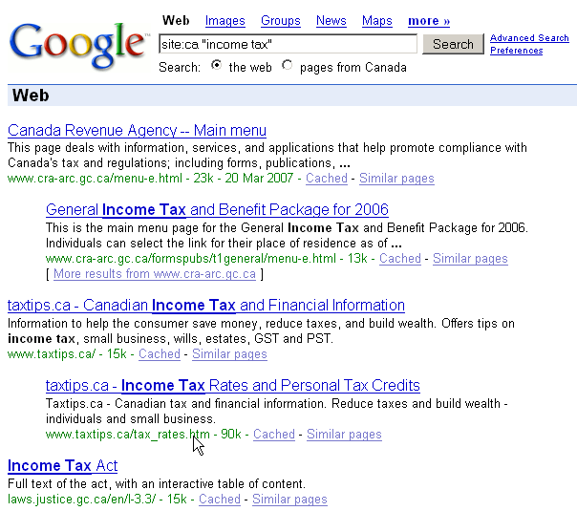
Advanced Google operators
Results from site:ca “sales tax”

Slide 14
Advanced Google operators
intitle:
lists web pages with certain text within their HTML <title> tag.
E.g., For example intitle:”Oregon Ducks Football”

Slide 15
Advanced Google operators
inurl:
lists web pages with specific text in their own URL.
Examples
inurl:OregonDucksFootball and…
inurl:”Oregon Ducks Football”
Which do you think will find more hits?

Slide 16
Try this
Search for information on hybrid cars. You only want to see pages with gas mileage in the title.
Search for information on soup recipes. You only want to see pages with vegetarian in the title.
Answer: “hybrid cars” intitle:“gas mileage”
Answer: “soup recipes” intitle:vegetarian

Slide 17
Advanced Google operators
link:
lists web pages that link to the given webpage.
E.g., For example link:http://www.tracktownusa.com/ will list web pages with links pointing to the TrackTownUSA website (returns ~20 hits)

Slide 18
Misc. Google operators
weather:
weather information for the given city
E.g., weather:eugene or
flights:
search for flights using airport codes
E.g., pdx sfo

Slide 19
Agenda
Performing your own Google searches
Google conversions
Gaining insights (e.g., marketing related) from others’ Google searches

Slide 20
Google conversions
you can use 100miles in km , 1m in mm, but also 200000 km in light-second etc.
just some samples: 100mph in kph 1 month in seconds 280 kelvin in celsius 50 fahrenheit in celsius

Slide 21
Google conversions
currency
Convert between different units
For example, 3 euros in dollars
Even solve complicated units-conversion problems! ☺ 3 teaspoons in oz 1 cup + 1 tablespoon in teaspoon
There are a lot of others possible conversions, just try some when you have the need!

Slide 22
Agenda
Performing your own Google searches
Google conversions
Gaining insights (e.g., marketing related) from others’ Google searches

Slide 23
Summary of Google searches: Google Triends
See what other people around the world are searching for (“Google Trends” technology)
Free!
This technology / database has proven to be valuable for marketers, political campaign managers, and even the general public
Google Flu Trends … may even keep you healthier

Slide 24
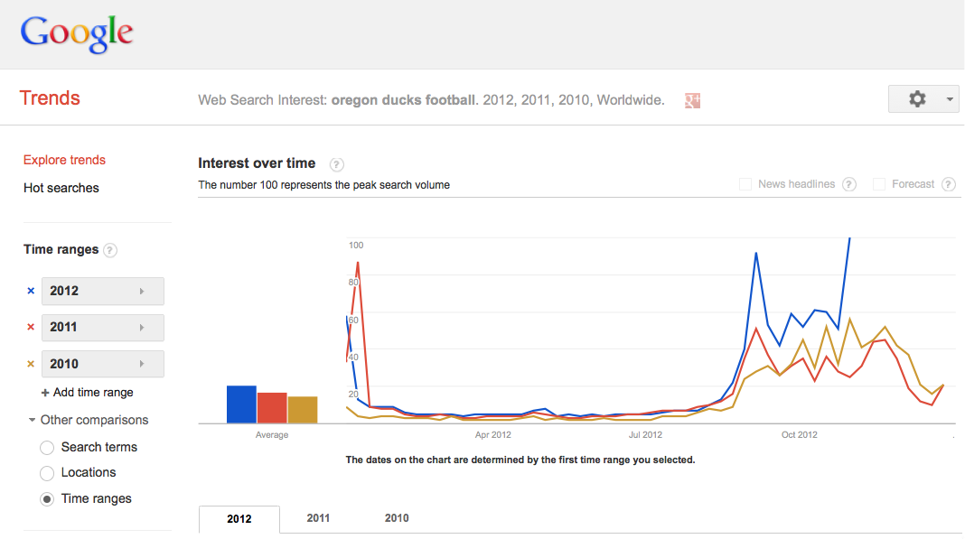
Example of Google Trends
Search terms: Oregon ducks football

