Slide 1
Final Project
Cinema Web Service
  Fodor Codrut

Slide 2
Reasoning
Create a full web application for a cinema service.

Slide 3
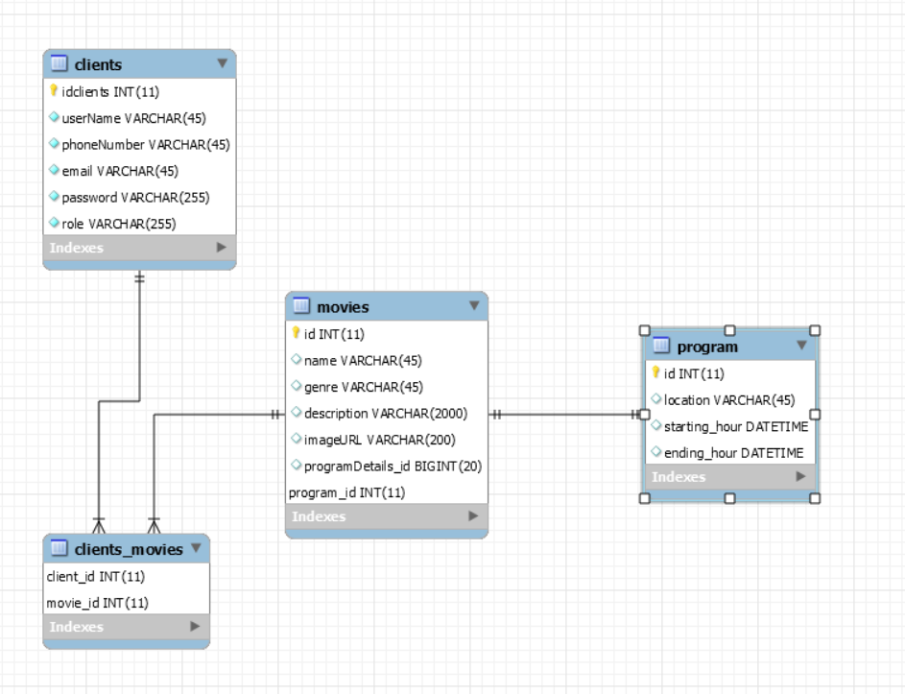
Database Structure Description

