Slide 1

CIVICPULSE AI
Turning citizen voices into intelligent city action
A streetlight, reported three times
Asha reported the dark streetlight near her bus stop three times in two weeks. Each report sat unranked in a 60-ticket queue.
(Illustrative scenario)
126,974
BBMP grievances in ~5.5 months
31.4%
Streetlights of total complaints
58%
Road maintenance resolved
Source: OpenCity analysis of BBMP data, Jul 2025.
Personas: Citizen (Asha) · Ward engineer (Kavitha)
Independent civic-tech prototype · Not affiliated with government
Notes:
This is Asha. Every evening, she walks home from the bus stop in Bengaluru along an unlit residential street. Over two weeks, she reported the broken streetlight three separate times on the municipal portal. Each report became a disconnected ticket in an unranked queue of sixty complaints on the desk of Kavitha, the ward engineer.
In five and a half months of 2025, Bengaluru recorded over 126,000 civic grievances. Streetlights alone made up over 31%, while road maintenance resolved only 58%. The problem isn't that citizens don't care, or that engineers don't work. The problem is that reports pile up blindly.

Slide 2
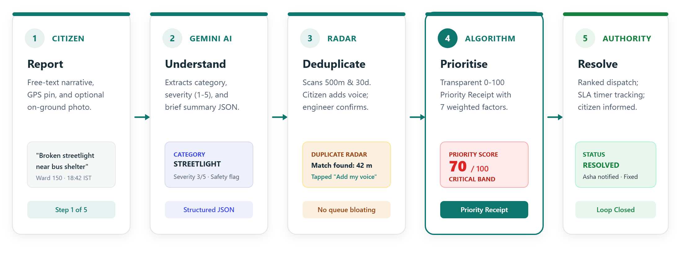
Reports pile up. Nothing gets ranked.
CivicPulse turns every report into ranked, located action.
TODAY: FIRST-COME QUEUES
• Duplicate inflation
Same broken light filed repeatedly, bloating unranked backlogs.
• Blind queues
Critical public hazards wait buried behind cosmetic tasks.
• Citizen silence
No updates sent back, destroying trust and triggering re-reports.
Notes:
Today, municipal portals operate on a first-come, first-served queue. When an issue goes unresolved, citizens file it again and again. This artificially inflates backlogs. More dangerously, it blinds engineers: a critical safety hazard filed today sits behind a cosmetic repair filed last week. And because citizens never receive updates, trust collapses.
CivicPulse changes this path completely. A citizen reports with free text and a map pin. Our AI understands the context, our Duplicate Radar surfaces existing reports, our deterministic engine scores the urgency, and officers dispatch targeted action.

Slide 3
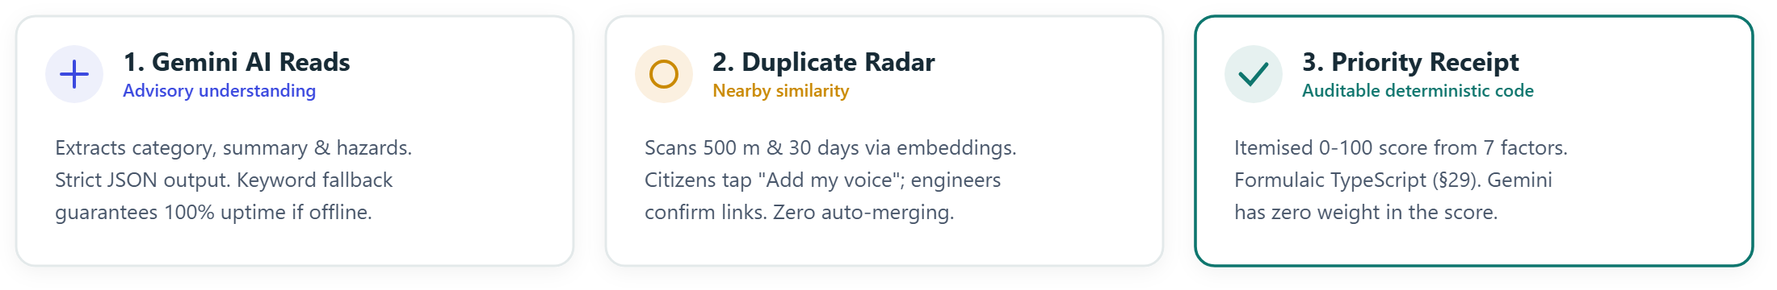
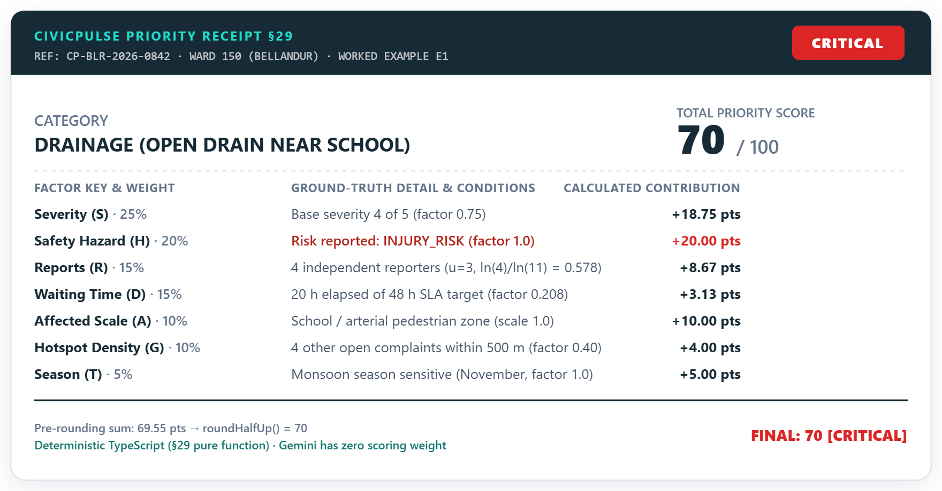
AI suggests. Code decides. People confirm.
Transparent civic triage with zero black-box scoring.
Notes:
Trust requires complete explainability. We divide responsibilities strictly: AI suggests, code decides, people confirm.
First, Google Gemini reads the unstructured text to identify category, safety flags, and a neutral summary. If the AI is ever offline, a deterministic keyword fallback takes over immediately.
Second, Duplicate Radar compares coordinates and semantic embeddings within 500 meters and 30 days. Instead of filing duplicates, neighbors tap 'Add my voice'.
Finally, our Priority Receipt calculates a transparent 0-to-100 score using seven auditable factors. Gemini has zero influence on this score. Ward engineers retain full authority to confirm or adjust.

Slide 4
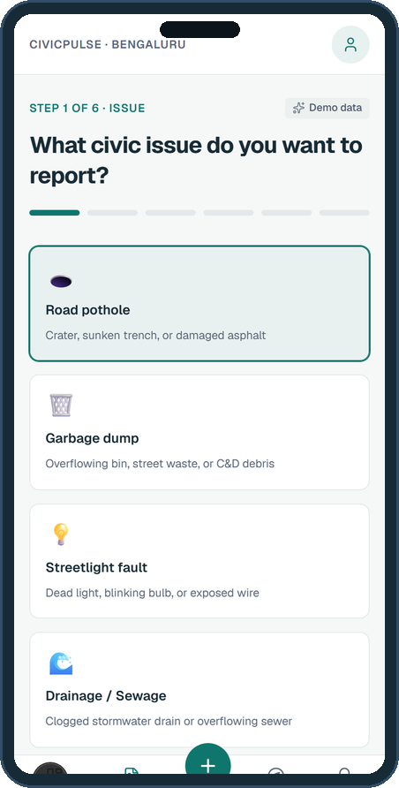
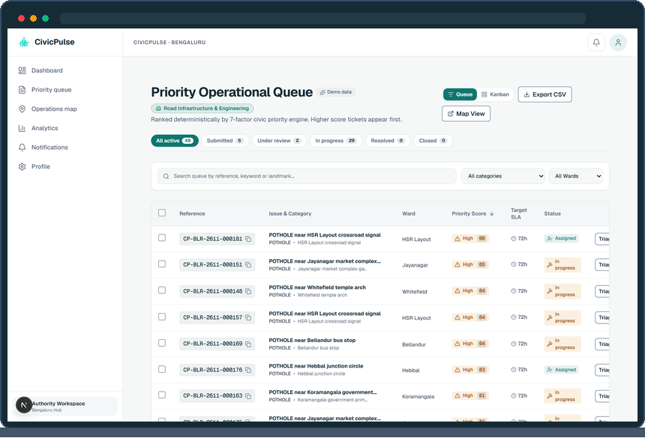

It works today
A verified prototype deployed on production free tiers.
civicpulse.vercel.app
Judge Access: 1-Click Demo Roles
Citizen · Roads Authority · Admin
Pre-seeded with 240 active reports
Authority Triage Queue · Ranked 0-100 tickets with SLA countdowns
Mobile Citizen Wizard
AI suggestion & location
Citizen reports → AI analyses → Duplicate linked → Engineer resolves → Citizen notified
Notes:
CivicPulse is not a concept deck. It is an operational system running right now on production infrastructure.
On the left, citizens file reports via our clean mobile wizard, receiving immediate AI categorization and duplicate alerts. In the center, ward engineers manage a ranked queue where urgent public hazards immediately rise to the top with SLA countdowns. On the right, live geospatial maps highlight ward clusters.
You can test this yourself right now at civicpulse.vercel.app with one-click demo logins for citizens, engineers, and administrators.

Slide 5
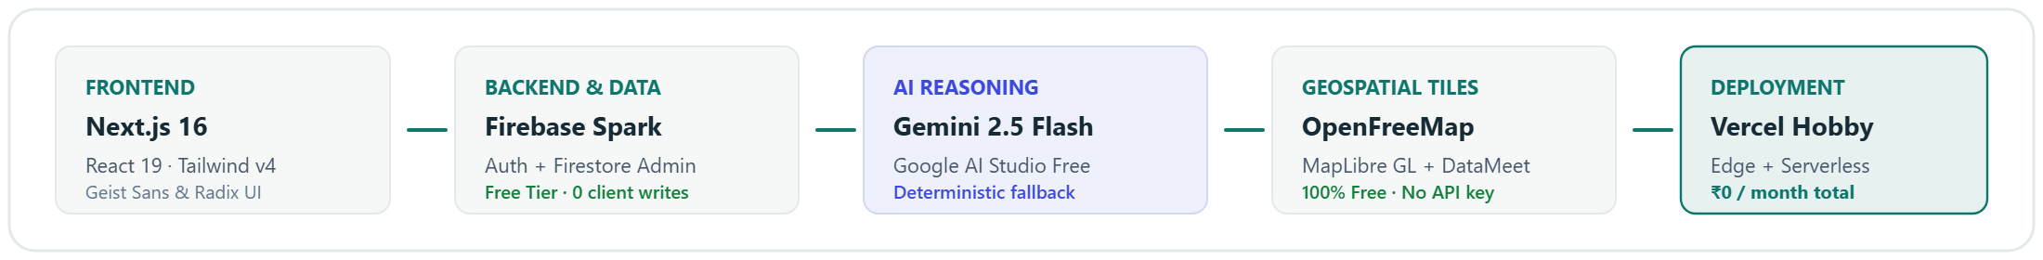

Built free, built to scale, built honestly
Open civic technology on ₹0 infrastructure.
OPEN DATA SOURCES & LICENCES
• BBMP Grievance Records: OpenCity.in analysis (Jul 2025)
• Bengaluru Ward Boundaries: DataMeet Community Maps (CC BY 4.0)
• Base Vector Maps: OpenFreeMap / OpenStreetMap (ODbL)
• Synthetic Evaluation Data: 240 seeded reports labelled 'Demo data'
PROTOTYPE IMPACT & NEXT STEPS
Labelled Prototype data · Single-ward municipal pilot with Hindi & Kannada support.
240
Reports analysed
18%
Duplicates averted
< 3s
Median triage time
Reported once. Prioritised. Fixed. And Asha knew.
CivicPulse AI · INNOVATE Online Hackathon 2026 by Aveeranex on Unstop
Notes:
We built CivicPulse sustainably on open public technologies: Next.js, Firebase, Gemini API, MapLibre, and OpenFreeMap, running entirely on ₹0 free-tier infrastructure.
We use open datasets from OpenCity and DataMeet, and evaluate on 240 synthetic complaints where we have already prevented 18% duplicate inflation and reduced triage to under three seconds.
Our next step is a single-ward pilot with voice support for Kannada and Hindi.
The streetlight Asha walked past is now fixed. Reported once. Prioritised. Fixed. And Asha knew. Thank you.

