Slide 1



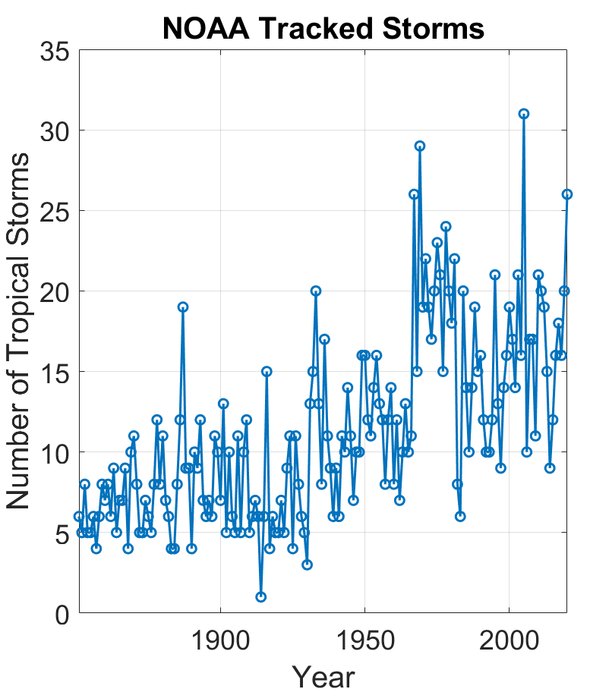
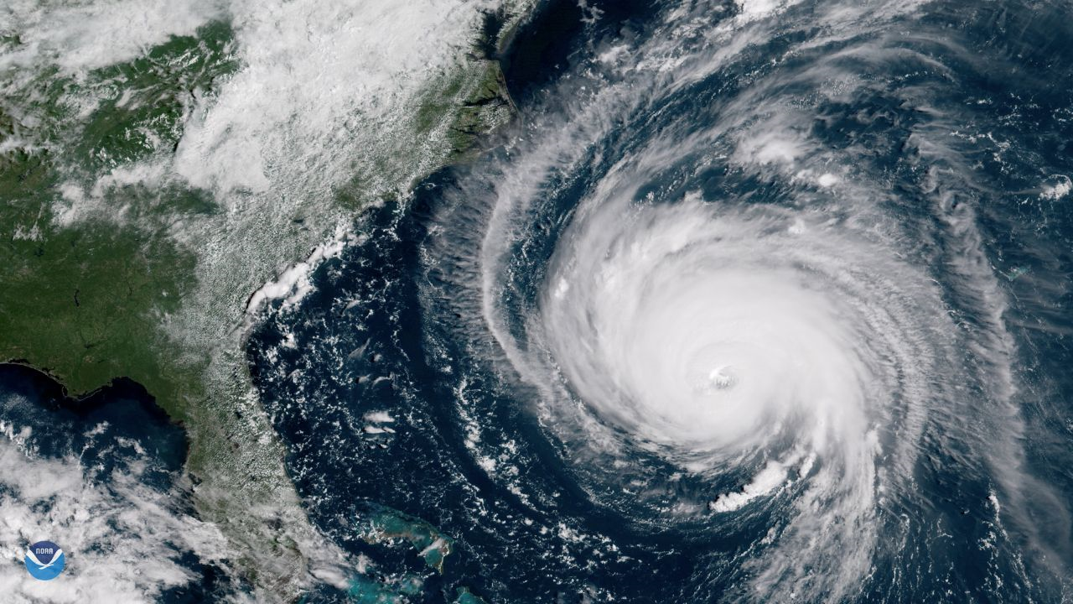
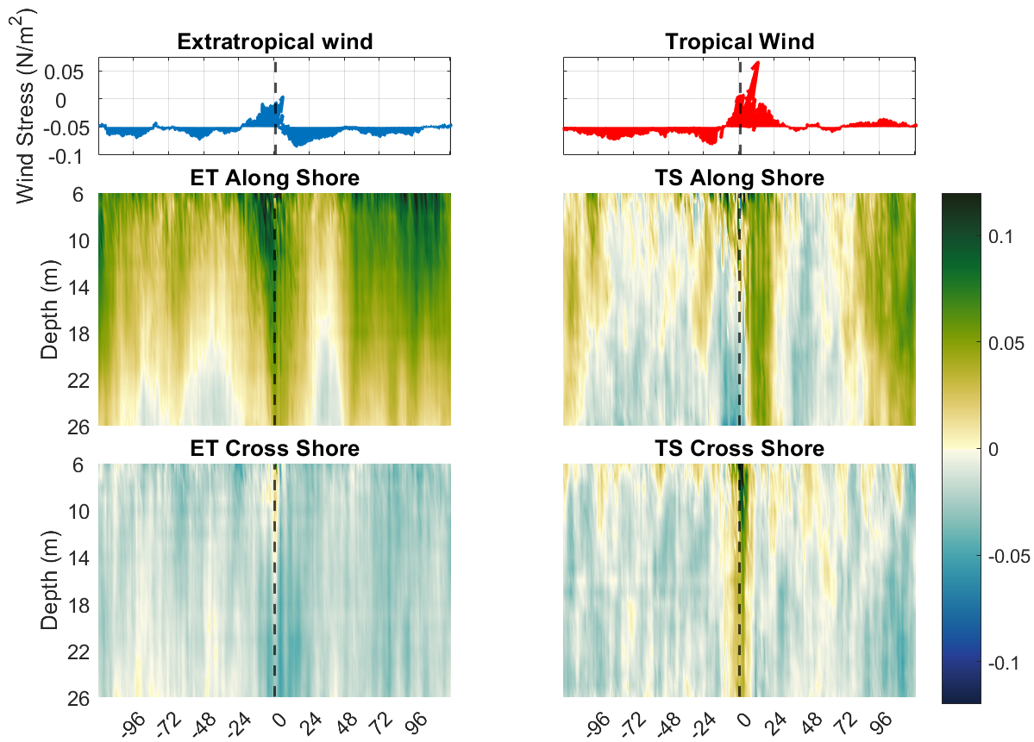
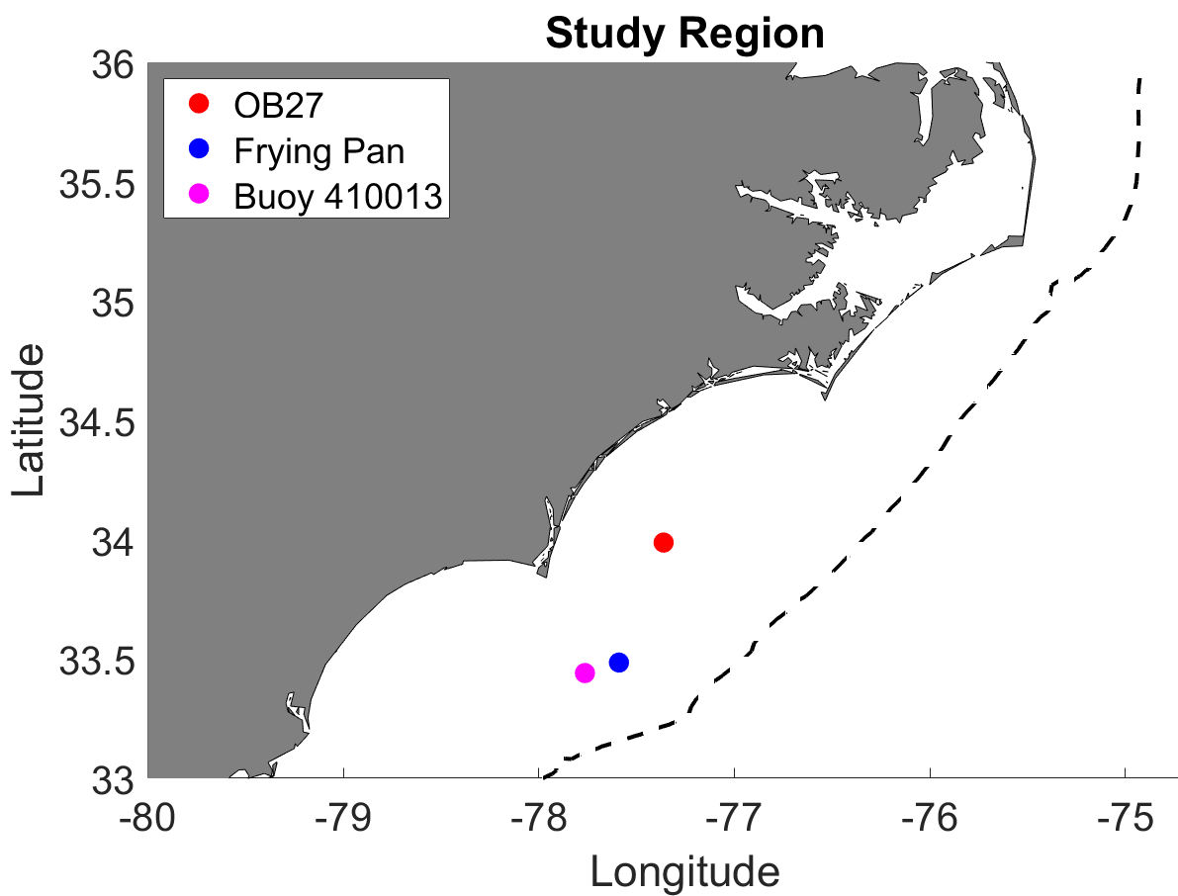
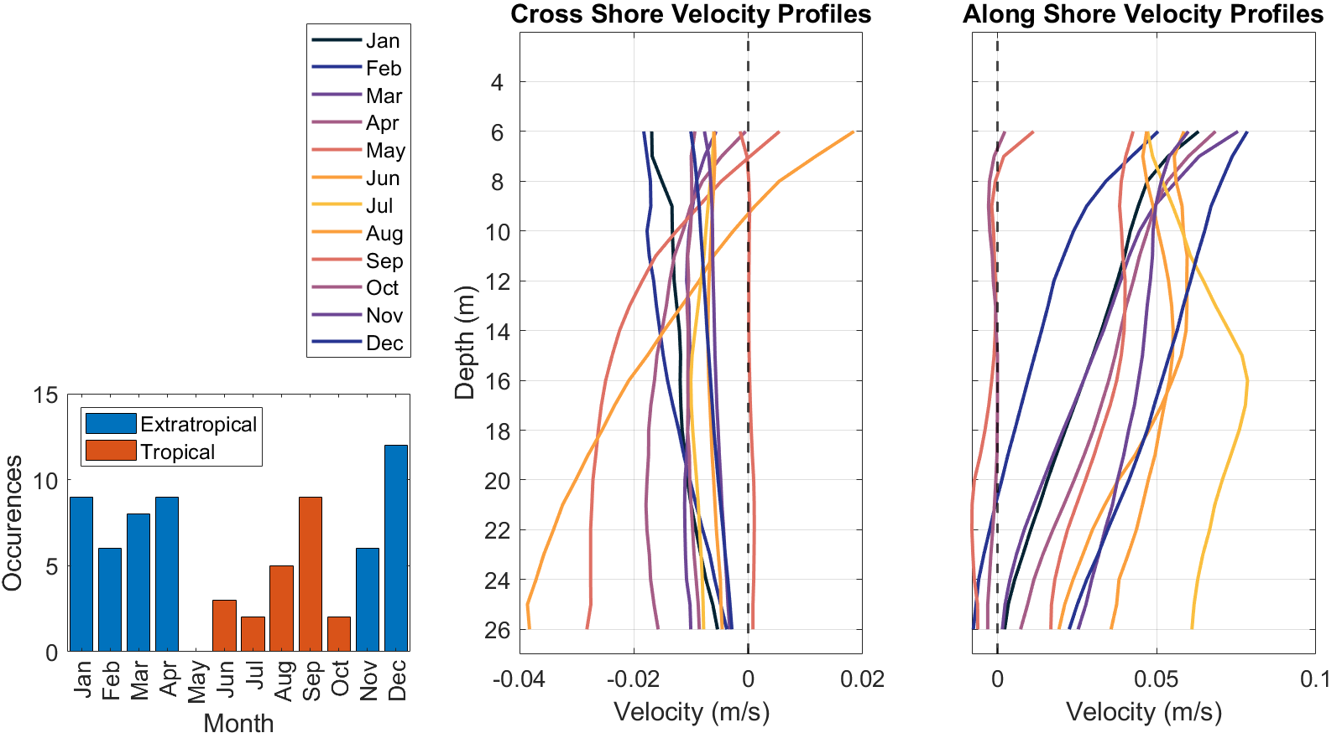
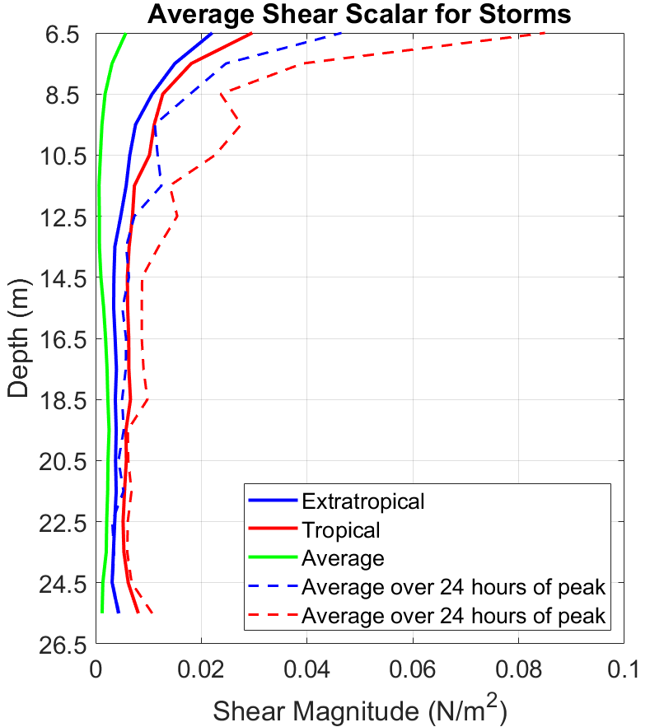
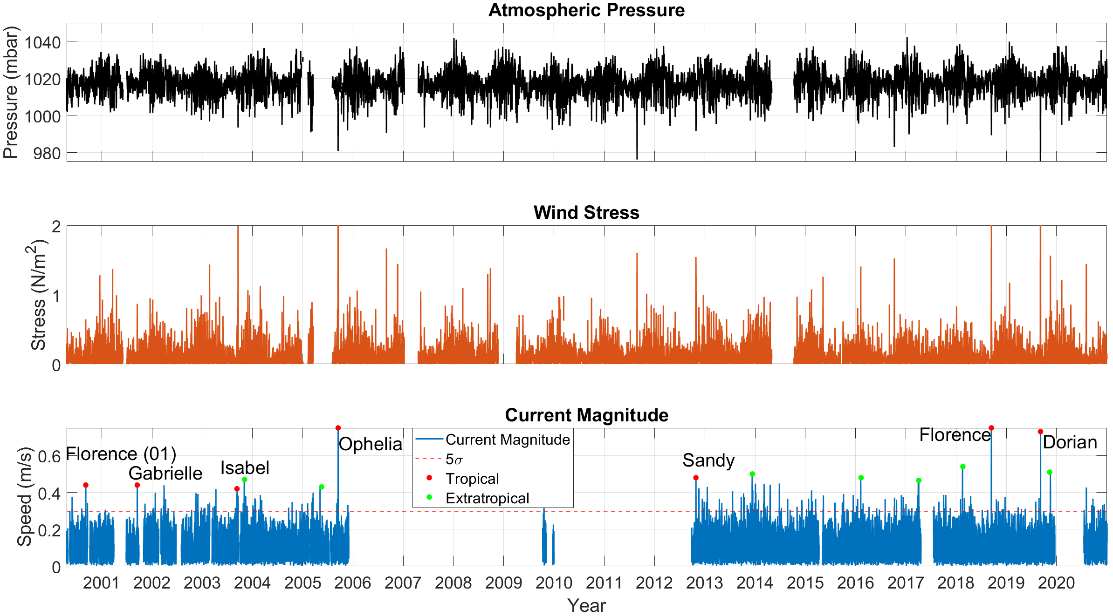
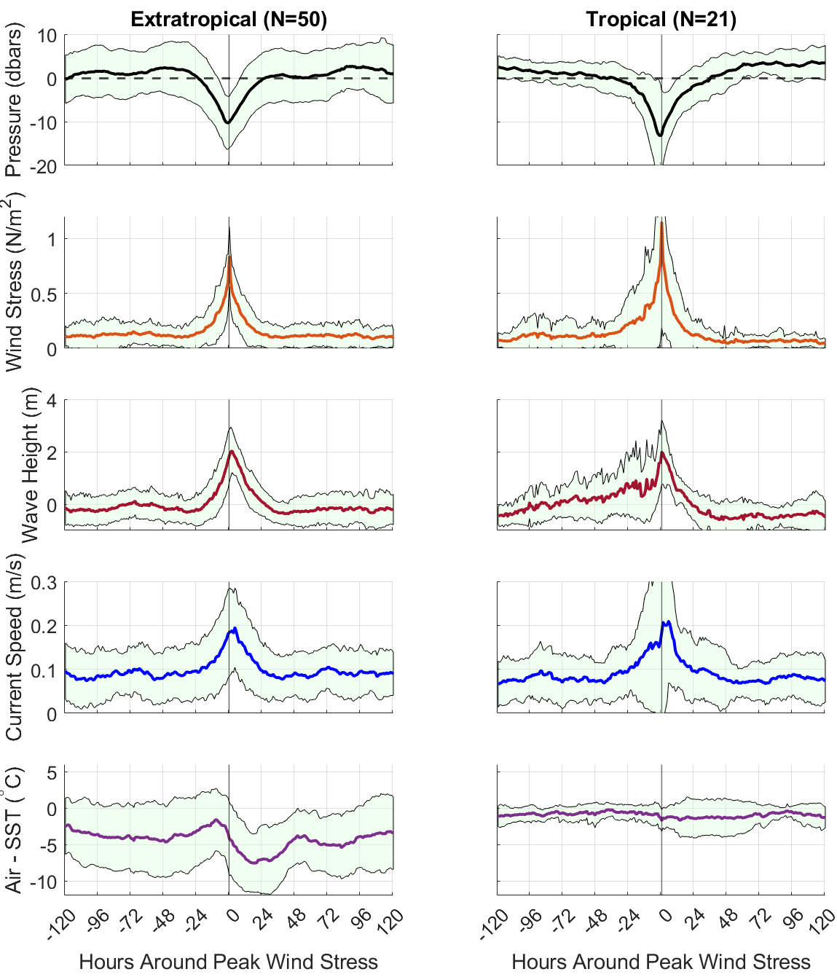

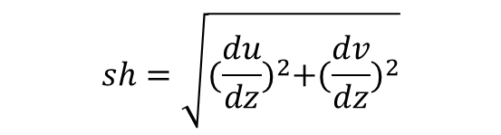
The Effects of Major Wind Events on North Carolina Shelf Currents
Authors: Cody Benton*, Sutara Suanda and Lynn Leonard
Center for Marine Science, University of North Carolina Wilmington, *email: crb2001@uncw.edu
Data Processing & Creating Ensembles
Results continued
Introduction
.
Vertical Structure
Both events have a peak northward wind at the center (fig. 6)
ET events experience a switch to strong southward winds
Both event types effect the entire water column (30m)
At the peak, TS events have a significant offshore flow
Fig. 1. Satellite image of hurricane Florence on the East Coast in 2018. Top left, number of Tropical storms per year in the Atlantic [2]. Study region outlined in yellow.
Current data processed using IOOS’s Quality Assurance/Quality Control of Real Time Oceanographic Data (QARTOD) protocol [3]
Three QC tests used; Error velocity (0.05m/s), Correlation Magnitude (110), and Echo Intensity (change of 10 decibels or more)
Thresholds were determined for OB27
The top 6m were not used as 50% of the values failed the QC test
All data was hourly binned
ET and TS events are identified by a drop in air pressure, this follows other work done in the South Atlantic Bight [4]
ET events occurred November-April while TS events occurred June-October
All variables are averaged over 10-day period resulting in an ensemble for each event type
Ensembles centered around peak wind stress extend 5 days prior and 5 days after peak
All ensembles have the climatological average and tidal currents removed
Tropical (TS) and extratropical storms (ET) are extreme weather events that cause significant coastline damage and sediment transport every year [1].
North Carolina has both TS and ET events
The frequency of tropical storms have increased in the last century (fig. 1,[2])
Results
Along shore
Climatology
September has the most TS events (fig. 4)
TS events, N = 21
ET events, N = 50
Summer months (TS events) have a mid-depth current maximum (fig. 4)
Cross shore
Fig 2. East Coast of North. Symbols represent observational assets. Shelf break indicated by dashed line.
Goal: Better understand the impact that TS and ET events have on shelf waters. To accomplish this, we identify the average forcing and oceanic response for both event types.
Currents flow towards Cape Hatteras for most of the year
Summer months have the strongest cross shore circulation (fig. 4)
Fig 6. Top; wind stress vectors with positive being northward. Bottom; Current speed with tide and climatological average removed.
TS events have a strong SE flow followed by a strong flow in the opposite direction. This ‘rebounding’ has been seen in individual storms [5]
Shear scalar values for both events are several times higher than yearly average
For both events shear values have a maximum at the surface(TS > ET)
Historical Data Set
$$sh=\sqrt{{(\frac{du}{dz})}^{2}+{(\frac{dv}{dz})}^{2}}$$
Fig. 4. left; bar graph showing number of event occurrences per month. Middle; cross shore average depth dependent current created from the historical current data. Right; same as middle but for along shore currents.
Ensembles
Both event types experience a similar ensemble average drop in pressure (fig. 5)
TS events experience a higher wind stress
TS events experience more variability and higher maximums for wave height, wind stress, and current speed
Even after the tides and climatological averages are removed, current speeds are significant for both event types ($\frac{2}{3}$of 5σ)
ET events coincide with a high difference in air temperature and SST
Fig. 7. Average Shear profiles of the raw current speeds for both events and yearly average. Also shown is the average within24 hours of peak wind stress
Florence 2018 max current = 1.2 m/s
Future Work
Investigate if the wind stress explains the current response
Explore how other parameters such as stratification and air-sea temperature differences could affect the ocean’s response
Incorporate more CORMP datasets to determine how the forcing and or response may vary in the cross and along shore directions
Fig 3. Top; atmospheric pressure measured at Frying Pan and buoy 410013. Middle; wind stress measured at Frying Pan and Buoy 410013. Bottom; depth averaged current speed measured at OB27.
Pressure, wind speed, temperature and wave height data were collected from two NBDC locations, Frying Pan tower and buoy 410013 (fig. 2)
Current measurements were collected from OB27, an upward facing ADCP in 30m of water that is part of the CORMP array
Extreme currents coincide with low pressure and high wind stress (fig. 3)
5σ current events coincide with both TS and ET events (fig. 3)
References:
[1] Wren, A. and Leonard, L. ‘Sediment transport on the mid-continental shelf in Onslow Bay, North Carolina during Hurricane Isabel’. Estuarine Coastal and shelf Science, 2004.
[2] NOAA. ‘Hurricane Database (HURDAT)’, NOAA.gov, 2014.
[3] IOOS. ‘Manual for Real-Time Quality Control of In-Situ Current Measurements’. QARTOD, July 2019. DOI: 10.25923/sqe9-e310.
[4] Wu, X., et al. ‘Parameterization of Synoptic Weather Systems in the South Atlantic Bight for Modeling Applications’. Ocean Dynamics, 2017. DOI: 10.1007/s10236-017-1084-x
[5] Bingham, F. M. ‘Physical response of the coastal ocean to hurricane Isabel near landfall’. Ocean Science, 2007.
Fig 5. Ensemble average across all storms. Storms were centered around the peak wind stress then time was normalized for a 10-day period. To account for seasonal differences, pressure and wave height were demeaned for the 10-day period. Current speed is the depth averaged, detided current. Green shading indicates +/-1 STD.
Acknowledgments: SECOORA Data Challenge 2021, CORMP and Chris LeClair, UNCW’s Center for Marine Science

