Slide 1
2023 ASME Turbo Expo
A Proposed Framework for Minimizing Starts and Extending Maintenance Intervals Through Optimized Scheduling with Mixed Integer Programming
Cody Allen / June 29, 2023

Slide 2
Outline
Introduction
Setup of the Problem
Numerical Examples
Theoretical Results
Conclusion

Slide 3
Introduction: What Is This Talk About?
Maintenance planning has a rich history primarily based in Reliability Theory.
The digital age has seen large increases in computational as well as information storage capacity.
The combination of Reliability Theory and increased computational power is leading to new paradigms of operation and maintenance planning.
This talk will outline one such framework that provides a probability of success in extending a time before maintenance.

Slide 4
Introduction: Need For Maintenance
Aging systems experience degradation which can lead to risk of forced outages.
Forced outages can range from a few hours to many weeks depending on the severity of the outage and the required maintenance to get assets up and running.
This variability leads to questions around the cost to perform or not perform preventative maintenance, and how these costs can be optimized.

Slide 5
Introduction: Maintenance Optimization
Maintenance optimization objectives generally fall into the following buckets:
Minimize system maintenance cost rate
Maximize system reliability/availability
Minimize system maintenance cost rate while the system meets its reliability requirement
Maximize the system reliability while the system meets its maintenance cost requirement
The proposed framework is closest to (4), but is different. Reliability is not explicitly maximized in the objective function, rather, operational goals are minimized, such as aggregated number of starts and over-fired hours.
Solutions to the framework problem seek to provide guidance on extending time between maintenance by finding optimized run schedules and their corresponding likelihood of being achieved.
This problem will be referred to as the Maintenance Extension Problem, or MEP.

Slide 6

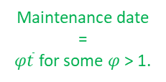
Introduction: Visual Problem Statement
Engine 1
Available Operating Time based on most time limited component
Engine 2
Engine 3
Engine 4
$$\overline{t}$$
Maintenance date
=
$φ\overline{t}$ for some $φ$ > 1.
Time
Forecast Plant Demand
Time

Slide 7
Introduction: RUL
MEP relies on estimates of Remaining Useful Life of components in the system.
RUL calculations can be as involved as modeling components with FEA analysis or as simplified as using manufacturer’s average estimates.
Given the set of RUL time values for the various components and sub-systems, we seek an optimized solution that meets the forecast demand while not exceeding any specific component RUL time value.
The solution of the maintenance extension problem described above finds an optimal operation schedule such that each individual unit’s running time is limited to not exceed the minimum RUL time.

Slide 8
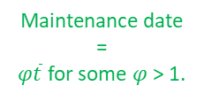

Introduction: Visual Problem Statement
Engine 1
Engine Start
Engine Running
Engine 2
Engine N running
Engine 3
Engine 4
$$\overline{t}$$
Maintenance date
=
$φ\overline{t}$ for some $φ$ > 1.
Time
Forecast Plant Demand
Time

Slide 9
Introduction: Visual Problem Statement
Over-fire
Engine 1
Engine Start
Engine Failed Start
Engine 2
Engine Running
Engine N running
Engine 3
Engine 4
$$\overline{t}$$
Maintenance date
=
$φ\overline{t}$ for some $φ$ > 1.
Time
Forecast Plant Demand
Time

Slide 10


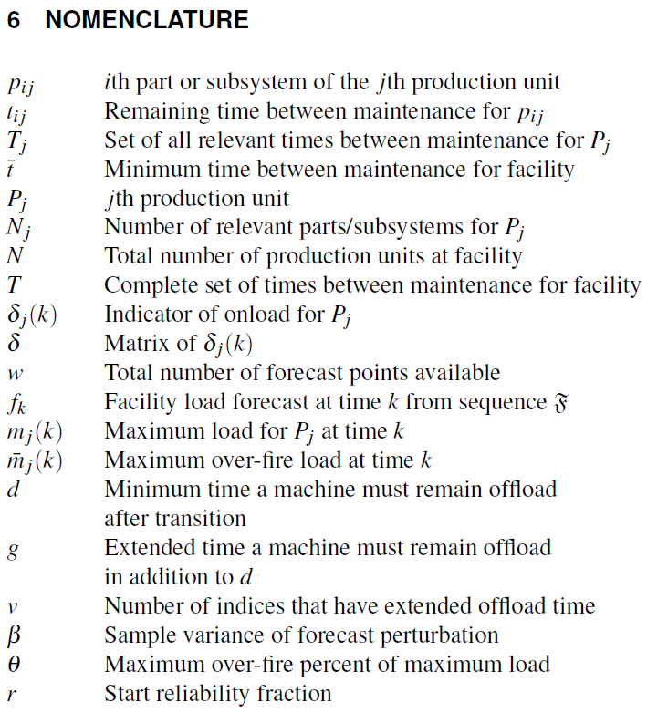



Problem Statement and Setup
MEP Problem Statement:
Find the facility running schedule that minimizes total number of starts and over-fire hours across machines while accounting for historical start reliability, ensuring no machine runs more than $\overline{t}$ units of time, and always has enough capacity to meet the load demand forecast.
Constraint: Maximum Power
where
Sum of total power with over-fire must be greater than plant power demand at time k without exceeding allowed over-fire percentage.
Sum of non over-fire maximum power at time k.
Forecast Variability:
such that
and

Slide 11


Problem Setup: Constraints
Constraint: Maximum Run Time
Each machine is limited to $\overline{t}$ time units of run-time.
Asset j must not have more than $\overline{t}$ units of time spent on.
All assets must obey this time constraint, which we call the maintenance time constraint set.

Slide 12



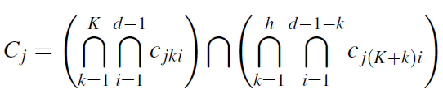

Problem Setup: Constraints
Constraint: Start Reliability - Intermezzo
Start reliability is handled by imposing certain required sequential periods of off-load time.
The constraint requires sequentially linked optimization variables.
For a given sequence length, each sub-sequence must also impose off-load time.
This constraint excludes
${(10⋯01)}_{n}$ from the solution space.
Sequence contains d consecutive 0s.
Variable constraint set for asset j at time k for sequence length n.
Set of sequences to implement at least d consecutive off-load periods.
Set of all necessary constraints to impose consecutive off-load periods across machine j across the entire forecast horizon.

Slide 13


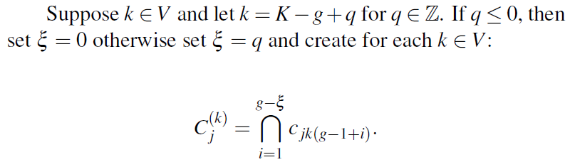
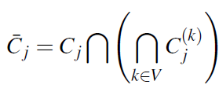
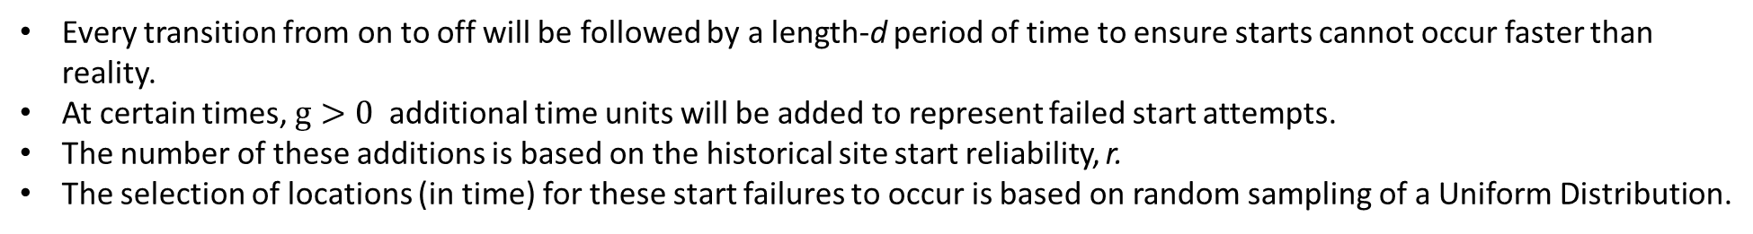
Problem Setup: Constraints
Constraint: Start Reliability
Every transition from on to off will be followed by a length-d period of time to ensure starts cannot occur faster than reality.
At certain times, $g>0$ additional time units will be added to represent failed start attempts.
The number of these additions is based on the historical site start reliability, r.
The selection of locations (in time) for these start failures to occur is based on random sampling of a Uniform Distribution.
with
Augmented downtime constraint set
Additional downtime added for selected points in time

Slide 14

Problem Setup: Optimization Objective
Objective Statement: Starts and over-fire time units
Minimize the total number of starts and over-fire time units
The max() function ensures -1 is not part of the objective.
Over-fire is weighted by maximum power but can be adjusted based on requirements.

Slide 15
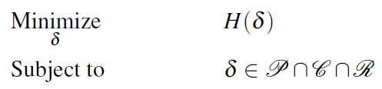


Optimization Problem
Optimization Problem:
Building the Probability for given $φ\overline{t}$ for $φ>1$:
Build $m_{1}$ sets of extended off-load times (sets sampled from Uniform distribution)
Build $m_{2}$ sets of forecasts (sets sampled from Normal distribution)
Attempt to solve the optimization problem $m_{1}m_{2}$ times.
The ratio of the number of successful solutions to $m_{1}m_{2}$ is the probability that a proposal of a $φ\overline{t}$ length extension will be successful.

Slide 16
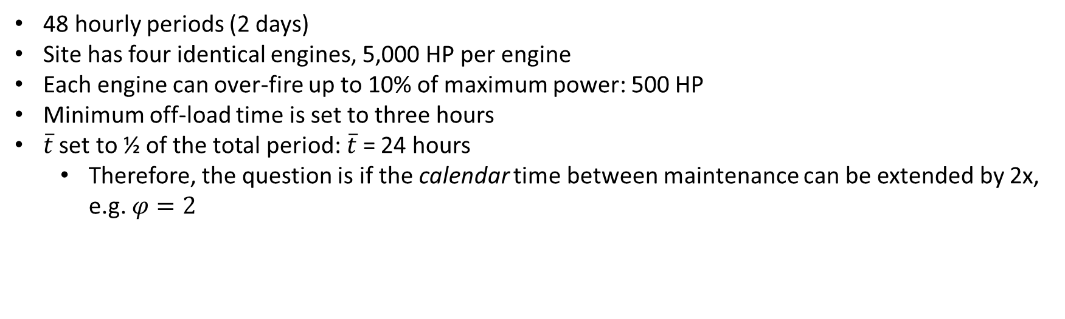
Numerical Examples: Example 1
Example 1: A single instance of the optimization problem being solved.
Example 1:
48 hourly periods (2 days)
Site has four identical engines, 5,000 HP per engine
Each engine can over-fire up to 10% of maximum power: 500 HP
Minimum off-load time is set to three hours
$\overline{t}$ set to ½ of the total period: $\overline{t}$ = 24 hours
Therefore, the question is if the calendar time between maintenance can be extended by 2x, e.g. $φ=2$

Slide 17
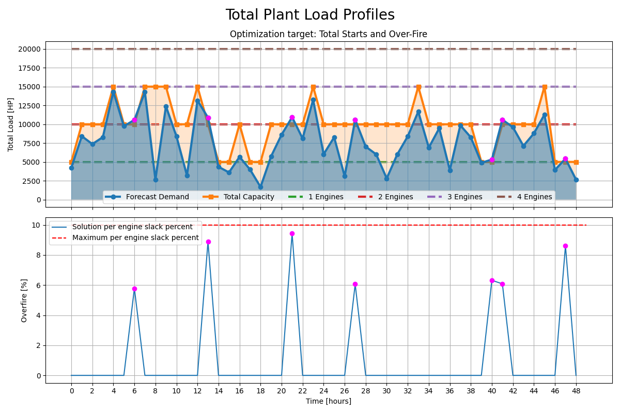
Numerical Examples: Example 1 Result
Forecast demand never requires all 4 engines
Engines overfire 7 periods

Slide 18
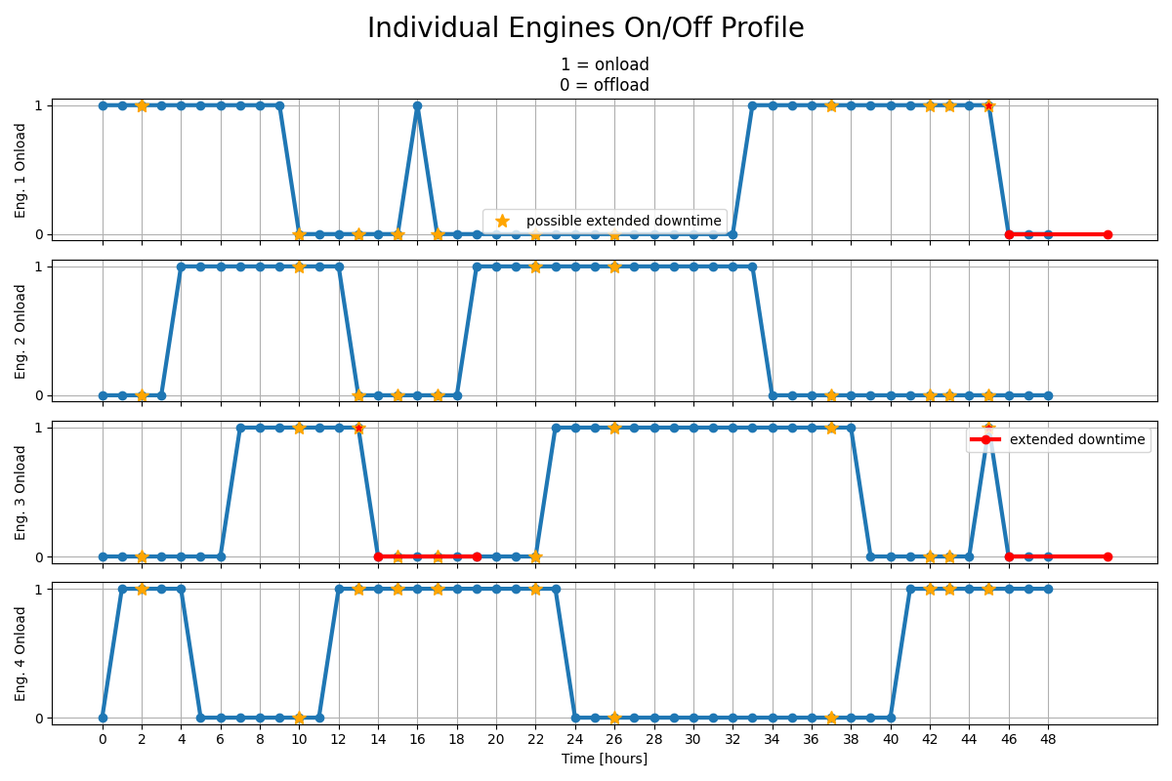
Numerical Examples: Example 1 Result
Total Starts
2
Engine 1 experiences a failed start
2
3
Engine 3 experiences two failed starts
3

Slide 19


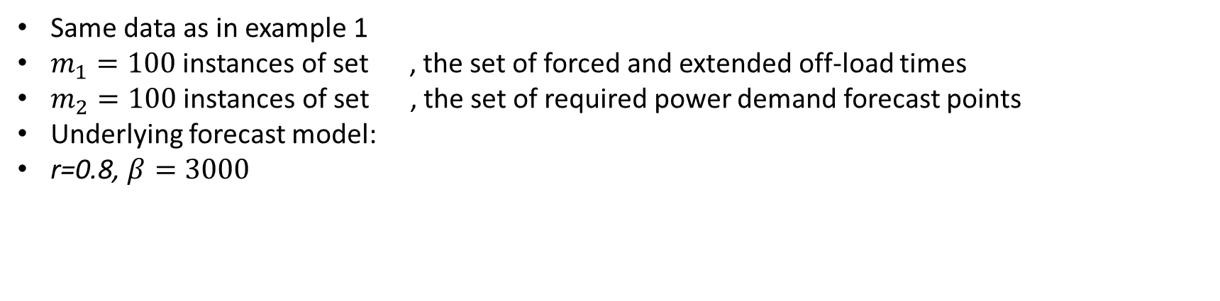
Numerical Examples: Example 2
Example 2: A set of 10,000 instances of the optimization problem being solved.
Example 2:
Same data as in example 1
$m_{1}=100$ instances of set , the set of forced and extended off-load times
$m_{2}=100$ instances of set , the set of required power demand forecast points
Underlying forecast model:
r=0.8, $β=3000$

Slide 20
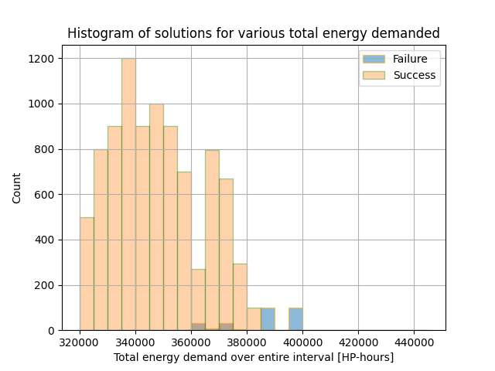
Numerical Examples: Example 2 Result
9,789 of 10,000 runs found an optimal solution
Answer: 97.9% probability of achieving the proposed 2x maintenance extension
Provides operators with data-driven conclusion of likelihood to meet extension date without running beyond any component or subsystem RULs.

Slide 21
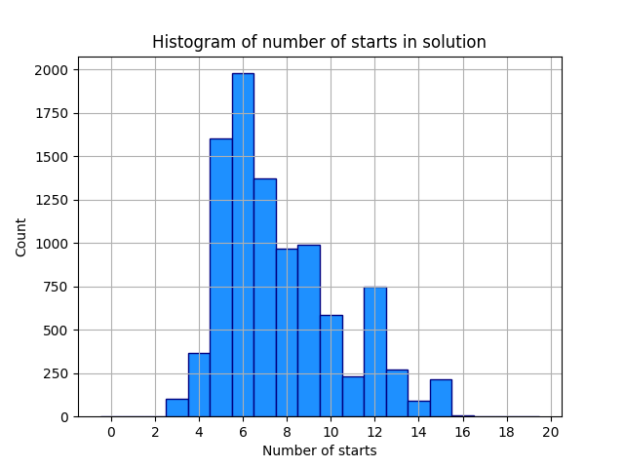
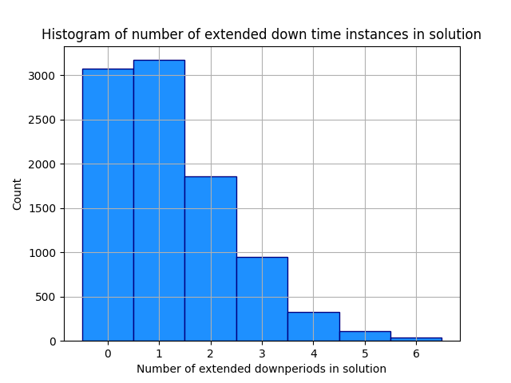
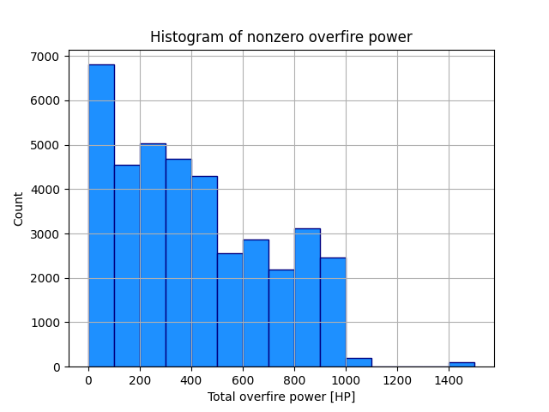
Numerical Examples: Example 2 Result
97.9% probability of achieving the proposed 2x maintenance extension
Median: 7 starts
Median: 1 failed start
Median: 0* HP
* There are a total of 10,000x48 data points, zero accounted for 428,299 of these points (89.2%), and was left off of the histogram for visual scaling purposes.

Slide 22
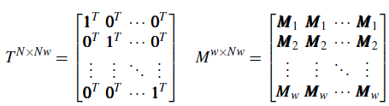
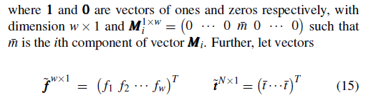
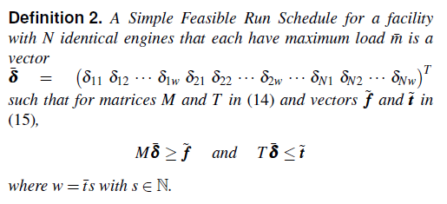
Theoretical Results
Create block Matrices:
Create Vectors:

Slide 23
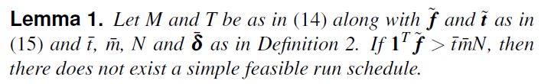
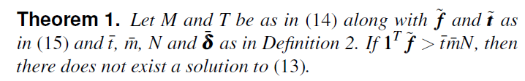
Theoretical Results
Lemma 1 is a necessary but insufficient condition for an simple feasible schedule to exist.
Said differently, if a simple feasible schedule exists, this condition must be true.
Theorem 1 is again a necessary but insufficient condition for an optimal schedule to exist.
It does provide an immediate check of feasibility, allowing many candidate solutions to be withdrawn prior to running a numerical optimization routine
(13) Is our primary optimization problem.
Theorem 1 has a physical interpretation:
If the total interval energy required is greater than the energy that can be produced in the forecast interval given the maintenance time constraint, then an optimal run schedule for (13) does not exist.

Slide 24
Conclusion
A framework for the MEP problem has been rigorously developed and tested on a small example.
The Monte Carlo solution to the MEP problem provides operators with actionable data:
Probability of success in extending the calendar time between maintenance given a forecast power demand
Statistics on expected number of starts, failed starts and over-fire hours
A possibly new approach to sequential dependence optimization of binary elements was proposed and shown to work quite nicely (start minimization with forced sequential downtime)
Theoretical results were presented that can aid in reducing the computational time of running the MC scheme.
Bonus:
Change the objective to minimize run hours and correspondingly, CO2 emissions.
Re-solve periodically to refine the probability of success and incorporate better forecasts.

Slide 25
Thank You Questions?

