Slide 1
AI POWERED GYM TRAINER
TEAM - 10

Slide 2
TABLE OF CONTENTS
01
03
02
04
POSE ESTIMATION
BLAZEPOSE
K NEAREST NEIGHBOUR
APPLICATIONS OF POSE ESTIMATION

Slide 3
01
POSE ESTIMATION

Slide 4
What is Pose Estimation ?
Pose estimation is a computer vision task that infers a person's or object's pose from a photograph or video.
Pose estimation can alternatively be defined as the challenge of determining the location and orientation of a camera in relation to a person or an item.

Slide 5
Why does Pose Estimation matter
We can monitor an object or person (or numerous individuals) in real-world space at an extraordinarily detailed level using posture estimation.
This tremendous capacity brings up a plethora of potential uses.
Pose estimation, in addition to tracking human movement and activity, has a wide range of applications, including:
Augmented Reality
Animation
Game
Robotics

Slide 6
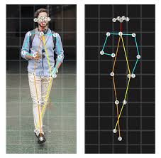
Logic Behind Behind Pose Estimation
The goal is to track down the keypoints in the video.
These keypoints indicate important joints such as elbows, knees, wrists, and so on while working with individuals.
Keypoints will be in different places compared to others if we bend our arms or legs

Slide 7

MediaPipe
MediaPipe is a framework for creating applied machine learning pipelines that are multimodal (e.g. video, audio, any time series data) and cross platform (i.e. Android, iOS, web, edge devices).
Cutting Edge ML Model :
Face Detection
Multi – hand Tracking
Hair Segmentation
Object Detection
Objectron : 3D Object Detection and Tracking
AutoFlip : Automatic video Cropping Pipeline

Slide 8
02
K NEAREST NEIGHBOUR

Slide 9
“A k-nearest-neighbor algorithm, abbreviated as knn, is a data categorization method that calculates how probable a data point is to belong to one of two groups based on which group the data points closest to it belong to.”

Slide 10
KNN ALGORITHM
Load the data
Set K to the number of neighbours you want.
From the data, calculate the distance between the query example and the current example.
To an ordered collection, add the example's distance and index.
Sort the ordered set of distances and indices by their distances from least to greatest (in ascending order).
Choose the first K entries from the sorted list.
Get the labels for the K entries you've chosen.
Return the mean of the K labels if there is a regression.
Return the mode of the K labels if there is a classification.

Slide 11
Advantages and Disadvantages
Advantages :
The algorithm is straightforward and simple to implement.
There's no need to create a model, tweak a few parameters, or make any more assumptions.
The algorithm is extremely adaptable. It has classification, regression, and search capabilities (as we will see in the next section).
Disadvantages :
As the number of samples and/or predictors/independent variables grows, the process becomes much slower.

Slide 12
03
BLAZEPOSE

Slide 13
“BlazePose is a convolutional neural network architecture for estimating human pose that is optimised for real-time inference.”

Slide 14
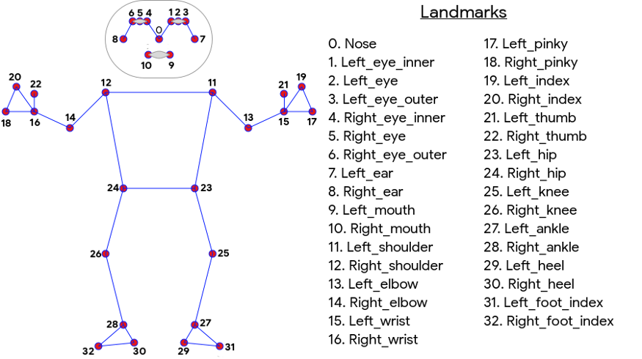
There are two machine learning models in BlazePose:
The Detector removes the human region from the input image.
Estimator inputs a 256x256 resolution image of the discovered person and returns keypoints.
The 33 keypoints are output by BlazePose according to the following ordering convention.

Slide 15
Detector
The Detector's architecture is based on Single-Shot Detectors (SSD).
It returns a bounding box and a confidence score after receiving an input image.
The bounding box in box mode is calculated using :
the position
and size of the bounding box

Slide 16
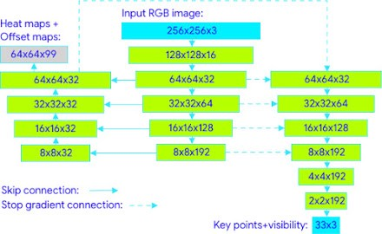
Estimator
The Estimator employs heatmap for training but computes keypoints directly without using heatmap.

Slide 17
04
APPLICATIONS OF POSE ESTIMATION

Slide 18
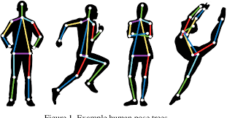
Human Activity and Movement
Pose estimation can be used to track and measure human movement, which is one of the most obvious applications.
Consider an AI-powered personal trainer that operates by simply pointing a camera at a person conducting a workout and letting a human pose estimation model (trained on a number of specific poses relevant to a training regimen) determine whether or not a certain exercise has been executed correctly.

Slide 19
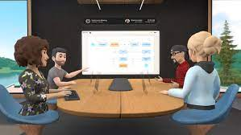

Augmented Reality
Pose estimation, while not immediately apparent, offers the potential to develop more realistic and responsive augmented reality (AR) experiences.
The metaverse is a hybrid of virtual, augmented, and physical reality that blurs the lines between online and offline activities.

Slide 20
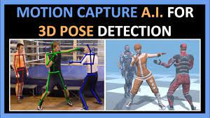
Animation and Gaming
Character animation has traditionally been a labor-intensive technique that relies on large, expensive motion capture devices.
However, with the development of deep learning approaches to pose estimation, these systems have the potential to be streamlined and automated in many ways.

Slide 21
Robotics
Traditionally, 2D vision systems have been used in industrial robotics to enable robots to accomplish their varied jobs.
However, with the introduction of 3D pose estimation, the possibility of creating more responsive, adaptable, and precise robotics systems now exists.

Slide 22

THANK YOU
VENKATAKRISHNAN R - 20078​
B SIVA JYOTHI NATHA REDDY - 20063​
SARTHAK YADAV - 20055
SHAIK HUZAIFA FAZIL - 20060​
PRAVINE MUKESH - 20050

