Slide 1

Machine Learning-Based Analysis of Celestial Objects Using the SDSS17 Dataset
Florin Octavian ROBU
co-author professor Dan MUNTEANU
Faculty of Automation, Computers, Electrical Engineering and Electronics
Dunărea de Jos University of Galați, Romania — October 2025

Slide 2

What is this study about?
This study is about using machine learning on the Sloan Digital Sky Survey (SDSS) Data Release (DR) 17 dataset.
We will classify, predict, and group stars, galaxies, and quasars.
We use colors (photometric), redshift, and position data. We use Python and tools like scikit-learn, LightGBM, and XGBoost.
We use Logistic Regression, k-Nearest Neighbors, Random Forest, and XGBoost for classification. We use Multiple Linear Regression, Polynomial Regression, LightGBM for regression. We use K-means and DBSCAN for clustering.

Slide 3
Introduction – SDSS Project
The Sloan Digital Sky Survey is a big project in modern astronomy. It is one of the largest projects to map the universe. It has made the most detailed 3D map of the universe. This map shows the large structure of the universe with voids and filaments. The SDSS data help test the standard cosmological model. It shows dark matter and dark energy are important.
It combines old astronomy methods with machine learning. It observes 2000 square degrees of sky each night and finds millions of objects.

Slide 4
What are Square Degrees?
Square degrees measure the sky. The whole sky has 41,253 square degrees.
One square degree is about the size of your thumb at arm’s length.
SDSS looks at 2000 square degrees each night, finding objects in the range of millions. This helps map the sky quickly. It shows how big the observations are.
However, the project takes years (started 2000, SDSS-V ends 2025) because observations are limited by weather, seasons, equipment maintenance, and the need to target specific, small regions of the sky multiple times.

Slide 5
SDSS Data Collection and Labeling
SDSS publishes datasets in Data Releases. It started with DR1 and the latest is DR19 in July 2025.
SDSS has two data types: Photometric and Spectroscopic.
Photometric data covers 470 million objects with position and brightness in five color bands: u, g, r, i, z (u – 'ultraviolet', g – 'green', r – 'red', i – 'near-infrared', and z – 'infrared‘). This helps with initial classifications.
Spectroscopic data, for 4.5 million objects, gives precise labels and redshift.
The success of SDSS comes from new tools and automated software. It uses public classification algorithms. These algorithms mix traditional astrophysics with machine learning.

Slide 6
Understanding PhotoZ and SPoT Algorithms
PhotoZ estimates redshift using brightness from five color bands. It uses color differences to give rough labels for millions of objects.
SPoT (Spectroscopic Targeting) picks 1-5% of objects for detailed checks with a spectrograph. This gives exact redshift and object types.
PhotoZ is fast; SPoT is more accurate.
The accuracy of the SPoT algorithm is considered to be perfect (100% or extremely close) because it uses spectrometry.
PhotoZ is fast, but it uses simple non-ML methods that are much less accurate in prediction.

Slide 7
Detailed Role of SPoT in Spectral Analysis
SPoT chooses objects for study based on PhotoZ or special interest. A spectrograph splits light into a spectrum, showing lines. The shift of these lines tells us redshift and object type (stars, galaxies, or quasars) with high accuracy.
Only 4.5 million of 470 million objects get this detailed study.

Slide 8
Redshift: A scientific perspective
Redshift happens when objects move away. Light shifts to redder colors. This is due to the Doppler effect and universe expansion.
Hubble showed it means distance - more redshift means farther away. We measure it with spectrometry.
Stars have low redshift; quasars have high redshift. This is important for our study.

Slide 9

Spectrometry in Redshift measurement
Spectrometry is key to measuring redshift.
A spectrograph breaks light into a spectrum, showing lines. The shift of these lines helps us calculate redshift.
SDSS uses this for 4.5 million objects to get exact distances. Hubble’s law turns these shifts into very large distances.

Slide 10
Discoveries from SDSS
SDSS changed astronomy with big discoveries. It made a 3D map of the universe, showing its structure. It found dark matter and dark energy.
A teacher from the Netherlands found Hanny's Voorwerp, a strange gas cloud. SDSS also mapped tidal streams from small galaxies.
These discoveries help us.

Slide 11
Why SDSS17 Data?
The Stellar Classification Dataset SDSS17 is derived from SDSS Data Release 17
We chose SDSS17 because it is large and varied. SDSS maps the sky with colors (photometric) and redshift (spectroscopic) data. It has multi-band data and distance signs. It is free and helps global research.
Our sample of 100,000 objects is good for machine learning tests.

Slide 12
Tools we used
We used Python (ver. 3.10.11) for coding because it is easy. Scikit-learn (ver. 1.4.2.) helped with machine learning. Pandas (ver. 2.1.4) handled data. Matplotlib (ver. 3.7.5) made plots.
Also, we used the LightGBM (Light Gradient Boosting Machine, ver. 4.6.0) and XGBoost (Extreme Gradient Boosting, ver. 3.0.0) libraries.

Slide 13
Detailed Dataset Features (SDSS17)
Our dataset contains 100,000 celestial objects and 17 total features. These features include the target variable 'class' (STAR, GALAXY, QSO), the photometric colors (u, g, r, i, z), redshift, celestial coordinates (alpha, delta), and additional identifiers (like obj_ID, run_ID, rereun_ID, cam_col, field_ID, spec_obj_ID, plate, MJD, fiber_ID).
obj_ID | alpha | delta | u | g | r | i | z | run_ID | rerun_ID | cam_col | field_ID | spec_obj_ID | class | redshift | plate | MJD | fiber_ID
1,23766096132774E+018 | 135.6891066036 | 32.4946318397087 | 23.87882 | 22.2753 | 20.39501 | 19.16573 | 18.79371 | 3606 | 301 | 2 | 79 | 6,54377736929518E+018 | GALAXY | 0.6347936 | 5812 | 56354 | 171
1,23766487995115E+018 | 144.826100550256 | 31.2741848944939 | 24.77759 | 22.83188 | 22.58444 | 21.16812 | 21.61427 | 4518 | 301 | 5 | 119 | 1,17601420367073E+019 | GALAXY | 0.779136 | 10445 | 58158 | 427
1,23766096133043E+018 | 142.188789562506 | 35.5824441819976 | 25.26307 | 22.66389 | 20.60976 | 19.34857 | 18.94827 | 3606 | 301 | 2 | 120 | 5,15220025602555E+018 | GALAXY | 0.6441945 | 4576 | 55592 | 299

Slide 14
Detailed Dataset Features (SDSS17)
We cleaned the data (removed noise) and kept important data like colors (u, g, r, i, z), redshift, celestial coordinates (alpha, delta) and the target variable (class).
An imbalanced dataset (uneven classes like STAR, GALAXY, QSO) can affect the accuracy of our models. To ensure the results are reliable, we use stratification when splitting the data. Stratification makes sure that the proportion of each class is maintained in both the training and testing sets.

Slide 15
Why we use ML on already classified data?
The SPoT method is very precise, but it only classifies a small fraction (4.5M) of the sky.
The PhotoZ method is fast, providing a distance estimate (redshift) for all 470M objects, but it is known to be inexact.
Our goal is to classify and predict distance for the entire sky quickly and with high accuracy. Our advanced ML model provides the necessary solution to this problem.

Slide 16
Experiments: Classification summary
We did tests to classify objects. We used four methods: Logistic Regression, k-Nearest Neighbors, Random Forest, and XGBoost.
We ran several tests with different groups of features and finally with all features. We used 5-fold cross-validation (K-Folding) to ensure our results were reliable.
Features | spectral features (u, g, r, i, z) |  |  |  | redshift |  | alpha, delta |  | all features
Method/ Results | Logistic regression | k-NN | Random Forest | XGBoost | k-NN | Random Forest | k-NN | Random Forest | k-NN | Random Forest
Accuracy | 0.7540 | 0.8592 | 0.8742 | 0.8686 | 0.9492 | 0.9244 | 0.6667 | 0.6749 | 0.8327 | 0.9796
precision GALAXY | 0.79 | 0.90 | 0.91 | 0.90 | 0.94 | 0.94 | 0.73 | 0.76 | 0.83 | 0.98
precision QSO | 0.66 | 0.80 | 0.82 | 0.81 | 0.92 | 0.81 | 0.42 | 0.43 | 0.87 | 0.97
precision STAR | 0.68 | 0.79 | 0.82 | 0.81 | 1.00 | 1.00 | 0.59 | 0.54 | 0.79 | 0.99

Slide 17
Experiments: Classification summary
The best result for classification was obtained with the Random Forest algorithm, using all features. It achieved an accuracy of 0.9796 and an F-score of 0.9782.
Features | spectral features (u, g, r, i, z) |  |  |  | redshift |  | alpha, delta |  | all features
Method/ Results | Logistic regression | k-NN | Random Forest | XGBoost | k-NN | Random Forest | k-NN | Random Forest | k-NN | Random Forest
Accuracy | 0.7540 | 0.8592 | 0.8742 | 0.8686 | 0.9492 | 0.9244 | 0.6667 | 0.6749 | 0.8327 | 0.9796
precision GALAXY | 0.79 | 0.90 | 0.91 | 0.90 | 0.94 | 0.94 | 0.73 | 0.76 | 0.83 | 0.98
precision QSO | 0.66 | 0.80 | 0.82 | 0.81 | 0.92 | 0.81 | 0.42 | 0.43 | 0.87 | 0.97
precision STAR | 0.68 | 0.79 | 0.82 | 0.81 | 1.00 | 1.00 | 0.59 | 0.54 | 0.79 | 0.99

Slide 18
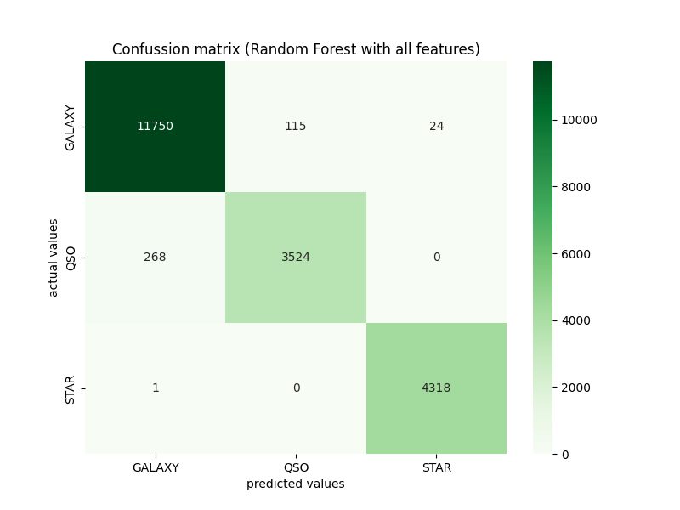
Confusion Matrix (Random Forest)
This matrix shows the best result from Random Forest.
We found 11,750 GALAXY right and 4,318 STAR right. We found 524 QSO right.
The dark green means we found many objects correctly. Redshift is important because objects are at very different distances.

Slide 19
Comparison with related work
Our Random Forest model (0.9796 accuracy) is comparable to other published findings. For instance, one result from the paper Comparison of ML Algorithms and feature importance analysis for star classification, Zhou, T. (2023), achieved an accuracy of approximately 0.9786. This shows that our integration of spectral data, celestial position, and redshift allows us to maintain a strong level.

Slide 20
Another experiments: Regression summary
We tested to predict object distances (Redshift).
We used Linear Regression, Polynomial Regression, and LightGBM. K-Nearest Neighbors worked best with a score of 0.4328 (R-squared). This shows good distance estimation using color and position data.
Method /Metrics | Linear regression | Polynomial regression of degree 2 | k-NN (k=22) | LightGBM
R² | 0.2792 | 0.2939 | 0.4328 | 0.4259
MSE | 0.3902 | 0.3823 | 0.3071 | 0.3070

Slide 21
Detailed Regression results
This table shows the Redshift prediction results. The best result is from k-NN (k=22). The R-squared score is 0.4328. This score tells us the model is okay at predicting distance. Linear Regression is the worst (0.2792). This shows that the distance relationship is not a straight line (non-linear).
Method /Metrics | Linear regression | Polynomial regression of degree 2 | k-NN (k=22) | LightGBM
R² | 0.2792 | 0.2939 | 0.4328 | 0.4259
MSE | 0.3902 | 0.3823 | 0.3071 | 0.3070

Slide 22
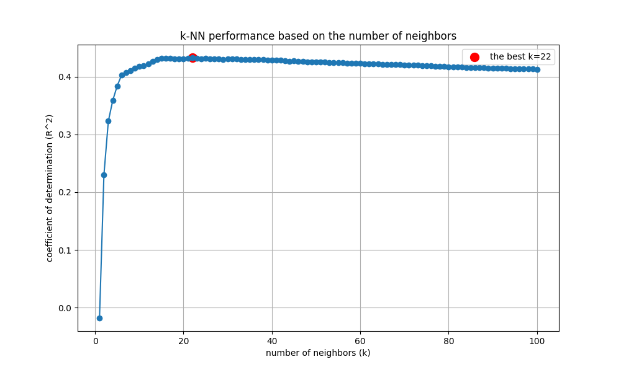
k-NN Performance optimization
We had to find the best 'k' for k-NN.
We tested many numbers of neighbors. The best 'k' is 22. This number gave us the highest R-squared score (0.4328).
The score goes up fast, and then it stays high.

Slide 23
LightGBM Hyperparameter tuning
The LightGBM model was carefully tuned to find the best settings and prevent over-fitting.
Key parameters like n_estimators=600, learning_rate=0.015, and max_depth=12 were selected.
We also used regularization (reg_alpha and reg_lambda) to control the model's complexity and ensure the results are robust.

Slide 24
Another experiments: Clustering summary
We grouped objects with clustering tests. We tried K-means and DBSCAN. K-means gave the best score, 0.6692 (Silhouette Score). K-means groups objects by distance. This found new patterns for our study.
Features | spectral (u, g, r, i, z) |  |  | celestial (alpha and delta) |  |  | redshift |  |  | all features
k | 3 | 4 | 5 | 3 | 4 | 5 | 4 | 5 | 6 | 3 | 4 | 5
silhouette score | 0.3765 | 0.3842 | 0.3562 | 0.4727 | 0.4852 | 0.4248 | 0.6569 | 0.6692 | 0.6569 | 0.3015 | 0.2820 | 0.2784

Slide 25
Detailed Clustering results
This table shows the Clustering results. The Silhouette Score shows how good the groups are. The best score is 0.6692 when we use Redshift with 5 groups (k=5). Using just colors (spectral) gives a lower score (0.3842). This means Redshift is best for grouping objects by distance.
Features | spectral (u, g, r, i, z) |  |  | celestial (alpha and delta) |  |  | redshift |  |  | all features
k | 3 | 4 | 5 | 3 | 4 | 5 | 4 | 5 | 6 | 3 | 4 | 5
silhouette score | 0.3765 | 0.3842 | 0.3562 | 0.4727 | 0.4852 | 0.4248 | 0.6569 | 0.6692 | 0.6569 | 0.3015 | 0.2820 | 0.2784

Slide 26
Clustering: Redshift performance
The K-means clustering algorithm was tested using only the Redshift feature, and this approach achieved a high Silhouette Score of 0.6692. This excellent result confirms that the Redshift value is a dominant feature for separating celestial objects.

Slide 27
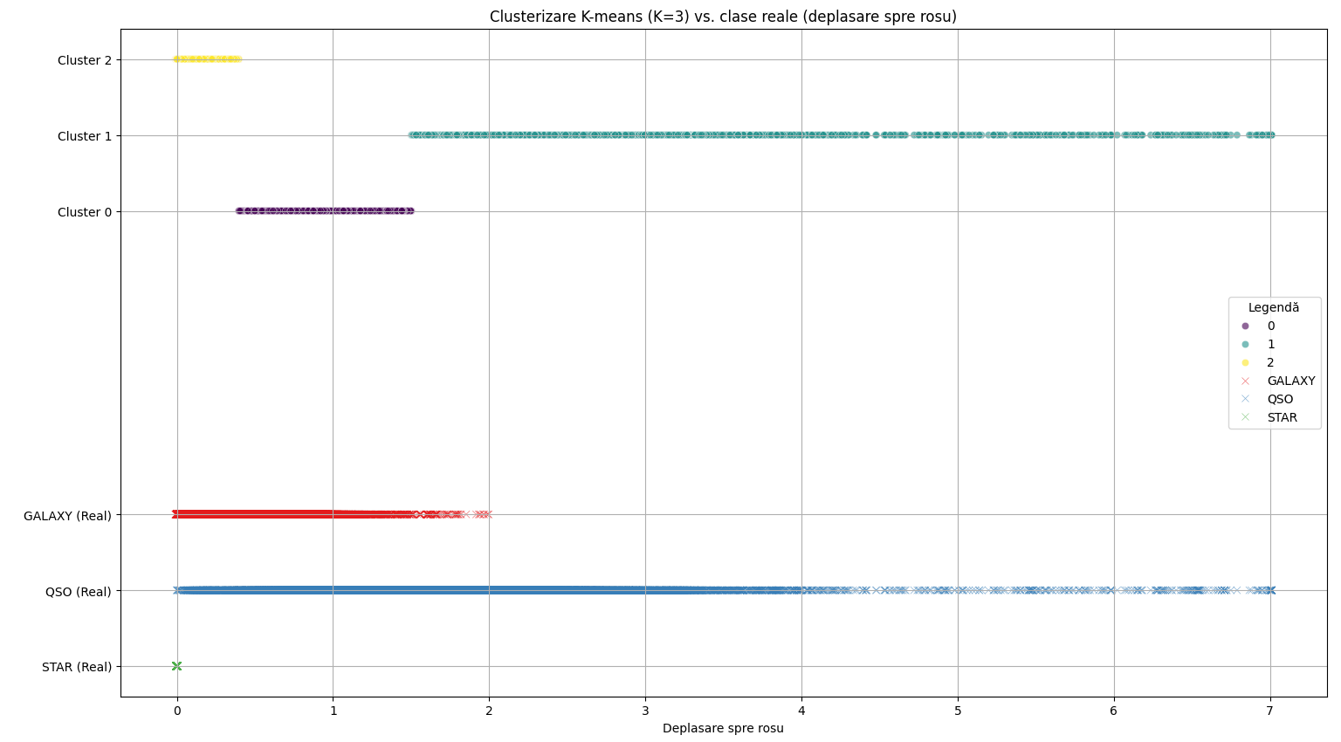
Clustering: Redshift performance

Slide 28
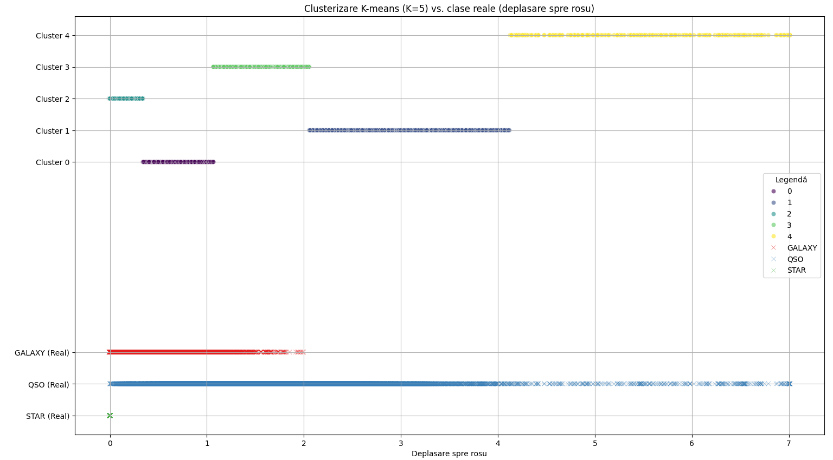
Clustering: Redshift performance

Slide 29
Redshift: Physical interpretation
The effectiveness of clustering by redshift has a clear physical meaning.
Stars are the closest objects, showing a small redshift.
Galaxies are farther away and have a medium redshift.
Quasars are the farthest objects in our dataset, which results in a large redshift. This natural grouping by distance (redshift) explains why our clustering models can separate the classes so effectively.

Slide 30
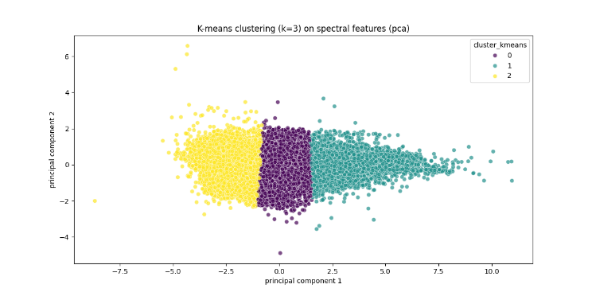
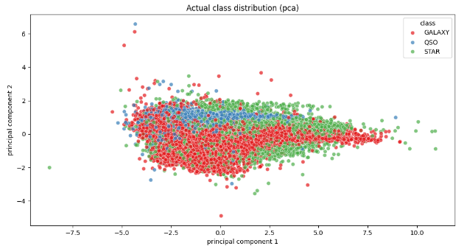
K-means Cluster map
This visual shows the K-means result using spectral features with 3 groups (k=3). The automatically generated clusters are visible, but they do not perfectly match the real object types. This confirms that spectral features alone are not sufficient for clear separation.

Slide 31
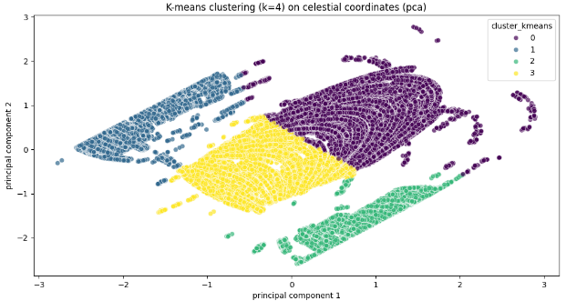
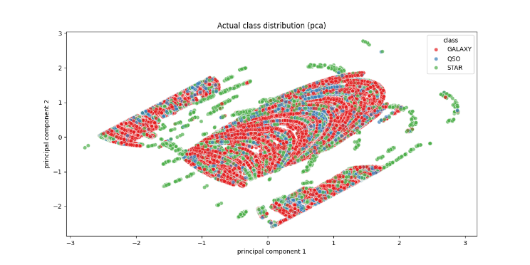
K-means Cluster map
This map presents K-means clustering based on position features (celestial coordinates) with 4 groups (k=4). Due to the overlap of object positions on the sky, this clustering also shows limited success in separating the object classes.

Slide 32
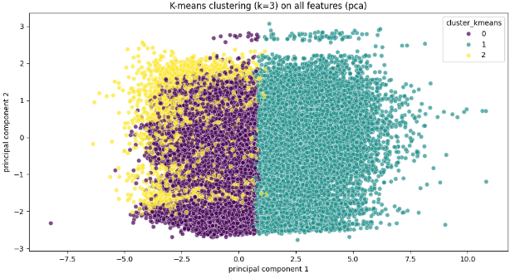
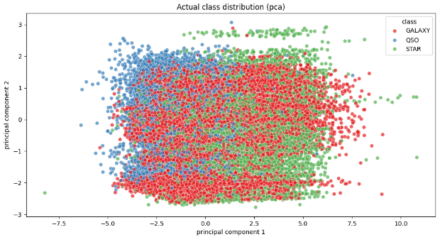
K-means Cluster map
This shows the K-means result using all features with 3 groups (k=3). Although it combines all data, the overlap is still significant, confirming that a perfect separation of classes with K-means is difficult because the real object types do not have distinct spectral features.

Slide 33
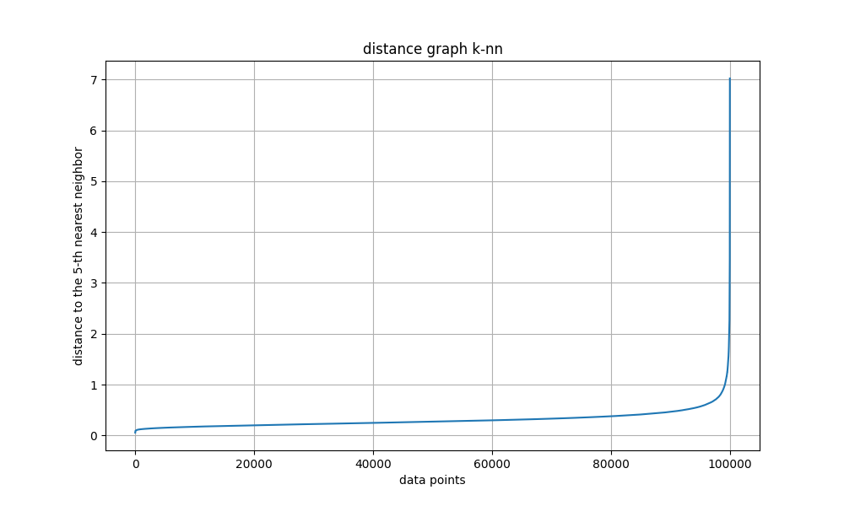
DBSCAN Analysis graph
This is the k-NN distance graph used to select the optimal parameter 'eps' (epsilon) for the DBSCAN algorithm.
We look for the "elbow" (the sharp change in slope) to determine the best distance threshold.
The chosen starting value for 'eps' is around 0.38.

Slide 34
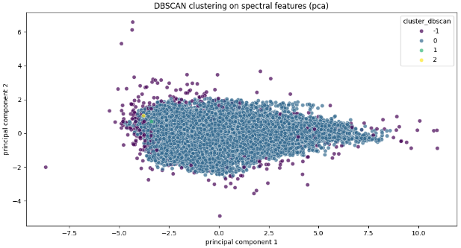

DBSCAN Clustering result
This is the result of DBSCAN clustering. The method performed poorly (V-measure score of 0.00), failing to group objects correctly. It marked many data points (811) as noise. This failure proves DBSCAN is not suitable for this dense dataset.

Slide 35
Results summary and Scientific impact
Our results are strong. Classification (0.9796) is competitive with other high-accuracy studies and better than rough estimates like PhotoZ. This proves our ML model is a fast and efficient alternative to the precise but slow SPoT method.
This work helps streamline future astronomy classifications.
The study also confirms the high importance of the redshift feature for classification and a grouping.

Slide 36
How it compares to other studies
We compare our work to other studies.
One study used deep networks and got 98% accuracy.
Another used Random Forest and got 97.86% accuracy.
Our result of 97.96% with Random Forest is competitive.
We show that ML with open data works well.

Slide 37
Why our work is important
Our work is important because it validates ML for astronomy. SDSS data teaches us about the universe. Our 0.9796 accuracy proves our methods work.
Open data helps everyone.
This work may help large space missions later.

Slide 38
Future plans
We want to continue our research. We will improve machine learning with SDSS data. We will add data from other sky surveys (implicit in future work).
The reported metrics represent single-run results for each algorithm. Future work will include multiple runs with different random seeds to compute standard deviations and confidence intervals, providing a more robust statistical evaluation of model performance.
We will study dark matter and dark energy (implied by SDSS science goals). This will help science grow.

Slide 39
Challenges we faced
The main challenges were: Data cleaning (100,000 objects), Selecting optimal ML methods, and handling the failure of DBSCAN to form clusters, which suggests the inadequacy of density-based methods for this feature distribution.
We successfully overcame these issues.

Slide 40
Additional Scientific impact
The study confirms the high importance of the redshift feature for classification and grouping. It also highlights the didactic value of the SDSS17 dataset, supporting the use of ML in educational settings, training future researchers with open-source tools and data.

Slide 41
Conclusion
In summary, we used SDSS17 data with ML for strong results in classification, prediction, and grouping.
We emphasize the importance of open science in democratizing access to high-quality astronomical data. Our findings help advance astronomy.
Thank you for listening.
Are there any questions?

