Slide 1
Preliminary Results 1
Project: Strength & Volume Optimization Engine
Neural Network-Based | Cody Grandt
Notes:
Hello everyone, my name is Cody Grandt, and this is Preliminary Results 1 for my Neural Network-Based Strength and Volume Optimization Engine. This milestone shows that the full setup works end to end and that the results are heading in the right direction.

Slide 2
The Full Pipeline
Data: OpenPowerlifting baselines + 30-day fatigue simulator
Split: 600 test lifters held out entirely
Models: MLP regressor (64, 32) and MLP classifier (32, 16)
Serving: FastAPI inference microservice, Next.js + Recoil interface
Correction: the regressor is a function approximator, not a “Progression Forecaster”
Notes:
Here is the pipeline as it runs today: real lifter baselines from OpenPowerlifting, a thirty-day fatigue simulator, six hundred lifters held out for testing, two MLPs, and a FastAPI inference microservice that my Next.js interface calls in about a millisecond. One correction from my Structure presentation: I called the regressor a Progression Forecaster. That was the wrong word. It is a function approximator that maps a lifter's current state to a prescribed load for the next session.

Slide 3
Real Lifter Baselines
4,054,260 OpenPowerlifting competition entries
436,706 unique Raw lifters with a valid bench
3,000 sampled for this milestone
Per lifter: bodyweight, age, sex, bench 1RM
Why simulate: meets record one best lift, not daily training
Notes:
The baseline data is real. OpenPowerlifting has just over four million competition entries. Filtering to Raw lifters with a valid bench, one entry per lifter, leaves 436,706 lifters, and I sample three thousand for this milestone. Competitions only record a single best lift, not daily training, so the sessions themselves are simulated.

Slide 4
The Fatigue Simulator
Each session adds hidden fatigue; it decays ~20% per day of rest
Fatigue lowers capacity: reps fall and RPE rises across sets
Target: load for 5 reps @ RPE 8 at the next session
Inputs: bodyweight, age, sex, 1RM, session volume, mean RPE, rep drop-off
The network never sees the fatigue value directly
Notes:
Each simulated lifter has a hidden fatigue state. Sessions add fatigue in proportion to volume and effort, and it decays about twenty percent per day of rest. Fatigue lowers capacity, so reps fall and RPE rises. In this example, as fatigue builds over two weeks, the right load for the next session drops from about 82 to 70 kilograms. That load, for five reps at RPE 8 next session, is the regression target. The network never sees the fatigue value, only what a lifter could log.

Slide 5
Evaluation Design
Split by lifter: every test lifter is unseen
Baselines: static Epley, 1RM × k, linear regression, feature-only rule
Metric: error as % of 1RM
  “0.73 × 1RM” alone scores R² = 0.985, so absolute R² flatters any model
Notes:
Every test lifter is someone the model has never seen, and every result is compared against a baseline: the static Epley formula, a single fitted ratio of one-rep max, linear regression, and for the classifier, its own labeling rule given only the visible inputs. I report error as a percentage of one-rep max, because just multiplying one-rep max by 0.73 already scores an R squared of 0.985. Absolute R squared would flatter any model.

Slide 6
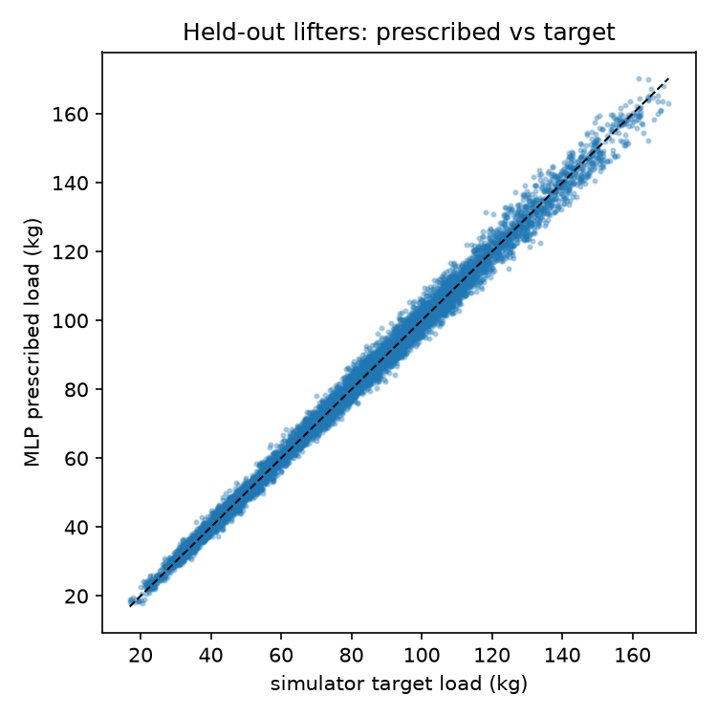
Regression Results
Mean absolute error, % of 1RM:
  Static Epley: 8.22%
  1RM × k: 2.67%
  Linear regression: 1.88%
  MLP regressor: 1.79% (1.90 kg)
MLP beats every baseline; lead over linear is small
Noise floor: 0.80 kg
Notes:
On held-out lifters, the MLP's error is 1.79 percent of one-rep max, about 1.9 kilograms. Static Epley is off by over eight percent because it ignores fatigue. Scaling one-rep max alone gets 2.67, and linear regression gets 1.88. So the MLP beats every baseline, but its lead over linear regression is small, and with a noise floor of 0.8 kilograms there is clear room to improve.

Slide 7
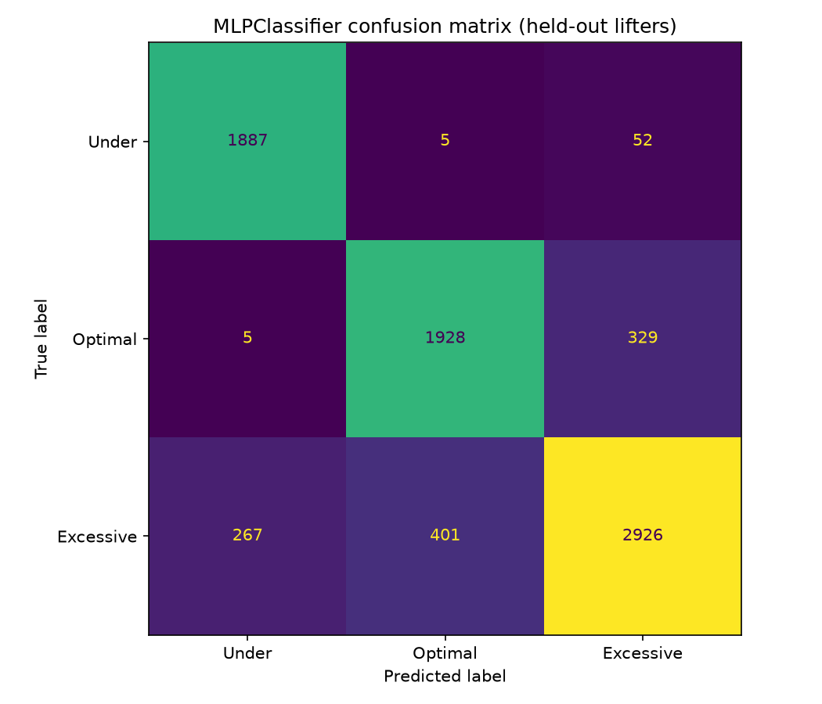
Classification Results
Held-out accuracy:
  Majority class: 46.1%
  Feature-only rule: 76.3%
  MLP classifier: 86.4%
Recall: Under 97%, Optimal 85%, Excessive 81%
Most errors: Optimal ↔ Excessive
Notes:
The classifier reaches 86 percent accuracy. The fair baseline is its labeling rule given only the visible inputs, at 76 percent, so the network is recovering part of the hidden fatigue. Most remaining errors are between optimal and excessive, exactly where hidden fatigue decides the label.

Slide 8
Live Demo
Train: python train_pipeline.py
Serve: uvicorn main:app --port 8000
Use: npm run dev → localhost:3000
Log sets, run inference, try edge cases
Notes:
Now the code running live. [Terminal 1, in the server folder] python train_pipeline.py simulates 39,000 sessions, trains both networks, and prints the tables you just saw. [Terminal 2] Uvicorn starts the inference service; the models load once at startup. [Browser, localhost:3000] I log a bench session set by set, and Recoil computes volume, mean RPE, and drop-off live. Run inference: about 89 kilograms, Optimal Hypertrophy. [Change set 3 to 6 reps at RPE 9.5 and set 4 to 4 reps at RPE 10, then run again] When the last sets grind, the session moves to Excessive Fatigue, but the prescribed load barely changes: one session says little about accumulated fatigue, which is exactly why history features come next. [Clear the Age field] And invalid input is explained instead of being sent to the model.

Slide 9
What the Results Show
Supported
Not yet supported
Pipeline works end to end on real baselines
MLP beats Epley, 1RM scaling and linear regression
Classifier beats its feature-only rule (86% vs 76%)
Real-world accuracy (targets come from my simulator)
A large margin over linear regression (0.09 points)
Statistical confidence (single seed)
Notes:
So: the pipeline works end to end on real baselines, and both networks beat their baselines on held-out lifters. It does not yet show real-world accuracy, because the targets come from my own simulator, which uses the Epley relationship internally. The margin over linear regression is small, and these are single-seed results.

Slide 10
Next Steps: Preliminary Results 2
History features: previous sessions, days of rest, load used
Rigor: multiple seeds, confidence intervals, tuning
Application: PostgreSQL history, proxy route, live URL
Notes:
For Preliminary Results 2: first, history features, meaning previous sessions, days of rest, and the load used, because that is where accumulated fatigue lives and where the MLP should pull ahead of linear regression. Second, rigor: multiple seeds, confidence intervals, and tuning. Third, the application: PostgreSQL history, a proxy route, and a deployed live URL.

Slide 11
AI Use Disclosure
I used Claude Code (Anthropic) as a coding and writing assistant for this milestone. From my specifications it generated most of the implementation: the OpenPowerlifting preparation script, the fatigue simulator, the training and evaluation pipeline, the FastAPI service, and the Next.js interface, along with these slides and the script. I also used it to run three automated peer reviews (ML methodology, code correctness, and course compliance); their findings led to the honest % of 1RM metrics, the added baselines, and the input-validation fixes shown here. I verified the work by running the pipeline, checking every reported metric against its baselines, and testing the live app end to end.
Notes:
Finally, my AI use disclosure, as the syllabus requires. I used Claude Code to generate most of the implementation from my specifications, along with these slides, and to run three automated peer reviews that led to the corrected metrics and validation fixes. I verified the work by running the pipeline, checking the metrics against the baselines, and testing the live application. Thank you, and I'm happy to take questions.

