Slide 1
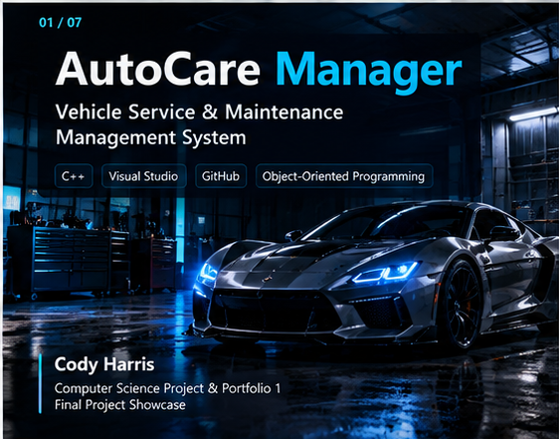
Notes:
My name is Cody Harris, and this is my final Project and Portfolio 1 showcase.
For this course, I developed AutoCare Manager, a C++ Vehicle Service and Maintenance Management System.
The purpose of the application is to manage vehicles, service records, service history, and reusable service types while using object-oriented programming and structured data management.
Throughout the project, I also used Visual Studio and GitHub to manage development, testing, documentation, and version control.

Slide 2
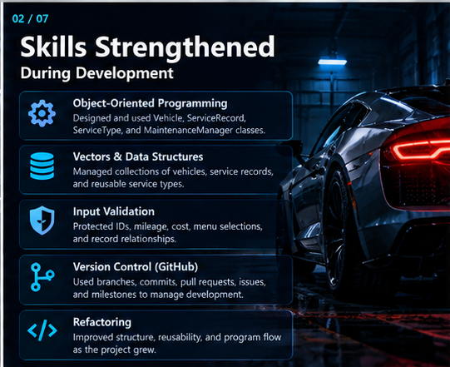
Notes:
Several concepts from this course played an important role in developing my project.
The first was object-oriented programming. I used separate Vehicle, ServiceRecord, ServiceType, and MaintenanceManager classes. This helped me understand how different objects can work together instead of putting all of the program logic into one file.
The second concept was vectors and data structures. I used vectors to manage collections of vehicles, service records, and service types.
I also improved my understanding of input validation. The program checks for invalid IDs, duplicate records, negative mileage or costs, invalid menu selections, and relationships between vehicles and their service records.
Another major skill was version control. I used GitHub branches, commits, pull requests, issues, and milestones throughout development.
Finally, I improved my ability to refactor code so that the program became more organized and reusable as it grew.

Slide 3
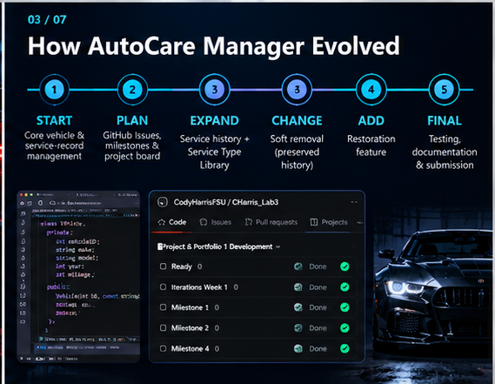
Notes:
I developed AutoCare Manager over several milestones rather than trying to build the entire application at once.
The project began with the basic structure for managing vehicles and service records. I then expanded the application with stronger validation and the ability to view the complete service history for an individual vehicle.
Later, I created a reusable Service Type Library. This allowed predefined services and pricing to be reused when creating service records, while still allowing custom service types.
Another major improvement was changing service record deletion into a soft-removal system. Instead of permanently deleting maintenance history, removed records remain stored and are clearly marked as removed.
During the final milestone, I expanded this again by adding restoration functionality so an accidentally removed service record can be returned to active status.
GitHub Issues, milestones, and my project board helped me organize these changes and track the project from development through final testing.

Slide 4
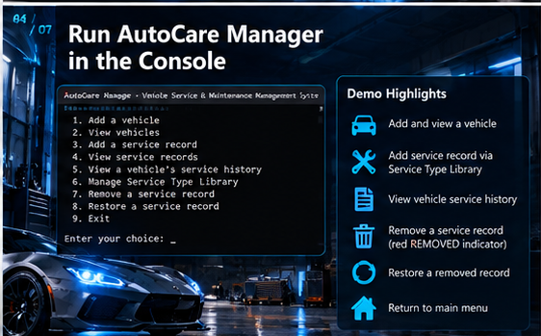
Notes:
At this point, switch from PowerPoint to Visual Studio and run the program.
Now I’ll demonstrate the completed AutoCare Manager application.
This is the main menu, which provides access to the major functions of the program.
I can add a vehicle and then view the vehicles currently stored by the application.
When adding a service record, the program verifies the vehicle and allows me to select a service using the reusable Service Type Library.
I can then view the service records or select an individual vehicle and display its service history.
One of the final features I developed is the service-record removal system. When I remove a service record, the record is not permanently deleted. It remains part of the vehicle's maintenance history and is displayed with the red REMOVED indicator.
If that record was removed accidentally, I can select it again and cancel the removal status. The program restores the record and returns it to its normal active display.
This allows AutoCare Manager to preserve historical maintenance information while still allowing the status of a record to be corrected.

Slide 5
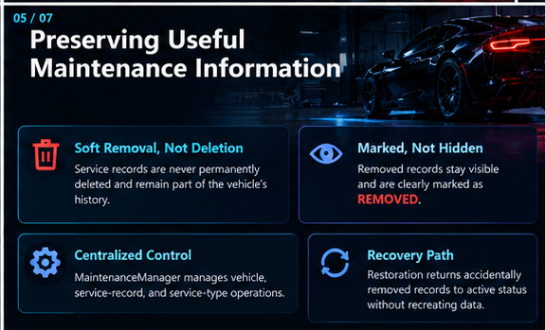
Notes:
Switch back to PowerPoint.
Preserving service history became one of the important design decisions in the final application.
Instead of deleting data from the vector, the program changes the status of the ServiceRecord object.
MaintenanceManager provides centralized functionality for managing vehicles, service records, service types, removal, and restoration.
This design gave me a better understanding of how objects and data structures can work together to solve a practical problem.

Slide 6
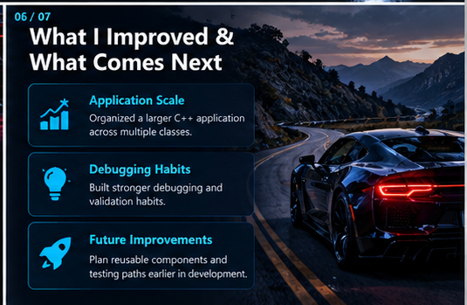
Notes:
One of my biggest improvements during this course was learning how to organize a larger C++ application.
Earlier projects were easier to manage because they contained fewer files and features. AutoCare Manager required me to think more about class responsibilities, validation, debugging, program flow, and how a new feature could affect existing functionality.
I also became more comfortable using GitHub as an actual development tool instead of simply using it as a place to store code.
If I were starting the project again, I would plan some of the reusable components and testing paths earlier. That would make later development and refactoring more efficient.
These are skills that I can continue building on as I move into larger Computer Science and software development projects.

Slide 7
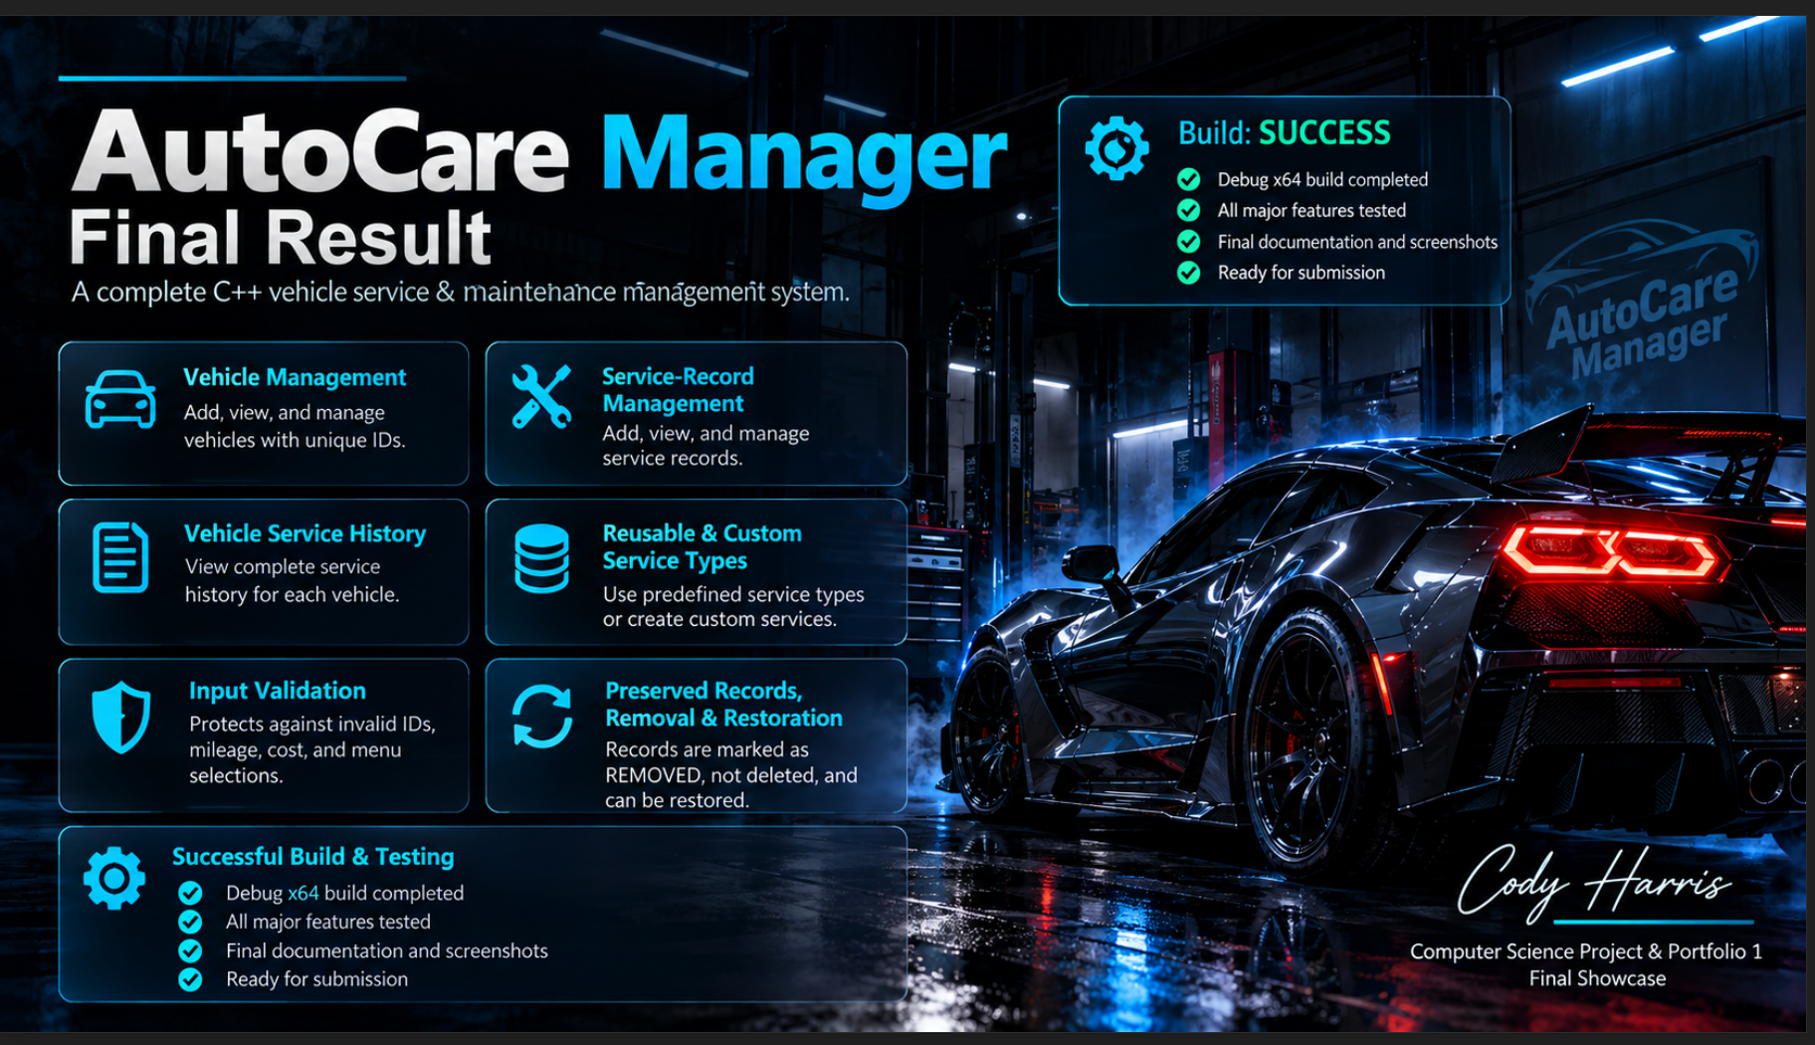
Notes:
The final version of AutoCare Manager includes vehicle management, service-record management, vehicle service history, reusable and custom service types, input validation, and preserved service records with removal and restoration.
The completed project was successfully rebuilt using the Debug x64 configuration in Visual Studio. I also completed final feature testing, documentation, and screenshots in preparation for submission.
This project helped me combine the individual C++ concepts I learned into a complete application while also gaining experience with a structured development and GitHub version-control workflow.
My name is Cody Harris, and this concludes my final Project and Portfolio 1 showcase. Thank you.

