Slide 1
Notes:
Cover Slide

Slide 2
Support Assy Generate Yield Report
Le Tien Hiep l TEST IT
Notes:
Title Slide

Slide 3
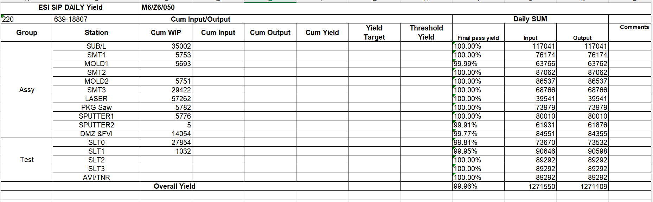
Purpose
Check yield in all station

Slide 4
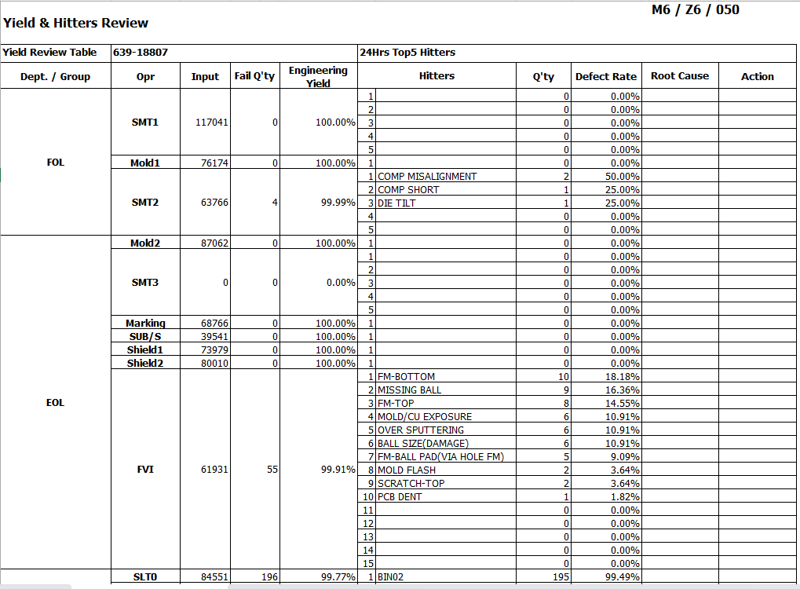
Require
Generate report
Automation send email

Slide 5
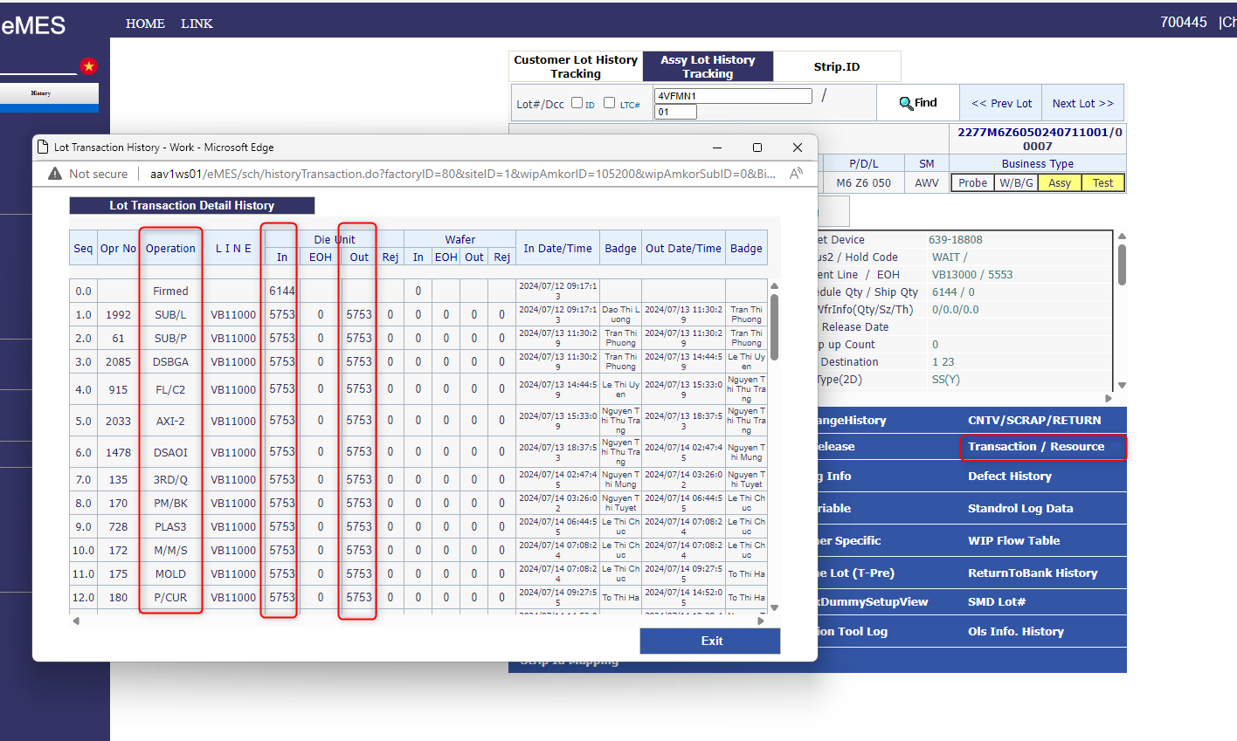
WIP Data
EMLIB.ASCHMP03
EMLIB.AWIPMP01

Slide 6
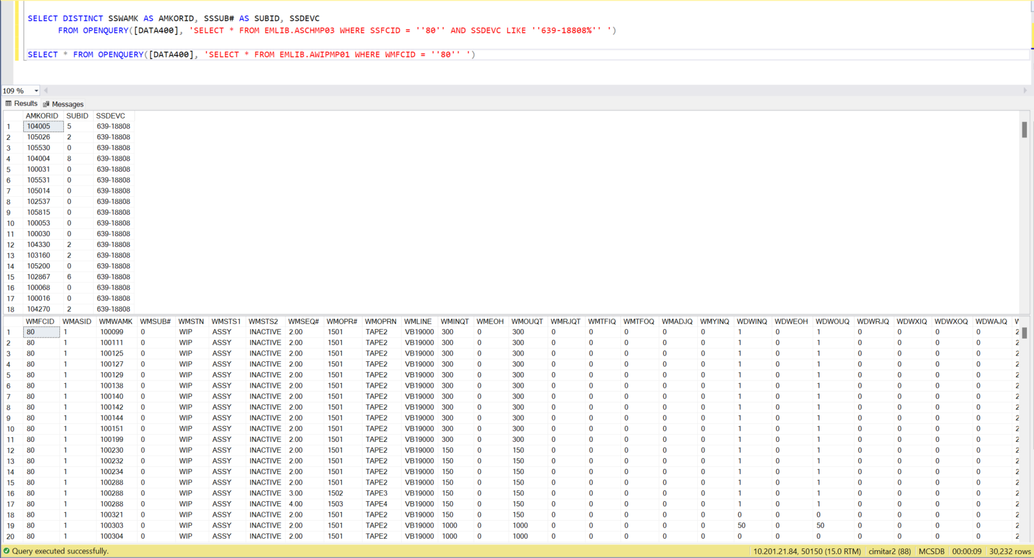
Database
Get AmkorID, SubID base on Device No
Then check quantity input output
Notes:
Agenda/Outline Slide – Option 1

Slide 7
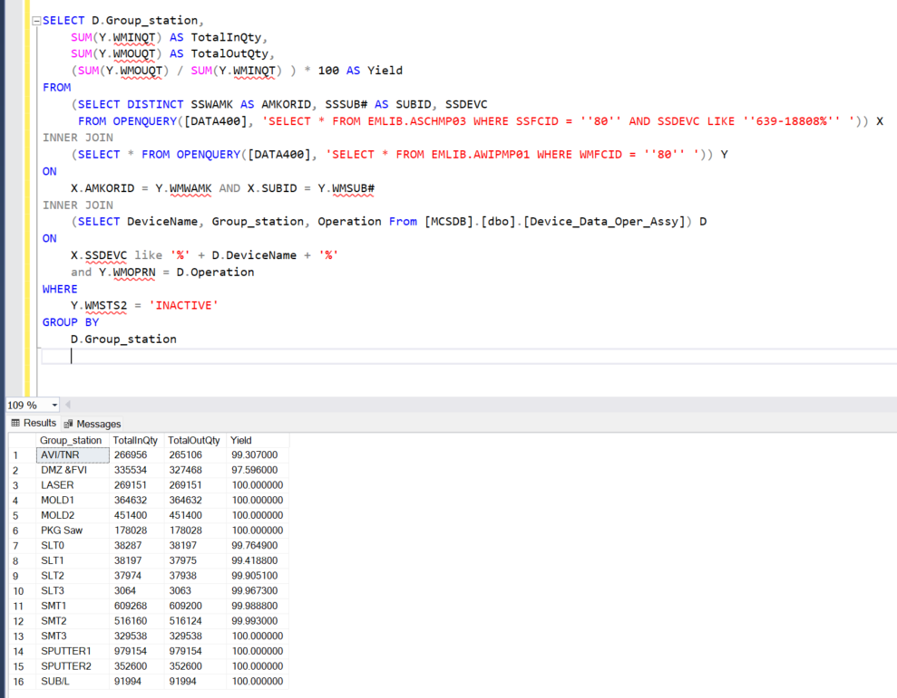
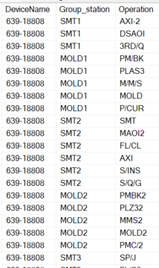
Database
SUM as Group Station as In Qty, Out Qty and Yield
Notes:
Agenda/Outline Slide – Option 1

Slide 8
Yield & Hitters Review

Slide 9
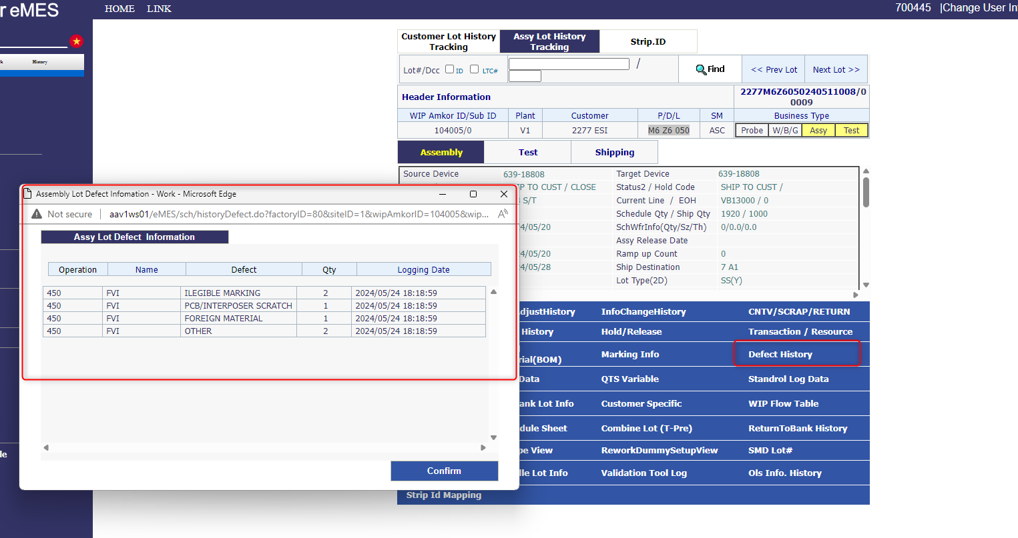
eMES

Slide 10
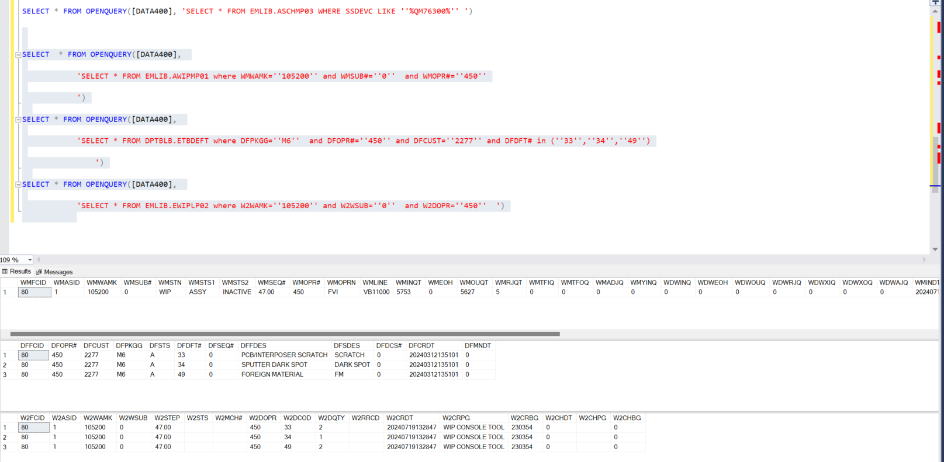
Database

