Slide 1
Project 5: LEO + Terrestrial Integrated Routing with Prediction-Aware Handover
Interim Pitch
Zhuokai Chen (123090057)
Yiyu Ren (122090445)
Zhangcheng Kang (122090873)
Kudzai Dandadzi (122010002)

Slide 2
Problem + Artifact + Metrics
Problem: LEO (low Earth orbit) satellite visibility windows change on the order of seconds but reactive routing picks paths that are about to break, causing outages and excessive handovers.
Artifact: A time-varying LEO–ground network simulator with prediction-aware routing/handover policies that optimize over a short forecast horizon.
Type: Frontier
Metrics:
Outage probability: fraction of timesteps with no feasible path
95th-percentile latency: tail end-to-end delay across delivered packets
Handover rate (per minute)

Slide 3
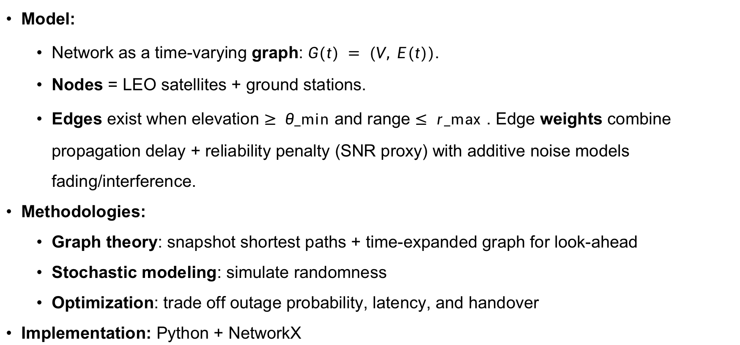
Technical Core
Model:
Network as a time-varying graph: $G(t) = (V, E(t))$.
Nodes = LEO satellites + ground stations.
Edges exist when elevation $≥ θ_min⁡$and range $≤ r_max⁡$. Edge weights combine propagation delay + reliability penalty (SNR proxy) with additive noise models fading/interference.
Methodologies:
Graph theory: snapshot shortest paths + time-expanded graph for look-ahead
Stochastic modeling: simulate randomness
Optimization: trade off outage probability, latency, and handover
Implementation: Python + NetworkX
Notes:
Network as time-varying graph snapshots $G(t) = (V, E(t))$sampled every $Δt$ seconds. Nodes = LEO satellites + ground stations. Edges exist when elevation $≥ θ_min⁡$and range $≤ r_max⁡$. Edge weights combine propagation delay + reliability penalty (SNR proxy). Additive noise models fading/interference.

Slide 4
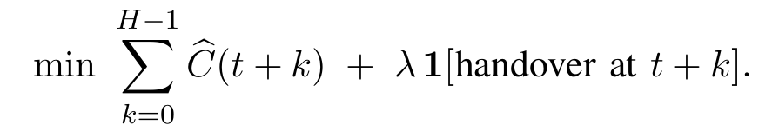
Baselines + Evaluation Plan
Baseline:
Reactive shortest path (Dijkstra on current snapshot)
Greedy handover (attach to best visible satellite, ignore future)
Learned predictor (frontier): Minimize predicted cost over horizon H with handover penalty:
Experiment sweeps:
Scale/geometry: vary satellite count, plane count, ISL (inter-satellite link) radius
Stress: random link/satellite failures, noisy costs
Forecast quality: inject 10%/30%/50% forecast error → robustness curves
Outputs: Outage prob, latency CDFs (p50/p95), handover stats with confidence intervals

Slide 5
Milestones + Risks
Milestones:
Simulator: G(t) graph generator + link-cost model, sanity checks
Baselines + harness: reactive shortest path + greedy handover, metric logging/plotting
Prediction-aware policy + eval: horizon-H controller, forecast-error robustness sweeps
Top risks & mitigation:
Risk 1: Perfect simulator modeling costs too much time Mitigation: start simple & testable and add realism (e.g., SGP4) only after baseline is stable.
Risk 2: Forecast errors for edge cases Mitigation: controller degrades gracefully (bounded horizon, limited switching) and benchmark break-even accuracy.
Risk 3: Overfitting to one scenario Mitigation: evaluate across diverse constellations/stressors, report robustness curves.

Slide 6
Verification Plan + Fail-Soft Fallback
Verification:
Ablation: test with oracle forecasts vs. noisy forecasts vs. no forecasts (baseline)
Robustness plot: outage & p95 latency as function of injected forecast error
Sanity: as forecast error → 100%, performance must approach reactive baseline; flag any regime where look-ahead hurts
Fail-soft fallback: If learned predictor is unreliable, then deliver simulator + prediction-aware controller using a simple hand-crafted (geometry-extrapolation) predictor, with full baseline comparisons.

Slide 7
Thank You

