Slide 1

Tutorial 8 Kraken
By Cody Scully & Christopher Uzokwe

Slide 2
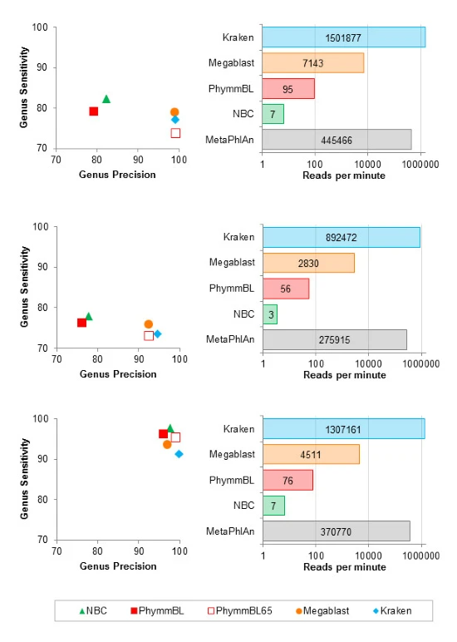
Taxonomic Classification
Blast (Magablast)
The Naïve Bayes Classifier (NBC)
PhymmBL
MatePhlAn
Kraken
Notes:
These are some of different Taxonomic Classification programs that are often used as comparison.

Slide 3
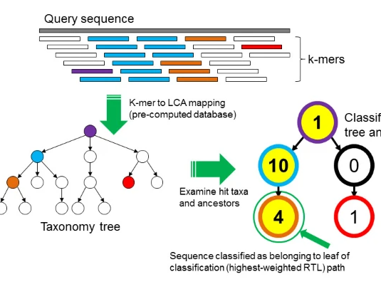
Overview of Kraken
This is a Program that reads in Group of unmapped data
Classifies the data using k-mers to map the LCA
Creates a Taxonmy tree with the Classifications
Removes any unclassified leaves from the tree

Slide 4
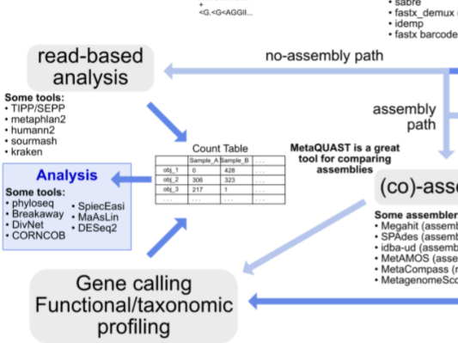
Overview of metagenomics workflow

Slide 5
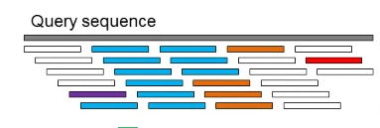
Query Sequence
The First step that Kraken takes is to sequence the data set
This is done by a library of metagenome data
Every k-Mer is either
Classified with the data from the library
Unclassified if nothing is found for them.

Slide 6
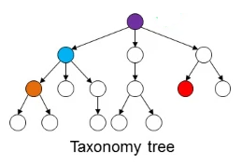
Taxonomy tree
Each K-mer is mapped to the lowest common ancestor (LCA) of the genomes that contains that k-mer

Slide 7
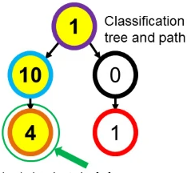
Classification tree and path
Finally the unclassified K-mers are removed and the tree is reduced and weighted/scored

Slide 8
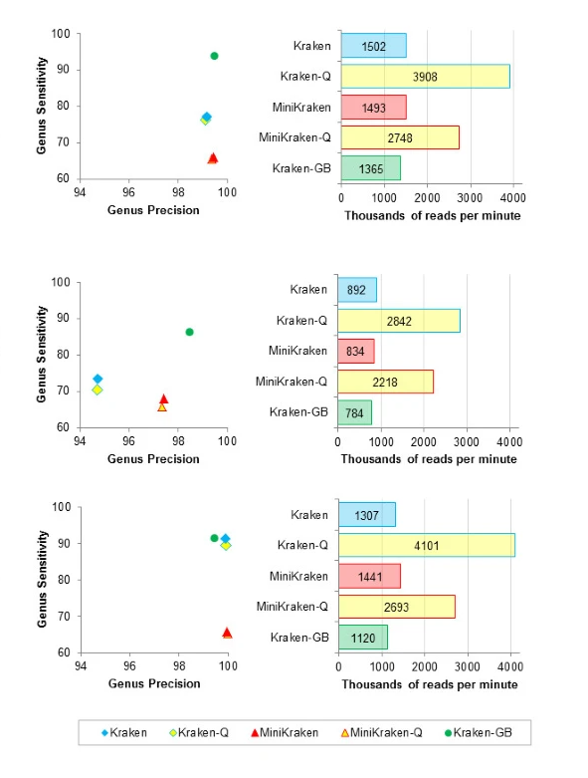
Kraken Variance
Kraken
Needs 70 GB of RAM
Kraken-Q/MiniKraken-Q
Faster then Kraken /MiniKraken
Decreased Accuracy
MiniKraken
Reduced database
Needs 4 GB of RAM
Less overall Sensitivity (~11-25%)
Kraken-GB
Uses GenBank Database
Very high sensitivity

Slide 9
KRAKEN2 Tutorial

Slide 10


Installation & downloads
Download Kraken2 Docker:
(Or) find it on Picotte:
Must also download taxo database:
Also available on picotte

Slide 11
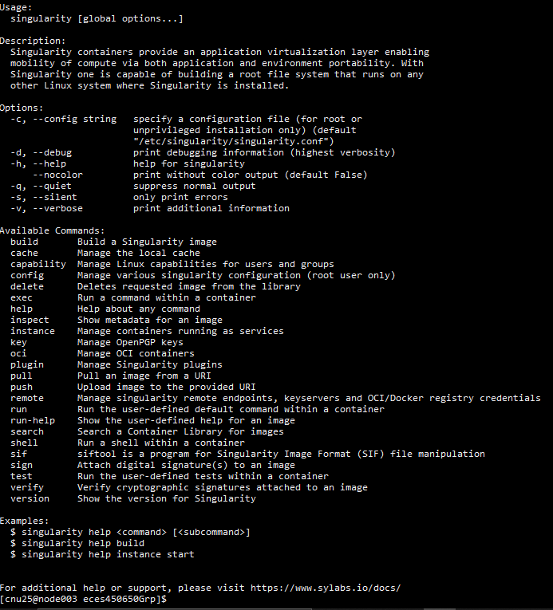
Run kraken2 container in singularity
Request node to run on:
Run the docker using singularity, bind to our groups folder
We are using the run command to execute through the kraken container

Slide 12
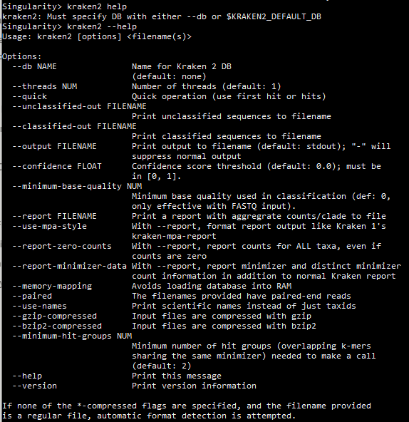
Usage notes (kraken)
`--use-names`: print scientific names
`--db`: Database reference file path
`--fastq-input`[deprecated] : We are using fastq formatted files
`--paired`: We are dealing with paired end data
`--report FILE`: This provides us with a sample-wide report

Slide 13
Kraken2 command, I/O, Runtime
Input files: /ifs/groups/eces450650Grp/data/mappings/evol1.sorted.unmapped.R1.fastq
/ifs/groups/eces450650Grp/data/mappings/evol1.sorted.unmapped.R1.fastq
Output files: ./ECES450650_SP21/Tutorial8/evol1.kraken ← classifications
./ECES450650_SP21/Tutorial8/report ← report
Execution time:

Slide 14
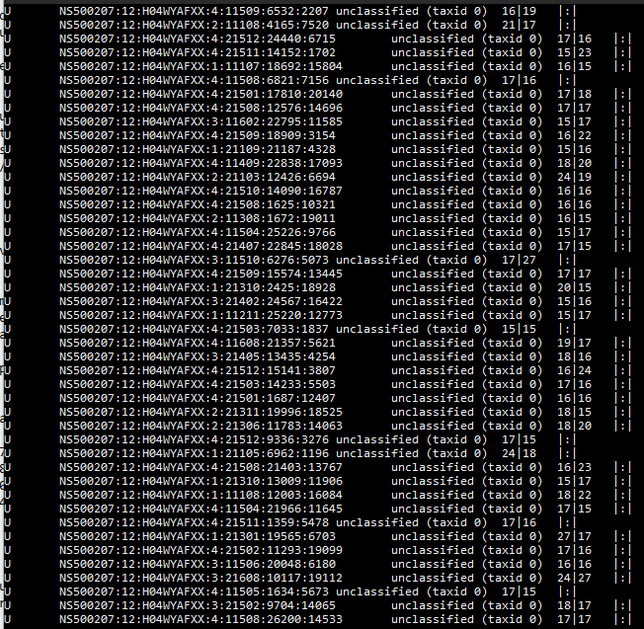
RESULTS & Understanding - Classifications
C/U: one letter code indicating that the sequence was either classified or unclassified.
The sequence ID, obtained from the FASTA/FASTQ header.
3.The taxonomy ID Kraken2 used to label the sequence; this is 0 if the sequence is unclassified and otherwise should be the NCBI Taxonomy identifier.
4.The length of the sequence in bp.
A space-delimited list indicating the lowest common ancestor (in the taxonomic tree) mapping of each k-mer in the sequence. For example, 562:13 561:4 A:31 0:1 562:3 would indicate that:
the first 13 k-mers mapped to taxonomy ID #562
the next 4 k-mers mapped to taxonomy ID #561
the next 31 k-mers contained an ambiguous nucleotide
the next k-mer was not in the database
the last 3 k-mers mapped to taxonomy ID #562
Source: https://genomics.readthedocs.io/en/latest/ngs-taxonomic-investigation/index.html#wood2014

Slide 15
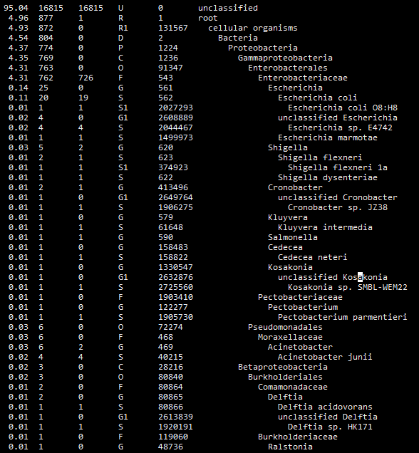
RESULTS & Understanding – Report Summary
Percentage of reads covered by the clade rooted at this taxon
Number of reads covered by the clade rooted at this taxon
Number of reads assigned directly to this taxon
A rank code, indicating (U)nclassified, (D)omain, (K)ingdom, (P)hylum, (C)lass, (O)rder, (F)amily, (G)enus, or (S)pecies. All other ranks are simply “-“.
NCBI Taxonomy ID
The indented scientific name
Source: https://genomics.readthedocs.io/en/latest/ngs-taxonomic-investigation/index.html#wood2014

Slide 16
Sources
“6. Taxonomic investigation¶,” 6. Taxonomic investigation - Genomics Tutorial 2020.2.0 documentation. [Online]. Available: https://genomics.readthedocs.io/en/latest/ngs-taxonomic-investigation/index.html#kraken2. [Accessed: 20-May-2021].
D. E. Wood and S. L. Salzberg, “Kraken: ultrafast metagenomic sequence classification using exact alignments,” Genome Biology, 03-Mar-2014. [Online]. Available: https://genomebiology.biomedcentral.com/articles/10.1186/gb-2014-15-3-r46. [Accessed: 20-May-2021].
D. Wood, “DerrickWood/kraken2,” GitHub. [Online]. Available: https://github.com/DerrickWood/kraken2. [Accessed: 20-May-2021].
M. Lee, “Genomics,” Happy Belly Bioinformatics, 2021. [Online]. Available: https://astrobiomike.github.io/genomics/. [Accessed: 20-May-2021].

