Slide 1

Tutorial 8 Kraken
By Cody Scully & Christopher Uzokwe

Slide 2
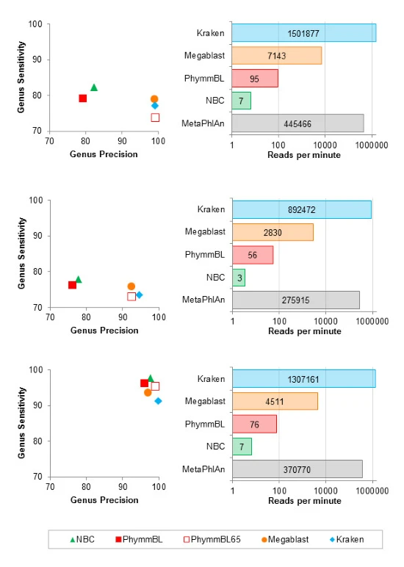
Taxonomic Classification
Blast (Magablast)
The Naïve Bayes Classifier (NBC)
PhymmBL
MatePhlAn
Kraken
Notes:
These are some of different Taxonomic Classification programs that are often used as comparison.

Slide 3
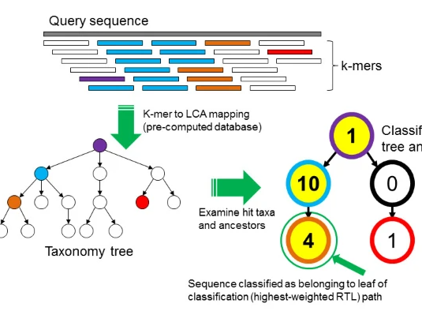
Overview of Kraken
This is a Program that reads in Group of unmapped data
Classifies the data using k-mers to map the LCA
Creates a Taxonmy tree with the Classifications
Removes any unclassified leaves from the tree

Slide 4
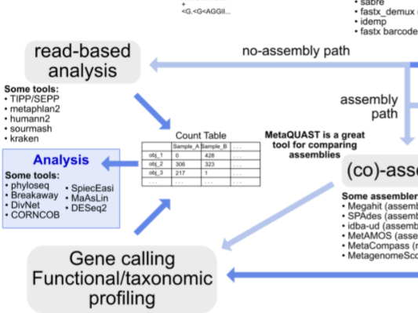
Overview of metagenomics workflow

Slide 5
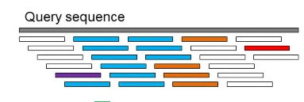
Query Sequence
The First step that Kraken takes is to sequence the data set
This is done by a library of metagenome data
Every k-Mer is either
Classified with the data from the library
Unclassified if nothing is found for them.

Slide 6
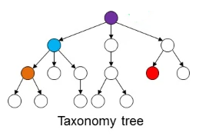
Taxonomy tree
Each K-mer is mapped to the lowest common ancestor (LCA) of the genomes that contains that k-mer

Slide 7
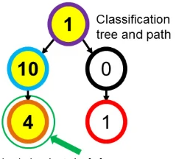
Classification tree and path
Finally the unclassified K-mers are removed and the tree is reduced and weighted/scored

Slide 8
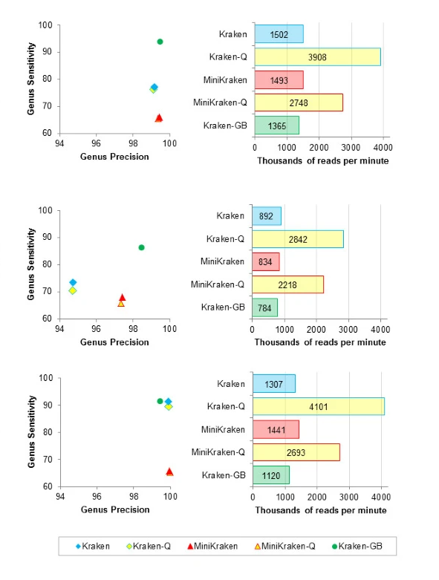
Kraken Variance
Kraken
Needs 70 GB of RAM
Kraken-Q/MiniKraken-Q
Faster then Kraken /MiniKraken
Decreased Accuracy
MiniKraken
Reduced database
Needs 4 GB of RAM
Less overall Sensitivity (~11-25%)
Kraken-GB
Uses GenBank Database
Very high sensitivity

Slide 9
Sources

