Slide 1
Relevance-Based Biomedical Information Retrieval
Cody Valle
Jinous Esmaeili

Slide 2
Overview
Introduction
Algorithm
First Round
Second Round
Third Round
Implementation
Testing
Conclusion
Contributions
Questions

Slide 3

Introduction
Takes user selected CUIs
Relevance-based search
Ranking
Returns the top documents

Slide 4

Algorithm
Total of three rounds
Each round has a different algorithm

Slide 5
First Round-Goal
Received CUIs from user
Compared each document with CUIs
Ranked each document by A-TF-IDF
Determine P@10 and AveP

Slide 6
First Round-Algorithm
IDF Values
Used HashMap to keep track of IDFs of each CUI
TF Values
Calculated TF for every CUI for every document
A-TF-IDF
Calculate A-TF-IDF
Stored all A-TF-IDF in an ordered list
Ranked the list in a descending order

Slide 7
Second Round-Goal
Calculate the I^{w} values for every concept in every document
Build the P_{Z} profile
Calculate and rank each document by their RBO
Determine P@10 and AveP

Slide 8
Second Round-Algorithm
I^{w} Values
HashMap to store the partial count for every sentence in Z
Calculate the necessary values to get the I^{w} for each document
P_{Z} profile
Maximum number of concepts from the I^{w} list and concepts in Z
RBOs
Size of the intersection at depth

Slide 9
Third Round-Goal
Rebuild Z
Rebuild the P_{Z} profile
Calculate and rank each document by their RBO
Determine P@10 and AveP

Slide 10
Third Goal-Algorithm
P_{Z} profile
Maximum number of concepts from the I^{w} list and concepts in Z
RBOs
Size of the intersection at depth

Slide 11

Implementation
HashMap
HashSet
ArrayList
IwStructure

Slide 12
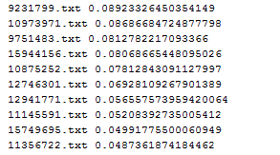
Testing
Compared A-TF-IDF values with previous assignment
Checked functionality of file reading function
Compared each round results with previous round results

Slide 13
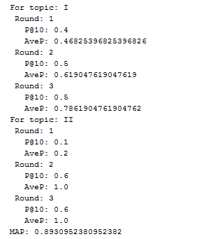

Conclusion
Precision and AveP increase every round
The more rounds the more relevant documents

Slide 14
Contributions
Cody Valle
Wrote the Java Code
Explained the algorithm to Jinous
Jinous Esmaeili
Kept Cody on track
Made the presentation

Slide 15

Questions

