Slide 1
Computer Graphics Final Project: 3D Space Shooter
By Cody Valle and Andrew Burke

Slide 2
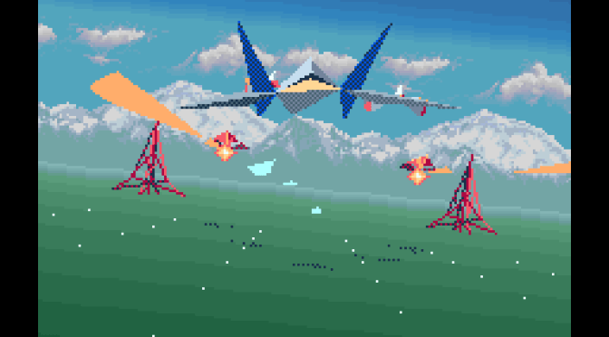
Inspiration and Initial Idea
Star Fox, a video game released on the Super Nintendo Entertainment System
Control over a ship in a “moving” 3D environment with enemy targets to shoot

Slide 3
New Classes
Drawing and Animation
Transform
Drawable
Node
Animator
Environment Interactivity
Bounding Box
Collider
Transform

Slide 4
Drawing and Animation
Node – a leaf in a hierarchy which contains objects to be drawn and children nodes
Transform – handles transformations for the modelview matrix for each Node
Drawable – handles vertex and color data for objects
Animator – handles drawing updates

Slide 5
Environment Interactivity
Bounding Box – surrounds a given Node for the purpose of collision detection
Collider – detects when a bullet has hit an enemy ship
Transform – controls the size and location of a bounding box

Slide 6
Lighting
Light source in upper left out of view
Reflections can be seen on the space ships and bullets

Slide 7
Code Example
DrawableFactory* factory = new SolidDrawableFactory();
Drawable* sphereObject = factory->makeSphere(30, 30);
Node* sphereNode = new Node();
sphereNode->addChild(sphereObject);
root->addChild(sphereNode);
sphereNode->getTransform().setTranslate(0, 0, -50);
sphereNode->getTransform().rotate(90, 0, 0);

Slide 8
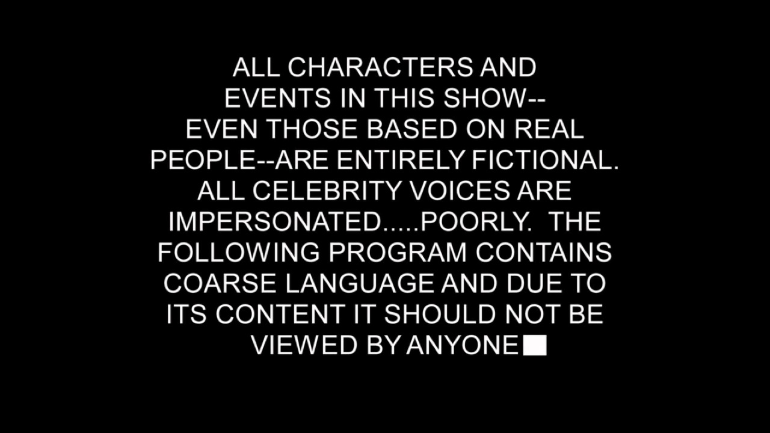
Demo
GAME

Slide 9
Problems
Using multiple shaders
Playing music files
Making a sphere

Slide 10
Further Development
More scenery
Enemy AI with attack capabilities
Score tracking
Limited number of lives
Varied enemies
Increased difficulty over time
Power-ups
Cockpit camera view

Slide 11
Questions?

