Slide 1
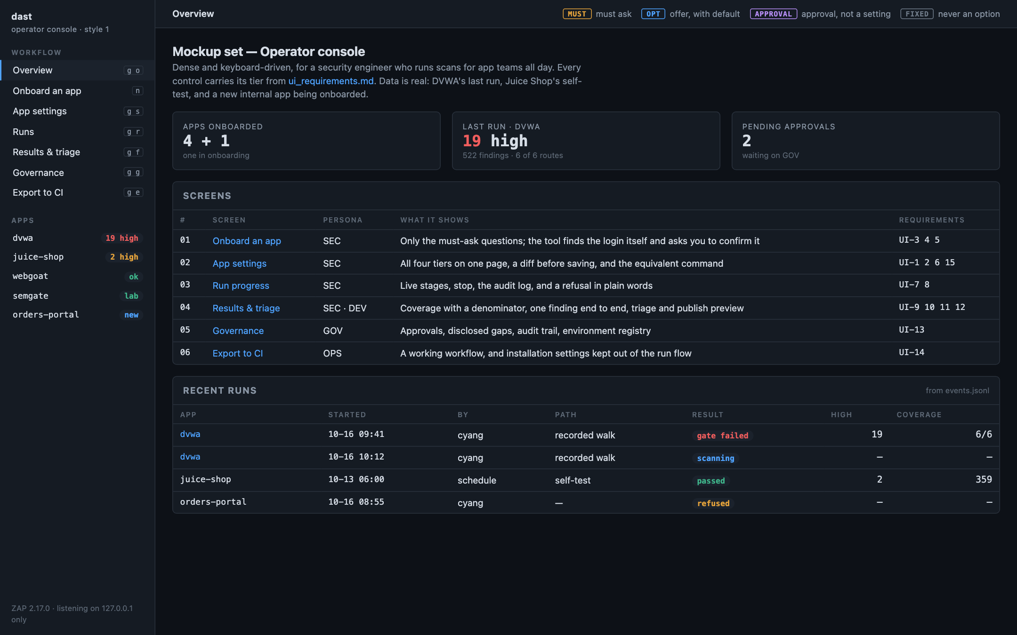
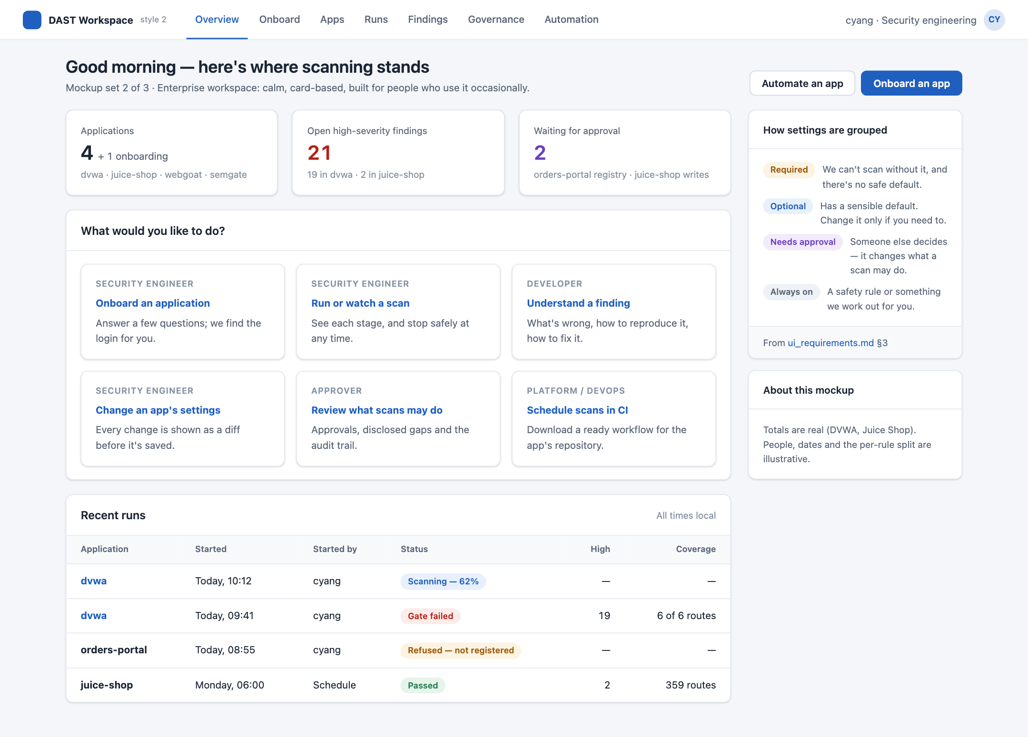
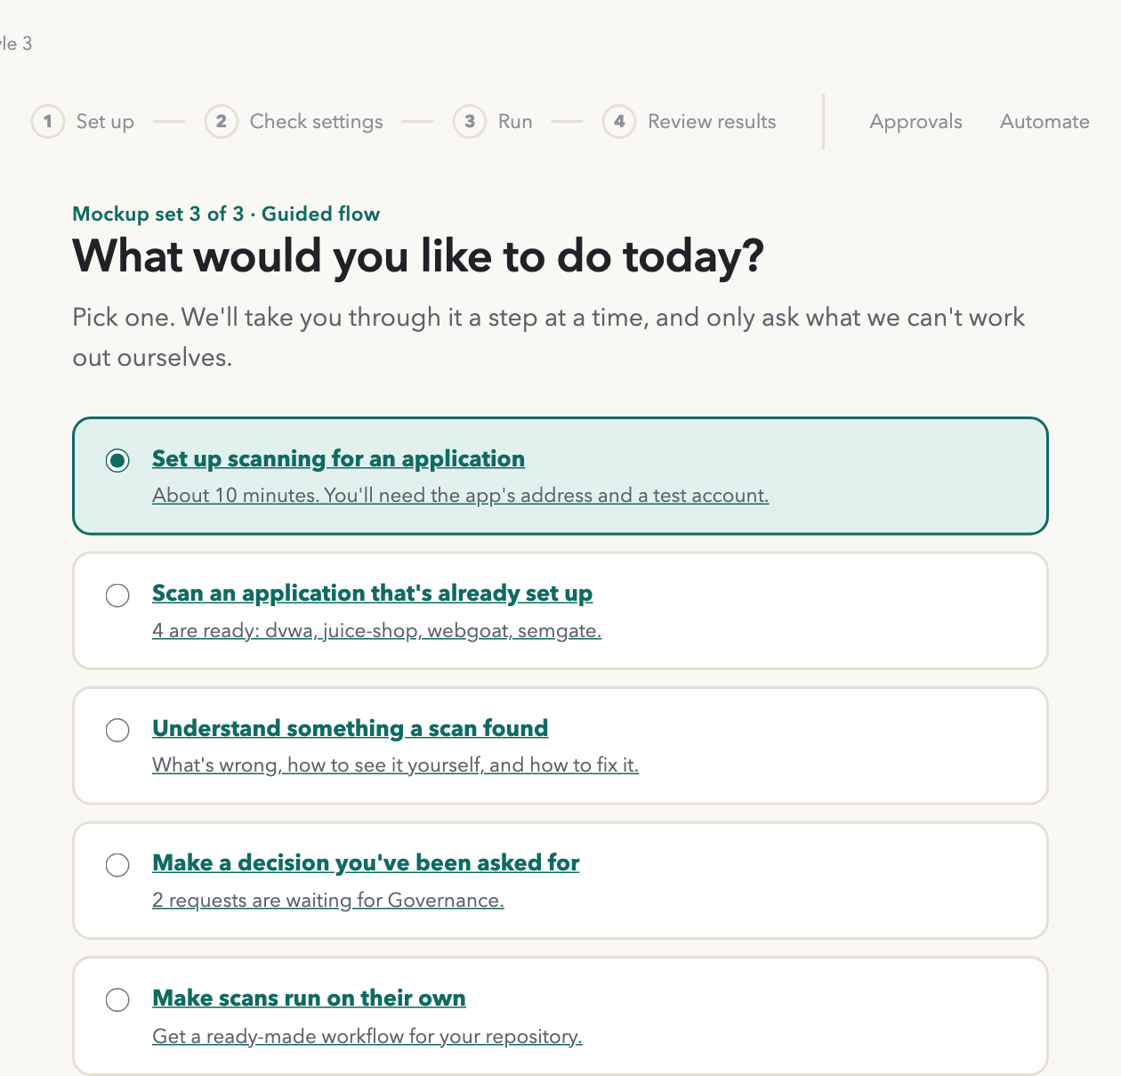
A UI for the DAST tool
Requirements, and three design directions for the same seven screens
Style 1
Style 2
Style 3
Notes:
Draft for discussion. The requirements come from docs/ui-docs/ui_requirements.md; the mockups are static HTML in docs/ui-docs/style-1..3.

Slide 2
The goal: run a scan without reading the runbook
Today a scan means a long runbook, several terminals, exported credentials — and knowing which of about 120 settings matter.
Three rules the UI must keep
1
The config file stays the source of truth
The UI reads and writes app.yaml. Nothing that changes a scan lives only in the UI.
~120
settings today
4 commands, ~60 app.yaml fields, ~30 env vars
2
A front end to the dast commands
Every action maps to onboard, author, scan or report — and the UI can show the command.
4
personas
DEV · SEC · OPS · GOV
4
tiers
every setting gets exactly one
3
Never more permissive than the CLI
Guardrails live in the core. The UI shows them; it can't turn them off.
Notes:
From remediation plan §1: config in, contracts out, one command, one artifact. The UI must not break that.

Slide 3
Four people meet this tool, for different reasons
SEC
DEV
OPS
GOV
Security engineer
The operator
App developer
Receives findings
Platform / DevOps
Runs it unattended
Governance
Approves
Onboard an app, verify login, choose what gets tested, run scans, read results, approve triage.
Understand a finding, reproduce it, propose "false positive" or "won't fix".
Move a working setup into CI on a schedule; set installation settings once.
Approve what a scan may do, see what was excluded and why, audit who ran what.
Sees Everything except approvals they don't hold
Sees Results and triage — their home stays GitHub
Sees Export to CI, install settings, run history
Sees Approvals, gaps, audit — read-only elsewhere
Assumption in the draft: the primary user is SEC, running scans for app teams (open question Q1).

Slide 4
Every setting gets exactly one tier
A
Must ask
B
Offer, with a default
No safe default — the tool refuses to run without it. A wizard step that blocks until answered.
A real choice, but the default suits most apps. Under "Advanced", with the default and its cost shown.
e.g. App URL · dev/test/staging · hosts in scope · login type · which secret holds the test account
e.g. Time limits · request rate · DOM-XSS pass · API spec · exploration limits
C
Approval, not a setting
D
Never an option
Needs deciding, but not by the person running the scan. Shown read-only with who approved it and when.
A fixed guardrail, something the tool works out, or an installation setting set once by OPS.
e.g. Forms that change data · "data is disposable" · rules switched off · fail threshold · AI provider
e.g. Production refused · ZAP key · login selectors · Artifactory and CA bundle

Slide 5
What sorting the settings revealed
1
The hardest part shouldn't be a question
Login selectors and the "signed-in" proof make onboarding hard today. dast onboard --discover already proposes and verifies them — the UI asks one yes/no question instead.
15
2
About 25 settings belong to installation
Package mirror, CA bundle, images, Copilot path: OPS sets them once. Kept out of the run flow, they stop crowding every screen.
functional requirements
11 must · 4 should
5
3
"AI on" means "stop if the AI is unavailable"
A silent fallback would make a deterministic run look AI-driven. In the UI, --require-llm is not an option — it's how AI mode works.
non-functional, e.g. loopback only, secrets by reference, validation in the core
4
The fail threshold belongs to Governance
The person whose scan is gated shouldn't be the one lowering the bar.

Slide 6
Five open questions shape the design
Q1
Who is the primary user?
SEC operating for app teams, or app teams self-serving. This decides which style fits.
Q2
Local tool or shared service?
A shared service needs its own login, roles and secret store — a much larger project.
Q3
Where do approvals happen?
Recommended: pull-request review of app.yaml, with GOV as code owners.
Q4
Does DEV use the UI at all?
Recommended: GitHub stays their home; the UI serves the finding detail and triage.
Q5
Which settings are approvals?
Depends on W4-8 (write endpoints) and scan postures SP-1…SP-7, not yet decided.

Slide 7
Three directions, the same seven screens
 | 1 · Operator console | 2 · Enterprise workspace | 3 · Guided flow
Feel | Dark, dense, keyboard-driven | Light, calm, card-based | One task at a time, plain language
Tiers show as | Badges: MUST · OPT · APPROVAL · FIXED | Card bands: Required · Optional · Needs approval · Always on | Sentences: "We need this from you"
Fits best if | SEC runs scans for app teams | Many teams use it occasionally | App teams run scans themselves

Slide 8
Style 1
Operator console
Dark, dense and keyboard-driven. Every control carries a tier badge.
Fits best if security engineers run scans for app teams.

Slide 9
Style 1 · Overview
Persona
All
What it shows
Where each persona starts: recent runs, what's waiting, and the four tiers explained.
Requirements
—

Slide 10
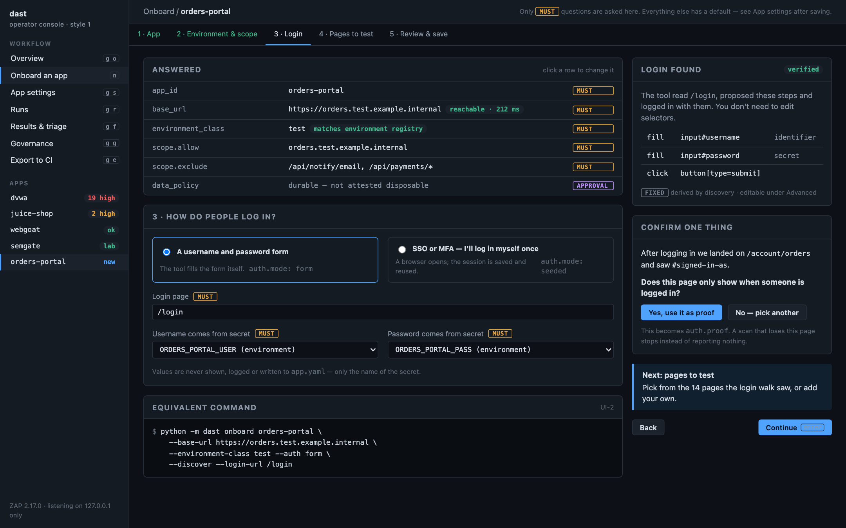
Style 1 · Onboard an app
Persona
SEC
What it shows
Only the must-ask questions. The tool reads the login page, signs in with the test account, and asks one thing: does this page only show when you're signed in?
Requirements
UI-3, 4, 5

Slide 11
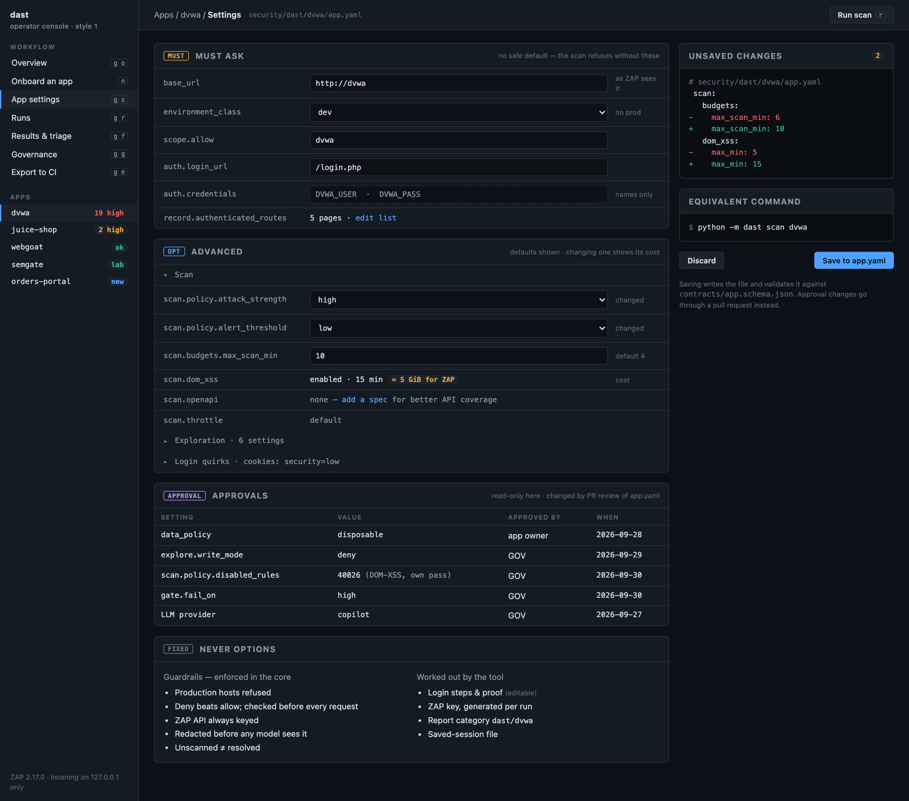
Style 1 · App settings
Persona
SEC
What it shows
All four tiers on one page: required answers, optional settings with their cost, approvals read-only with who decided, and the safety rules. Changes show as a diff before saving.
Requirements
UI-1, 2, 6, 15

Slide 12
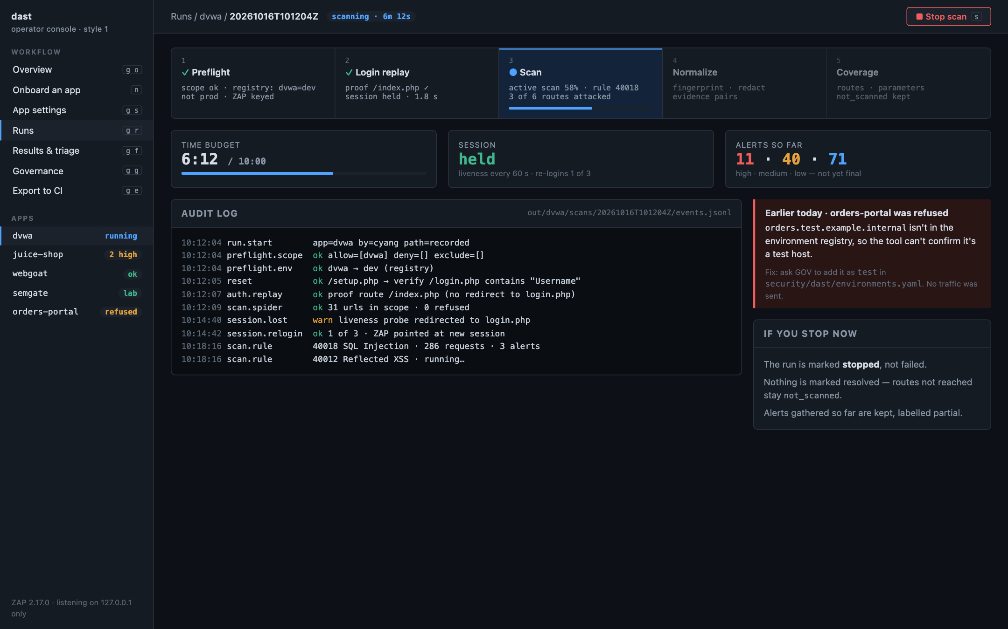
Style 1 · Run progress
Persona
SEC
What it shows
Five live stages, session health, and a safe stop that never marks untested pages as fixed. A refusal is explained in one sentence, with the fix.
Requirements
UI-7, 8

Slide 13
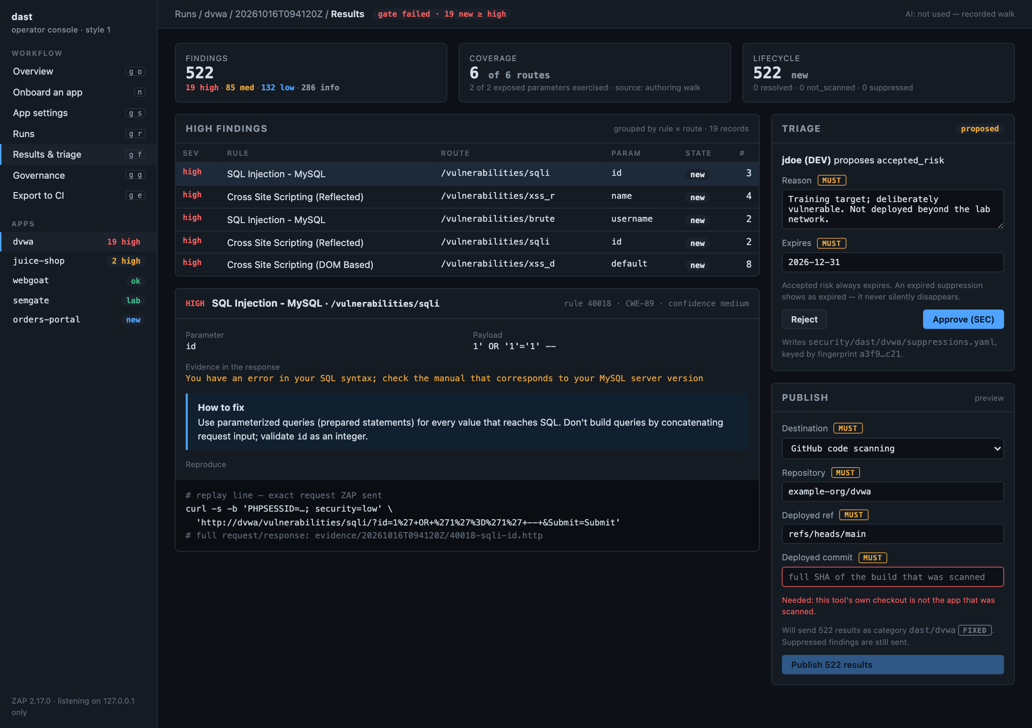
Style 1 · Results and triage
Persona
SEC · DEV
What it shows
Coverage with a denominator, one SQL injection explained end to end, triage that needs a reason and an expiry, and publishing blocked until the deployed commit is known.
Requirements
UI-9 to 12

Slide 14
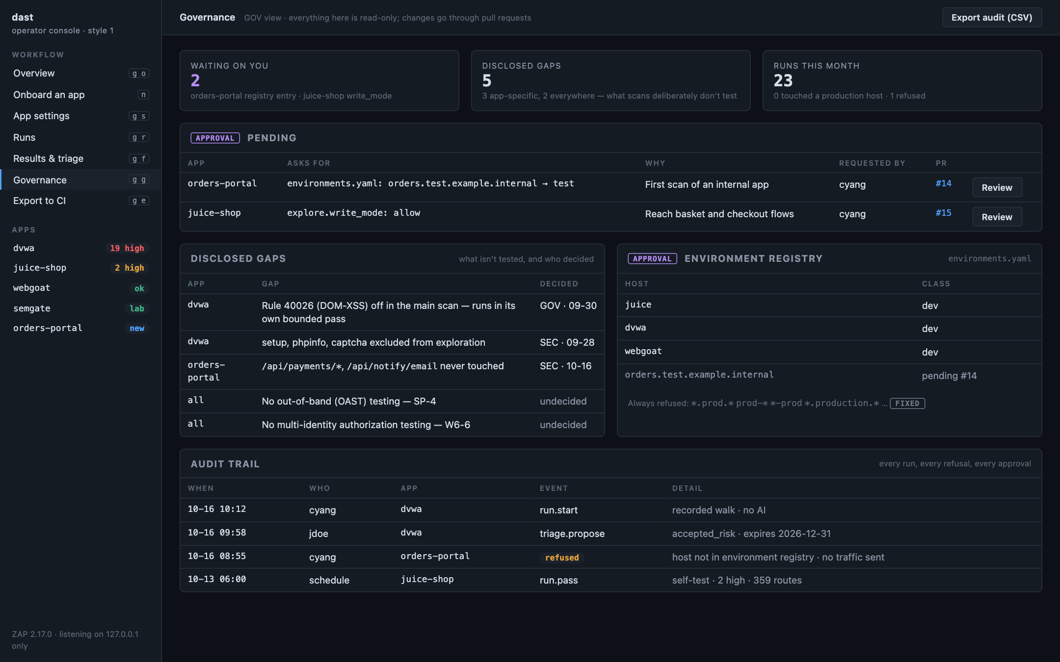
Style 1 · Governance
Persona
GOV
What it shows
Pending approvals as pull requests, what scans deliberately don't test, the environment registry and the audit trail.
Requirements
UI-13

Slide 15
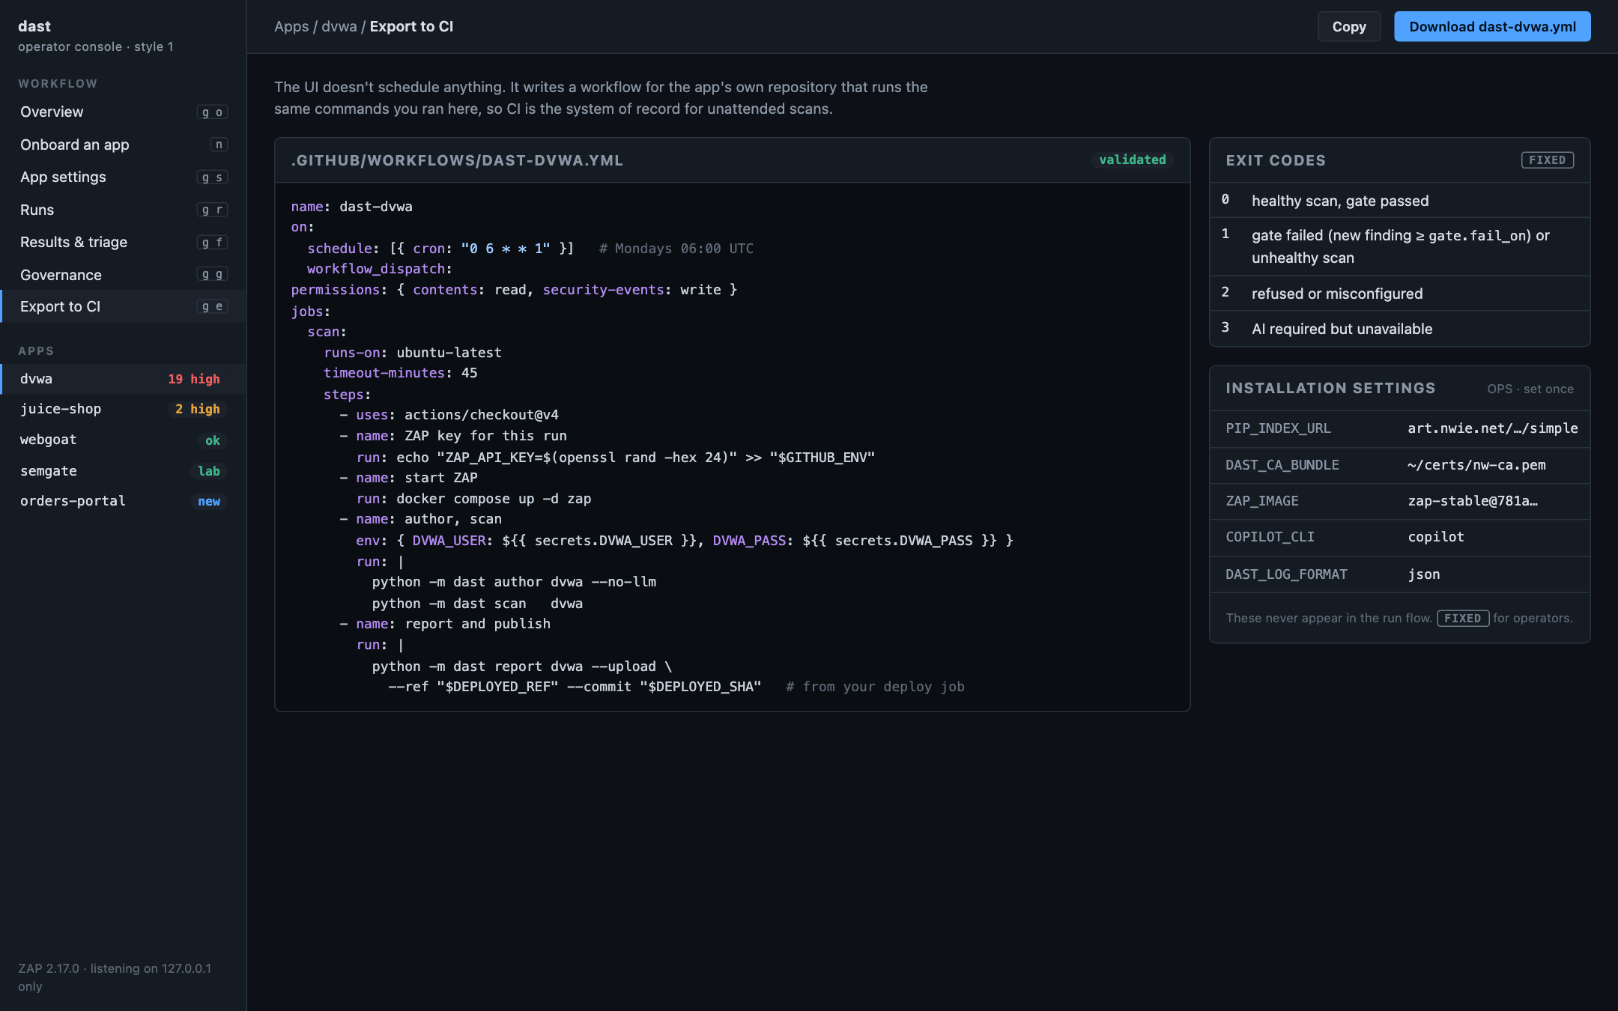
Style 1 · Export to CI
Persona
OPS
What it shows
A ready workflow for the app's repository, what each result means, and installation settings kept out of the run flow.
Requirements
UI-14

Slide 16
Style 2
Enterprise workspace
Light and card-based, with top navigation and a "what this means" help panel.
Fits best if many teams use it occasionally.

Slide 17
Style 2 · Overview
Persona
All
What it shows
Where each persona starts: recent runs, what's waiting, and the four tiers explained.
Requirements
—

Slide 18
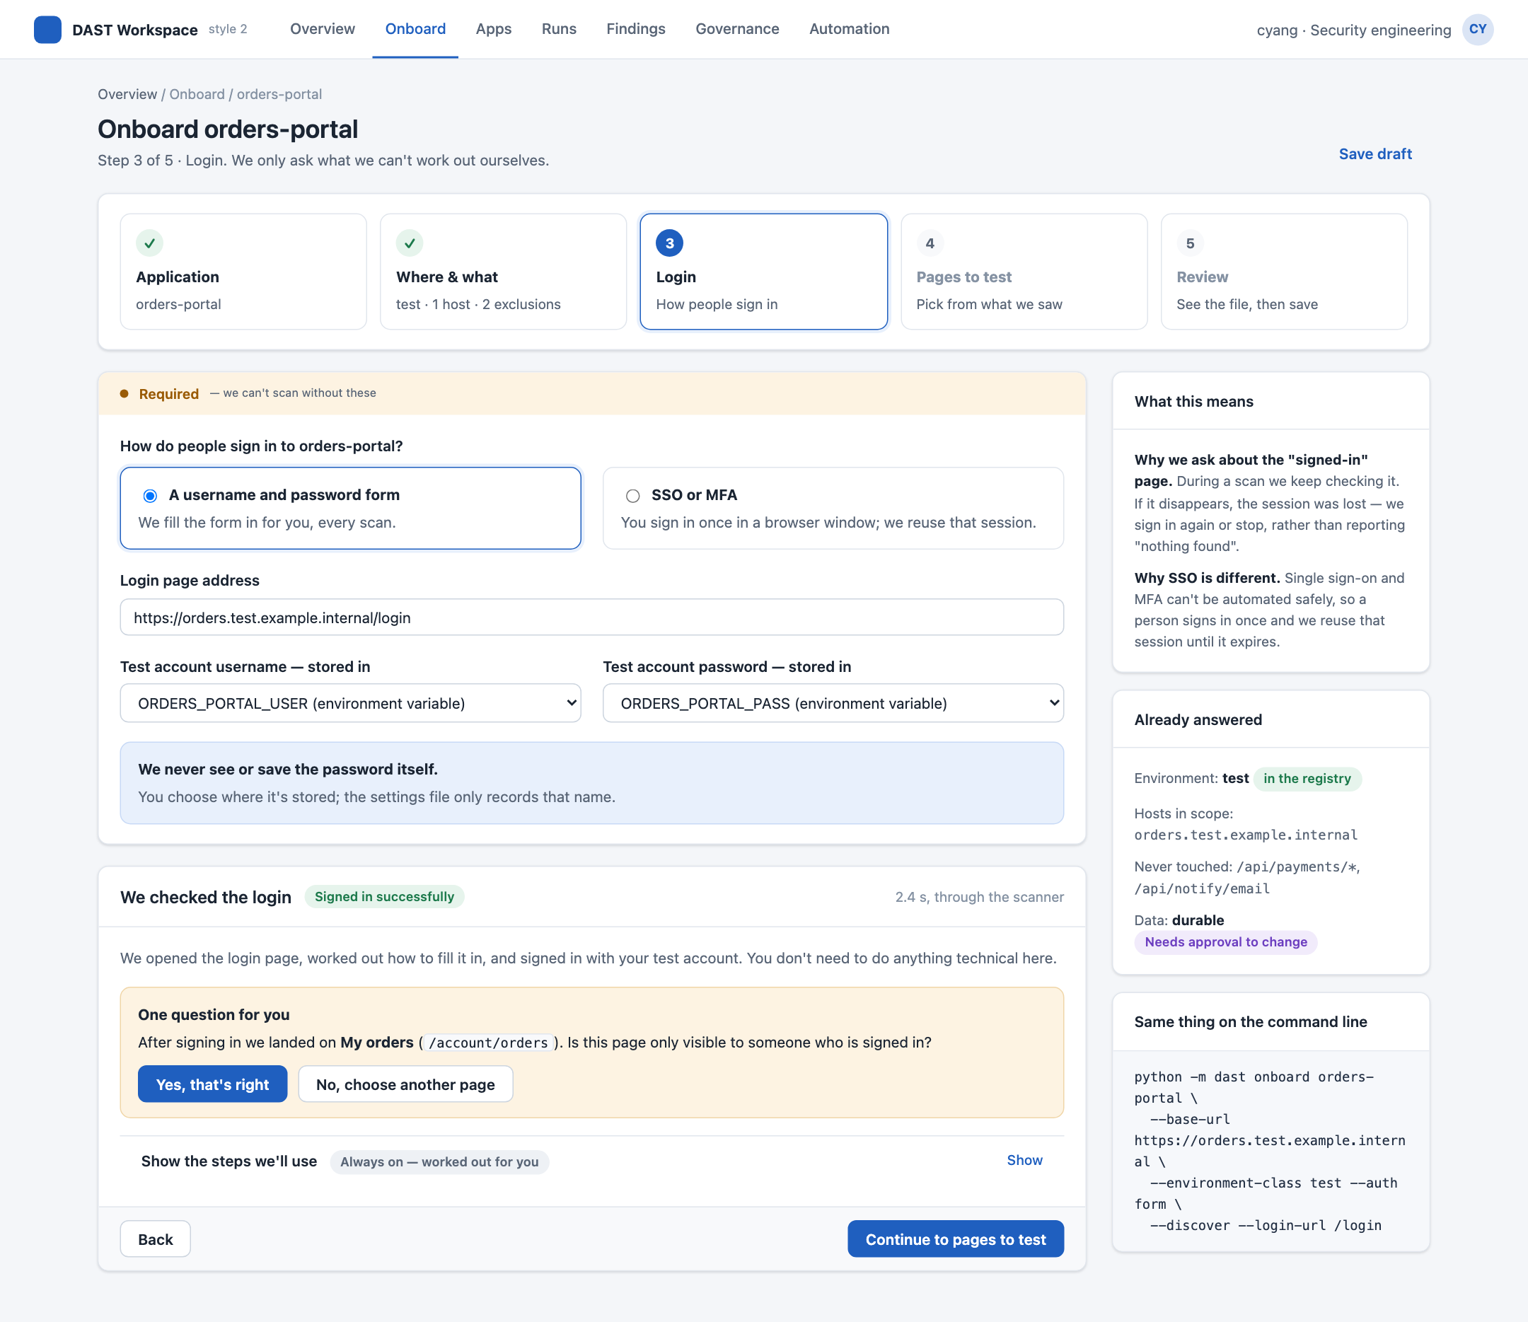
Style 2 · Onboard an app
Persona
SEC
What it shows
Only the must-ask questions. The tool reads the login page, signs in with the test account, and asks one thing: does this page only show when you're signed in?
Requirements
UI-3, 4, 5

Slide 19
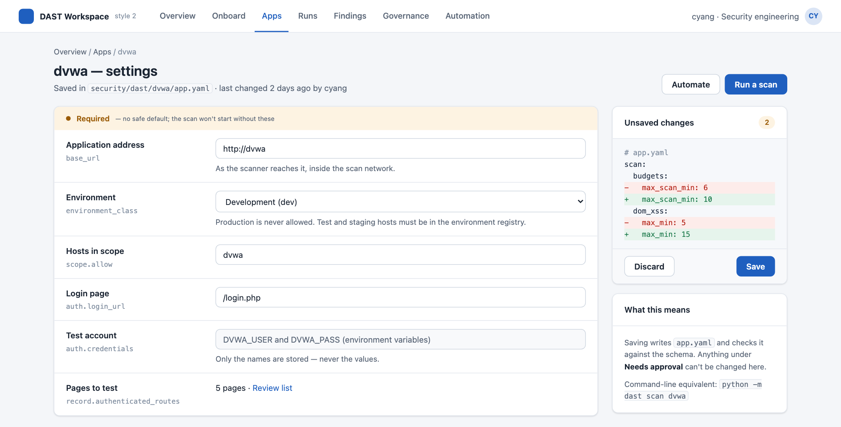
Style 2 · App settings (1 of 2)
Persona
SEC
What it shows
All four tiers on one page: required answers, optional settings with their cost, approvals read-only with who decided, and the safety rules. Changes show as a diff before saving.
Requirements
UI-1, 2, 6, 15
Part 1 of 2 of a long page.

Slide 20
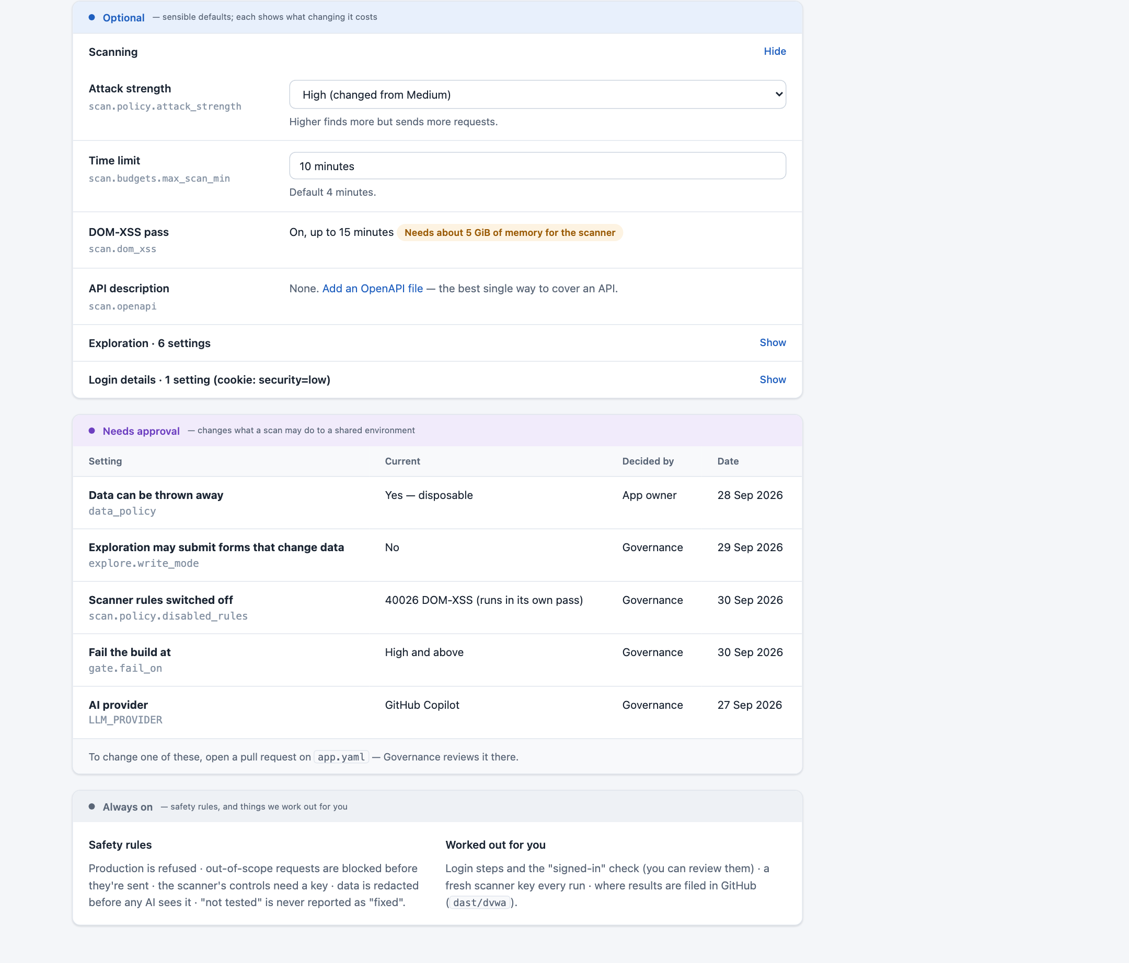
Style 2 · App settings (2 of 2)
Persona
SEC
What it shows
All four tiers on one page: required answers, optional settings with their cost, approvals read-only with who decided, and the safety rules. Changes show as a diff before saving.
Requirements
UI-1, 2, 6, 15
Part 2 of 2 of a long page.

Slide 21
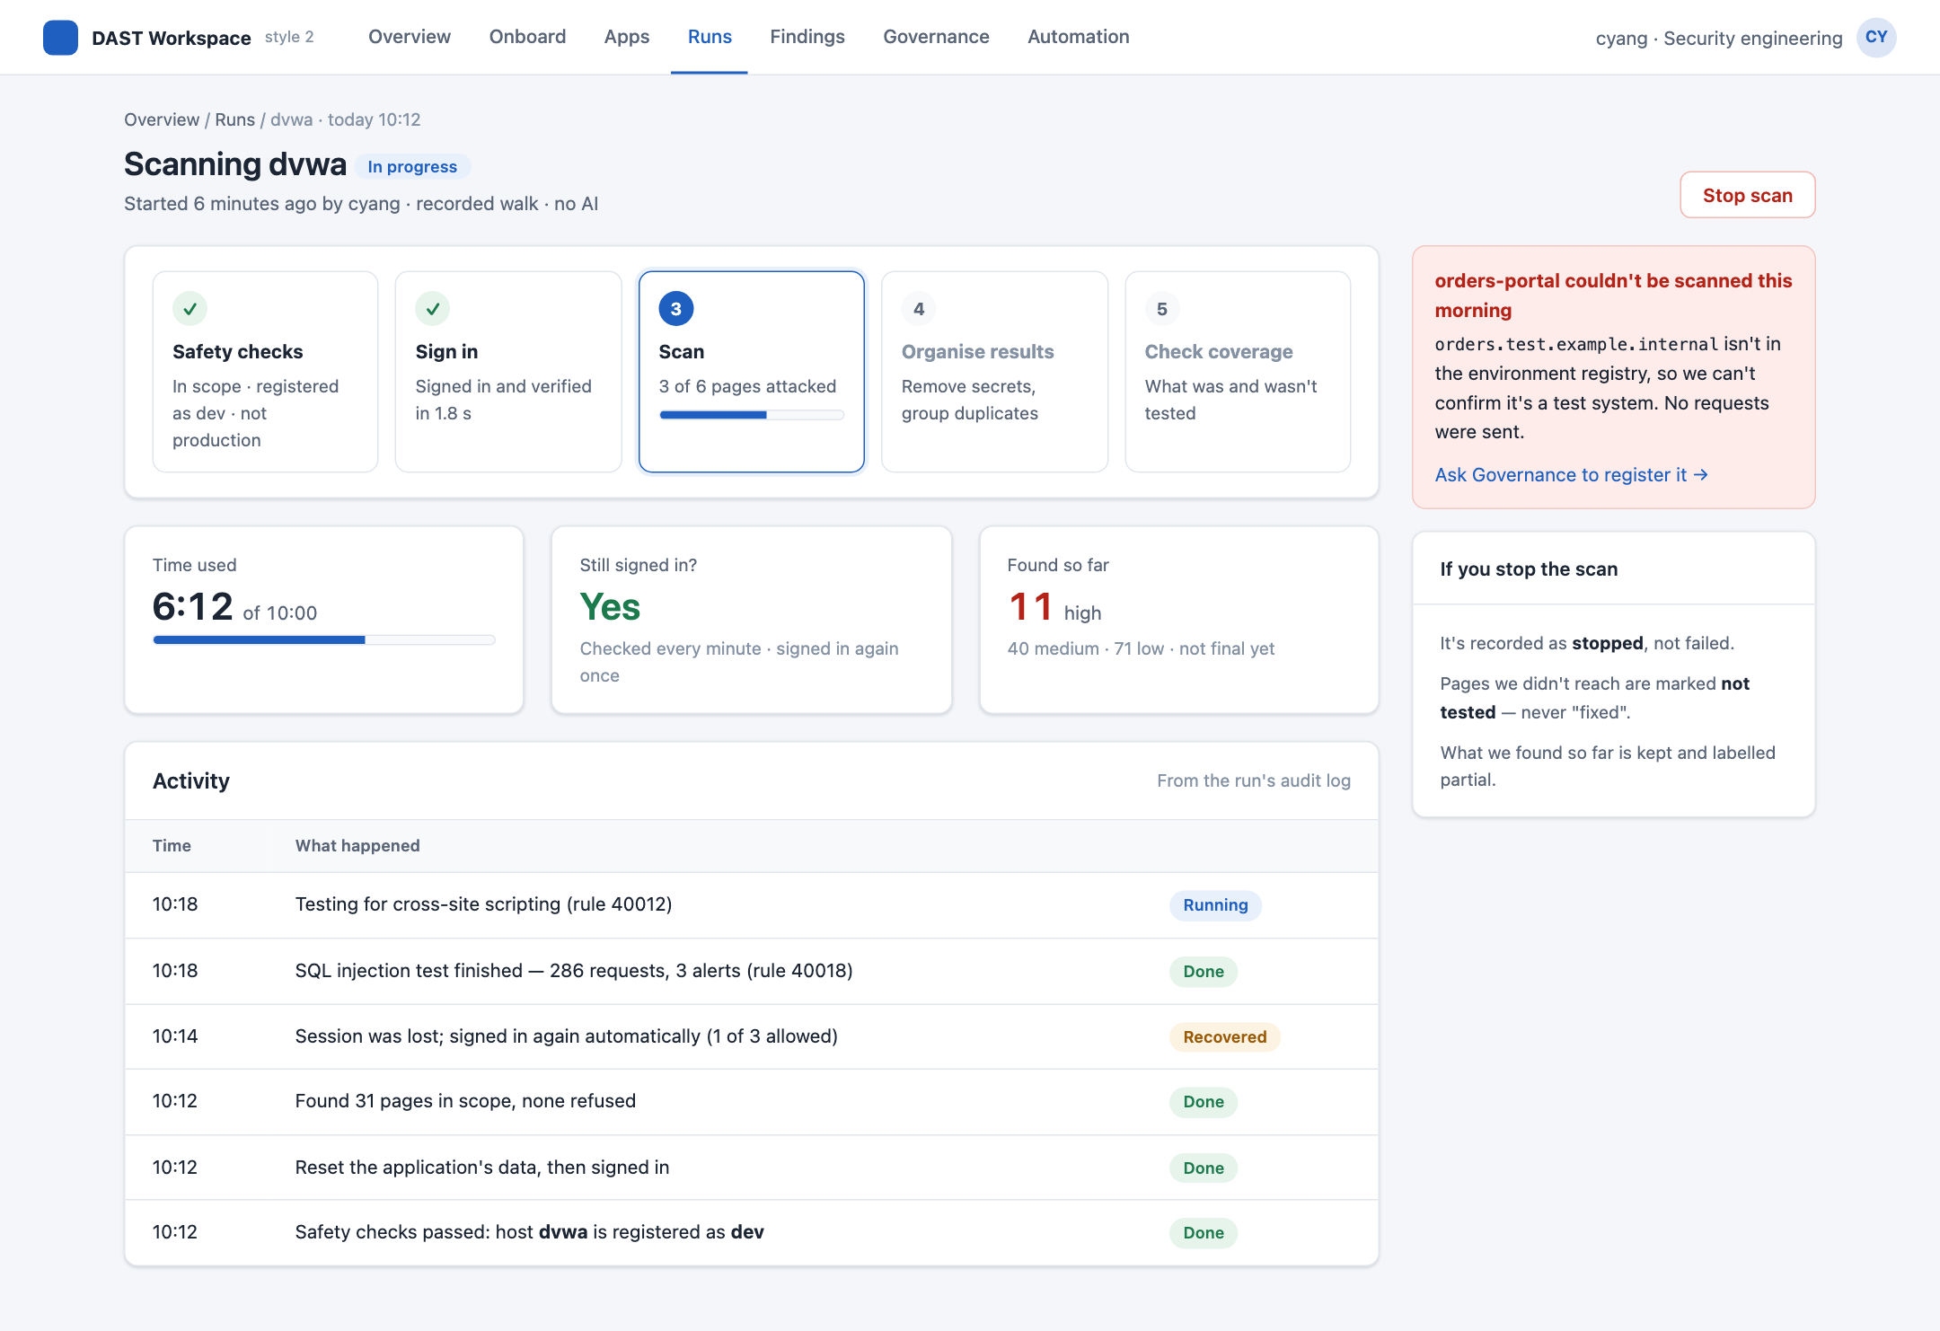
Style 2 · Run progress
Persona
SEC
What it shows
Five live stages, session health, and a safe stop that never marks untested pages as fixed. A refusal is explained in one sentence, with the fix.
Requirements
UI-7, 8

Slide 22
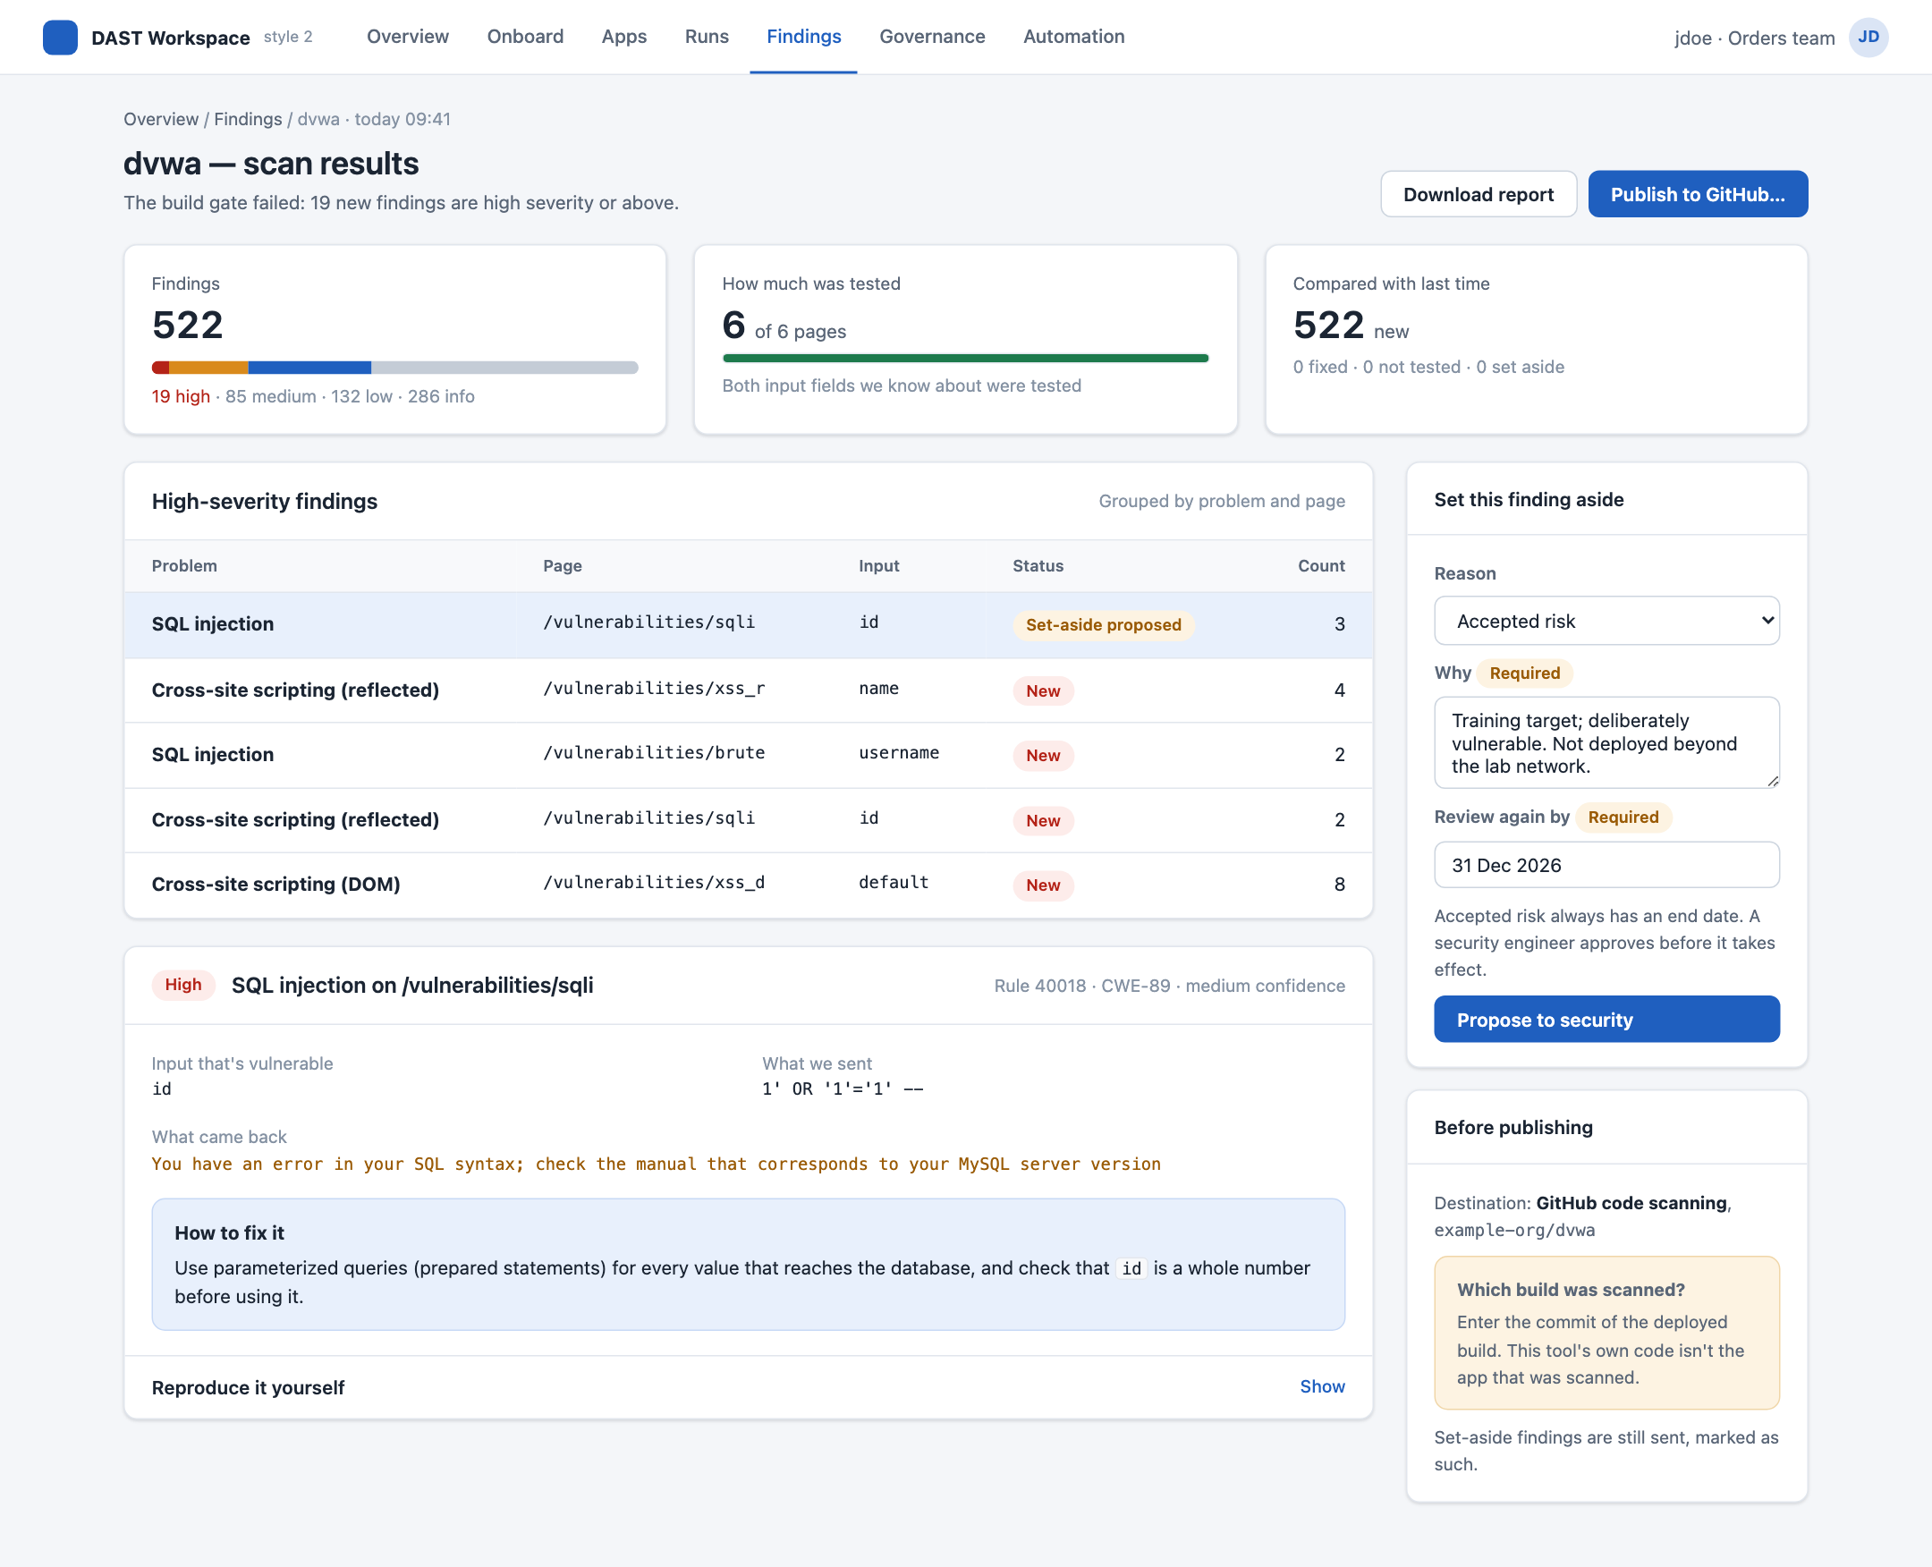
Style 2 · Results and triage
Persona
SEC · DEV
What it shows
Coverage with a denominator, one SQL injection explained end to end, triage that needs a reason and an expiry, and publishing blocked until the deployed commit is known.
Requirements
UI-9 to 12

Slide 23
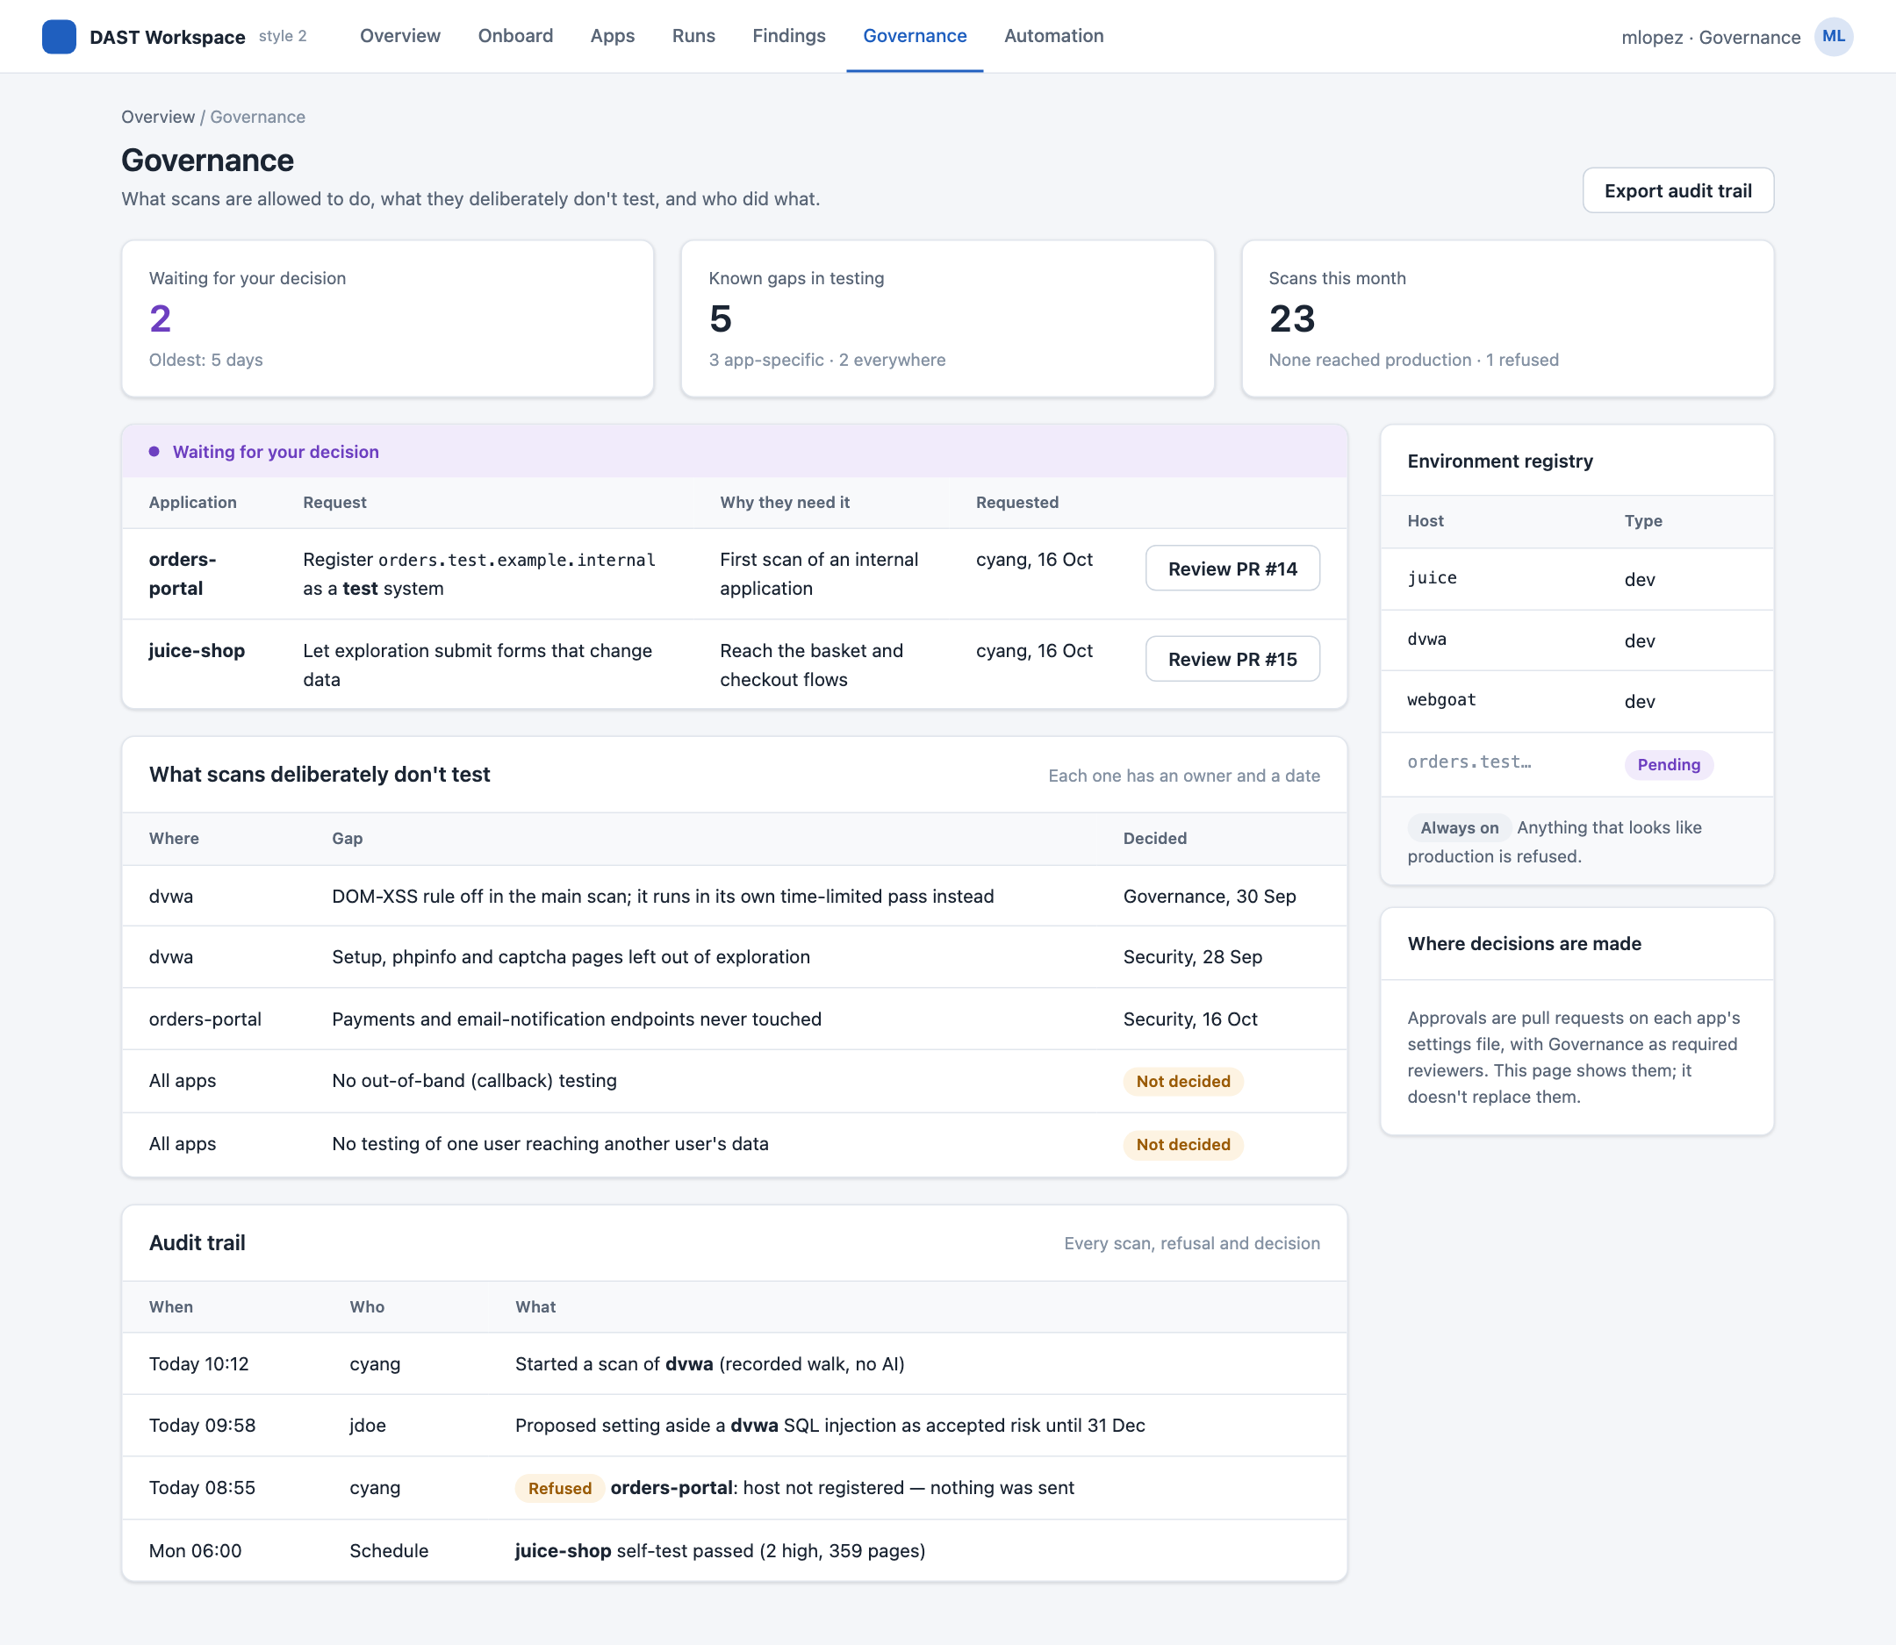
Style 2 · Governance
Persona
GOV
What it shows
Pending approvals as pull requests, what scans deliberately don't test, the environment registry and the audit trail.
Requirements
UI-13

Slide 24
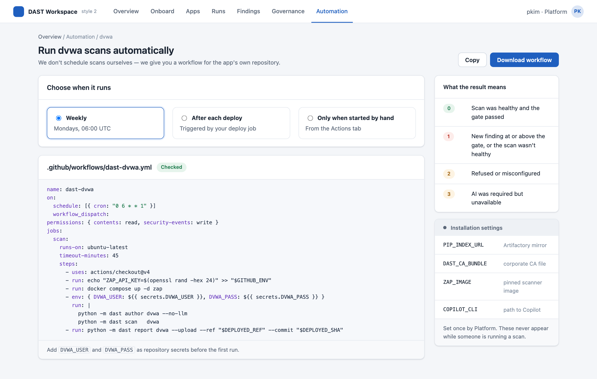
Style 2 · Export to CI
Persona
OPS
What it shows
A ready workflow for the app's repository, what each result means, and installation settings kept out of the run flow.
Requirements
UI-14

Slide 25
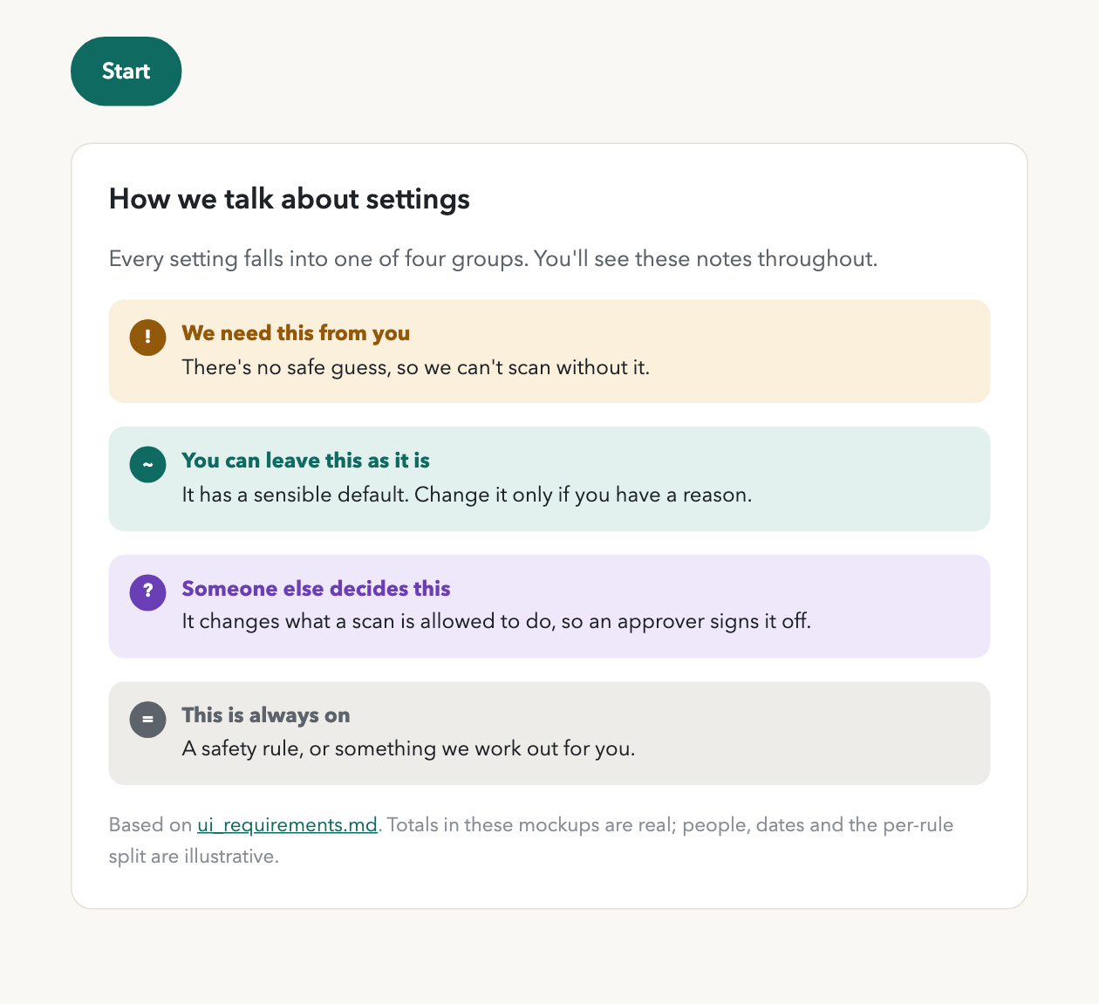
Style 3
Guided flow
One task at a time, large type, plain language. Tiers explained in sentences.
Fits best if app teams run scans themselves.

Slide 26
Style 3 · Overview
Persona
All
What it shows
Where each persona starts: recent runs, what's waiting, and the four tiers explained.
Requirements
—
The page is shown in two halves, top on the left.

Slide 27
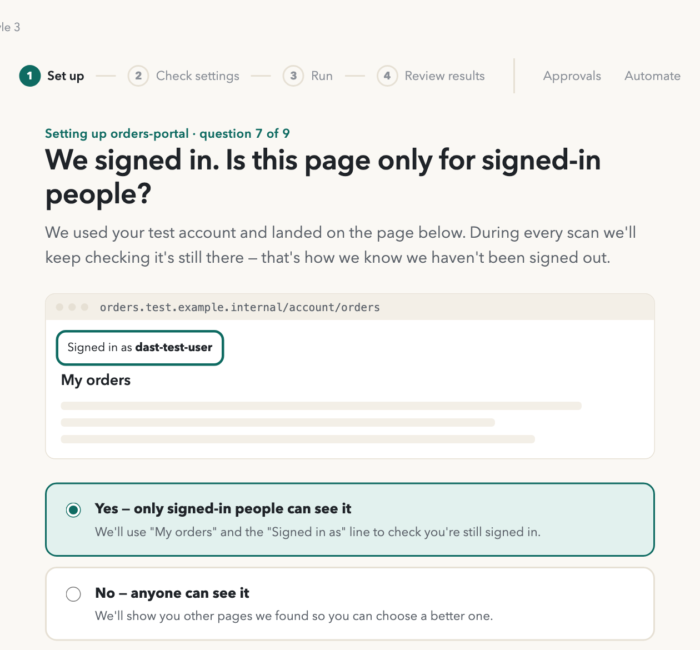
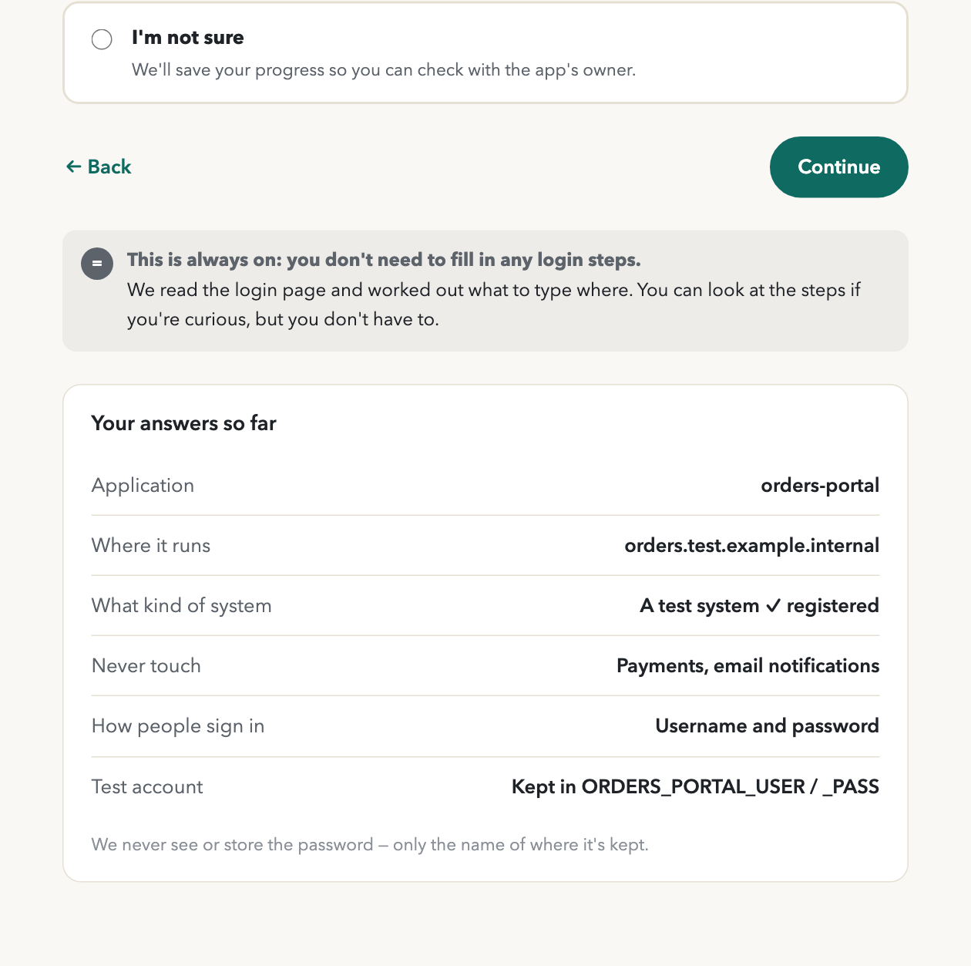
Style 3 · Onboard an app
Persona
SEC
What it shows
Only the must-ask questions. The tool reads the login page, signs in with the test account, and asks one thing: does this page only show when you're signed in?
Requirements
UI-3, 4, 5
The page is shown in two halves, top on the left.

Slide 28
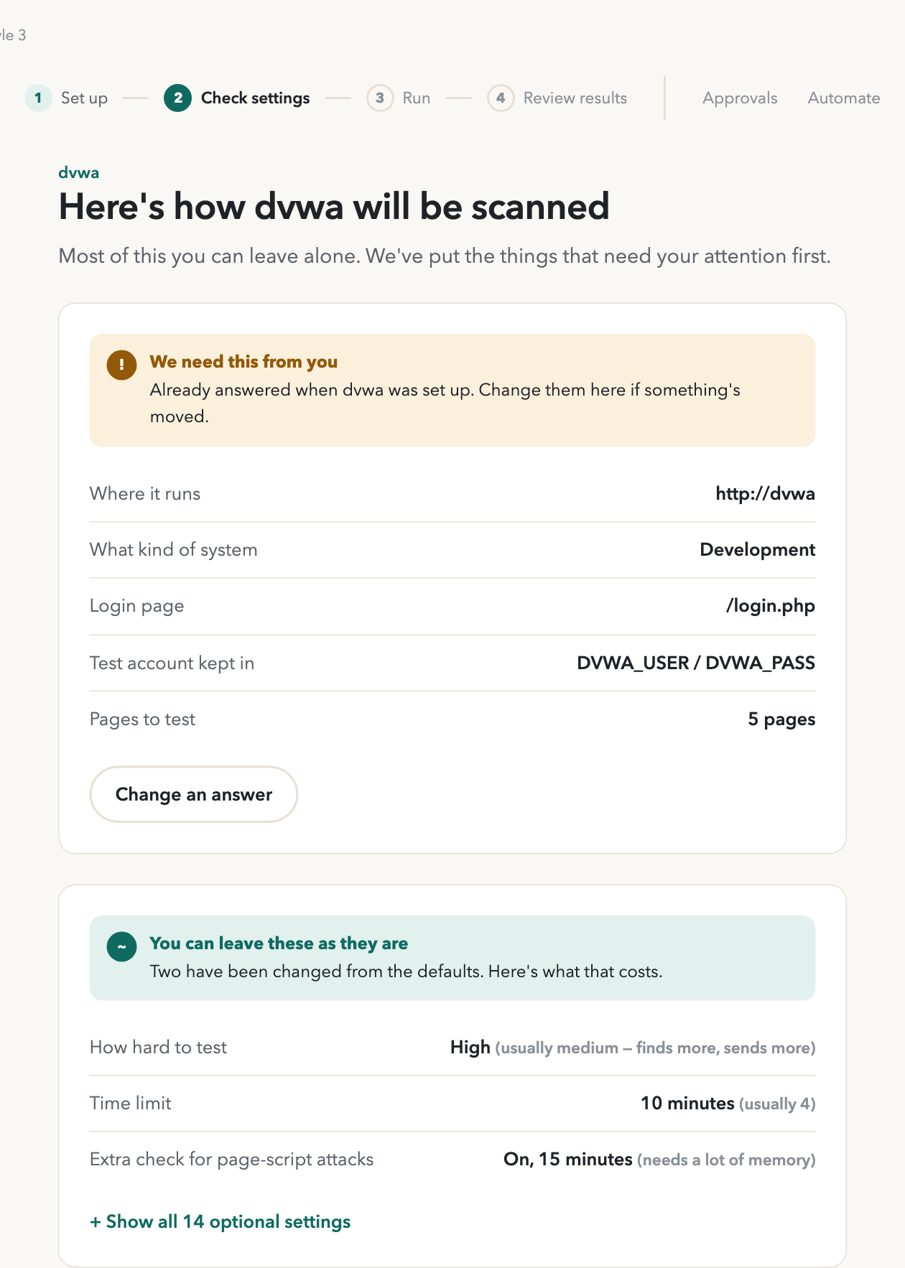
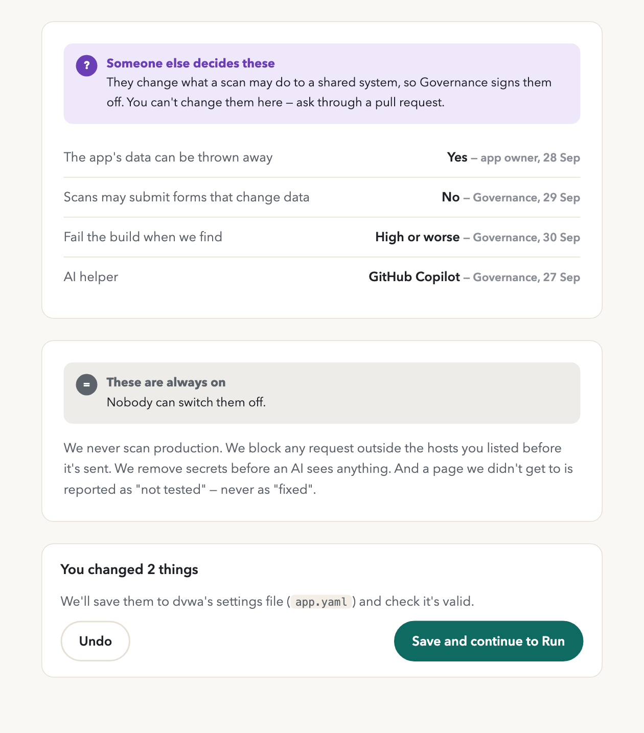
Style 3 · App settings
Persona
SEC
What it shows
All four tiers on one page: required answers, optional settings with their cost, approvals read-only with who decided, and the safety rules. Changes show as a diff before saving.
Requirements
UI-1, 2, 6, 15
The page is shown in two halves, top on the left.

Slide 29
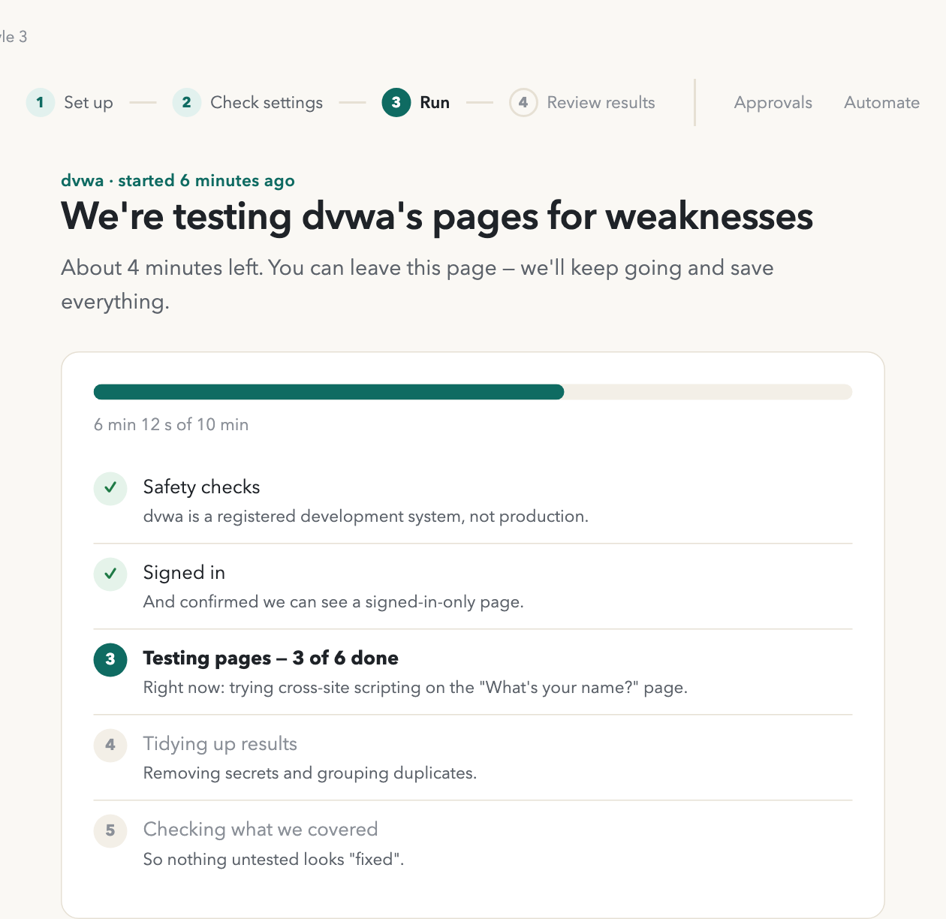
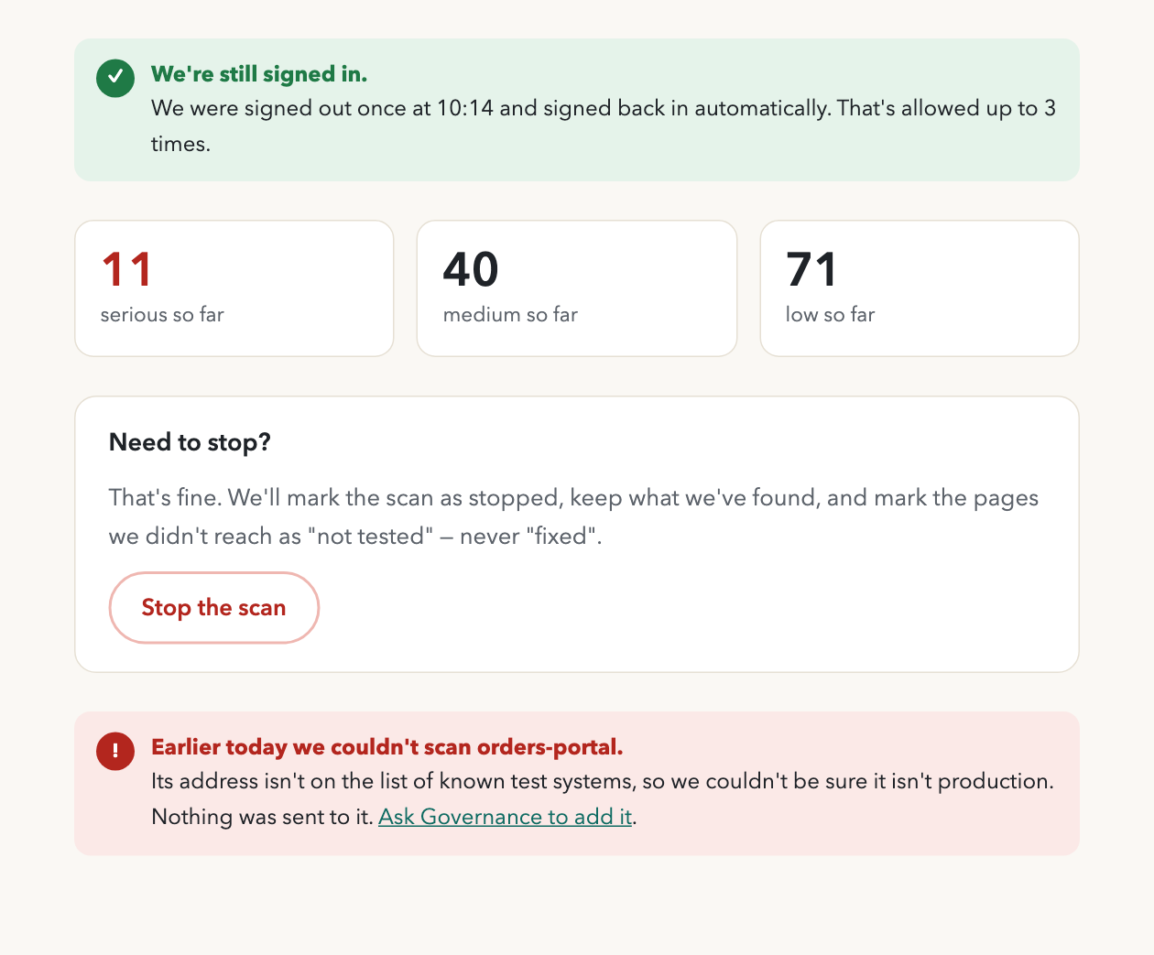
Style 3 · Run progress
Persona
SEC
What it shows
Five live stages, session health, and a safe stop that never marks untested pages as fixed. A refusal is explained in one sentence, with the fix.
Requirements
UI-7, 8
The page is shown in two halves, top on the left.

Slide 30
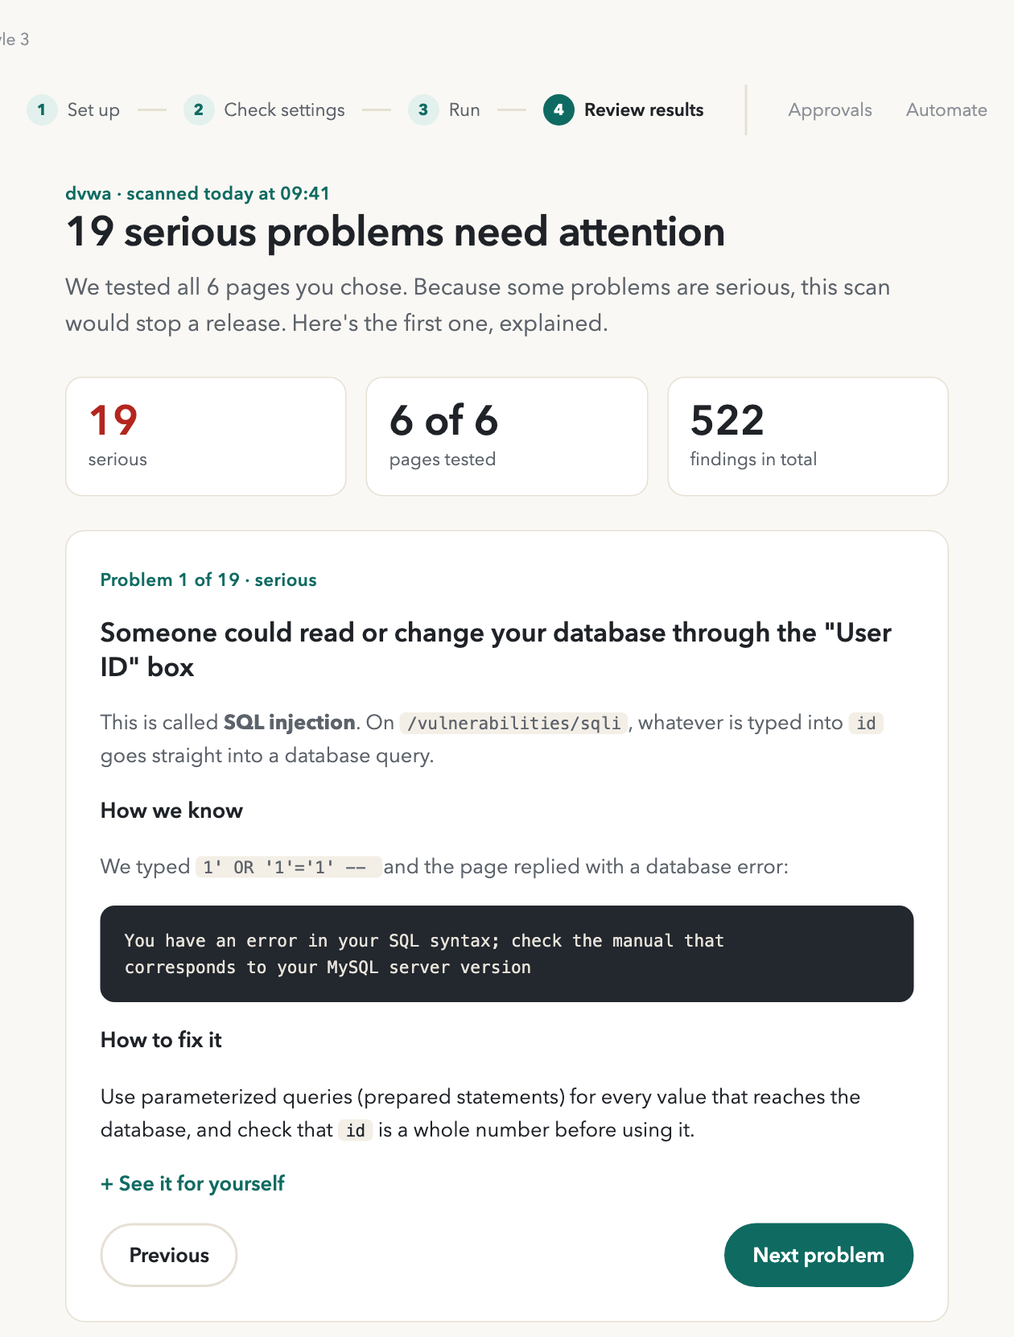
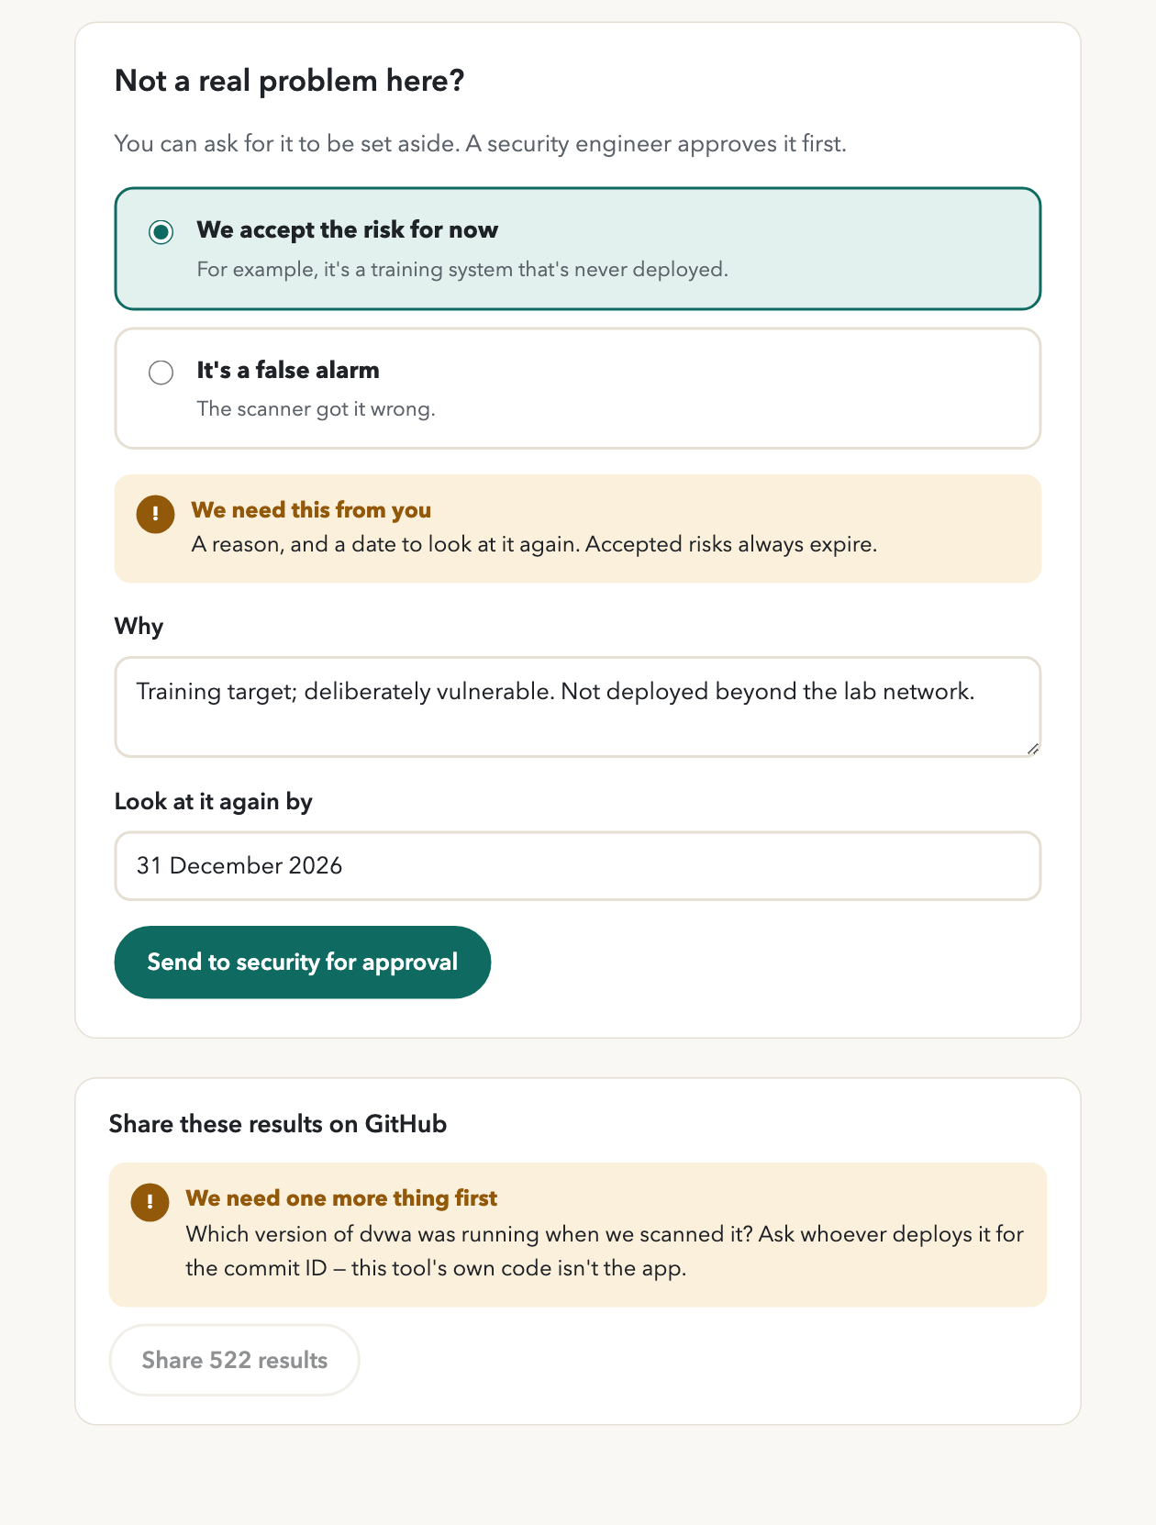
Style 3 · Results and triage
Persona
SEC · DEV
What it shows
Coverage with a denominator, one SQL injection explained end to end, triage that needs a reason and an expiry, and publishing blocked until the deployed commit is known.
Requirements
UI-9 to 12
The page is shown in two halves, top on the left.

Slide 31
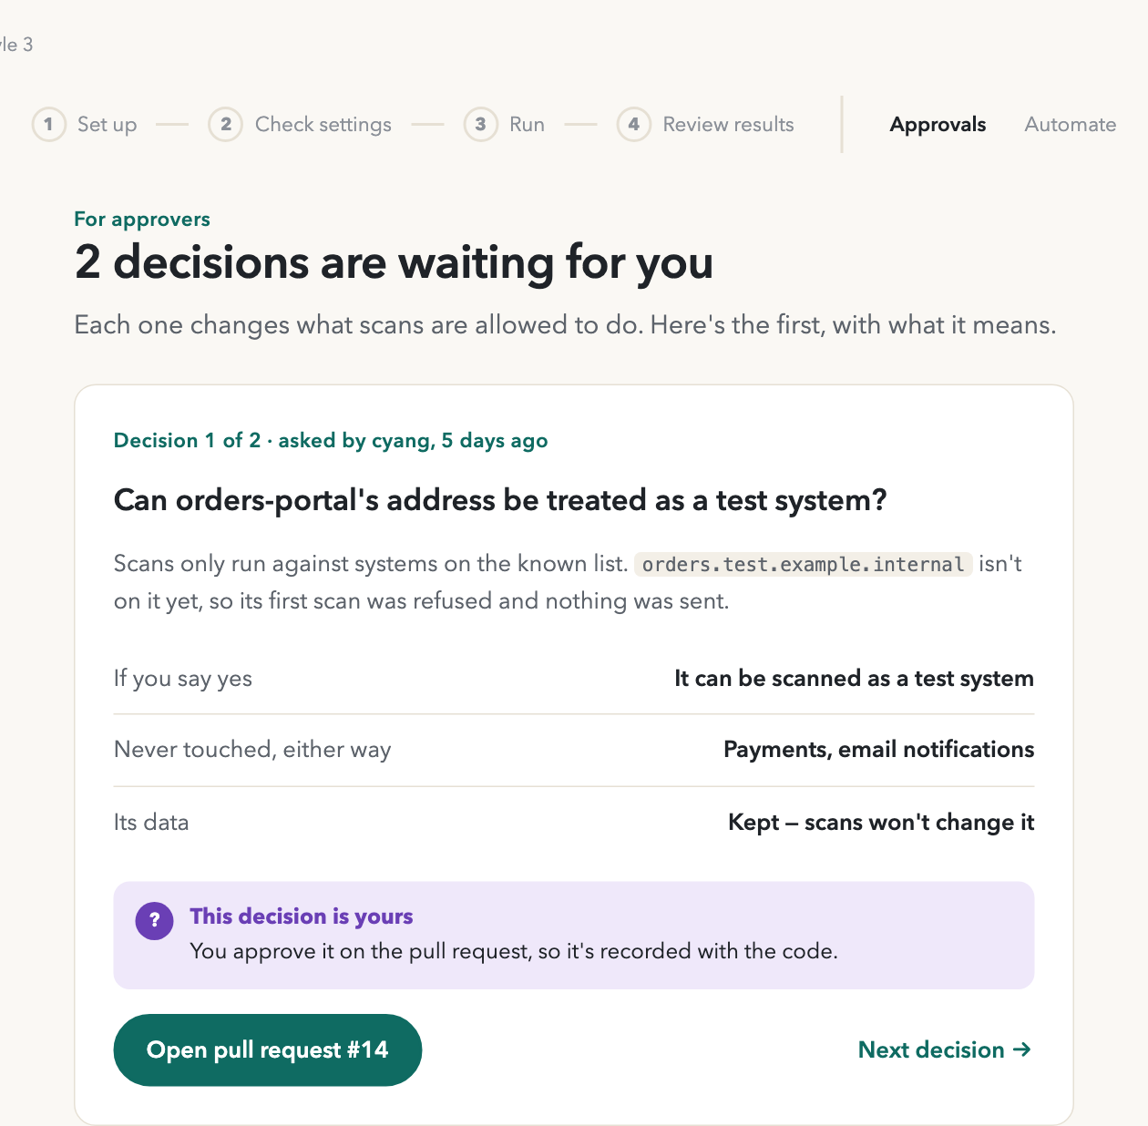
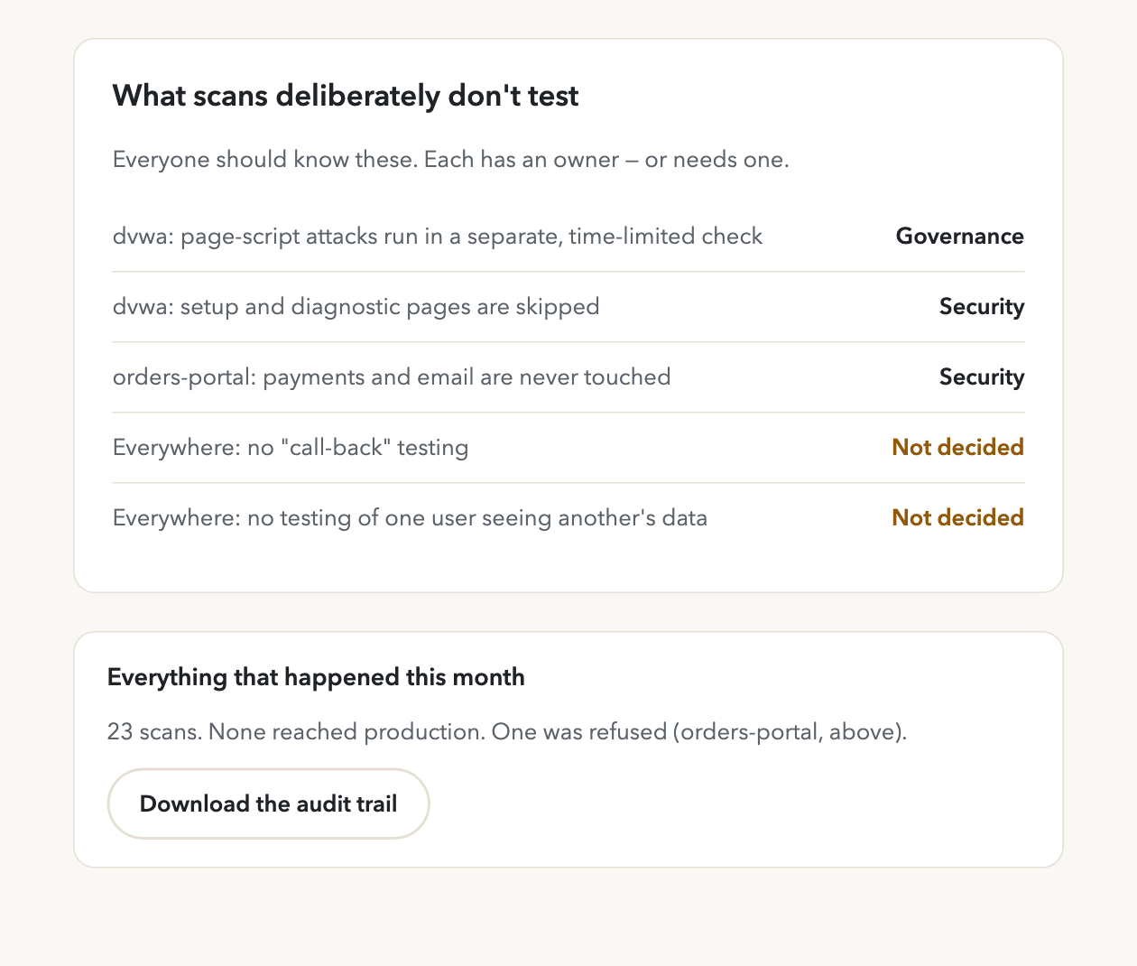
Style 3 · Governance
Persona
GOV
What it shows
Pending approvals as pull requests, what scans deliberately don't test, the environment registry and the audit trail.
Requirements
UI-13
The page is shown in two halves, top on the left.

Slide 32
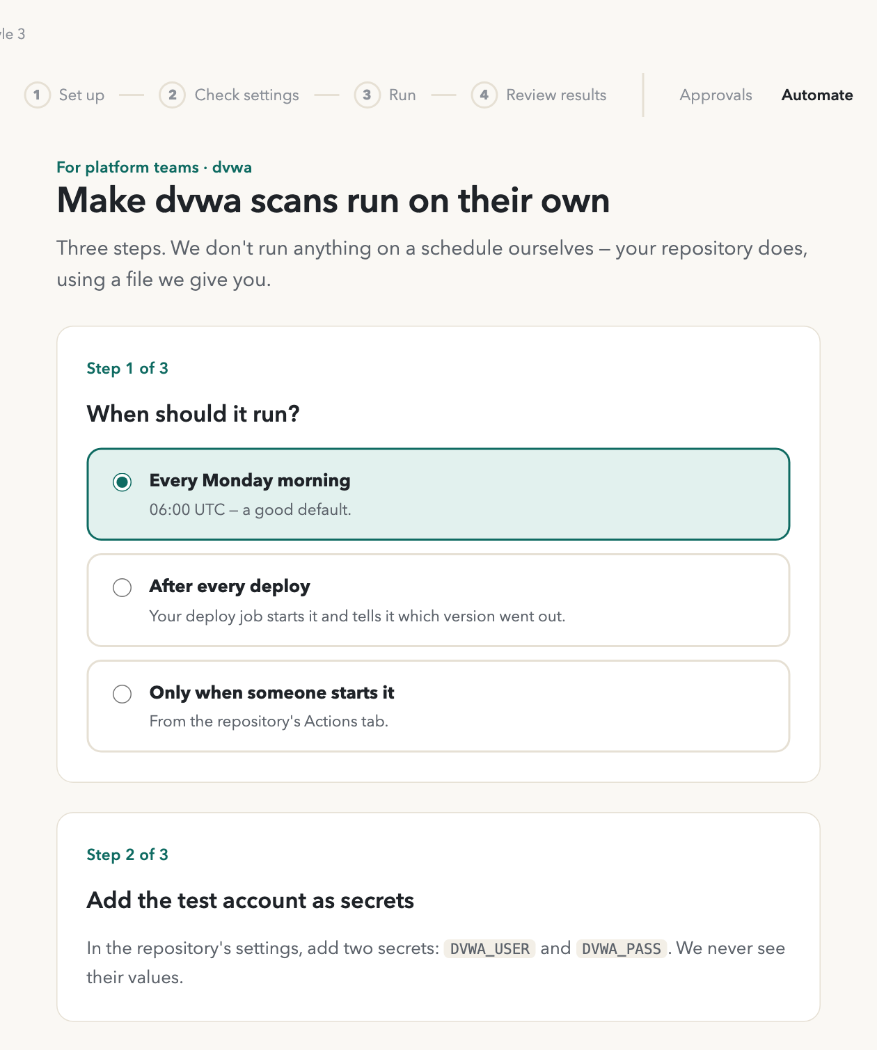
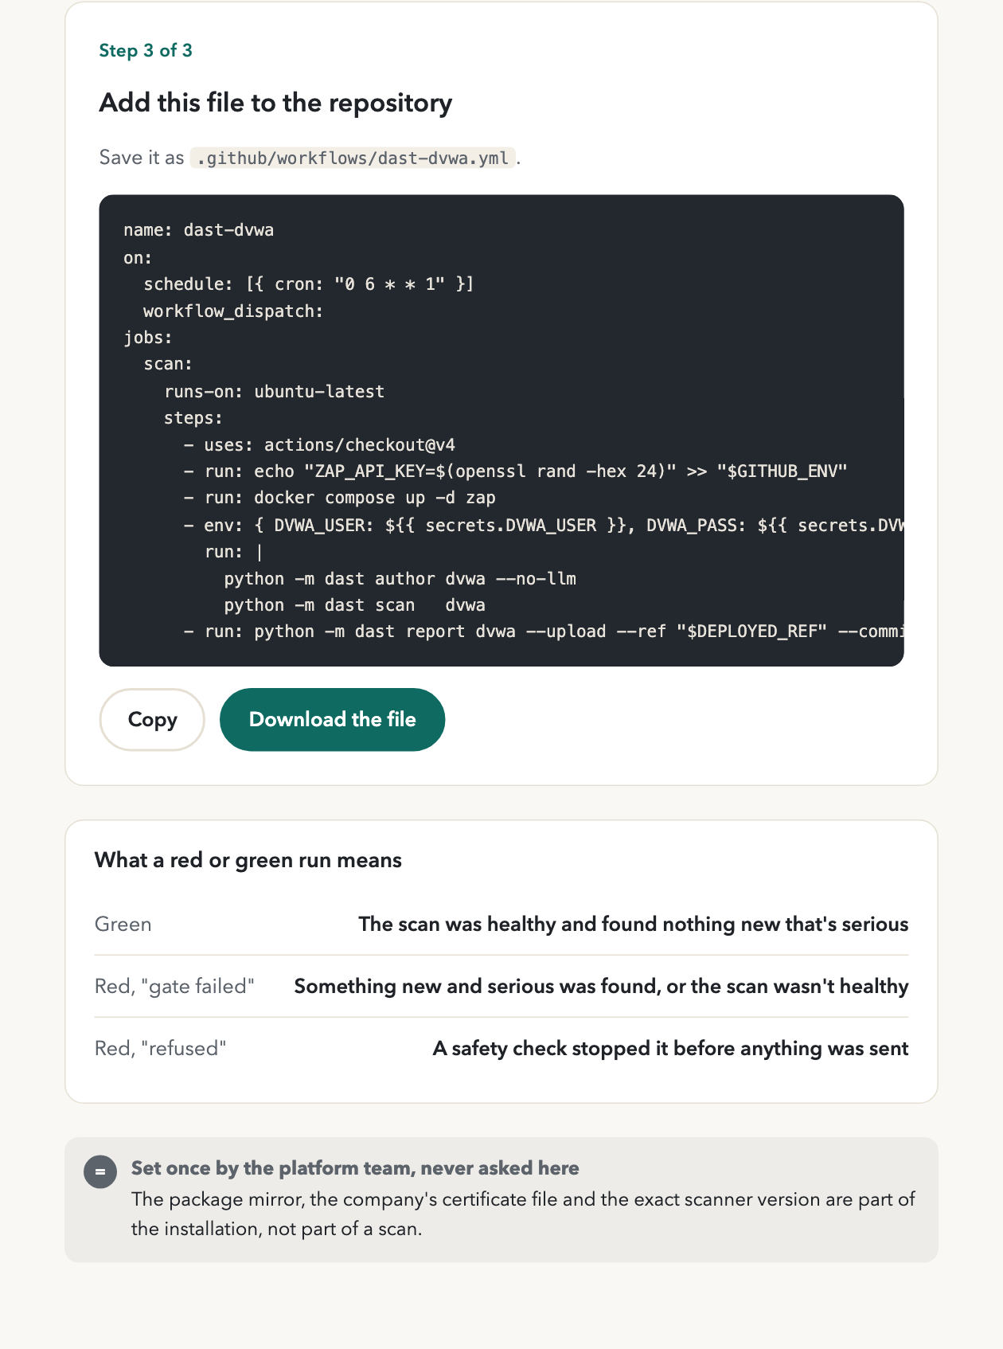
Style 3 · Export to CI
Persona
OPS
What it shows
A ready workflow for the app's repository, what each result means, and installation settings kept out of the run flow.
Requirements
UI-14
The page is shown in two halves, top on the left.

Slide 33
Decision needed: who is the primary user?
If the answer is
If the answer is
If the answer is
Security engineers run scans for app teams
A mix of teams, using it occasionally
App teams run scans themselves
1
Style 1 · Operator console
Dense, fast, every tier visible as a badge.
2
Style 2 · Enterprise workspace
Calm cards, a help panel, readable by approvers and developers.
3
Style 3 · Guided flow
One question at a time; tiers become plain sentences.
Then: answer Q2–Q4, settle W4-8 and the scan postures, and refine the chosen style against those answers. Mockups and requirements live in docs/ui-docs/.

