Slide 1
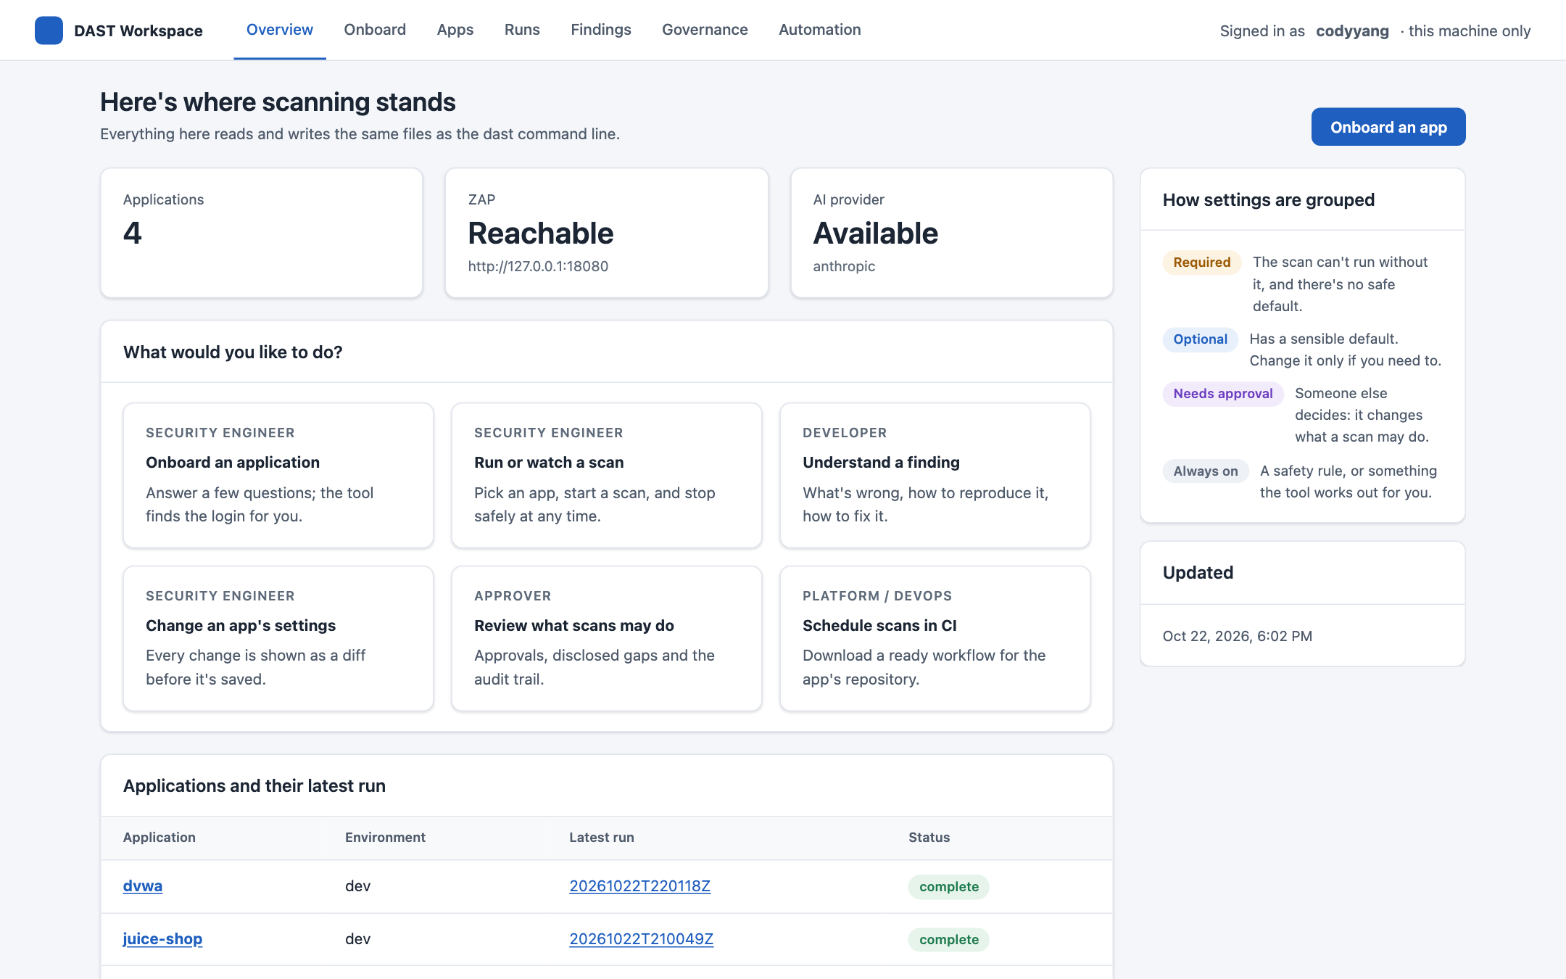
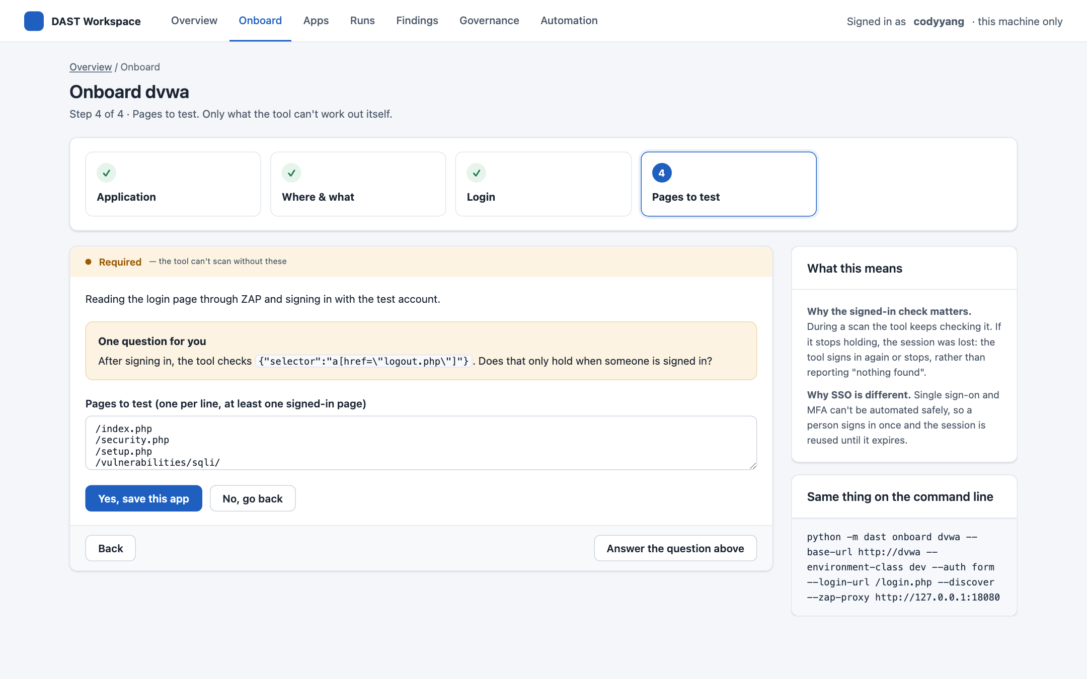
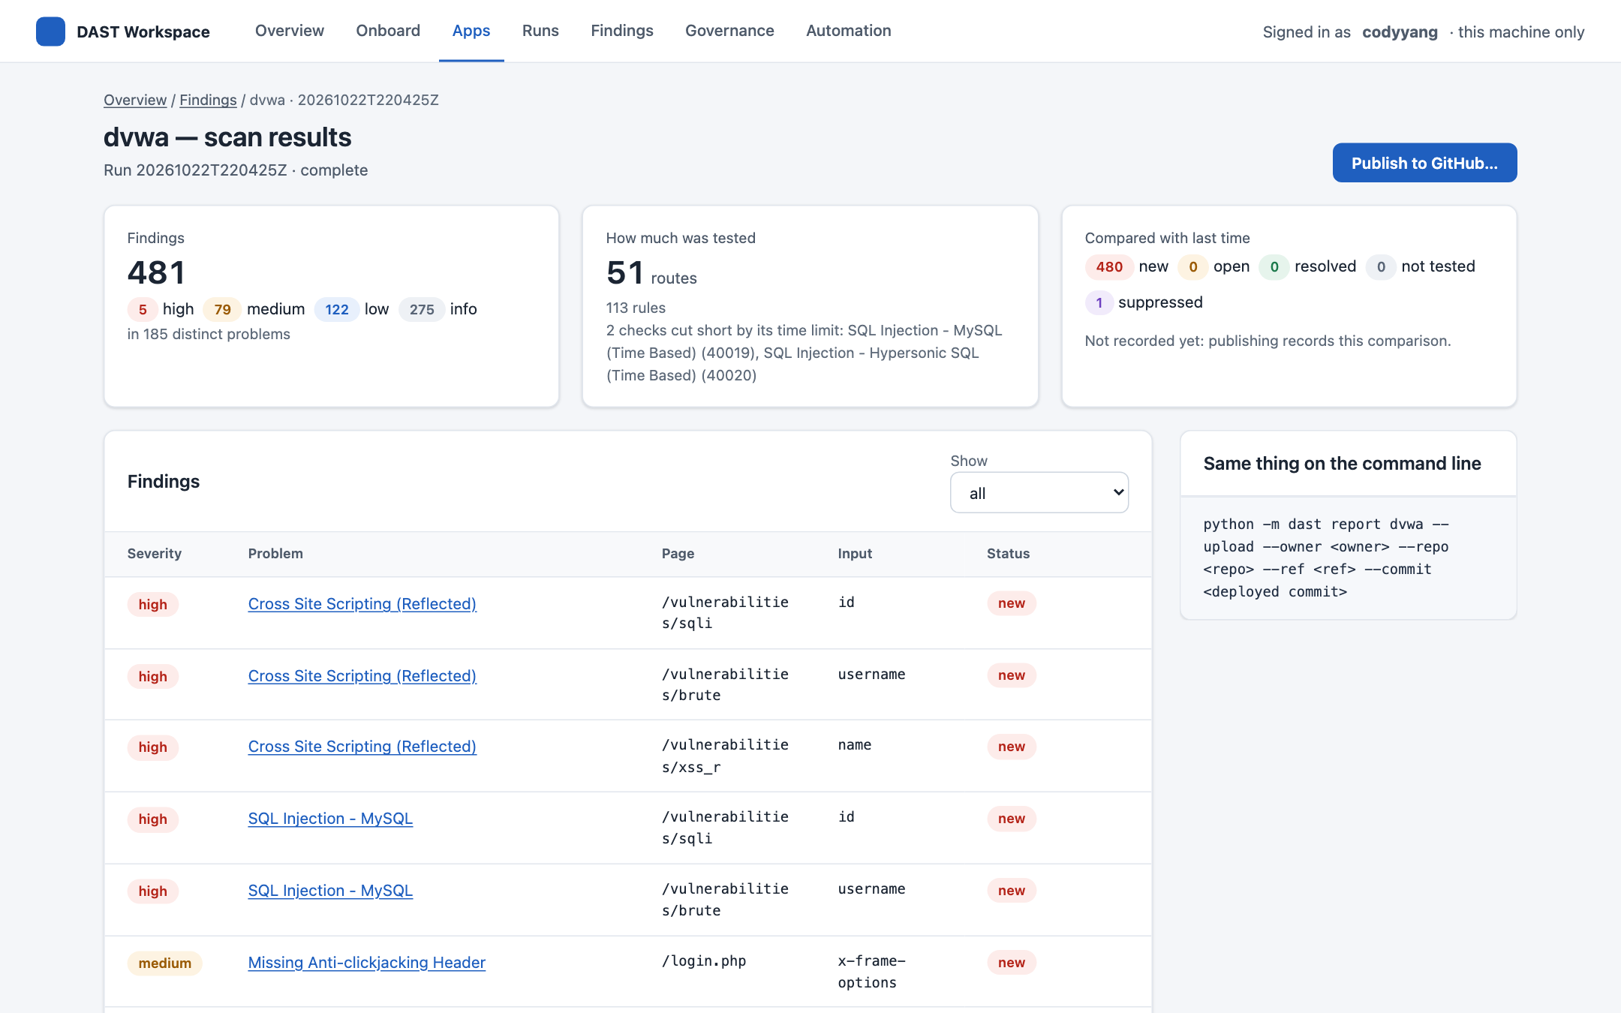
The DAST UI: built, tested and in use
Progress since the requirements-and-mockups deck of 21 October
Overview
Onboarding a new app
Real results: DVWA
Notes:
The last deck asked for decisions on a UI that existed only as three sets of mockups. Every screenshot in this one is the working UI, captured on 22 October; the DVWA screens are from a real onboarding and scan of an app that wasn't configured before the run.

Slide 2
Since the last deck: from three mockups to a working tool
21 October · the last deck
22 October · today
Requirements: ~120 settings, four personas, four tiers
Three mockup styles of the same seven screens
Five open questions and one decision needed
No UI code yet
A working web UI in style 2: ten screens over the real dast commands
Built test-first, against acceptance tests frozen before the code
Tested by hand: a 67-step QA run and the demo preparation found 14 issues; all 14 are fixed
A new app taken from nothing to real findings through the UI alone
Seven pull requests merged since (#12–#18)
Notes:
One working day separates the two decks. The PRs: #12 the web UI, #13 evidence redaction, #14 status docs, #15 the QA script and findings, #16 eleven QA fixes and the demo, #17 recording a login from the UI, #18 onboarding discovery through ZAP.

Slide 3
In numbers
1,227
41
14 / 14
58 s
automated tests in Python
UI tests
QA issues fixed
new app to first results
including the frozen acceptance tests
17 component + 24 in a real browser, with accessibility checks
from a 67-step manual run and demo prep; each fix tested first
DVWA: onboard, record the login, scan, through the UI
And after tuning two settings, the same DVWA scan found 5 high-severity vulnerabilities: SQL injection and reflected cross-site scripting.
Sources: pytest, vitest and Playwright on main (8b60a21); docs/ui-docs/ui_qa_findings.md; the DVWA run in this deck.
Notes:
58 seconds is from opening Onboard to a finished first scan on DVWA, including 11 seconds of AI discovery and 14 seconds recording the login. The 5 high findings came from the third scan, after two edits explained on the tuning slide.

Slide 4
The open questions, answered
The last deck ended on five questions and one decision. Four are decided and built; the fifth waits on the scan postures.
Notes:
Decisions recorded in docs/ui-docs/ui_requirements.md §8 on 21 October.

Slide 5
Q1–Q4 decided and built; Q5 waits on the scan postures
Question
Decision
What's built
Q1
Who is the primary user?
Everyone, in style 2
One UI for all four personas. Optional settings stay under Advanced; approvals are read-only.
Q2
Local tool or shared service?
Local first, ready to share
Loopback only, one-time sign-in link, CSRF on every change; every action records who did it.
Q3
Where do approvals happen?
Designed for pull-request review
Approval settings show read-only with the git author and date (checked against the real configs).
Q4
Does DEV use the UI?
Yes: triage happens only there
Propose → approve, with a reason and a review date; an expired set-aside counts again.
Q5
Which settings are approvals?
Pending: scan postures SP-1…SP-7
Until each is decided its settings stay approval-only, the safe default (docs/decisions_needed.md).
Notes:
Q3: tier C settings show who approved and when, read from git blame of app.yaml; QA step G7 checked this against the real configs. Q4's follow-up (importing dismissals made in GitHub) is still to be retired or turned into a proposal.

Slide 6
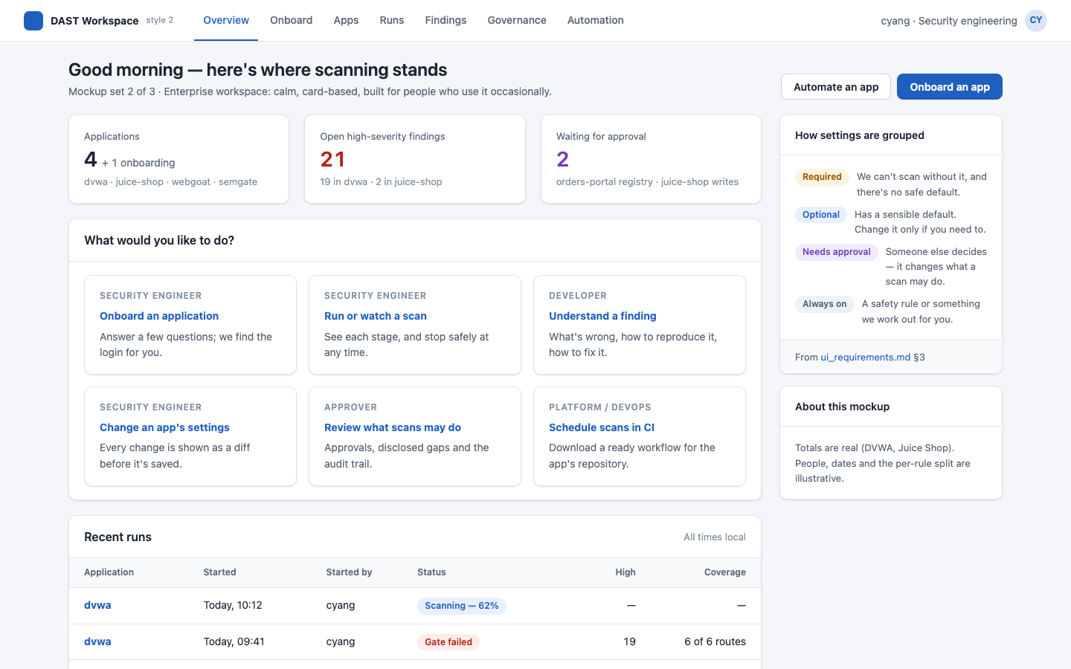
The decision asked for: style 2, now built
Mockup, 21 October
Built, 22 October
Light, card-based, with top navigation and a help panel: the same frame for all four personas.
Notes:
The overview on the right is the demo workspace after the DVWA run: ZAP reachable, the AI provider available, four apps.

Slide 7
The three rules held
1
2
3
The config file stays the source of truth
A front end to the dast commands
Never more permissive than the CLI
Every save is a diff of app.yaml, shown before it's written, with comments kept. Tuning DVWA took one UI edit and one line in the file: both plain YAML, reviewable in a pull request.
Every screen shows the same thing on the command line, and a browser test checks it. Jobs run onboard, author, scan and report: the UI adds no scanning logic of its own.
Guardrails stay in the core. Production and unregistered hosts are refused before any traffic, by the same check the command line uses; the UI shows the refusal and its fix.
Notes:
These were the three rules the last deck set for the UI. The evidence for each is in this deck: the DVWA settings diff on the tuning slide, the command-line panel on every screenshot, and the refusals on the guardrails slide.

Slide 8
What sorting the settings revealed is now in the product
1
The hardest part became one question
2
Installation settings stay out of the run
AI discovery found DVWA's login and a verified signed-in check in 11 seconds. The person answers yes or no.
The ZAP key, AI key and GitHub token come from the shell. The UI shows only whether each is set, by name.
3
“AI on” never pretends
4
The fail threshold belongs to Governance
With no AI provider, onboarding says so and saves a starting point instead of a guessed login.
gate.fail_on is an approval setting: read-only in the UI, with who approved it and when.
Notes:
These were the four findings of the last deck's slide 5. Each is now behaviour you can see in the UI.

Slide 9
From mockup to working screen
The style 2 mockups beside the same screens in the working UI. The built screenshots are from the DVWA run later in this deck.
Notes:
Mockups: docs/ui-docs/style-2. They are cropped to the same 16:10 window as the real screenshots.

Slide 10
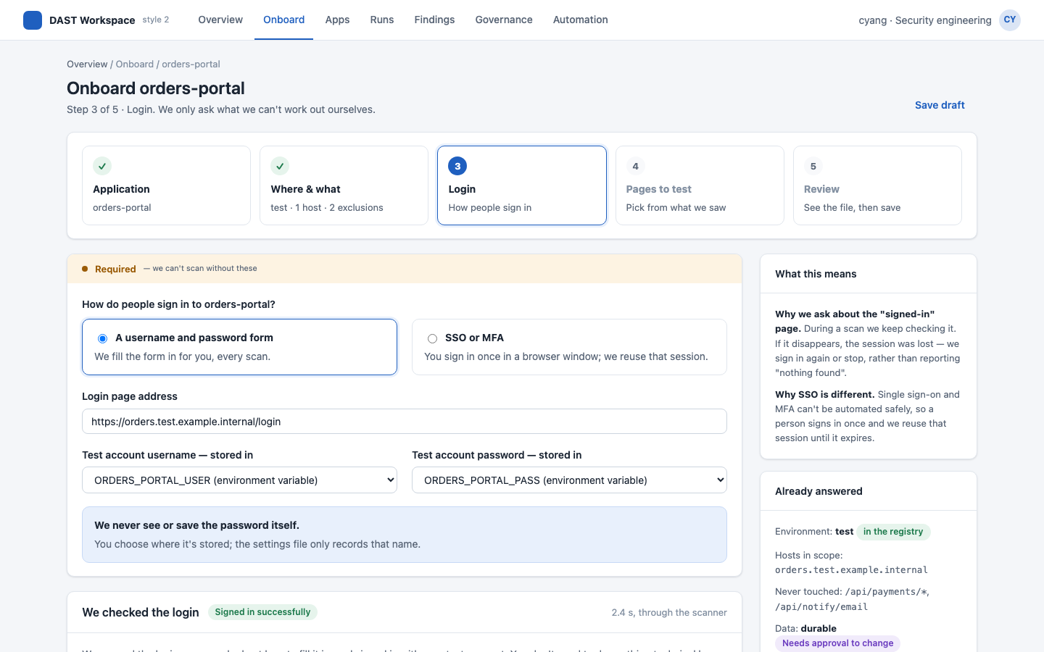
Onboarding: only what the tool can't work out
Mockup, 21 October
Built, 22 October
As designed: four steps and one question about the signed-in check. Built adds discovery through ZAP and the command-line equivalent.
Notes:
On the right, discovery has just found DVWA's login; the person confirms the check and reviews the pages it proposes.

Slide 11
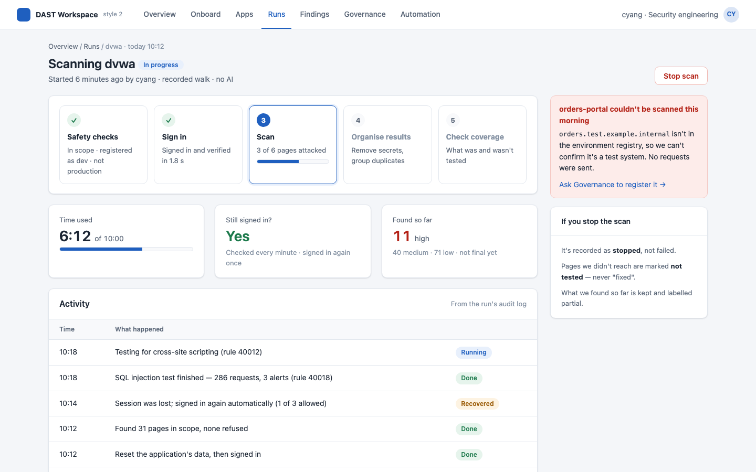
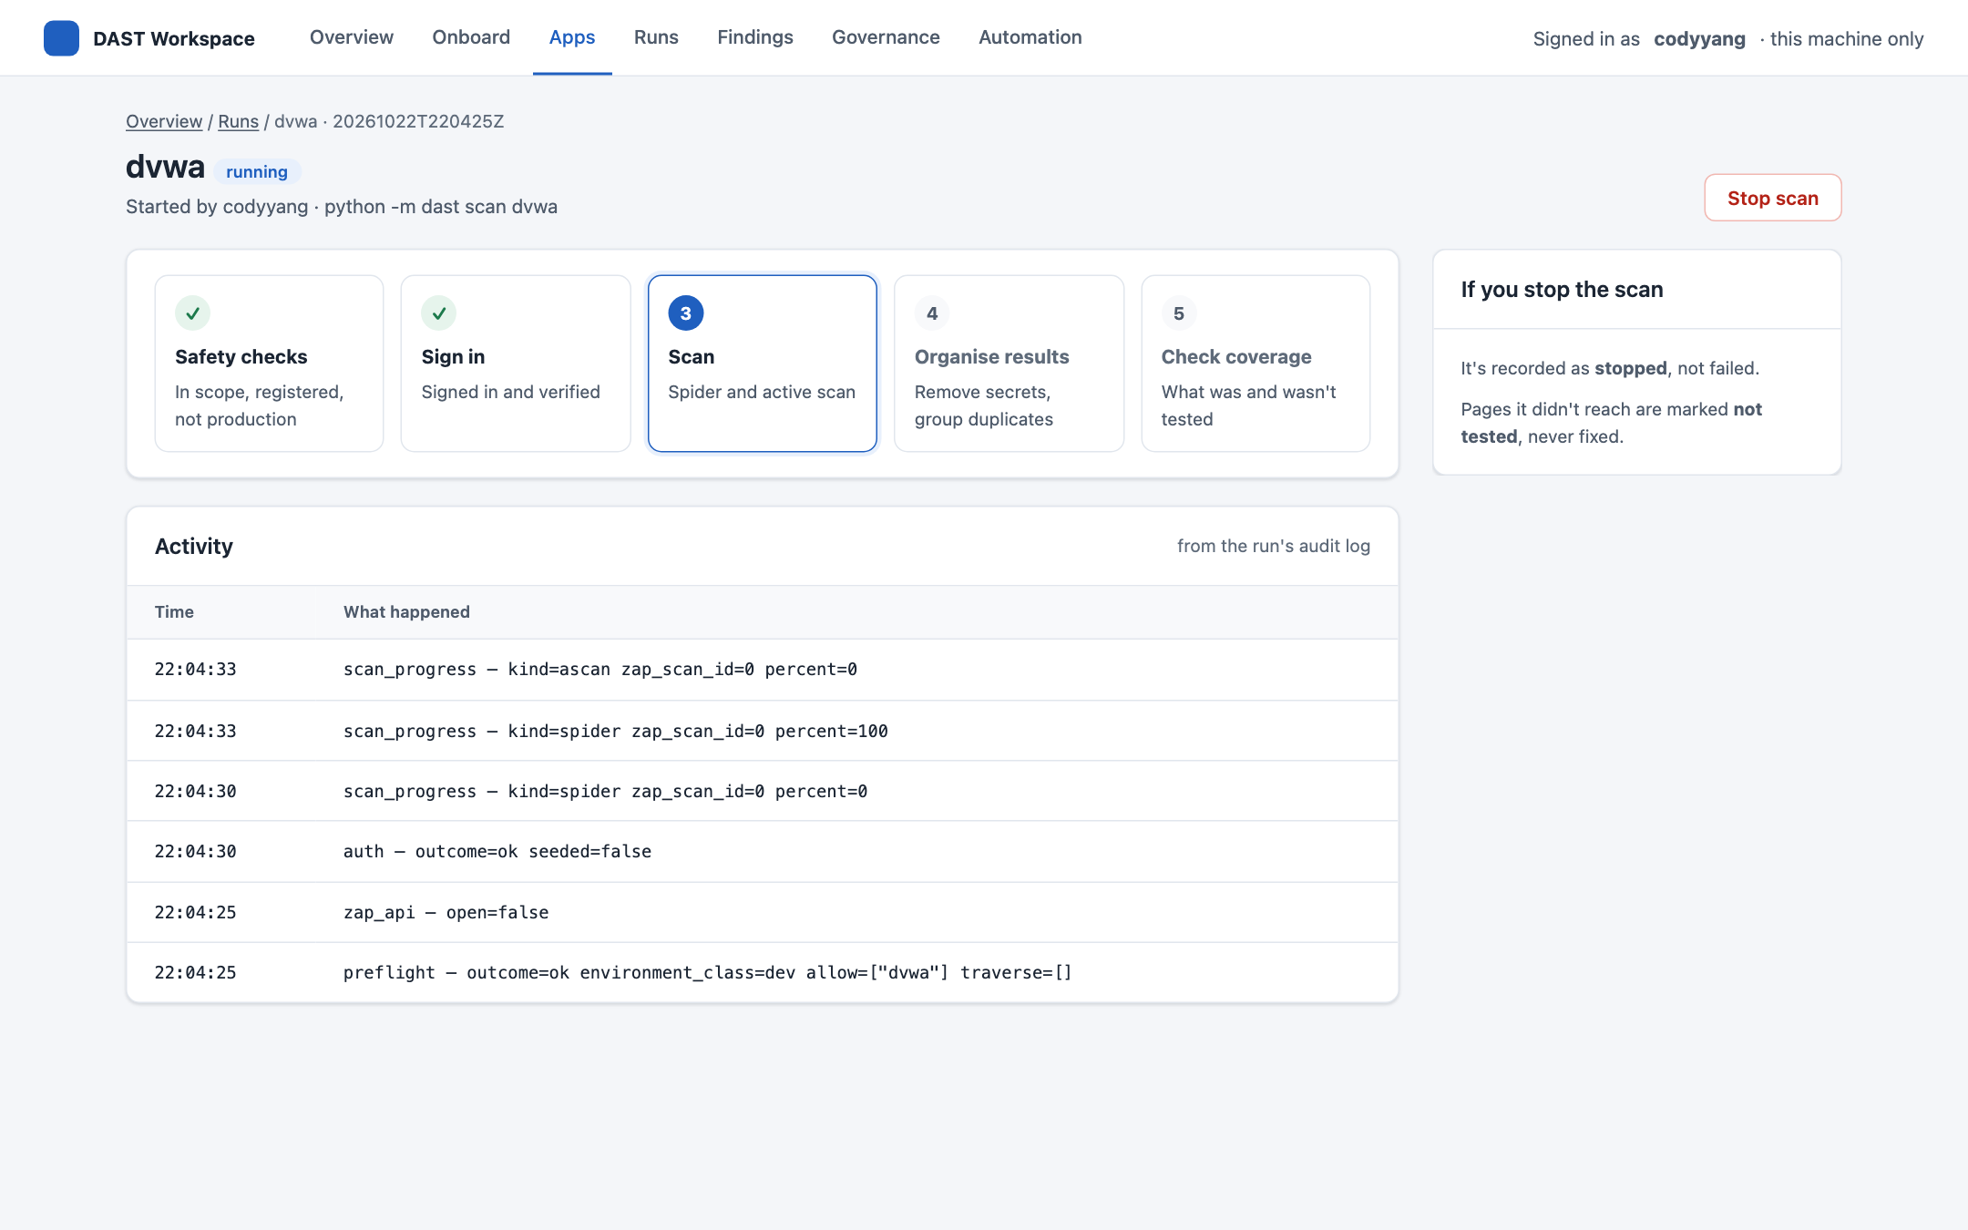
Run progress: five live stages and a safe stop
Mockup, 21 October
Built, 22 October
Safety checks, sign in, scan, organise, coverage. A stopped scan is “stopped”, never “fixed”; the activity comes from the run's own audit log.
Notes:
The built screenshot is DVWA's third scan, a minute in.

Slide 12
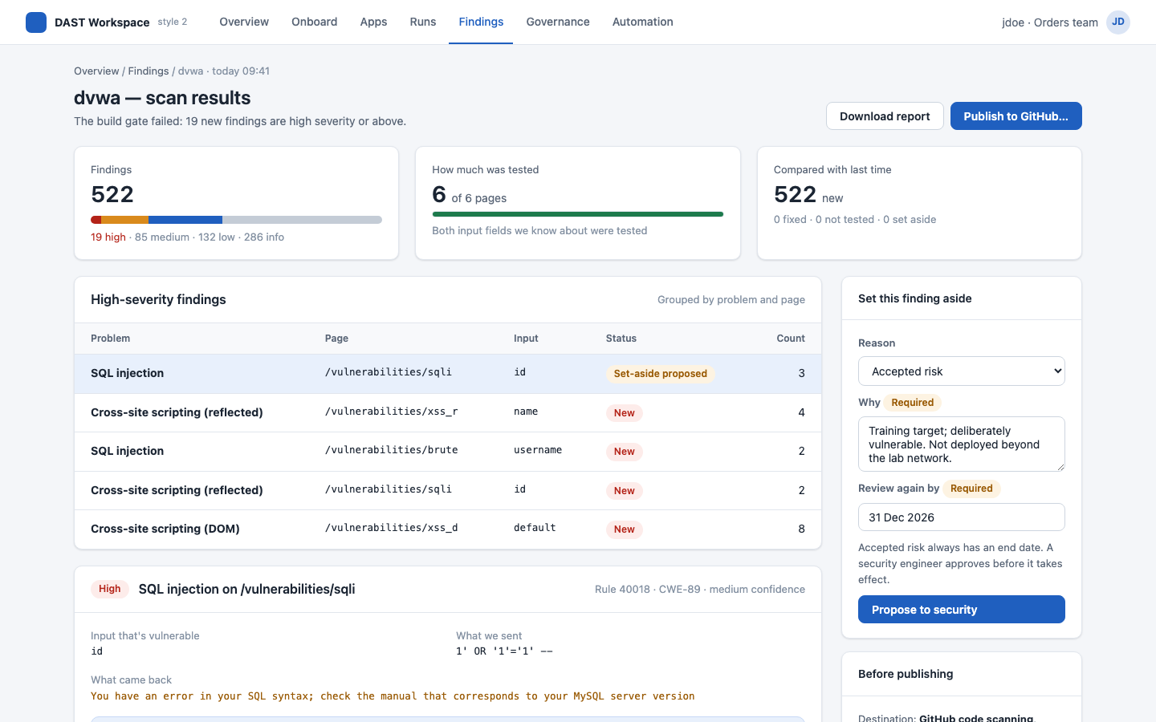
Results: the mockup imagined DVWA; this is DVWA
Mockup, 21 October
Built, 22 October
The mockup's numbers were invented. The built page's are a real scan: 481 findings, 5 high, coverage and cut-short checks named.
Notes:
Both screens are DVWA results. The mockup grouped by problem with a count; the built page groups copies too (×N) and keeps every finding one click from its detail.

Slide 13
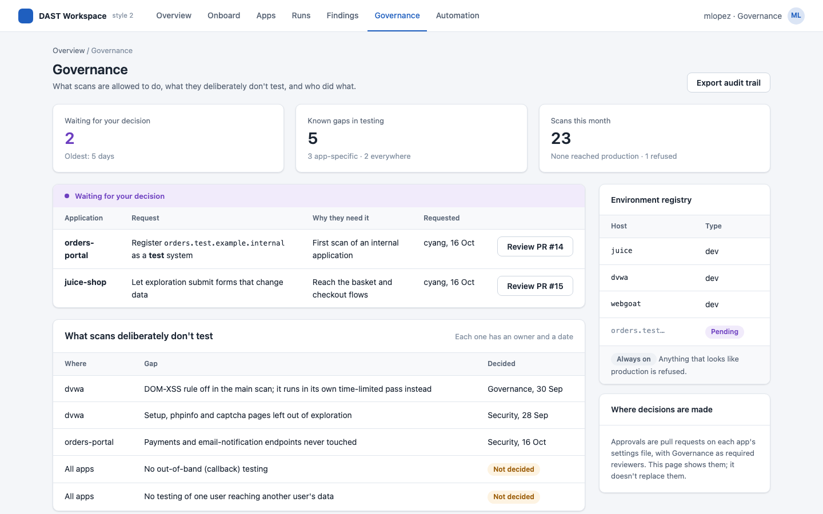
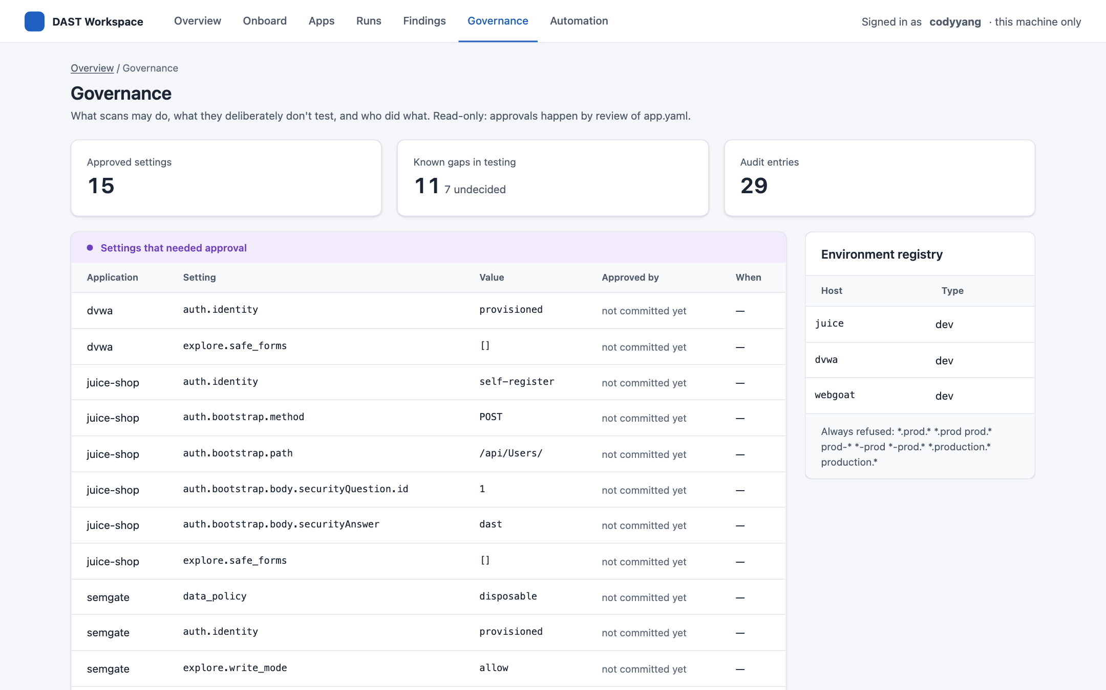
Governance and automation
Mockup, 21 October
Built, 22 October
Approvals with who decided, what scans deliberately don't test, the environment registry and the audit trail.
Notes:
Approvals show 'not committed yet' here because the demo workspace isn't a git repository; against the real configs they show the git author and date.

Slide 14
A new app, from scratch: DVWA
0 · Before onboarding: put the app where ZAP can reach it
Nothing is uploaded. ZAP never receives the app: it sends traffic over the network to a copy that is already running.
The image. The public vulnerables/web-dvwa from Docker Hub, pinned by digest in compose.yaml (DVWA_IMAGE points at a mirror).
Where it runs. A container on the dast Docker network beside ZAP, at http://dvwa: the name ZAP resolves, not localhost. Never port 8080, which is ZAP's own.
Check it. docker exec zap curl http://dvwa/ answers 2xx or 3xx. A real app can be any dev or test URL ZAP can reach.
Onboarded through the UI alone on 22 October, against its own isolated ZAP. Nothing about DVWA was configured in the tool beforehand; every screenshot is from that run.
Notes:
Step 0, on the right: the scanner never gets a copy of the app. DVWA is the public vulnerables/web-dvwa image, pinned in compose.yaml and run as a container on the same Docker network as ZAP, which reaches it as http://dvwa. Environment prep, not configuration: DVWA's database was created once (its /setup.php), and DVWA_USER/DVWA_PASS were set in the shell that started the UI. The repository's hand-tuned DVWA config was moved aside first.

Slide 15
0 · Prepare, then start the stack
Non-production only
Shared hosts registered
A test account
Production hosts are refused before any traffic, whatever the scope says. DVWA is dev.
Test and staging hosts must be in security/dast/environments.yaml with their class. Dev hosts needn't be.
The tool never creates accounts unless the app allows it. DVWA's admin; log in once by hand to check it.
One-time app prep
Secrets in the shell, by name
Start ZAP, the app and the UI
What a person does by hand the first time. DVWA: /setup.php → Create / Reset Database.
DVWA_USER, DVWA_PASS, ZAP_API_KEY (the key ZAP started with); ANTHROPIC_API_KEY for discovery, optional.
docker compose --profile dvwa up -d dvwa zap, then python -m dast ui and open its one-time link.
Notes:
Prep that a person does once, before onboarding; none of it is in the 58 s. Sources: docs/onboarding_a_new_application.md §1 and docs/ui-docs/ui_demo.md. ZAP_API_KEY must be the key ZAP was started with: a test or staging scan refuses an open ZAP API.

Slide 16
First results in 58 s; real flaws in about five minutes
1
2
3
4
5
6
Onboard
Record the login
First scan
Tune
Rescan
Triage, publish, automate
22 s
14 s
22 s
2 edits
2 min 48 s
~25 s
login found in 11 s
one click
480 findings, 0 high
cookie + pages to test
5 high
in the UI
Every step ran in the UI but one: a line added to app.yaml for DVWA's difficulty cookie. What a person brought was knowledge of the app (which pages take input, and that cookie). That's the step after discovery for any real app, and here it took two small edits.
Notes:
Times are measured by the headless browser that drove the UI. Steps 1-3 total 58 s from opening Onboard to a finished first scan; the whole first pass including triage, publish preview, workflow and governance took 86 s. The setup on the two slides before is not timed. Step 4 is on the next-but-four slide, “5 · Two edits”.

Slide 17
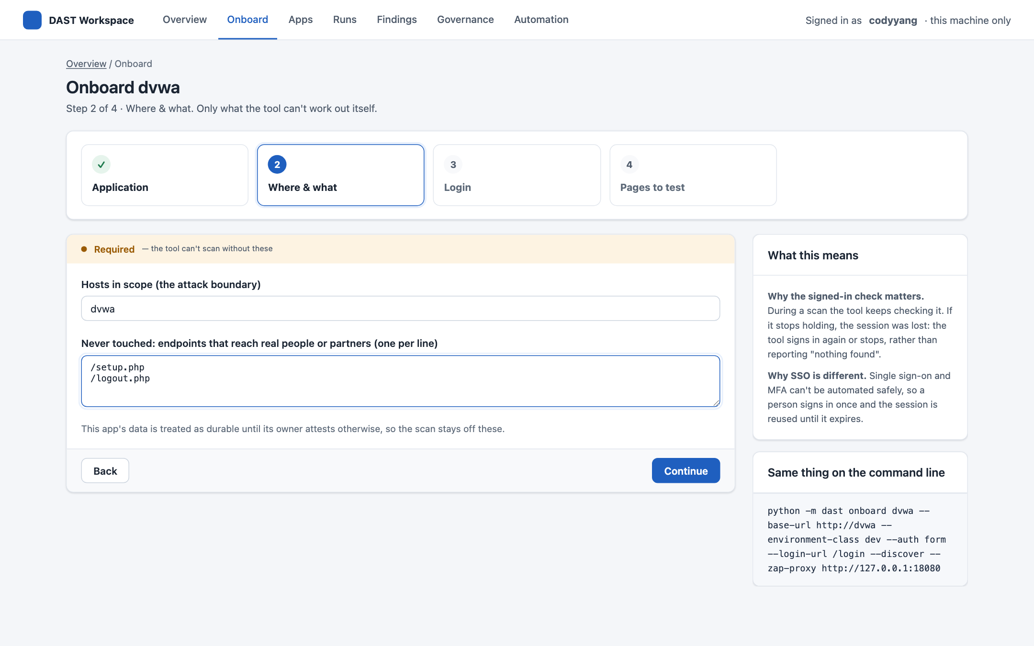
1 · Tell it about the app: three answers
Application
An id, the address as the scanner reaches it (http://dvwa), and the environment.
Refused early
A production or unregistered host is refused at this step, before any traffic.
Where and what
Hosts in scope come pre-filled. Never touched: /setup.php, which resets DVWA's database, and /logout.php.
Notes:
Step 1 asked for three things; step 2 pre-filled the boundary from the address. Everything else the tool works out.

Slide 18
2 · The tool finds the login; you answer one question
Secrets by name
DVWA_USER and DVWA_PASS: “set in this shell”. The password never passes through the UI.
Discovery, through ZAP
3 login steps and a signed-in check, verified signed in and signed out: 11 seconds.
Your part
Confirm the check, and review the pages it proposes: here, take out /setup.php.
Notes:
Discovery going through ZAP is the QA-14 fix (PR #18): DVWA lives only on ZAP's network, so before the fix discovery couldn't reach it from the UI.

Slide 19
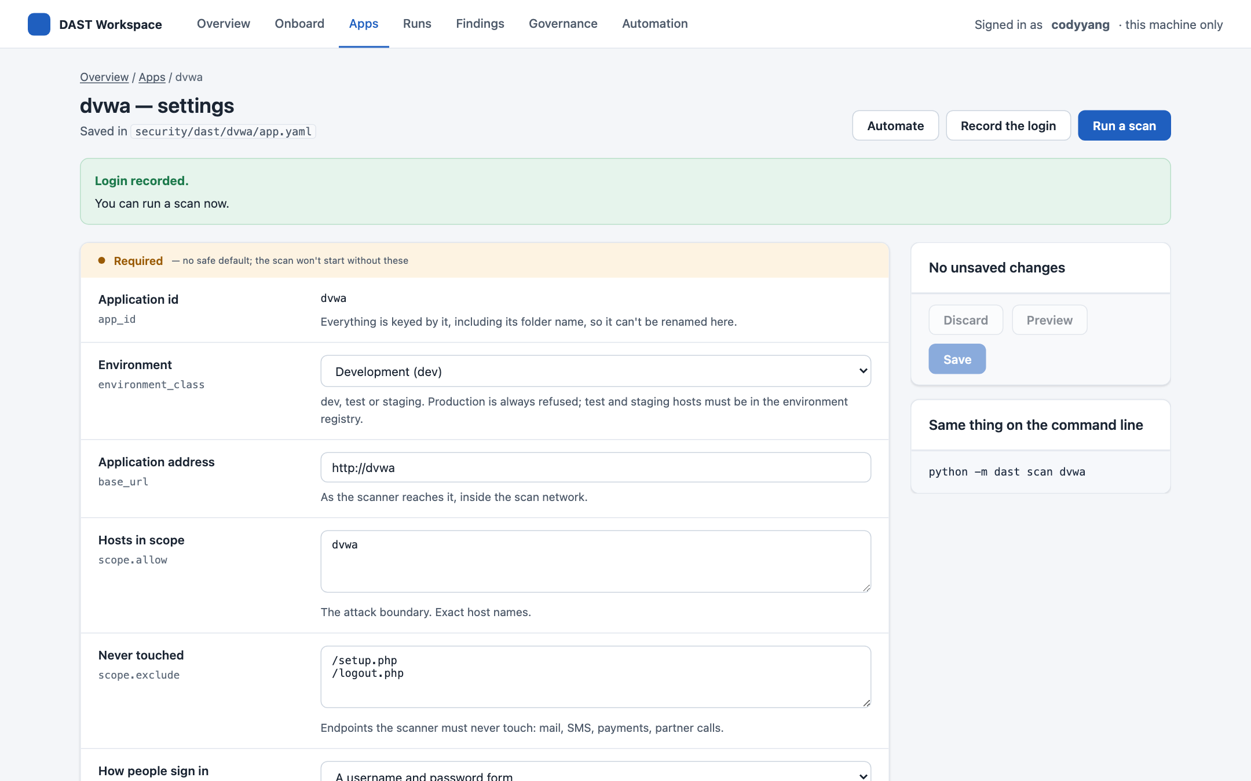
3 · Record the login, then scan
A clear next step
A new app's settings open with a banner: its login hasn't been recorded yet.
One click
Record the login: the tool signs in with the test account and saves the steps. 14 seconds.
Then
Run a scan. Before PR #17 this step needed a terminal.
Notes:
The banner disappears once the login is recorded. SSO apps get a Sign in (SSO) button instead.

Slide 20
4 · Watch it run
Five stages
Safety checks, sign in, spider and active scan, organise (secrets removed), coverage.
Live
Activity streams from the run's own audit log.
Safe stop
Stop at any time: the run is “stopped”, and pages it didn't reach are “not tested”, never fixed.
Notes:
This is the third scan, after tuning: about a minute into its 2 min 48 s.

Slide 21
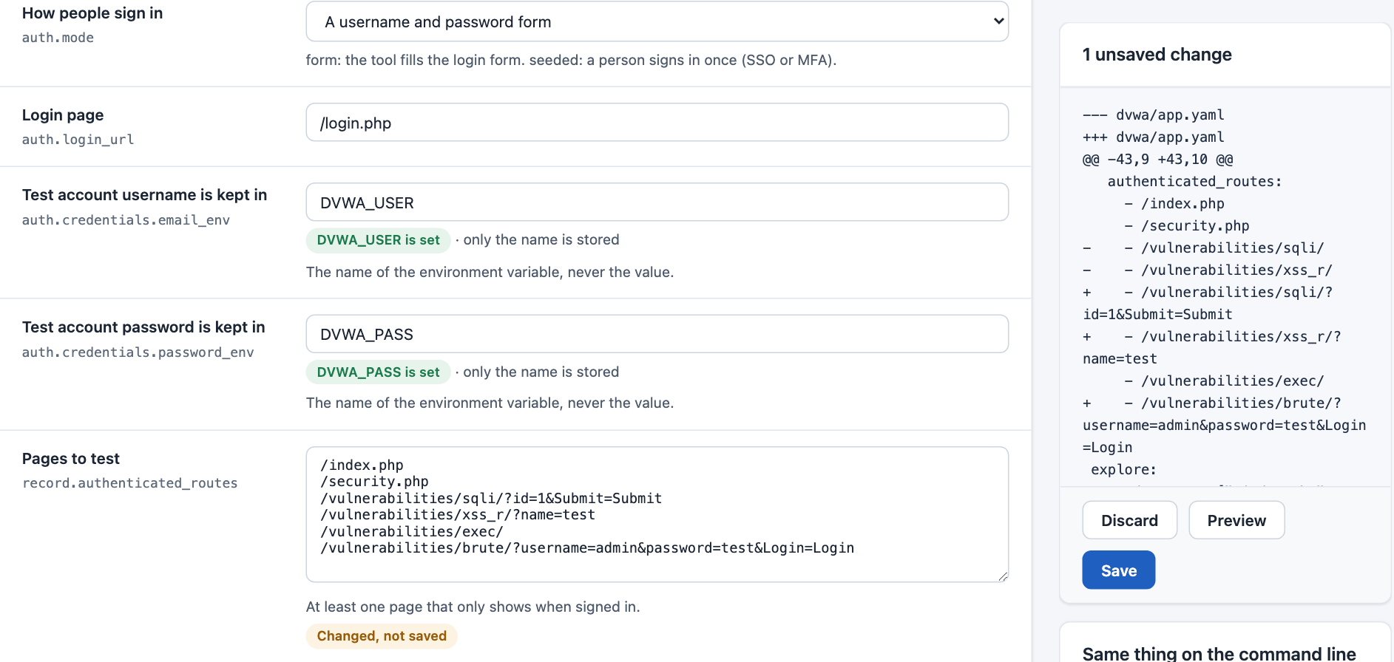
5 · Two edits turned 0 high findings into 5
Scan 1, as discovered: 480 findings, 0 high, in 22 s. Two reasons, both about DVWA rather than the tool.
Edit 1, one line in app.yaml: auth.cookies security: low. DVWA's default difficulty makes every attack fail.
Edit 2, in Settings: Pages to test with their inputs, e.g. /vulnerabilities/sqli/?id=1. Discovery proposed the pages without parameters, so there was nothing to inject into.
Scan 3: 5 high in 2 min 48 s.
Edit 2 as the UI showed it: the exact app.yaml diff, before saving.
Notes:
Discovery gets you a working, verified login; depth needs someone who knows the app. The repository's hand-tuned DVWA config has both of these settings. The cookie isn't in a newly discovered config, and the UI only edits settings that are in the file, so it was added to app.yaml directly - consistent with rule 1.

Slide 22
6 · Results
5 high
SQL injection on id and username; reflected cross-site scripting on three inputs.
Coverage
51 routes, 113 rules; the two time-based checks that ran out of time are named.
Compared with last time
Everything is new until a report is recorded; publishing records it.
Notes:
481 findings in 185 distinct problems; copies of one finding are grouped (QA-5). One informational finding was set aside on the first run, hence '1 suppressed'.

Slide 23
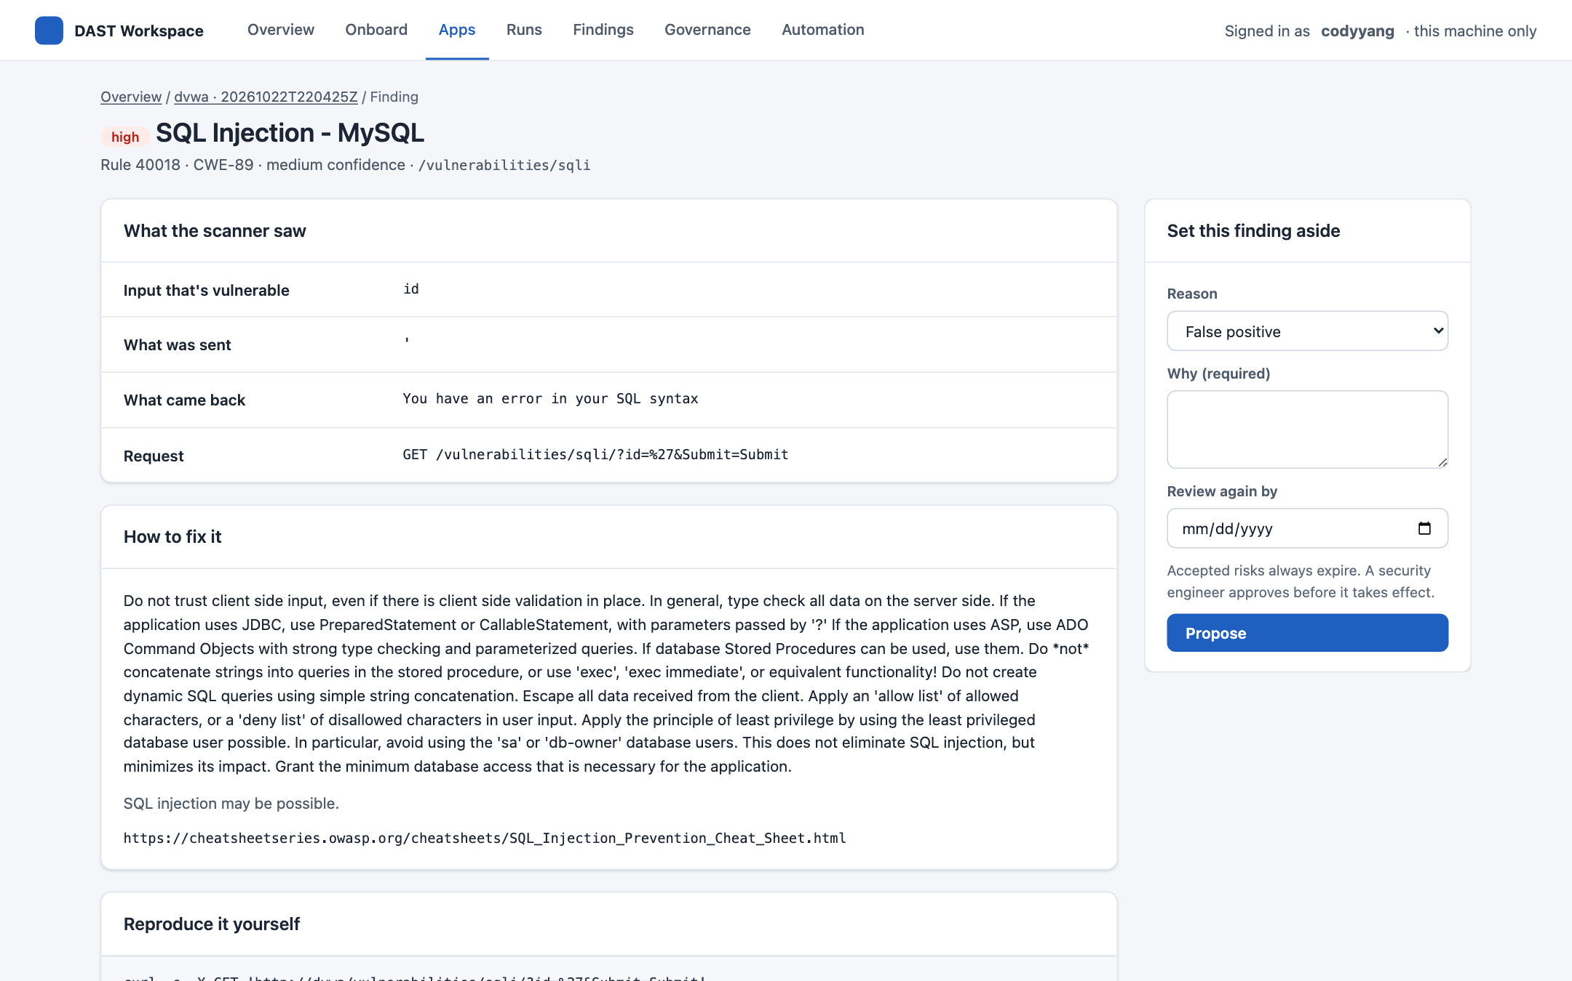
7 · Understand one finding
What the scanner saw
Input id. Sent: '. Came back: “You have an error in your SQL syntax”.
Why and how to fix it
Rule 40018, CWE-89, with the fix and references.
Reproduce it
A curl command for the exact request, for the developer.
Notes:
This is the finding a developer receives. Triage happens here too (Q4).

Slide 24
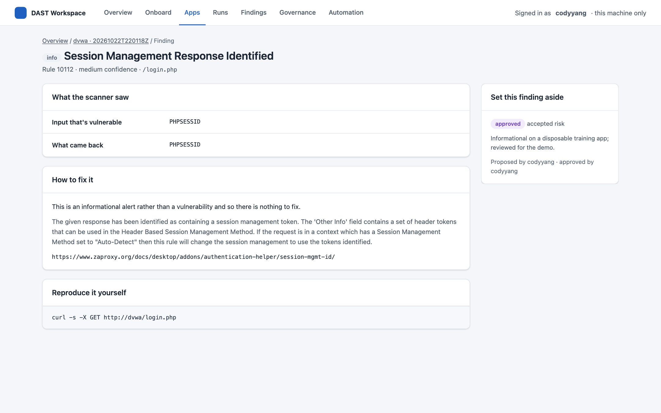
8 · Triage: a reason, a review date, an approval
Propose
Reason (false positive, accepted risk, won't fix, test data), why, and a review date.
Approve
A proposal changes nothing until a security engineer approves it.
Expiry
When the review date passes, the finding counts again and says so.
Notes:
The finding set aside here is informational, on a disposable training app. Decisions live in the app's suppressions.yaml, the file the report command already reads.

Slide 25
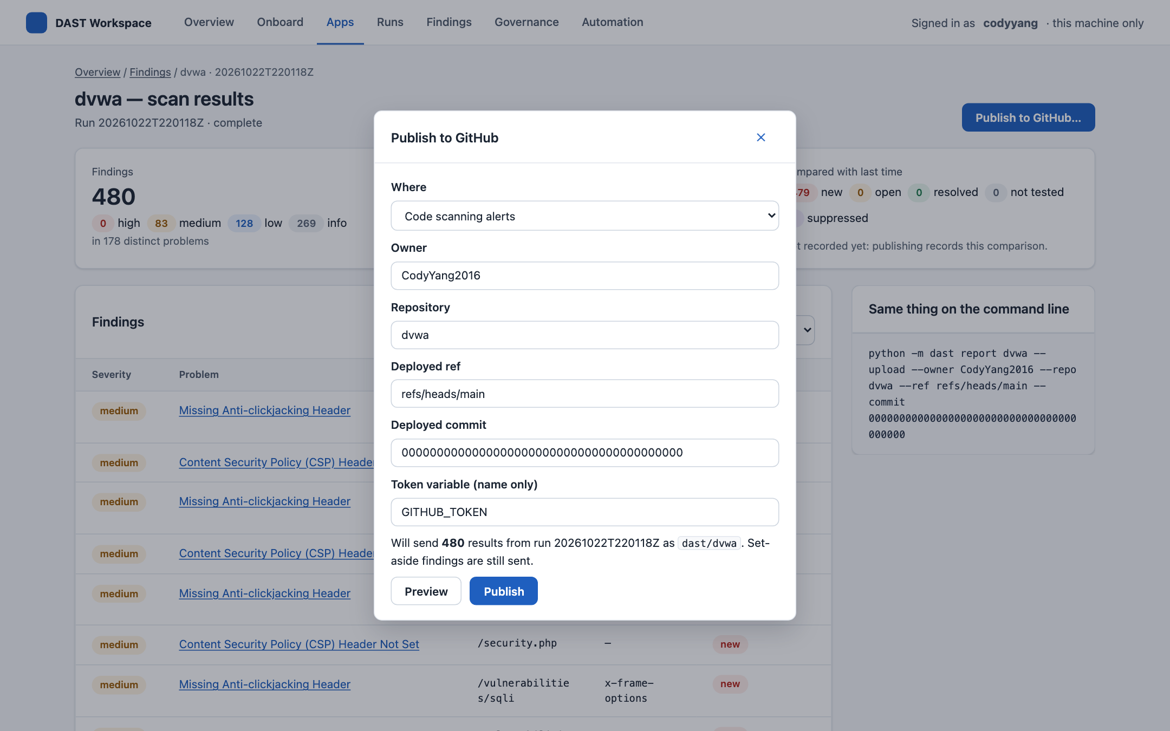
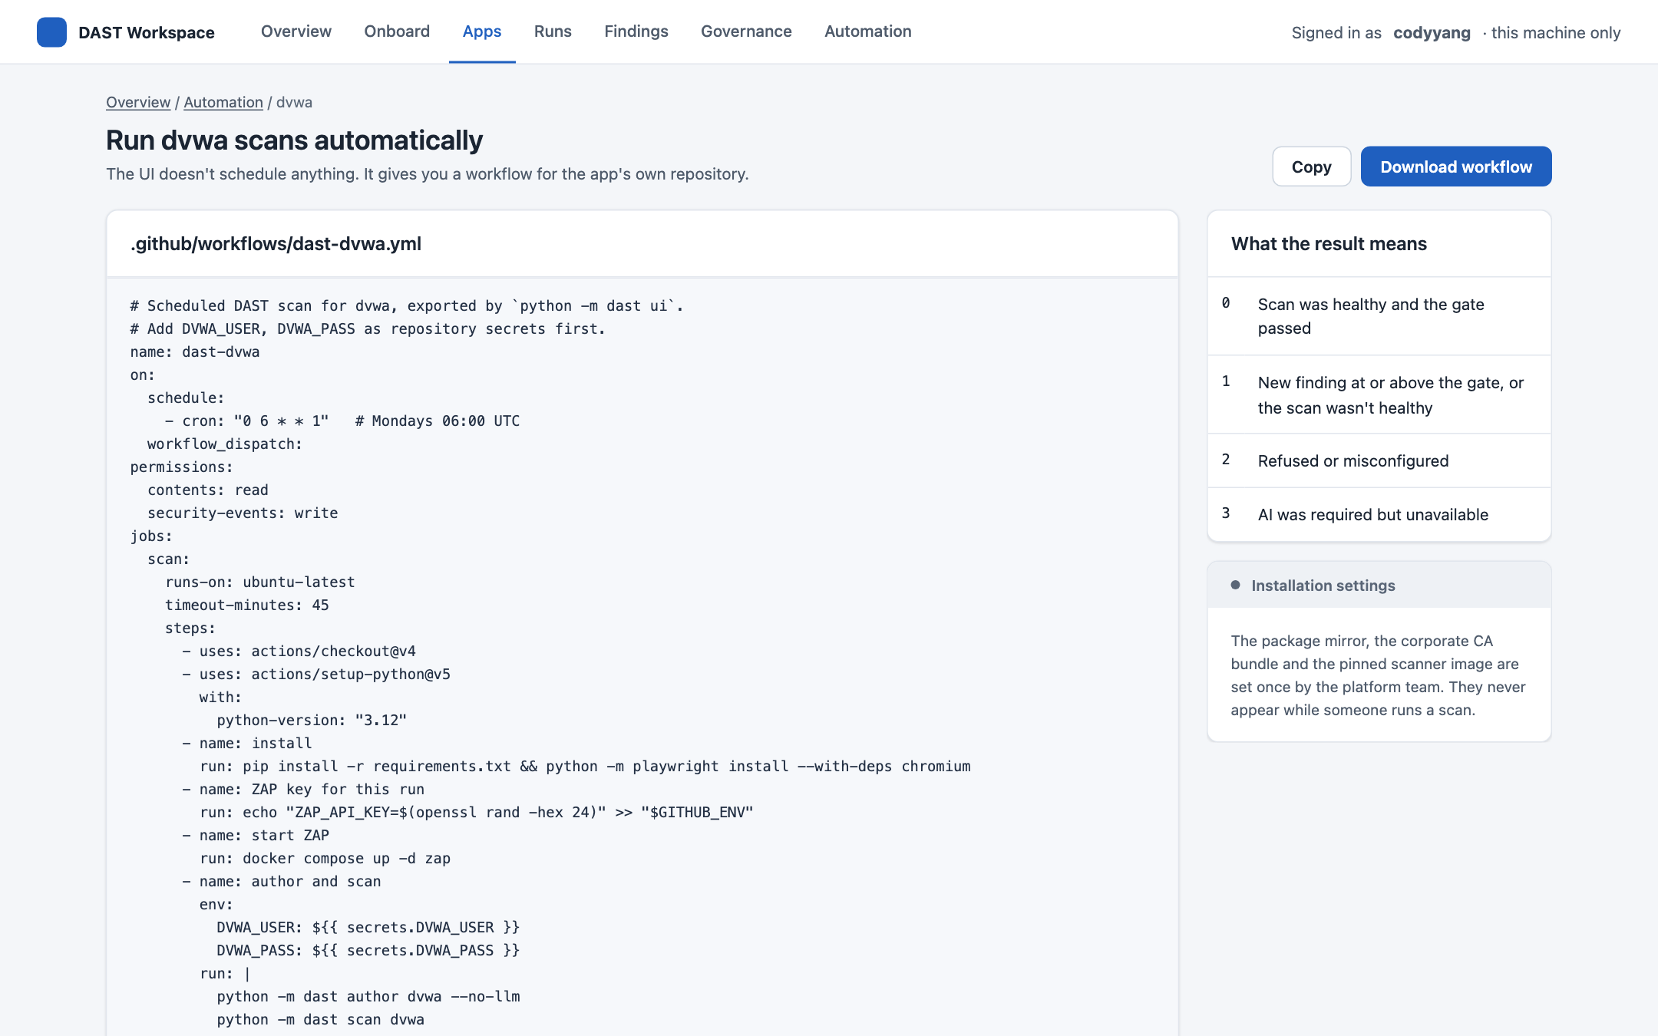
9 · Publish and automate
Publish to GitHub → Preview
Automation → workflow
What would go to code scanning: 480 results as dast/dvwa. Publishing needs the deployed commit, and the token by variable name. Evidence is checked for secrets first.
A scheduled GitHub workflow for the app's own repository, with its secrets named. The UI schedules nothing itself.
Notes:
The publish preview was taken after the first scan, hence 480. Nothing was sent: the demo runs with a placeholder token, and a real publish would need the app repository's commit.

Slide 26
The same run without the UI
1 · Onboard
2 · Record the login
3 · Scan
dast onboard dvwa ‑‑discover, given the address (http://dvwa), the login page and ZAP as proxy. Writes app.yaml.
dast author dvwa signs in with the test account, saves the steps and replays them to check.
dast scan dvwa: safety checks, sign in, spider and active scan, organise, coverage.
4 · Tune
5 · Report and publish
6 · Triage
Edit security/dast/dvwa/app.yaml: the cookie, and the pages with their inputs. Then scan again.
dast report dvwa compares with the last run and writes SARIF and summary.md; with ‑‑upload it publishes.
Proposals and approvals go in the app's suppressions.yaml, the file report already reads.
Notes:
Every UI screen runs these commands and shows them in its command-line panel. Each command is prefixed python -m. Details: docs/onboarding_a_new_application.md §2 (onboard) and §4 (author, scan, report).

Slide 27
Guardrails, seen working
Production refused
Unregistered test host refused
Secrets by name only
shop.prod.example.com: “looks like a production system, so it can't be scanned.”
A test host must be in the environment registry, or nothing starts.
Only variable names reach app.yaml or the page; values are masked in job logs.
Evidence checked before publishing
Every action audited
Looking never changes anything
Every scan's evidence is re-checked for secrets; both live runs came back clean.
Who started, stopped, saved or approved what, in one trail.
The comparison is computed read-only; a save keeps the file's permissions.
Notes:
All six were exercised in the live runs or the QA script: the production refusal in the demo dry run, the registry refusal in QA H1, masking in QA B and the job tests, the evidence check in QA I3.7, the audit in G3 and I3.8, and read-only viewing in the QA-10 tests.

Slide 28
Quality: built test-first, then tested by hand
How it was built
67
steps in the manual QA script, run end to end
Acceptance criteria written and frozen before any UI code; a test checks they never drift
Every fix starts with a failing test, committed first
CI on every pull request: Python, components, and a real browser with accessibility checks
A race that only showed on CI's slower machines was reproduced by slowing the CPU 6×, then fixed
14
issues found by the run and while preparing the demo and this deck
14
fixed in PRs #16–#18, each with its test
Run 2
the re-test of the fixes, in progress
Notes:
QA script: docs/ui-docs/ui_manual_qa.md. Findings and their fixes: docs/ui-docs/ui_qa_findings.md. Three of the fourteen were real bugs (the results filter showing stale rows, stale onboarding pre-fills, and saved configs becoming owner-only); QA-12 to QA-14 were gaps found while preparing the demo and this deck.

Slide 29
Known limits, stated plainly
!
Discovery finds the login, not the depth
Pages with inputs and app quirks still need someone who knows the app (DVWA: two edits).
!
Optional settings not in the file
The UI edits what's in app.yaml and every required setting; adding other optional ones is a file edit.
!
Discovery isn't perfect (ONB-8)
On the semgate lab it can't verify a signed-in check and falls back to a starting point.
!
Some tests stay off by default
DOM-XSS (~15 min, ~5 GiB on DVWA), out-of-band and multi-user checks: disclosed, awaiting decisions.
!
A long path wraps mid-word in results
Cosmetic; logged as QA-15.
Notes:
None of these block a first internal scan; each is either a known tuning step or a decision already listed for governance.

Slide 30
What's next
Decisions (docs/decisions_needed.md)
Engineering
Gate 0: which internal app is scanned first, and who runs it
A self-hosted GitHub runner, for unattended scans and hosted evidence
Who signs the scorecard against commercial scanners
The scan postures SP-1…SP-7, per app
Finish QA run 2: the hand re-test of all 14 fixes
Cache the browser install in CI (one job in two waits ~10 min)
QA-15, and decide how optional settings are added from the UI
Onboard the first internal app with its owners, using this flow
Notes:
The decisions have the longest lead time; none of the engineering items blocks a first internal scan.

Slide 31
Ready for a first internal app
The tool, the UI and the walkthrough are ready. What's needed now is the app and its owners (Gate 0).
Try it: docs/ui-docs/ui_demo.md walks through a 15-minute demo on an isolated ZAP and Juice Shop. docs/ui-docs/ui_manual_qa.md is the full test script.
Notes:
Close on the ask: name the first internal app and the people who will run it.

