Slide 1


Technical Contribution: Optimization-Based Fixture Allocation

Slide 2
My Contribution

Slide 3

Where I fit in the pipeline
Data
Demand Model
Volatility Tagging
Results
Optimization

Slide 4
From Demand → Space Allocation
Demand scores do not directly translate to space
Stores have limited fixture capacity
Need to allocate space efficiently under constraints
Demand score alone does not determine feasible allocation
Optimization ensures allocations satisfy operational constraints

Slide 5
Key Design Choices
Subcategory-level modeling (not fineline, not category)
Stable vs Flexible fixture separation
Weekly store-level optimization

Slide 6

Optimization Model: Allocating Space to Maximize Value
Set
i ∈ {subcategories in a store-week}
Decision Variables
$x_{i}^{stable}$: Stable fixture allocation
$x_{i}^{flex}$: Flexible fixture allocation
Objective
$\text{Max}\sum_{i}{{demand}_{i}(}$ $x_{i}^{stable}$+ $x_{i}^{flex})$
Constraints
$\sum_{i}{{(x}_{i}^{stable}+}x_{i}^{flex})≤Total Fixtures$
Upper bounds per subcategory
$x_{i}^{stable}$, $x_{i}^{flex} ≥0$

Slide 7
Why This Matters
Transforms predicted demand into constrained optimization decisions
Handles real-world constraints
Produces store-week level recommendations

Slide 8
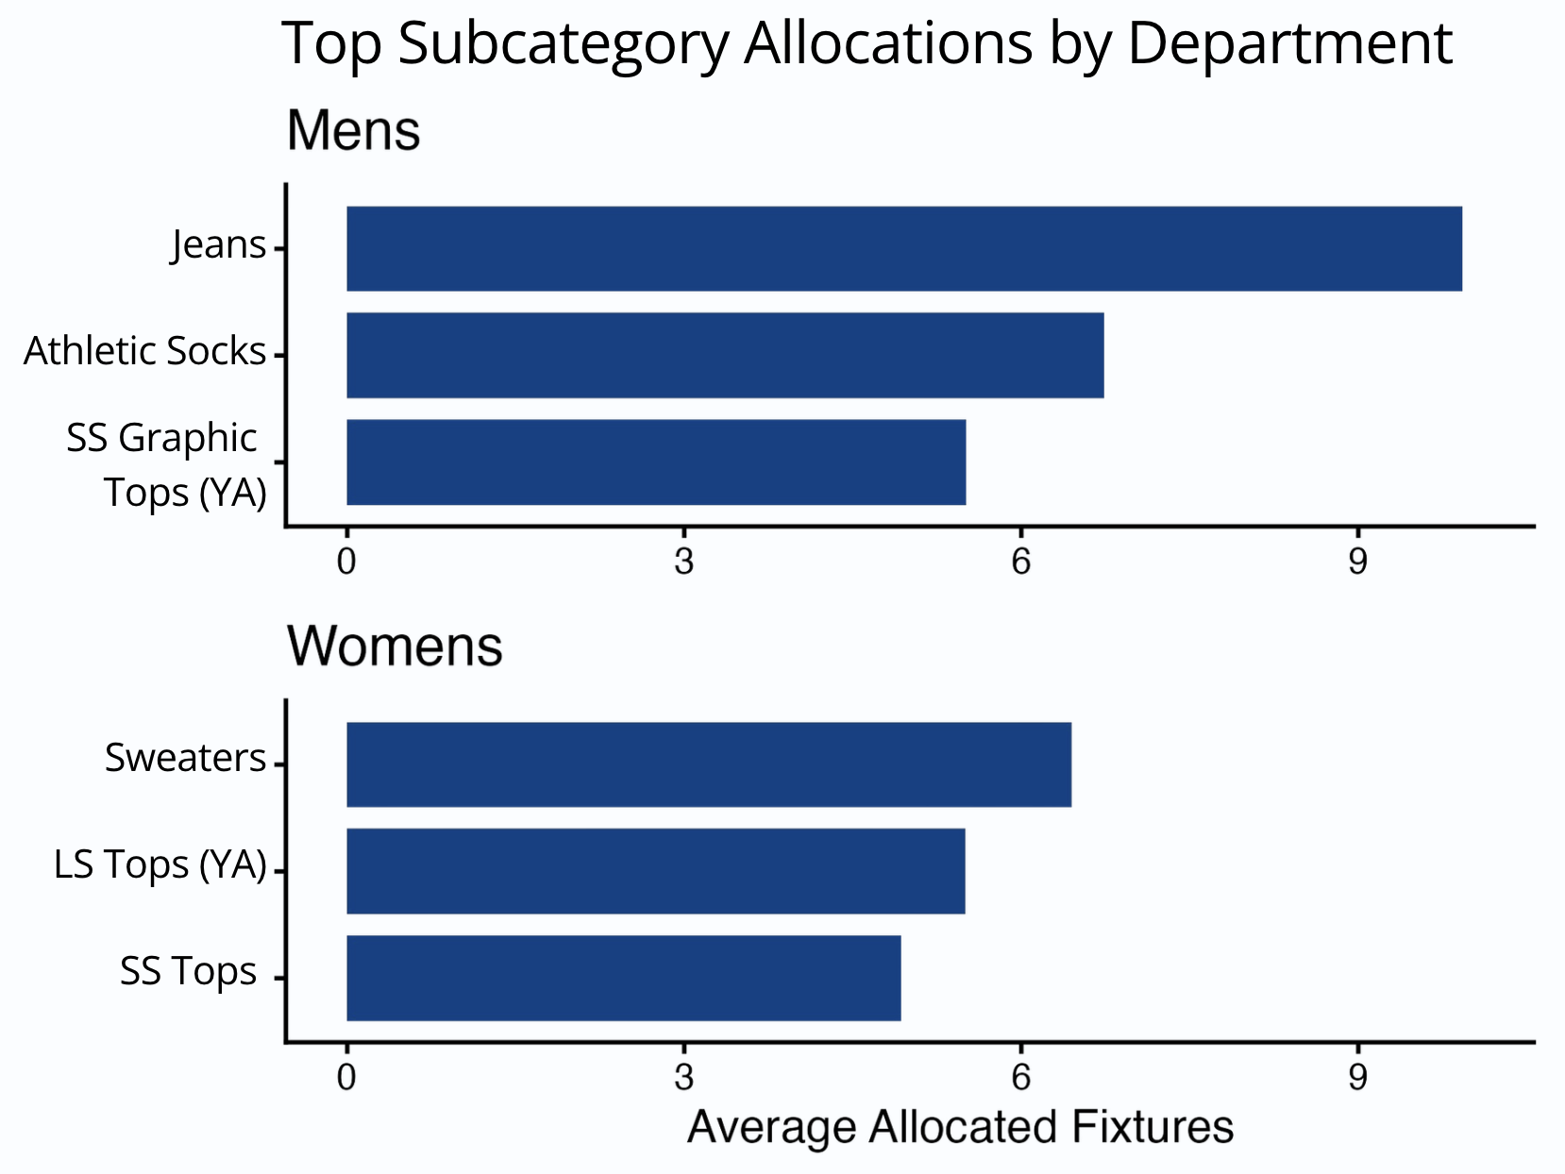
Sample Results
A small number of subcategories drive the majority of space allocation
High-demand categories consistently receive priority across stores
Space allocation is highly concentrated across a few key subcategories
Model allocates space proportional to demand signals

Slide 9
Challenges
Large-scale data (5M+ rows)
Runtime constraints
Data inconsistencies
Matching/join issues

Slide 10
What I’d Do Differently
Improve solver efficiency / scalability
1
Add fixture-type constraints
2
Better integration with demand model
3
Explore clustering (region/store types)
4

Slide 11
Final takeaways
Optimization bridges data -> decisions
Model produces actionable insights
Strong foundation for future improvements

