Slide 1
Baseball Data Analysis
Cody Zupnick, Priya Medberry, Max Mattioli, Mohammad Radiyat

Slide 2
Motivation
Exploratory analysis should be useful for fantasy baseball
Analysis may have potential applications for other sports
Baseball is at the core of American culture – often referred to as the ‘Great American Pastime’

Slide 3
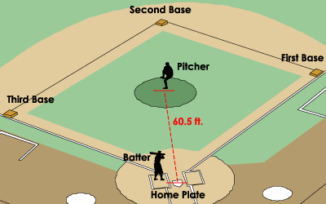
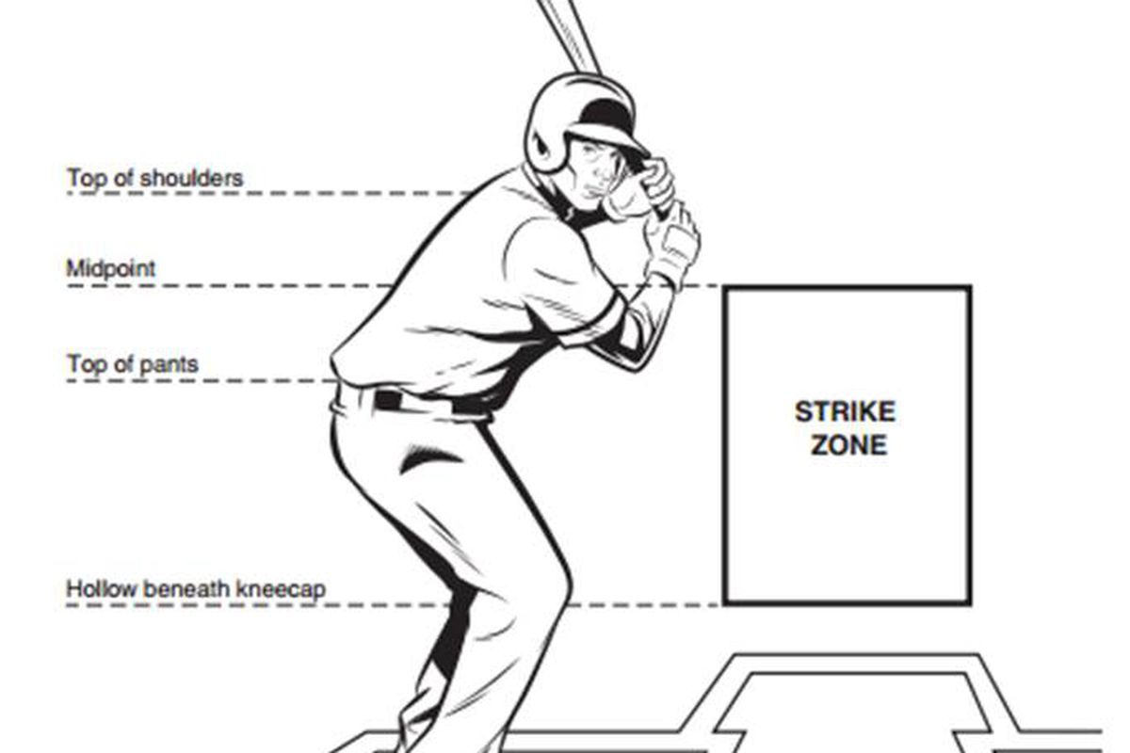
Quick Overview

Slide 4
Raw Data
Pitcher data
Total pitches, types of pitches (fastballs, changeups, etc.)
Batter data
Number of at-bats, slugging percentage, several other useful metrics
Injury data (scraped, not easily available)
Injury types, length of injury
Aggregate monthly data
Monthly hits, monthly homeruns, monthly strikeouts, etc.

Slide 5
Injuries

Slide 6
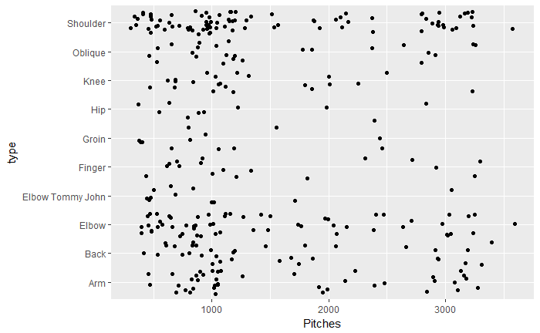
Injury Types vs Seasonal Pitching Volume
Shoulder injuries are the most common injury type for pitchers who throw high numbers of pitches in a season
Most common injuries overall are shoulder, elbow, back, and arm
Shoulder injuries are the most common injury type for pitchers who throw high numbers of pitches in a season
Most common injuries overall are shoulder, elbow, back, and arm

Slide 7
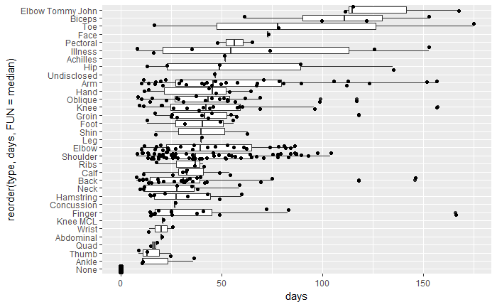
Injury Types vs Days Sustained
Elbow Tommy John injuries have highest median days
Lots of shoulder and elbow injuries, but these are among the bottom half in terms of median length

Slide 8
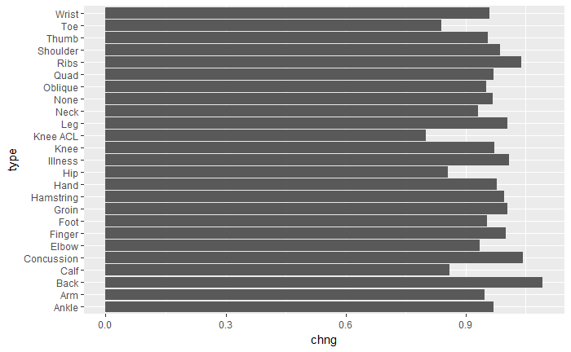
Injury Type vs Effect on Power
Lower body injuries affect batters the most; makes sense because much of batting power comes from lower body
Strangely (?), toe injuries are the among the worst for batting power

Slide 9
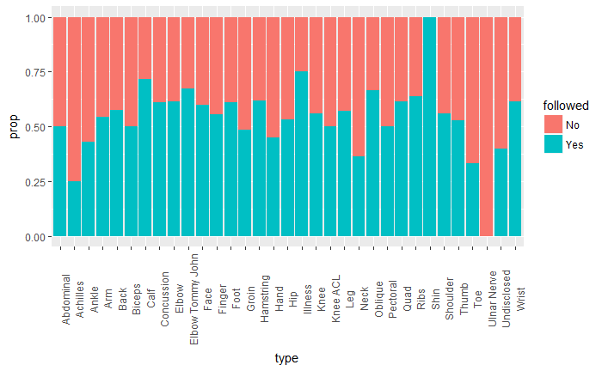
Injury Type vs Likelihood of Future Injury
Seems that some injuries are more predictive of future injury than others
Caveat: not much injury data because it’s hard to find

Slide 10
Home Run Spike in 2015

Slide 11
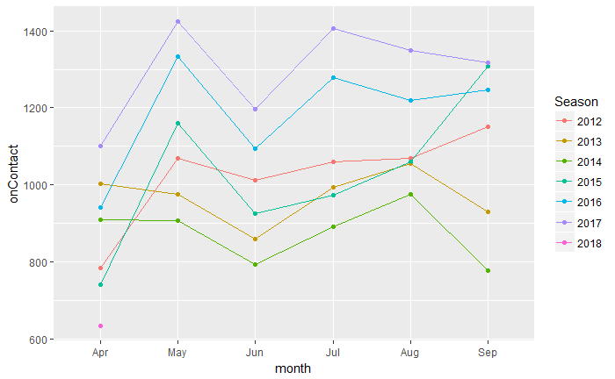
Total Home Runs on Contact Over Time
Totals seem to spike in 2015; top two lines are 2016 and 2017
Manufacturing change in 2015 may be the reason
MLB says nothing is different about the ball since 2015; they might be lying

