Slide 1
Baseball Data Analysis
Cody Zupnick, Priya Medberry, Max Mattioli, Mohammad Radiyat

Slide 2
Motivation
Exploratory analysis should be useful for fantasy baseball
Analysis may have potential applications for other sports
Baseball is at the core of American culture – often referred to as the ‘Great American Pastime’
Notes:
Baseball, sometimes referred to as the Great American Pastime, is one of the most popular sports in America. There is an immense amount of baseball data freely available for analysis and is effectively a statistician’s playground.
We chose the topic of baseball for our final project for a few reasons. One of our group members is involved in fantasy baseball, and we thought that exploring baseball data in-depth would probably help him in future fantasy bracket player selections. We also hoped that this analysis, or a similar analysis, would be potentially applicable to other sports including but not limited to basketball and American football. Lastly we wanted to get insight into a core element of American pop culture, and look into some interesting questions such as how injuries affect players and how to explain the recent increase in home runs.

Slide 3
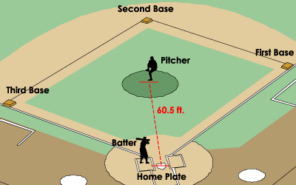
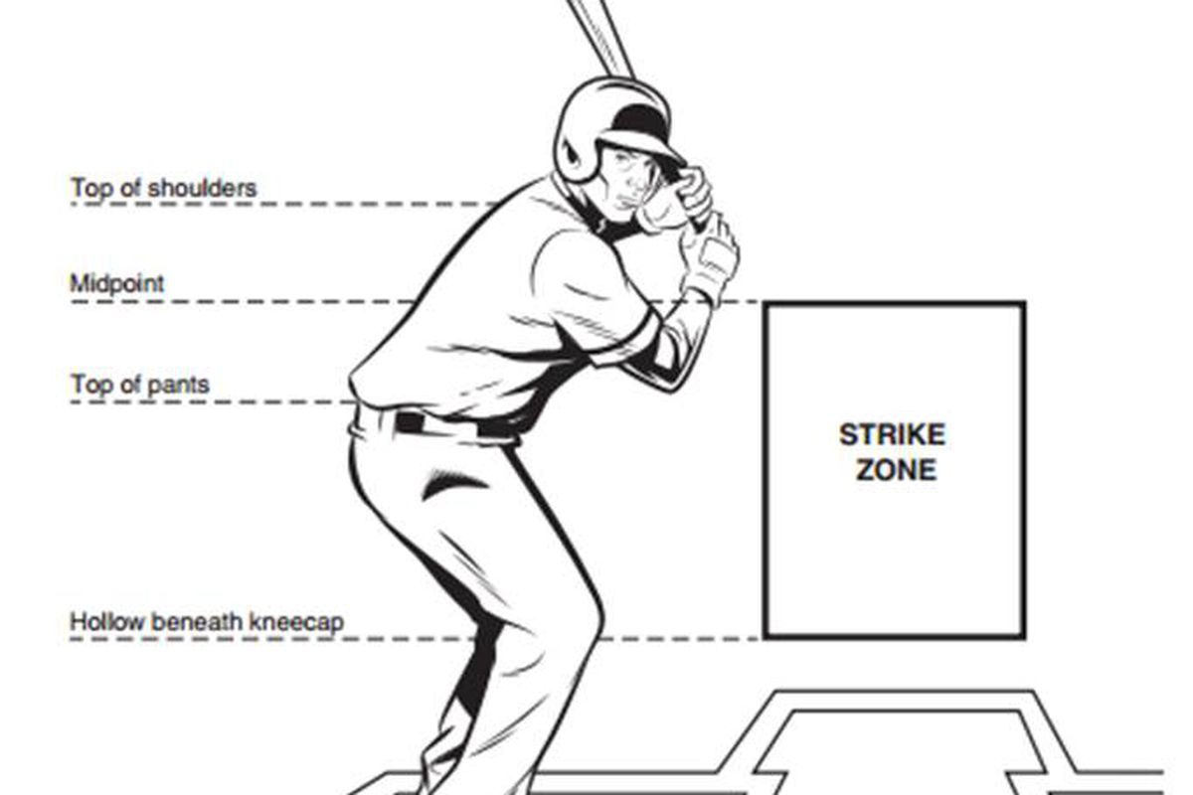
Quick Overview
Notes:
An offending player tries to hit the ball away from the reach of the defenders and score runs by running around the bases. Players of the defending team try to out the player who is batting. Both the teams take turns at batting and fielding. Three consecutive outs from each team make an innings, and nine innings make a game. The objective of each team is to win by scoring more runs and try to prevent opponents from scoring runs.
Pitchers try to make the batter miss when the ball is in the strike zone – that counts as a strike. Three strikes and you’re out. Batters can earn one, two, three, or four bases depending on how well they hit the ball away from the defenders. If the batter hits the ball over the wall in the back of the field, it’s a home run and everyone who’s on a base immediately scores.

Slide 4
Raw Data
Pitcher data
Total pitches, types of pitches (fastballs, changeups, etc.)
Batter data
Number of at-bats, slugging percentage, several other useful metrics
Injury data (scraped, not easily available)
Injury types, length of injury
Aggregate monthly data
Monthly hits, monthly homeruns, monthly strikeouts, etc.
Notes:
Fangraphs.com, scraping. We had a hard time finding injury data that goes back more than a few years.

Slide 5
Injuries

Slide 6
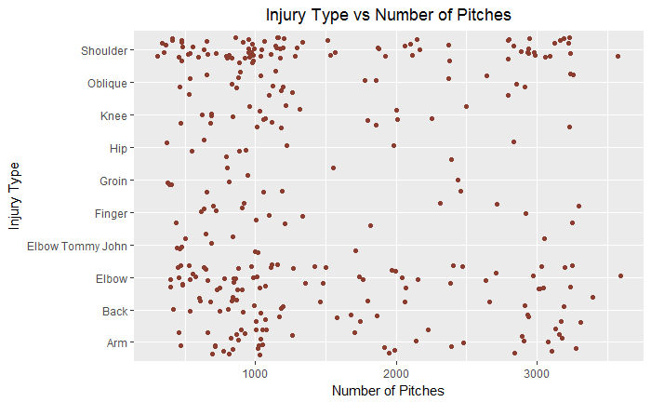
Injury Types vs Seasonal Pitching Volume
Shoulder injuries are the most common injury type for pitchers who throw high numbers of pitches in a season
Most common injuries overall are shoulder, elbow, back, and arm
Shoulder injuries are the most common injury type for pitchers who throw high numbers of pitches in a season
Most common injuries overall are shoulder, elbow, back, and arm
Notes:
This graph shows injury types that pitchers received vs the number of pitches those pitchers threw in one season. Not much jumps out in the scatterplots. It is conventional wisdom that high pitch total pitch volumes lead to more injuries, but this expected result is either not visible over the course of one season or it's being swamped by other factors. There does seem to be a little bit of clustering of shoulder injuries at high pitch volume (around 3000 pitches in one season), implying that players who throw more pitches may be more susceptible to shoulder injuries than other injuries. Overall, the most common injuries are shoulder, elbow, back, and arm injuries.

Slide 7
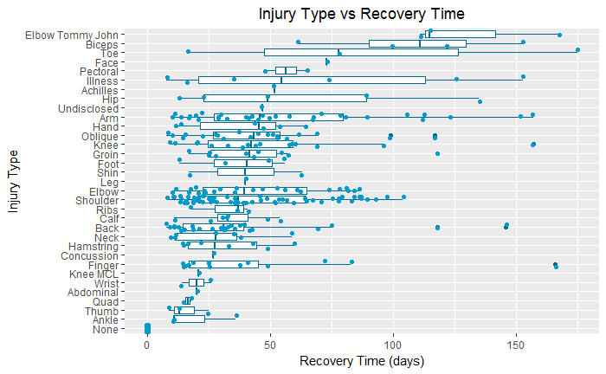
Injury Types vs Recovery Time
Elbow Tommy John injuries have highest median days
Lots of shoulder and elbow injuries, but these are among the bottom half in terms of median length
Notes:
We wanted to understand how severe different injuries are. As a measure of injury severity, we look at how many days each injury lasted in the data for 2016 and 2017. We use both boxplots and scatterplots. By using median days values, the most severe injuries seem to be elbow Tommy John injuries, bicep injuries, and toe injuries. Elbow Tommy John injuries being the highest on this list makes sense. This kind of injury refers to a special elbow injury that involves a torn UCL, which is an extremely important elbow ligament. The median injury length values may be important, but we also discovered something about frequency of injuries. The scatterplot indicates that pitching injuries (shoulder, elbow, and arm) are among the most frequent. It is worth noting that outliers (injuries that lasted more than 180 days) were removed.

Slide 8
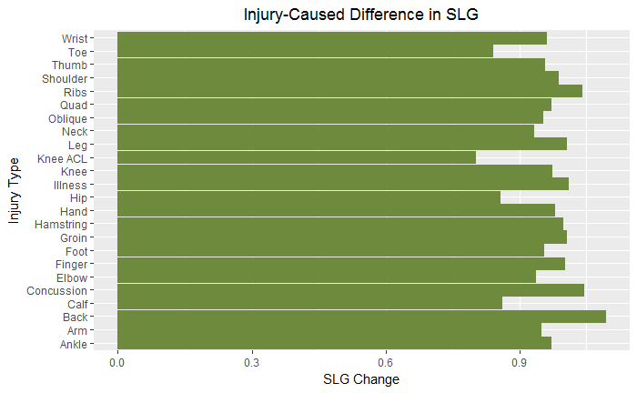
Injury Type vs Effect on Power
Lower body injuries affect batters the most; makes sense because much of batting power comes from lower body
Strangely (?), toe injuries are the among the worst for batting power
Notes:
Now we will look at how different kinds of injuries affect hitters differently. Presumably some kinds of injuries hurt hitters more than others, and we will look at how different kinds of injuries affect power performance as measured by the aforementioned *SLG*. *SLG* for one player is slugging percentage, which is total number of bases earned on hit divided by total number of at-bats. We use *SLG* averages across players who received the same injury type. Because we're interested in the long-term effects of injuries, we're going to be looking at a one year lag, *ignoring* the season in which the player was injured. For each player we look at he season before and seasons after the injury to look for changes. Lower body injuries seem to have the largest effect on power; ACL tears, knee injuries, toe injuries, hip, and calf injuries have the largest decreases in *SLG* the year after injury. This makes intuitive sense, since a large part of hitting involves building power from the lower half into the swing. However, some of the results are non-obvious; for example, it is remarkable that toe injuries have a larger effect on how hard a player
hits the ball than wrist injuries. Of course this analysis uses only four seasons of data, and we'd want to revisit this on larger datasets. Nonetheless the lower body/upper body difference seems strong.

Slide 9
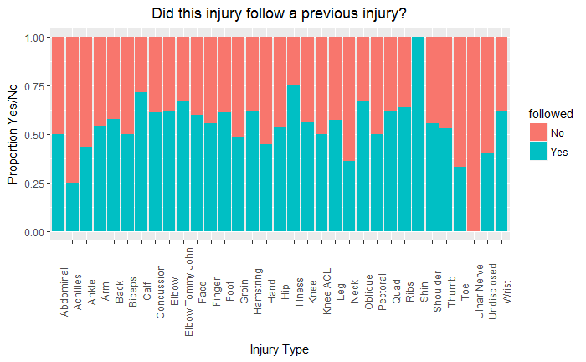
Injury Type vs Likelihood of Future Injury
Seems that some injuries are more predictive of future injury than others
Caveat: not much injury data because it’s hard to find
Notes:
Our next question involves the extent to which different injuries suggest future susceptibility to more injury. We combine all the injury data into one dataframe, and plot a stacked bar chart to see what percentage of players who sustained an injury got injured again. It seems that certain types on injuries are definitely more predictive of future injuries, but the caveat is that we don't have much data to work with. The numbers are not huge because finding injury data that goes back more than a few years is difficult. With a larger dataset, we could investigate if certain types of injuries could predict specific future injuries, but our slices would be too small for just three years of data.

Slide 10
Home Run Spike in 2015

Slide 11
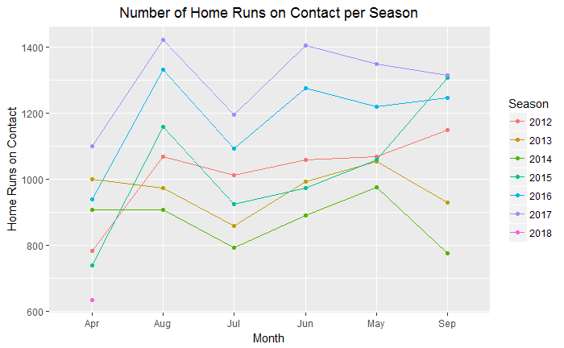
Total Home Runs on Contact Over Time
Totals seem to spike in 2015; top two lines are 2016 and 2017
Manufacturing change in 2015 may be the reason
MLB says nothing is different about the ball since 2015; they might be lying
Notes:
Did the Ball Change in the Middle of 2015? We use home run changes to look for significant differences. An informative thing to look at
would be *home runs on contact*, since how many strikeouts there are could be influencing the number of home runs. If fewer players are striking out then home runs will naturally go up. We can strip out all strikeouts to see what would happen if every ball was put into play. The gap between May 2015 and May 2017 looks like it's a little under 300, from a baseline of around 1150; an increase of around 25%! That's an enormous number; if a ball was put into play in May of 2017, it was 25% more likely to be hit for a home run than it was in 2015. There are of course other explanations - the composition of players isn't the same, ballparks in the league
could have changed, weather pattersn could be changing in specific ways that influence home runs. But there are hundreds of players in the league and compisition changes slowly, and the trend increase appears to have begun in the middle of a season, when none of the parks had changed. But the factory location was moved in the middle of the 2015 season, and anecdotal comments from players suggest that the seams are generally slightly lower (though still within the strict range allowed). But even a small decrease in seam height reduces drag on the ball and causes it to carry further. The league insists it has run tests and nothing has changed, but it would be fun to try to collect a bunch of balls from before and after the location change and see if seam height was any different.

Slide 12
Thanks!
https://github.com/Codyz/edavFinalProject/tree/master/

