Slide 1


Real-time geospatial Data processor and visualizer
Nsovo Baloyi
Maluleki Nyuswa
Keletso Molefe
Kamogelo Tswene
Client: Werner Raath (CSIR)

Slide 2
Architectural Specification
Shows active disasters, as well as weekly weather forecasts
Access channel –system accessed by different users via the web interface
Main quality requirements – scalability, maintainability, performance, usability
Architectural pattern – Layering pattern

Slide 3
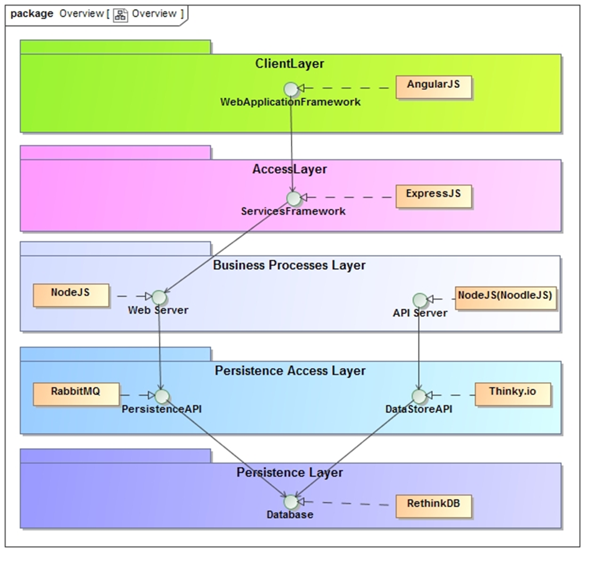
Architectural Pattern

Slide 4

DESKTOP PROJECT
Show and explain your web, app or software projects using these gadget templates.

Slide 5
Place your screenshot here
DESKTOP PROJECT
Show and explain your web, app or software projects using these gadget templates.

Slide 6
DESKTOP PROJECT
Show and explain your web, app or software projects using these gadget templates.

Slide 7
Thanks!
ANY QUESTIONS?

