Slide 1
Digital Rain / Strategy
One Operation
Action layer
AI
Perception
From today's operating core to agentic industrial intelligence
A visual story of the product evolution: current foundation, next-step AI and agent integration, and the path toward a full 3D operating model.
Agent layer
AI
Planning
Process engine
AI
Reporting
Semantic data
Operational core
AI on top
Agents in-line
3D twin next
From system of record to system of action.

Slide 2
What ONE already has in place today
The near-term story is extension, not replacement. The internal material consistently positions ONE/OPUS as an existing operational core with live workflows, APIs, dashboards, integrations, and maintenance coupling.
Operational foundation
Composable architecture
Ready for extension
Live workflows, issues, asset logic, and data pipelines in one platform
Features are vertically integrated and exposed through APIs
Harmonized data + process orchestration already exist
Shared operational touchpoints already exist in production settings
Services consume and publish events on a shared service bus
Grafana, inventory, reporting, and maintenance are already coupled
The core is described as the current operating foundation
Core supports modular-monolith patterns plus microservices
3D frontend support and telemetry-to-visual pipeline are already in reach
Today's stack
Dashboards / apps
This is the stable base the next phase should build on.
Existing deployment base
Processes / workflows
The key implication: the product evolution should treat AI and agents as extensions of the existing service bus, process engine, and semantic context — not as a detached assistant bolted onto the UI.
Existing operator workflows
Service APIs + bus
Existing integration surface
Harmonized data layer

Slide 3
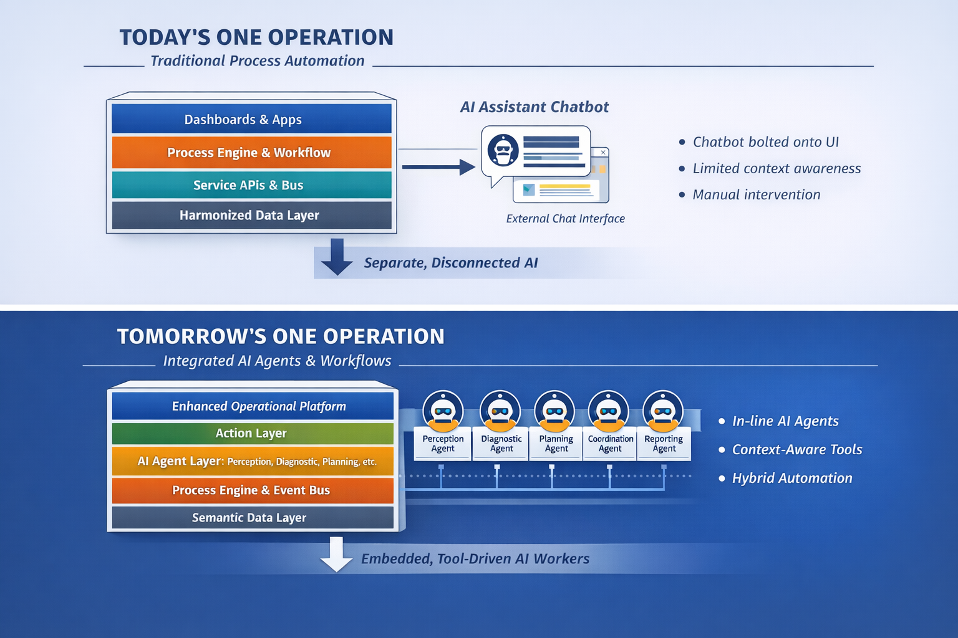
The product evolution in one view
The sequence appearing across the material is consistent: first activate AI on the core, then embed agentic workflows, then connect the logic to richer 3D spatial context.

Slide 4
How agents should fit inside ONE
The clean operating model is not “assistant on the side,” but bounded, tool-using agents triggered inside the existing process architecture.
Data sources
Semantic context
Process engine
Agent workers
Action layer
Sensors
Asset model
Rules
Perceive
Dashboards
Lab
History
Events
Diagnose
Work orders
Docs
State
Tasks
Plan
Inventory
ERP/CMMS
Relationships
Audit trails
Coordinate
Reporting
Design principle
Trigger agents from operational events
Expose ONE APIs / services / history as tools
Keep human approval for consequential actions
Write every invocation back to the audit trail

Slide 5
A practical rollout path
The recommended rollout sequence keeps delivery risk low while converting the current operational base into measurable intelligence and automation.
01
AI on the core
02
Agentic workflows
03
3D operating model
Start with prediction, anomaly detection, and guided decisions
Move from recommendations to drafted actions and escalations
Connect logic to the plant twin first
Use existing plant/process data and current workflows
Bind agents to process context and ONE tools
Expand from plant context into mine / broader physical model
Focus on operator-facing recommendations first
Keep humans in the loop for approvals
Use spatial context for diagnostics, simulation, and planning
Outcome
From a solid digital operations base to a profit-improvement system: higher throughput, less downtime, lower maintenance cost, fewer handoff errors, and leaner operations.

Slide 6
Bottom line
ONE should evolve by embedding intelligence into the platform it already has.
Not a chatbot beside operations. An agent-capable operating system inside operations.
Today
Composable operational core with workflows, APIs, service bus, dashboards, and data context
Next
AI models on the core for prediction, anomaly detection, and guided decisions
Then
Bounded agents that act through ONE tools and process context
Later
A full 3D operating model that adds spatial reasoning and simulation
Recommended framing for the story:
“We are not starting from zero. We are activating more of the architecture.”

