Slide 1
Study / Flashcards
Spaced Repetition System (SRS): Custom SrsCalculator schedules reviews based on Again, Hard, Good, and Easy ratings.
Study Modes: Filter by Specific Deck (DeckDue) or Review Today (DueToday) for all overdue words.
Real-time Progress: Live tracking of study fractions and remaining cards within a session.
STUDY INSERT HERE

Slide 2
Progress & Analytics
Continuous Tracking: Monitors current streak, longest streak, and total reviews mapped from ReviewHistoryEntity.
Retention Insights: Automatically computes retention rate and accuracy metrics.
State Management: Driven by Coroutine Flows delivering real-time ProgressAnalytics updates to the UI.
PROGRESS INSERT HERE

Slide 3
Settings & Profile
Study Goals: Personalize daily target for new words (default 10).
Notifications: Configure customizable daily review reminders (default 09:00 AM).
Profile Management: Edit profile attributes (Name, Goal, Level) synced deeply with UserEntity.
SETTINGS INSERT HERE

Slide 4

Core Data Models
DeckEntity: Represents a vocabulary deck holding multiple flashcards.
WordEntity: Represents a flashcard mapping word data to critical SRS attributes (easeFactor, nextReviewAt, reviewCount, correctCount).
ReviewHistoryEntity: Logs every review session outcome to fuel analytics and progress reporting.
UserEntity: Stores the user's base profile and study goals locally.

Slide 5
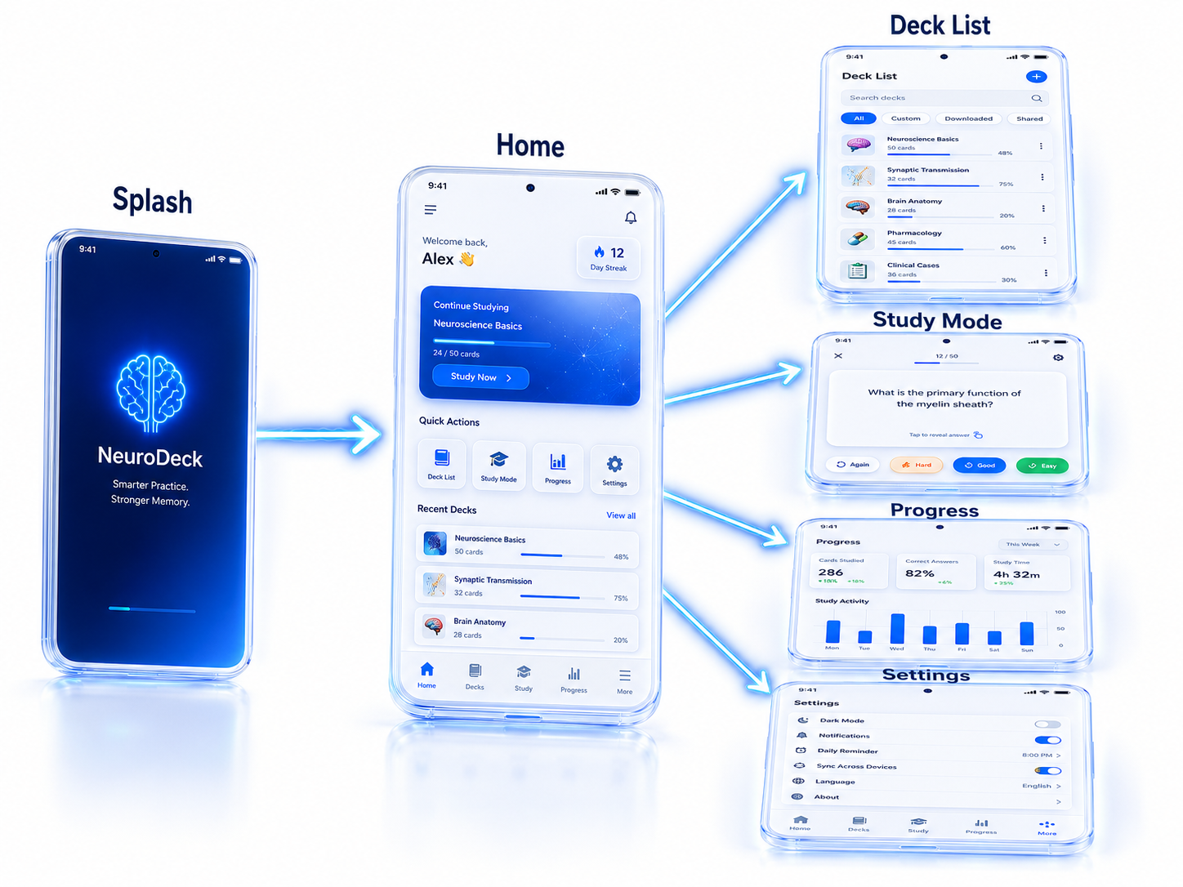
Navigation Flow
Splash Screen → Home Screen
From the Home Screen navigates to:
• Deck List
• Deck Detail
• Study Mode / Flashcard Review
• Progress & Analytics
• Settings & Profile Management

Slide 6
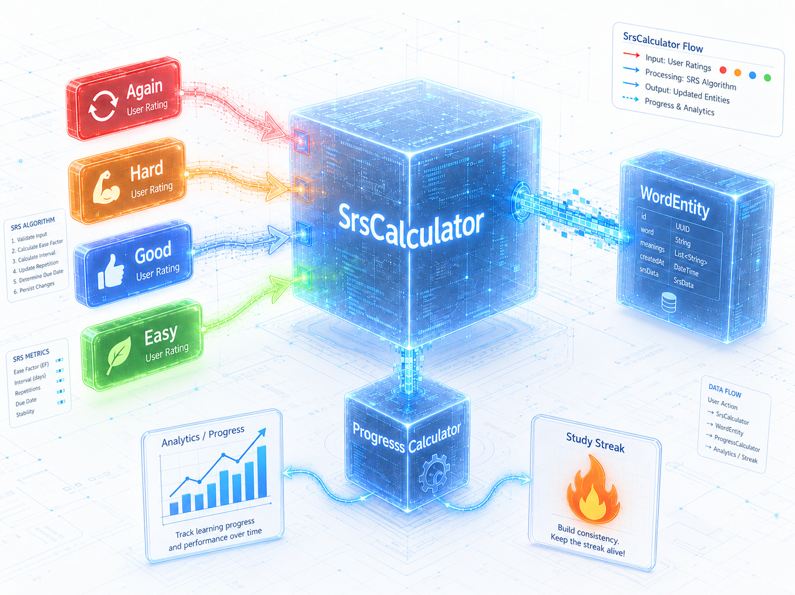
Algorithm & Logic
Spaced Repetition System (SRS): SrsCalculator computes the next review time (nextReviewAt) and modifies difficulty (easeFactor) relying on user self-evaluation (Again, Hard, Good, Easy).
Progress Calculation: ProgressCalculator derives learning streaks, tracking accuracy and review retention metrics extracted from ReviewHistoryEntity entries.

Slide 7
Current Strengths
Modern UI implementation leveraging Jetpack Compose and Material 3.
Robust local-first architecture securely powered by Room Database.
Highly effective custom Spaced Repetition (SRS) algorithmic integration.
Comprehensive analytics and progress tracking systems natively implemented.
Clean MVVM architecture efficiently decoupling UI elements from business logic.

Slide 8
Current Limitations
Relies on manual Dependency Injection (AppContainer) rather than standard DI frameworks like Hilt or Koin.
Limited cloud data synchronization capabilities (Data currently acts primarily as offline storage).
Heavy dependency on public and free translation/dictionary APIs which are susceptible to rate limits.

