Slide 1




“Documents”
Query
Doc Encoder
Query Encoder
Top-k Retrieval
Ranked List

Slide 2
“Documents”
Query
BM25
Multi-hot
Top-k Retrieval
Ranked List

Slide 3
“Documents”
Lucene Indexing
Query
BM25
Multi-hot
Top-k Retrieval
Ranked List

Slide 4
“Documents”
Lucene Indexing
Lucene Retrieval
Query
BM25
Multi-hot
Top-k Retrieval
Ranked List

Slide 5
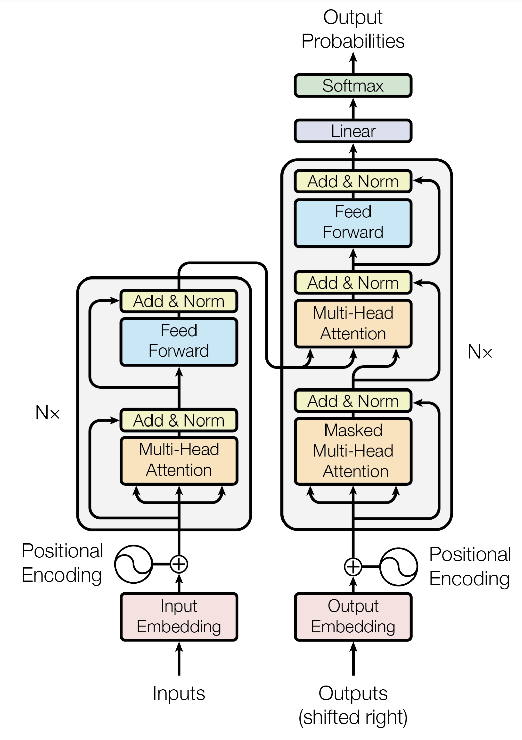

“Documents”
Query
Doc Encoder
Query Encoder
Top-k Retrieval
Ranked List

Slide 6
Pyserini
1
Anserini
Query
Corpus

Slide 7
Pyserini
Anserini
Query
1
Corpus

Slide 8
“Documents”
Query
Doc Encoder
Query Encoder
Top-k Retrieval
Ranked List

