Slide 1

COFFEE HOUSE
Leader: Ky Nguyen
Member: Luyen Ngo
Thuy Pham
Hieu Nguyen
Team members
Coffee House Project

Slide 2
Main Contents
1.
2.
Core Technology & Tasks
Our Ideas
3.
4.
User-Side Features
Admin-Side Features
5.
Difficulties & Solving Problems
6.
Q&A

Slide 3
1.
OUR IDEAS
Covid 19 Pandemic
Choose the suitable products
Easy to manage

Slide 4
2.
CORE TECHNOLOGY

Slide 5

Core Technology
HTML, CSS, Javascript
Bootstrap
MockAPI
Axios
ChartJS
SmtpJS
HTML2PDF
CryptoJS
SwiperSlides
Font Awsome

Slide 6
2.
OUR TASKS

Slide 7
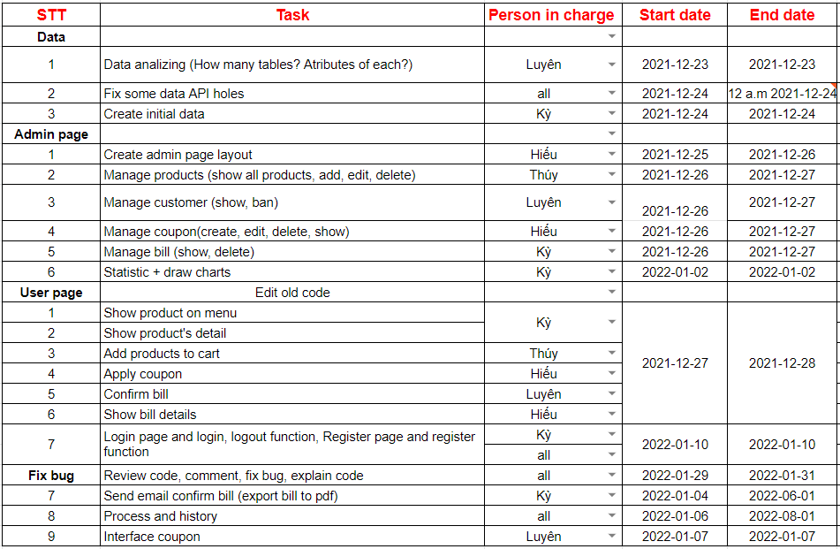

Slide 8
3.
USER-SIDE FEATURES

Slide 9
4.
ADMIN-SIDE FEATURES

Slide 10
5.
DIFFICULTIES

Slide 11
Difficulties
Combining code
MockAPI
Converting bill to pdf file.
Non-consistent in variables name,
function name and syntax, flow of the program.
Difficult to understand how to use mockAPI and Axios to get and post data.
Having some errors and difficulties to convert HTML code to pdf file.

Slide 12
5.
SOLVING PROBLEMS

Slide 13
Solving
Combining code
MockAPI
Converting bill to pdf file.
Set a norm for naming the variables and function, using all new syntax, discussing the flow and direction of solving some problems
Team leader helps team members to understand how to use Axios.
Dividing data into 2 accounts because it is limited resources per 1 account.
Using HTML2PDF for converting HTML code to pdf variable and attach into email.

Slide 14

Thanks For Your Attention!
Do You Have
Any Question
For Us?
Coffee House Project

