Slide 1

Protocol Layers

Slide 2
Protocol + Layers
Deals with one functional aspect of the communication
Set of rules, to exchange information

Slide 3
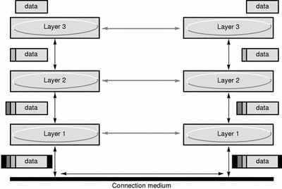
Fig : Layered protocols

Slide 4
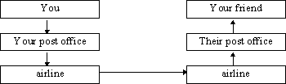
EXAMPLE

Slide 5
Two famous protocols
Open system interconnection (OSI) ------ 7 layers
Internet protocols (TCP/IP Suite) ------ 4 layers
(Widely used for internetworking)

Slide 6
Osi model
Physical layer
Data-link layer
Network layer
Transport layer
Session layer
Presentation layer
Application layer
Physical connection – Wire, plug shape, voltage level
Ex : Sonet
Reliable delivery of data. Ex: Ethernet
Routing machine-to-machine communications, congestion problems. Ex : Internet protocol
End-to-end data delivery if the service characteristics require it. Ex: TCP
Manages sessions between cooperating applications.
Standard routines that compress text or convert graphic images into bit streams for transmission
Consists of the user-level programs and network services. Ex : telnet, ftp, email.

Slide 7
TCp/ip suite
Accepting packets and transmitting.. Device driver
or a complex subsystem that uses its own data link protocol. Ex: Ethernet
A connectionless, "unreliable" packet-forwarding service that routes packets from one system to another. Ex : IP
Communication from one application program to another. Also, divides the stream of data. Ex: TCP
User-invoked application programs that access services available across a TCP/IP Internet.
Ex: HTTP
Device Drivers Layer
Internet Protocol Layer
Transport Layer
Application Layer

Slide 8
Thank you

Slide 9
Questions
1. Can you explain the concept of protocol layers and how they contribute to the design of network communication systems?
2. How do different protocol layers interact within the OSI model or the TCP/IP model, and what roles do they play in ensuring effective communication?
3. In the context of networking, what are the key responsibilities and functions associated with each of the OSI model's seven layers?
4. Can you provide examples of specific protocols associated with each layer of the OSI model, and explain how they facilitate communication between devices?
5. How does the concept of encapsulation work in the context of protocol layers, and why is it important for the reliable and efficient transmission of data across networks?

