Slide 1

Java Graphics
Graphical Components as objects

Slide 2
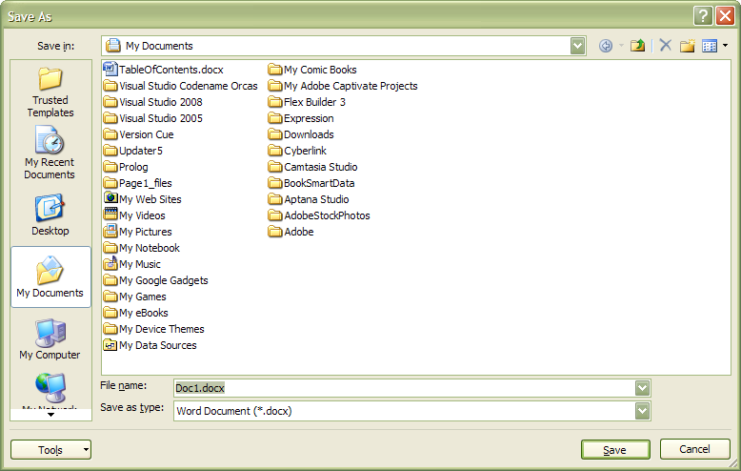
Graphics
A Component is
  A rectangular region of a computer screen
  A graphical entity
  Can sometimes contains children
    Other components that constitute the ‘parent’ component
    Can only contain children if the Component is a Container

Slide 3
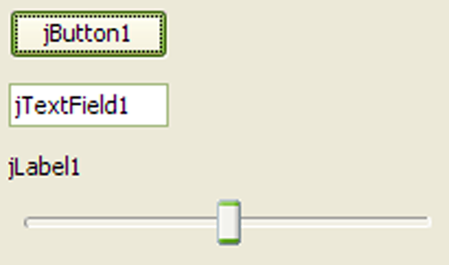
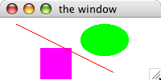
Components
Java contains some pre-defined types of components
  JFrame
  JButton
  JLabel
  JTextField
  JSlider
We will also use customized components
  Oval
  Rectangle
  Line
  EventButton
  EventField
  EventSlider

Slide 4
Components
All Components have the following traits
java.awt.Component
-int x,y,width,height -Color background
+ void repaint( ) + int getX() + int getY() + int getHeight() + int getWidth() +Color getBackground() + void setBackground(Color) + void setBounds(int, int, int, int) + void setLayout(LayoutManager) + void setLocation(int, int) + void setSize(int,int) + void setVisible(boolean)

Slide 5
Components
All Containers are Components that have the following traits
java.awt.Container
+Container() +void add(Component) +void add(Component, int) +void remove(Component) +void removeAll() +void setLayout(LayoutManager)

Slide 6
JFrame
A JFrame is a Container
A JFrame is a Window
A JFrame has a ‘title’.
JFrame
-String title
+JFrame(String)

Slide 7
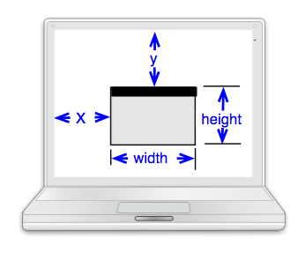
JFrame Class Specification
Invariant
A JFrame object
  is a rectangular window.
  is placed on a computer screen with its upper-left corner x pixels from the left and y pixels from the top. (The upper left corner of the screen is (0, 0).)
  has usable dimension of width pixels from side to side and height pixels from top to bottom; this region has a background color of backColor.
  has title displayed in the window's title bar

Slide 8
JFrame Class Specification
Constructor
public JFrame(String s)
post: a new JFrame (window) object is created
and s is displayed in the window’s title bar
note: this method call needs to be followed by calls to setBounds and setVisible
Update Methods
public void add(java.awt.Component pic, int j)
pre: j ==0 for best results
post: image pic will be drawn upon this JFrame
public void remove(java.awt.Component pic)
post: image pic will be removed from this JFrame (assuming it was previously added)
public void repaint()
post: this JFrame is marked to be redrawn as soon as possible
public void setBounds(int newX, int newY, int w, int h)
pre: w >= 0 and h >= 0
post: x == newX and y == newY
and width == w and height == h

Slide 9
JFrame Class Specification
Update Methods
public void setBackground(Color c)
post: backColor == c
public void setLayout(LayoutManager m)
pre: m == null (for our purposes)
post: added objects are rearranged via m
public void setLocation(int newX, int newY)
post: x == newX && y == newY
public void setSize(int w, int h)
pre: w >= 0 and h >= 0
post: width == w && height == h
public void setVisible(boolean b)
post: b == true implies this JFrame is made visible and brought to the front

Slide 10
Example (note ‘import’)
import java.awt.Color;
import javax.swing.JFrame;
public class Driver {
private JFrame blackWin, greenWin;
public Driver() {
blackWin = new JFrame("Mine");
blackWin.setBounds(10, 10, 100, 200);
blackWin.setLayout(null);
blackWin.setBackground(Color.black);
blackWin.setVisible(true);
greenWin = new JFrame("Yours");
greenWin.setBounds(150, 100, 100, 50);
greenWin.setLayout(null);
greenWin.ssetVisible(true);
greenWin.setBackground(Color.green);
}
}

Slide 11
The add method
A Component can be added to any Container
  Containers include Oval, Rectangle, JFrame
  Adding a ‘child’ to a ‘parent’
    Positions the child with respect to the parent
    A child can either zero or 1 parent
    If a child has no parent then it is not ‘seen’
    Children are added in order, so can be hidden or obscured by other children

Slide 12
The JLabel
JLabel
-int x,y,width,height -Color background
+JLabel(String) + void setText(String) + String getText(String)
import java.awt.*;
import javax.swing.JFrame;
public class Driver {
private JFrame win;
private Label wiLabel;
public Driver() {
win = new JFrame("the window");
win.setBounds(10, 10, 200, 200);
win.setLayout(null);
win.setVisible(true);
wiLabel = new JLabel("Wisconsin");
wiLabel.setBounds(10, 40, 120, 20);
wiLabel.setForeground(Color.blue);
wiLabel.repaint();
win.add(wiLabel, 0);
}
}
Note: must import java.awt.*

Slide 13
The Rectangle
Rectangle
-int x,y,width,height -Color background
+Rectangle(int,int,int,int)
import java.awt.Color;
import javax.swing.JFrame;
public class Driver {
private JFrame win;
private Rectangle box;
public Driver() {
win = new JFrame("the window");
win.setBounds(10, 10, 200, 200);
win.setLayout(null);
win.setVisible(true);
box = new Rectangle(50, 50, 10, 10);
box.setBackground(Color.magenta);
box.repaint();
win.add(box, 0);
}
}
Note: no import required for Rectangle, but Rectangle.class file must be in same folder as Driver.class.

Slide 14
The Oval
Oval
-int x,y,width,height -Color background
+Oval(int,int,int,int)
import java.awt.Color;
import javax.swing.JFrame;
public class Driver {
private JFrame win;
private Oval dot;
public Driver() {
win = new JFrame("the window");
win.setBounds(10, 10, 200, 200);
win.setLayout(null);
win.setVisible(true);
dot = new Oval(50, 50, 10, 10);
dot.setBackground(Color.magenta);
dot.repaint();
win.add(dot, 0);
}
}
Note: no import required for Rectangle, but Rectangle.class file must be in same folder as Driver.class.

Slide 15




Drawing rules for children
Children are ‘ordered’
  Children at the beginning are on top
  Children at the end are on the bottom
Two ways of adding
  add(Component) – adds at the end
  add(Component, int) – adds at the given position
Top layers may obscure lower layers
Children are always ‘clipped’ to their parents

Slide 16
Repaint
Repaint is sometimes needed to make sure that changes to an object are properly displayed
Repaint should usually be used after making some change to a component.

Slide 17
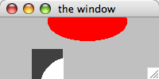
Example
import java.awt.Color;
import javax.swing.JFrame;
public class Driver {
private JFrame win, bottomWindow;
private Rectangle grayRect;
private Oval redOval, whiteDot;
public Driver() {
win = new JFrame("the window");
win.setBounds(10, 10, 200, 100);
win.setLayout(null);
win.setBackground( Color.lightGray );
win.setVisible(true);
grayRect = new Rectangle(40, 40, 40, 50);
grayRect.setBackground( Color.darkGray );
win.add(grayRect, 0);
whiteDot = new Oval(10, 10, 80, 80);
whiteDot.setBackground( Color.white );
grayRect.add(whiteDot, 0);
redOval = new Oval(60, -20, 100, 50);
redOval.setBackground( Color.red );
win.add(redOval, 0);
win.repaint();
}
}

Slide 18
Experiment
Write a program that draws this picture in the center of a 500 by 500 window.
  The “box” is 200 by 200
  The “circle” is 100 by 100

Slide 19
Another Supplier Example
When using ‘graphical’ components
  The data is called a ‘model’
  The drawing is called a ‘component’ or ‘view’
  No class should have both data and view mixed together!
Consider a BeerMug
  Develop a BeerMugModel
  Develop a BeerMugComponent

Slide 20
BeerMugModel
BeerMugModel
+BeerMugModel(int capacity) +void fill(int ozs) +void drink(int ozs) +int getLevel() +int getCapacity() +int getPercentFull() +int getTotalAmountDrunk() +boolean isEmpty() +boolean isFull()
What is the UML Class Diagram for BeerMugModel?

Slide 21
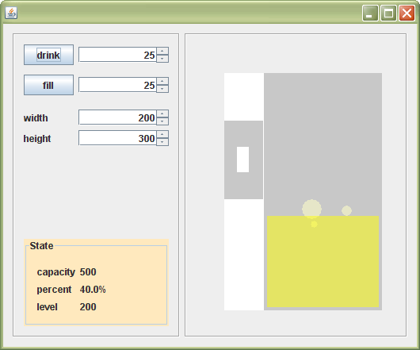
BeerMugComponent
Only task is to ‘draw’ a BeerMugModel!
  Need to know the location (x,y) and dimension (w,h)
  Possibly allow clients to choose color schemes (we won’t)

Slide 22
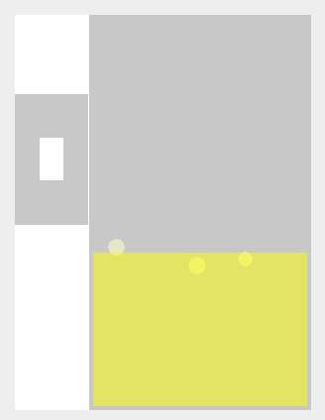
Component design
W
Must define ratios
  Given the width and the height of the mug, compute the dimensions and locations of everything else
W/4
3*W/4
H/5
H/4
H

