Slide 1
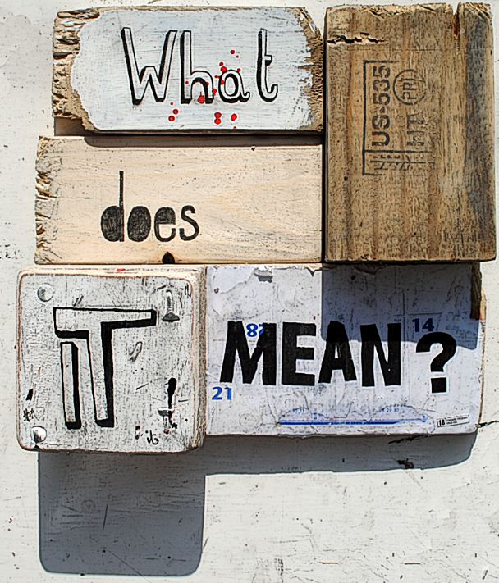
Types and Semantics
What does it mean?

Slide 2
Specifying Semantics
A BNF grammar can define the syntax of a language
No grammar can define the non-syntactic language rules.
all variables need to be declared prior to use
all variables must have been assigned a value prior to use
the types of the rhs and lhs of an assignment must be identical
Other techniques must be used to enforce rules that cannot be expressed in the grammar.
We will use a C-Like language as a case-study. The language is called "Clite"
We will describe how to write a type-checker
We will describe how to write an interpreter

Slide 3
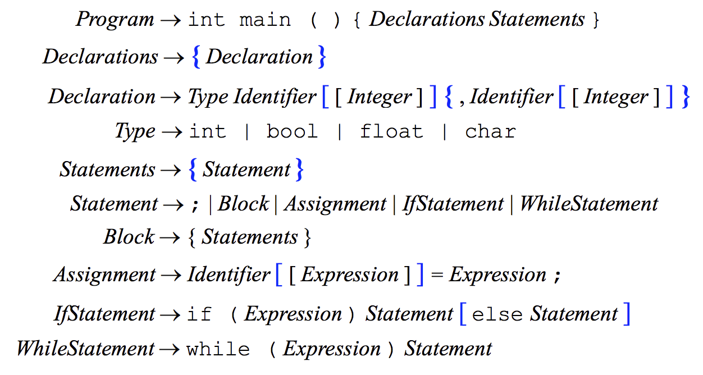

Slide 4
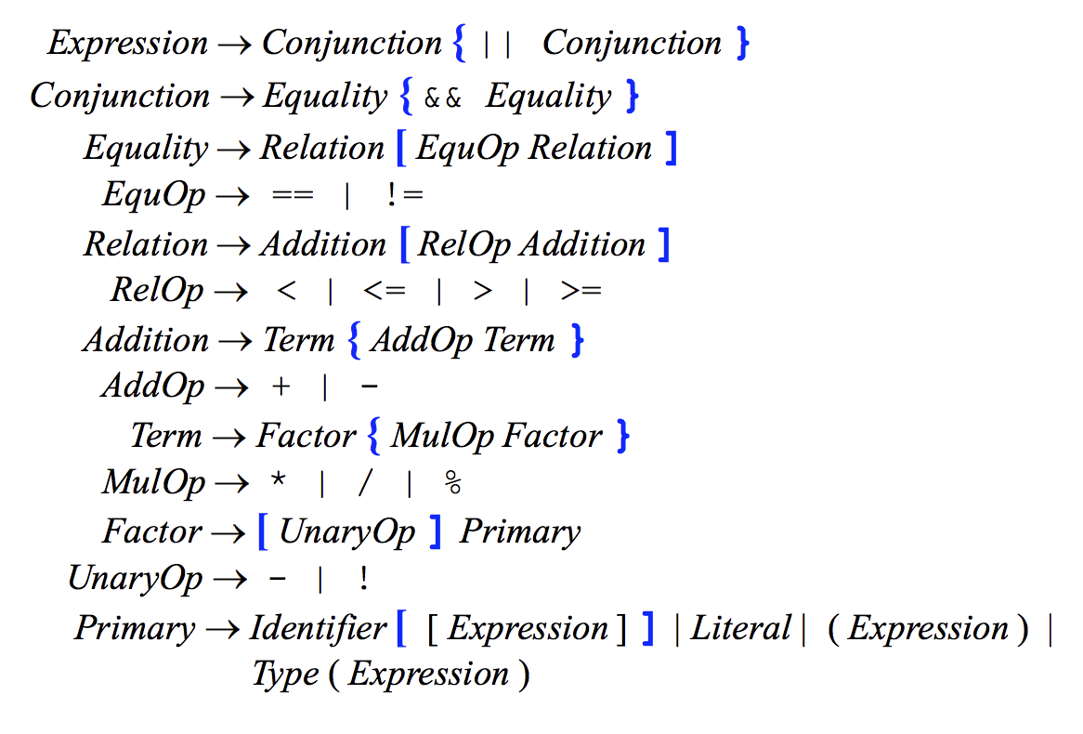

Slide 5
Abstract Syntax for CLite
Program = Declarations decpart; Block body
Declarations = Declaration*
Declaration = Variable v; Type t
Type = int | boolean | undef
Statement = Skip | Block | Assignment | Conditional | Loop
Block = Statement*
Assignment = Variable target; Expression source
Conditional = Expression test; Statement thenBranch, elseBranch
Loop = Expression test; Statement body
Expression = Variable | Value | Binary | Unary
Variable = String id
Value = int intValue | boolean boolValue
Binary = Operator op; Expression term1, term2
Operator = BooleanOp | RelationalOp | ArithmeticOp | UnaryOp

Slide 6
Semantic specification
Interpreters must implement the language semantics. There are many ways.
Operational Semantics
Program meaning defined by whatever happens on an actual computer
Axiomatic Semantics
Formal specification of what the program should do
Rigorous proof that the program does what it is supposed to do via logical reasoning
Denotational Semantics
Program defined by state-transforming functions in the abstract syntax
We’ll focus on this approach showing a Java implementation for CLite

Slide 7
Denotational Semantics
Defines the meaning of a language as a set of functions
Each function manages the environment, memory, and state of a program
Environment: the set of all active objects and their location in memory
Memory: the set of all memory addresses along with the values they hold.
State: Set of all active objects and their values
Is this C program (Clite) syntactically correct?
int main() {
int i, i, result;
n = 1;
i = true;
result = 1;
while(i < n) {
i = i + 1;
result = result * i;
}
}

Slide 8

Type Checking
An interpreter would also ‘type check’ the program for validity.
A language can be type-checked either
Statically: at compile time
Dynamically: at run time
A language is either
Strongly typed: an operation is never applied on values of inappropriate type.
Weakly typed: not strongly typed.

Slide 9
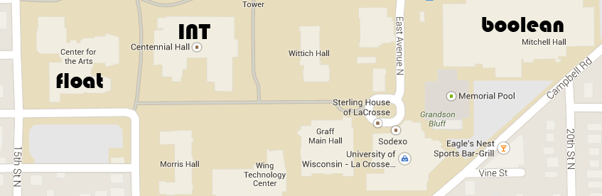
Type Maps
Before writing code to type-check or interpret a Clite program, denotational semantics requires that we formally define types and functions on those types.
type-map: a set of associations
Curly braces are used to denote a set: {}
Exactly one type map is active at any time during program execution.
association: a pair (denoted with angled brackets) consisting of a variable name and a type.
{<cost, int>, <taxRate, float>, <taxable, boolean>}

Slide 10
Type Maps
void main() {
int n, i, result;
n = 8;
i = 1;
result = 1;
while(i < n) {
i = i + 1;
result = result * i;
}
}
Consider the C-like program:
What types does C-like support?
What part(s) of this program affect the type map?
Consider writing an interpreter
The interpreter will process the constructs defined by the abstract syntax
How would you process a "Declaration"?

Slide 11
Types
void main() {
int n, i, result;
n = 8;
i = 1;
result = 1;
while(i < n) {
i = i + 1;
result = result * i;
}
}
What is the type of
i+1
result*i
i<n
How would an interpreter determine the type of an expression? Note that the interpreter is given an expression and returns a value.

Slide 12
typeOf function
typeOf only determines the type of an expression
typeOf does not determine whether the expression is correct.
typeOf(Expression e, TypeMap tm)
e.type if e is a Value
tm(e) if e is a Variable
e.op ∈ {ArithmeticOp} ⊃ int if e is a Binary
e.op ∈ {BooleanOp} ⊃ Boolean if e is a Binary
e.op ∈ {RelationalOp} ⊃ Boolean if e is a Binary
e.op ∈ {UnaryOp} ⊃ Boolean if e is a Binary
int x, y;
…
x+2*y
x<2*y
x<2*y && x>0
typeOf(x+2*y, {<x,int>,<y,int>}) = ???
typeOf(x<2*y, {<x,int>,<y,int>}) = ???
typeOf(x<2*y&&x>0, {<x,int>,<y,int>}) = ???

Slide 13
Type Checking C-LITE
void main() {
int n, i, result;
n = 8;
i = 1;
result = 1;
while(i < n) {
i = i + 1;
result = result * i;
}
}
Type checking rules include:
Each variable must have a unique identifier
Each variables type must be int or boolean
Each variable referenced must be declared
Every expression has a type determined by:
if the expression is a variable or value the type is the type of the variable or value
if the expressions operator is arithmetic (+,-,*,/) then it’s operands must be int and the resulting type is int
if the expressions operator is relational (<,<=,==,>=,>,!=) then it’s operands must be int and the resulting type is int
if the operator is logical (&&,||,!) then the operands must be boolean and the resulting type is boolean
For every assignment, the type of the target and source must be identical
For every conditional and loop, the type of it’s expression must be boolean

Slide 14
Validity of expressions
Given an expression and a type map, the expression is valid if it is
An int or boolean value:
3, true, 18
3.5, “hello”, ‘c’
A variable in the type map
Unary with a UnaryOp operator and a valid boolean operand
Binary with ArithmeticOp with two valid int operands
Binary with RelationalOp with two valid int operands
Binary with BooleanOp with two valid boolean operands
Consider a predicate named “v” for “valid”
V: AbstractSyntacticClass x Typemap → Boolean

Slide 15
Overview of Interpreter Implementation
For every non-terminal in the grammar
Define a class
Define a set of functions that operate on instances of that class
V (validity) – perform type-checking
M (meaning) – provides the meaning of the instance
class Program {
Declarations decpart;
Block body;
}

Slide 16
Semantic Domains
Environment : denoted as γ
A mapping of variables with memory locations
Memory: denoted as μ
A mapping of memory locations with values
γ = {<i, 154>, <j, 155>}
μ = {<0, undef>, …., <154, 13>, <155, -1>}

Slide 17
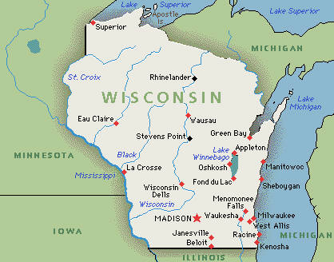
Semantic Domains
State (σ)
The product of environment and memory
For pedagogical purposes, treat the state without regard to low-level memory addressing issues.
σ = {<i, 13>, <j, -1>}
Prior to execution of any program, what is the state?

Slide 18
Semantic Domains
Define σ(exp) to be a function that returns the value of exp from the state σ
σ = {<i, 13>, <j, -1>}
σ(i) = ??
σ(i+j) = ??

Slide 19
State Transformations
Program statements usually change the state
σ = {<x, 1>, <y, 2>, <z,3>}
y = 2*z + 3;
State transformation
σ = {<x, 1>, <y, 9>, <z,3>}
w = 4;
σ = {<x, 1>, <y, 9>, <z,3>, <w, 4>}

Slide 20
State Transformations
Given state X and state Y
X over-riding-union Y : replace in X all pairs <a, v> whose first element matches a pair <a, w> from Y by <a, w> and then add to X any remaining pairs in Y.
The overriding union is a general mathematical model of assignment.

Slide 21
Denotational Semantics
Consists of three parts
Abstract syntax of the language
Semantic algebra defining a computational model
In our case – a type map, integers, booleans, state (a set of associations) and operations on those things
Mapping functions that map the syntactic constructs of the language to the semantic algebra.
The meaning of a program is then a sequence of state transformations. The meaning of a ‘program’ is the ‘final state’.
Each syntactic construct is mapped to some element of the semantic domain.

Slide 22
Denotational Semantics
The meaning function defines the meaning of program elements defined in the abstract syntax.
We define Σ to be the set of all states
The meaning function M takes an abstract syntactic element that when executed in some state produces another state.
Meaning functions are partial functions since they are not defined on all inputs
Some constructs are syntactically valid but have no meaning
for (i=1; i>-1; i++) i--;

Slide 23
Denotational Semantics
void main() {
int n, i, result;
n = 8;
i = 1;
result = 1;
while(i < n) {
i = i + 1;
result = result * i;
}
}
A program is a tree that is defined in terms of each of its parts
Define the meaning functions for every part
Combine meanings of the parts to define the meaning of the program
What are the parts whose meaning must be defined in the above example?
What is the meaning of a program?

Slide 24
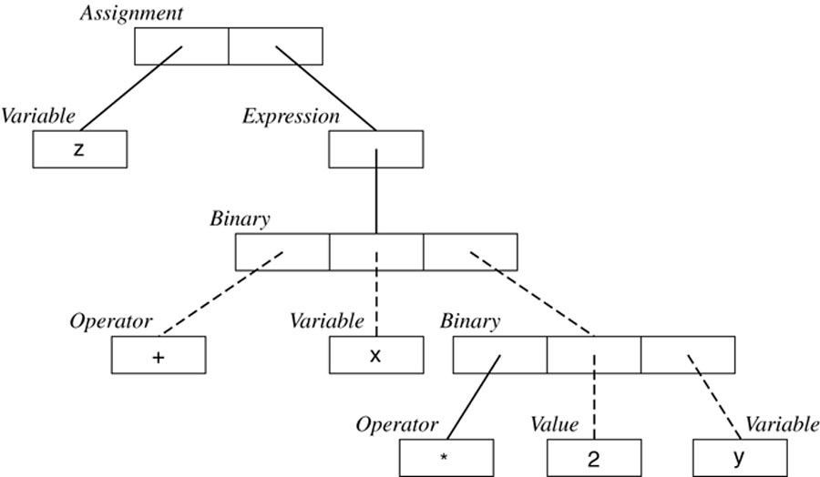
Assignment : Meaning
Abstract syntax tree for an assignment z=x+2*y;

Slide 25
Assignment : Meaning
The meaning of an assignment statement is the sate produced by the assignment.
Consider the assignment "z = x + 2 * y"
Execute in state = { <x, 2>, <y, -3> <z, 75> }

Slide 26
Expressions : Meaning
Write an ApplyBinary function to help us define what an expression means
This function accepts a binary operator (+, -, *, /) and two values
This function produces a value
There is no change to the state
ApplyBinary : Operator x Value x Value → Value
AppyBinary(Operator op, Value v1, Value v2)
= v1+v2 if op = +
= v1-v2 if op = -
= v1*v2 if op = *
= floor(|v1 / v2|) x sign(v1*v2) if op = /
Notes:
The division is complicated by the floor function. Consider the floor of -6/10 is -1. It should really be 0.

Slide 27
Expressions : Meaning
The meaning of an expression can then be described in terms of ApplyBinary
M : Expression x State → Value
M(Expressione e, State s)
e if e is a Value
s(e) if e is a Variable
ApplyBinary(e.op, M(e.term1, s), M(e.term2, s)) if e is a Binary
Example: Compute the meaning of the expression: x+2*y

Slide 28
Axiomatic semantics
Axiomatic Semantics are a more rigorous and general technique for semantic specification
The meaning of a language construct is defined by a pre-condition and post-condition.
The pre-condition is a predicate that characterizes all possible states in which construct might be executed.
The post-condition is a predicate that characterizes all possible states that might be generated by execution of the construct
The meaning of a language construct C is then given by the pre and post conditions.
Pascal is a language designed with proof rules.

