Slide 1
Names
What's in a name?

Slide 2
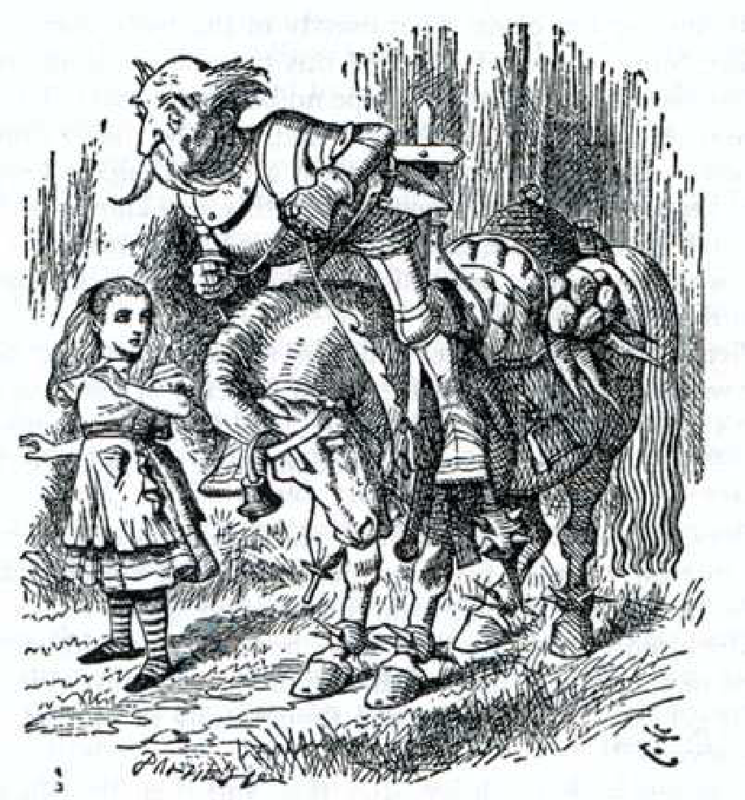
Names and Such
“You are sad," the Knight said in an anxious tone: let me sing you a song to comfort you.“
“Is it very long?" Alice asked, for she had heard a good deal of poetry that day.
“It's long,” said the Knight, “but it's very, very beautiful. Everybody that hears me sing it - either it brings the tears into their eyes, or else“
“Or else what?” said Alice, for the Knight had made a sudden pause.
“Or else it doesn't, you know. The name of the song is called `Haddocks' Eyes'.“
“Oh, that's the name of the song, is it?" Alice said, trying to feel
interested.
“No, you don't understand," the Knight said, looking a little vexed. That's what the name is called. The name really is `The Aged `Aged Man'."
Then I ought to have said `That's what the song is called'?" Alice
corrected herself.
“No, you oughtn't: that's quite another thing! The song is called `Ways And Means' : but that's only what it's called, you know!"
“Well, what is the song, then?" said Alice, who was by this time
completely bewildered.”
“I was coming to that," the Knight said. “The song really is `A-sitting On A Gate': and the tune's my own invention."

Slide 3
Name Binding
Binding – an association between a programmatic entity and a property.
Static binding: a binding is static if the association occurs before run-time.
Dynamic binding: a binding is dynamic if the association occurs at run-time.
Name Binding:
Associating an entity with a name

Slide 4
Names (Identifiers)
A variable is the binding of a name to a memory address. In addition, a variable has a type, a value and a lifetime.
Reserved words (keywords): words that have a pre-defined meaning that can’t be used as identifiers.
Pre-defined identifiers: words that have a pre-defined meaning that can be used as identifiers.
program yecch;
var true : boolean;
begin
true := false;
…
end.
public void foo() {
boolean true;
true = false;
…
}
Pascal
Does this work in C?

Slide 5
Variables
What is a variable anyway? In particular, what does the computer 'see' when it sees a variable name?
For example: what does this mean?
x = x + 1;
A variable is a binding between a name and a memory address.
Has a type
Has a value
Has a lifetime
A variable has two interpretations when seen by the computer:
lvalue : the memory location of x
value : the value at that memory location

Slide 6

Scope
Scope: the collection of statements which can access a name binding
Static scoping computed at compile time, based on program text
Subprograms and blocks generate a hierarchy of scopes
Two different scopes are related as either
Disjoint : Neither scope is contained in the other
Nested : One of the scopes is contained in the other
Defining scope: the scope in which a name is defined or declared.
Subprogram or block that declares current subprogram or contains current block is its static parent
Locality: A name is nonlocal if it occurs in a nested scope of the defining scope and is local otherwise.

Slide 7
Program Elements Defining Scope
 | Algol | C | Java | Ada
Package | n/a | n/a | Yes | Yes
Class | n/a | n/a | Nested | Yes
Function | Nested | Yes | Yes | Nested
Block | Nested | Nested | Nested | Nested
For Loop | No | No | Yes | automatic

Slide 8
Example
To find the declaration
First see if variable is local; if yes, done
If non-local recursively search static parent until declaration is found
If no declaration is found this way, undeclared variable error detected
void sort (float a[ ], int size) {
int i, j;
for (i = 0; i < size; i++){
for (j = i + 1; j < size; j++) {
if (a[j] < a[i]) {
float t;
t = a[i];
a[i] = a[j];
a[j] = t;
}
}
}
}
For every variable: identify locality

Slide 9
Static Scoping
A symbol table is a data structure used by a compiler that allows it to keep track of each declared name and its bindings.
A dictionary is a data structure that associates a name with it’s declaration.
Algorithm for finding nonlocal variable declarations:
Each time a scope is entered, push an empty dictionary onto a stack
Each time a scope is exited, pop the stack
Each time a declaration is encountered – bind the name to the declaration using the dictionary at the top of the stack
Each time a variable reference is encountered – search the top-most dictionary for the variable and it’s declaration. If not found, repeat going down the stack from top to bottom. If not found in the bottom-most dictionary, “unresolved symbol”.

Slide 10
Example: static scoping
int h, i;
void B(int w) {
int j, k;
i = 2*w;
w = w+1;
…
}
void A(int x, int y ) {
float i, j;
B(h);
i = 3;
…
}
void main() {
int a, b;
h = 5;
a = 3;
b = 2;
A(a, b);
B(h);
…
}
How would a compiler determine the variable bindings of this program using static scoping?
When a scope is entered, push an empty dictionary onto a stack
When a scope is exited, pop the stack
When a declaration is encountered – bind the name to the declaration using the dictionary at the top of the stack
When a variable reference is encountered – search the top-most dictionary for the variable and it’s declaration. If not found, repeat going down the stack from top to bottom. If not found in the bottom-most dictionary, “unresolved symbol”.

Slide 11
Dynamic Scope (not dynamic tyPE)
Usually not supported. Most programmers think this is bad.
Main example: original versions of LISP
Common LISP uses static scope
Perl allows variables to be declared to have dynamic scope
Determined by the calling sequence of program units; not static
Name bound to it’s most recent declaration based on the programs execution history.
A dictionary stack is constructed as the program executes.

Slide 12
Example: Dynamic scoping
int h, i;
void B(int w) {
int j, k;
i = 2*w;
w = w+1;
…
}
void A(int x, int y ) {
float i, j;
B(h);
i = 3;
…
}
void main() {
int a, b;
h = 5;
a = 3;
b = 2;
A(a, b);
B(h);
…
}
How would a compiler determine the variable bindings of this program using dynamic scoping?
When a scope is entered, push an empty dictionary onto a stack
When a scope is exited, pop the stack
When a declaration is encountered – bind the name to the declaration using the dictionary at the top of the stack
When a variable reference is encountered – search the top-most dictionary for the variable and it’s declaration. If not found, repeat going down the stack from top to bottom. If not found in the bottom-most dictionary, “unresolved symbol”.

Slide 13

Visibility
Visibility: A name is visible if its containing scope includes the name and the name is not declared in an inner scope.
public class Student {
private String name;
Student(String name) {
name = name;
}
public String getName() {
return name;
}
}

Slide 14
Overloading
Overloading uses the number or type of arguments to distinguish among identical function names or operators.
public class Student {
private String name;
public String name() {
return name;
}
public String name(int n) {
return name.substring(0, n);
}
…
}

Slide 15
Lifetime
Lifetime is the time during which an object is stored and accessible in memory.
The scope of the counter is the method foo.
The lifetime of the variable is congruent with program execution
int foo() {
static int numberOfTimesFooHasBeenCalled;
// do something
}

Slide 16
Names (Identifiers)
Many languages support organized namespaces
A heirarchical container for names/named items
In Java, names have both a “simple” and “fully qualified” version
the “simple” version is the name of the class
The “fully qualified” name is the name of the package appended by the simple name
String word = “Hello”;
Vector words = new Vector();
“Simple” or “fully qualified”?
java.lang.String word = “Hello”;
java.util.Vector words = new java.util.Vector();

Slide 17
Names (Identifiers)
C doesn’t support organized namespaces
Each name is part of a global space
Name clashes are frequent in large coding projects
Typically resolved by establishing naming conventions
Name clash: two things are given the same name.
Consider a large project where an ordering system and a restaurant booking system are being developed in parallel. Both projects would create a Customer class however their implementations would be different. The ordering system views the customer as a corporate entity, the restaurant system views the customer as an individual. In this situation we have two very different implementations of the Customer class but with a single namespace there can only be one class called Customer.
This problem is usually solved by prefixing class names with an application code. For example, the ordering system could be known as the 'OE' application and the restaurant booking system as 'RB'. The name clash problem is solved by creating the OECustomer and RBCustomer classes. Prefixing class names with project codes is common practice when working with languages supporting a single namespace.

Slide 18
C++ Namespaces
C++ has a “namespace” mechanism for resolving name clashes
class Vector {
public:
Vector();
~Vector();
operator[] (int i);
private:
int d_data[];
}
Vector::Vector() {
… some code here…
}
Vector::~Vector() {
… some code here…
}
int Vector::operator[](int i) {
return d_data[i];
}

Slide 19
C++ Namespaces
namespace ENS {
namespace GovSim {
using namespace ENS::GovSim::Vista;
using namespace Vista;
using namespace GovSim::Vista;
namespace Vista {
Vector::Vector() {
}
Vector::~Vector() {
}
int
Vector::operator( int i ) {
return d_data[i];
}
class Vector {
public:
Vector();
~Vector();
operator[] (int i);
private:
int d_data[];
}
}
}
}

