Slide 1

Memory Management

Slide 2
Memory Management
The process of binding values to memory
Requires deep understanding of both the dynamic and static characteristics of a program
Three types of memory
  Static: used to store values that are known at compile time and are constant throughout program execution. Also stores variables whose lifetime is equal to the programs duration.
  Runtime Stack: used to store local variables and “hidden” details of procedure calls
  Heap: used to store everything else (i.e. dynamically allocated objects)
class Program {
public static void main(String[] args){
Vector v = new Vector();
for(int i=0; i<10; i++){
v.add(new Integer(i));
}
for(int i=0; i<10; i++){
System.out.println(v.get(i));
}
}
}

Slide 3
Overview of Memory
A program has an address space – the program may only use memory from the address space.
The address space is broken into the sections shown to the right.
This program has n+1 bytes available for use
Note:
  The size of the static area is fixed at compile time
  The top of the stack is address (a-1) which varies as the program executes
  The beginning of the heap is at address h which is fixed at the beginning of execution
  The value n determines the amount of memory available in total and is fixed at the beginning of execution
0
1
.
.
.
.
.
a-1
a
.
.
.
.
.
.
h
.
.
n
Static Area
Stack
Available but unused
Heap

Slide 4


Methods
int max(int a, int b) {
int result;
if(a > b) result = a;
else result = b;
return result;
}
…
int x=10, y=30;
int z = max(x,y);
formal parameters
local variable
method call
actual parameters

Slide 5
Methods
How are actual parameters matched with formal parameters?
int max(int a, int b) {
int result;
if(a > b) result = a;
else result = b;
return result;
}
…
int x=10, y=30;
int z = max(x,y);
By position
(Java, C, C++, ML, Prolog, Ada, etc…)
max(12, 10)
By keyword
(Ada)
max(b=>10, a=>12)
double ipayment(double principle,
double numberOfPeriods,
double periodicRate,
double period) { … }
double interest = ipayment(period=>p,
principle=>loanAmount,
numberOfPeriods=>360,
periodicRate=>.0038)

Slide 6

Methods
How are formal parameters matched with actual parameters?
C++ matches by position but optional parameters are allowed
  Optional arguments are assigned a default value using the “=“ operator
  Arguments without a default value are required.
  Arguments with a default value are optional
int silly(int a=10, int b=20, int c=30) {
return a+b+c;
}
int willy(int a=10, int b=20, int c) {
return a+b+c;
}
int w=50, x=60, y=70;
int r1 = silly();
int r2 = silly(w);
int r3 = silly(w,x);
int r4 = silly(w,x,y);
int w=50, x=60, y=70;
int r1 = willy();
int r2 = willy(w);
int r3 = willy(w,x);
int r4 = willy(w,x,y);

Slide 7
Methods
How are formal parameters matched with actual parameters?
  Some languages support methods with explicit notation for variable-length argument lists
For example
String longestString(String… strings) {
// code goes here
}
Can the function then be called using:
String x = longestString();
String x = longestString(“hi”);
String x = longestString(“hi”, “there”);

Slide 8

Methods
If a method allows variable argument lists, how are the arguments named in the function itself?
For example
String longestString(String… strings) {
// How to refer to the first arg?
String firstArg = ???;
// other code here
}
Java supports variable argument lists.
  The actual args are packaged into an array and passed to the method
  The formal parameter (syntactically indicated by …) is actually an array
  Ellipses are a syntactic convenience for dispensing with array manipulation

Slide 9
Methods
Whenever a method is invoked, memory is needed on the stack
Methods need memory for
  arguments
  local variables
  administrative values (to keep track of program flow)
The memory associated with a single method is a stack frame
  A stack frame exists as long as the owning method is active. When the method is no longer active, the stack frame is no longer needed.
Where is my code and global data?
Where is the stack frame that called me?
Static Link
Dynamic Link
Argument variables
Local variables

Slide 10
Layout of Activation Records (C)
Incoming Parameter n
….
Incoming Parameter 2
Incoming Parameter1
Caller Saves
This frame
Local Variables
Callee Saves
Temporary Storage
(for computing expressions)
Top of
Stack
Outgoing Parameters
Incoming for next frame
Next frame
Local variables are referenced as an offset from the Frame Pointer Computed at compile time

Slide 11
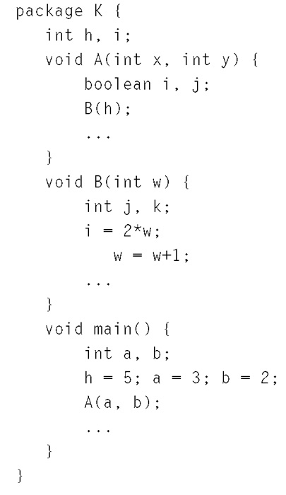
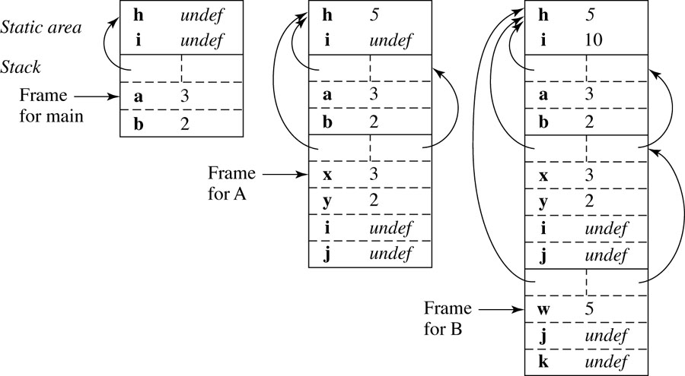

Example Program for Stack Frames

Slide 12

Parameter Passing Styles
When a method is called information is passed between the caller and the called method.
Direction of communication
  1) actual parameters to formal parameters (in mode)
  2) formal parameters to actual parameters (out mode)
  3) both (in-out mode)
Communication between the caller and the callee
  a) at the onset of the call
  b) throughout the call
  c) when the call ends

Slide 13

Passing Styles
Direction of communication
  1) actual parameters to formal parameters (in mode)
  2) formal parameters to actual parameters (out mode)
  3) both (in-out mode)
Communication between the caller and the callee
  a) at the onset of the call
  b) throughout the call
  c) when the call ends
Pass by value (1a)
  the value of the parameter is accessible by the callee at any time
Pass by result (2c)
  the value of the parameter is accessible by the caller after the subprogram ends
Pass by value-result (3ac)
  the value of the parameter is accessible by the callee at any time. Changes to that value will only be known by the caller after the subprogram ends
Pass by reference (3b)
  value of the parameter is shared between the caller and the callee
Pass by name (3b)
  more complex than the rest...

Slide 14

Argument-Parameter Linkage
Pass by value:
  An implementation of in-mode parameters
  The formal parameter is just like a local variable with the initial value provided by the caller
  The value of the actual argument is obtained at the time of call
  This value is used to initialize the corresponding formal parameter
void swap(in-mode int a, in-mode int b) {
int z = a;
a = b;
b = z;
}
void main() (
int x = 5;
int y = 7;
swap(x,y);
printf(“x=%d, y=%d\n”, x, y);
}

Slide 15

Argument-Parameter Linkage
Pass by reference
  An implementation of in-out-mode parameters
  The address (lvalue) of the argument is obtained at the time of call
  This address (lvalue) is given to the called method
  In effect, the formal parameter becomes an alias for the actual parameter
void swap(in-out int a, in-out int b) {
int z = a;
a = b;
b = z;
}
void main() (
int x = 5;
int y = 7;
swap(x, y);
printf(“x=%d, y=%d\n”, x, y);
}
Early Fortran allowed only pass-by-reference
Well-known bug allowed “constants” to change
void Foo(int x) { x = 10; }
Foo(3) ???

Slide 16

Argument-Parameter Linkage
Pass by reference difficulties
  A method can change the value of variables outside of it’s scope
  What to do with expressions?
Ouchhh. That hurts.
void swap(in-out int a, in-out int b) {
int z = a;
a = b;
b = z;
}
void main() (
int x = 5;
int y = 7;
swap(x+y*2, y+3);
printf(“x=%d, y=%d\n”, x, y);
}

Slide 17

Argument-Parameter Linkage
Pass by reference difficulties
  Aliasing presents difficulties in general….
  Difficult to predict all implications
int sumOfOneToN(in-out int n, in-out int answer) {
answer = 0;
int i = 1;
while(i < n) answer += (i++);
}
void foo() (
int x = 5, y;
sumOfOneToN(x, y);
printf(“%d\n”, y);
}
Change to x!

Slide 18
Argument-Parameter Linkage
Pass by result
  An implementation of out-mode parameters
  The argument is treated as a local variable
  Immediately prior to terminating the method, the value is copied back to the caller
void ooops(out int a, out int b) {
a = 12;
b = 8;
}
void main() (
int x = 5;
int y = 7;
oops(x,x);
printf(“x=%d, y=%d\n”, x, y);
}
void times2(in int a, out int b) {
b = 2 * a;
}
void main() (
int x = 5;
int y = 7;
times2(x,y);
printf(“x=%d, y=%d\n”, x, y);
}

Slide 19
Argument-Parameter Linkage
The formal parameter, as it is called in the procedure header, named Variety1, is of mode in which means that it is an input parameter, and therefore cannot be changed within the procedure. Variety1, along with Variety2 for the same reason, is a constant within the procedure, and any attempt to assign a value to it will result in a compile error. The formal parameter named Total, however, is of mode out and can therefore have a new value assigned to it within the procedure. Ada 83 defined that the out mode variable could not be read, but Ada 95 has relaxed this requirement and permits you to read the out mode variable within the procedure. Extra care must be taken that you do not attempt to read the value of an out mode parameter that has not yet been initialized to some meaningful value. Parameters that are of the modes in or in out do not have this problem since they are initialized, by definition, when the procedure is called.
If a parameter is defined as being of mode in out, it can be both read from and written to. If no mode is given, the system will use mode in as a default.
Pass by result (Ada example)
with Ada.Text_IO, Ada.Integer_Text_IO;
use Ada.Text_IO, Ada.Integer_Text_IO;
procedure Proced3 is
Dogs, Cats, Animals : INTEGER;
procedure Total_Number_Of_Animals(Variety1 : in INTEGER;
Variety2 : in INTEGER;
Total : out INTEGER) is
begin
Total := Variety1 + Variety2;
end Total_Number_Of_Animals;
begin
Dogs := 3;
Cats := 4;
Total_Number_Of_Animals(Dogs, Cats, Animals);
Put("The total number of animals is");
Put(Animals, 3); New_Line;
end Proced3;
-- Result of execution -- The total number of animals is 7

Slide 20
Examples
swap(int x, int y) {
int z;
z = x;
x = y;
y = z;
}
main() {
int i=0;
int A[3]=[1,2,3];
swap(i,A[i]);
print(”i=%d, A=%d",i,A);
}
Pass by value
  i=0, A=[1,2,3]
Pass by reference
  i=1, A=[0,2,3]
Pass by value-result
  i=1, A=[0,2,3] ?
  i=1, A=[1,0,3] ?

Slide 21

Argument-Parameter Linkage
Summary of pass by reference and pass by value
  Pass by value:
    Safer: a method can’t alter variables outside of it’s scope
    Requires copying of values
    Used in Java for primitives only (although really used for all parameters)
  Pass by reference
    Not as safe: a method can alter variables outside of it’s scope
    Requires copying a reference only
    Used in Java for Objects (kind of)
    Most imperative languages support this as an option

Slide 22
Call by Name
The name of the actual argument is textually copied to the called method.
  Seldom implemented!
  Macros, however, are closely related and often used…
In a C macro
  Actual parameters are textually substituted for the formals
  Resulting code body is textually substituted for the call
  This is done at compile time!
#define square(A) A*A
int main(int argc, char**args) {
int x = 5;
x = square(x);
}
change to “x+1”

Slide 23
Dynamic Data
Dynamically allocated data comes from heap memory.
  The lifetime of heap-allocated-memory extends until the memory is released either by a garbage-collection mechanism or by the program itself.
Local variables are allocated on the stack.
  The lifetime of stack-allocated memory extends until the method terminates

Slide 24
Garbage Collection
In C, memory management is entirely the responsibility of the programmer
In Java, memory management is entirely the responsibility of the JVM.
The central issues are
  How does the JVM identify unreachable objects
  How does the JVM free the objects
  When does the JVM free those objects

Slide 25
Garbage Collection
Reference Counting is the simplest technique for identifying unreachable objects
  Associate a reference count with each object
  This count increases whenever an object is bound to a variable name (this happens at assignment)
  The count decreases whenever an object is unbound (this also happens at assignment).
  The count is not accessible to Java programmers (or to Java programs) but is manipulated entirely by the JVM. Some hidden work takes place with every assignment.

Slide 26
Example
Consider this code:
The JVM might implement the assignment statement r1 = r2; as:
Object r1 = new Integer(12);
Object r2 = r1;
r1 = null;
r2 = null;
if(r1 != r2) {
if(r1 != null) {
r.count--;
}
r1 = r2;
if(r1 != null) {
r.count++;
}
}

Slide 27
Example
What about more complex objects?
After nulling r1, it’s count is zero but the counts of other objects are not. Modification of the reference count would ripple through the graph of objects and adjust counts as necessary as it frees memory.
public class Pair {
Integer one;
Integer two;
}
Object r1 = new Pair(new Integer(12),
new Integer(21));
r1 = null;

Slide 28
Example
public class Node {
public Node next;
public Node(Node n) { next = n; }
}
Node head = new Node(null);
head = new Node(head);
head = new Node(head);
Node tail = …find tail…
tail.next = head;
head = null;
What about cycles?
Reference counting fails in the presence of cyclic data structures.
Summary:
  Reference counting is simple
  Requires the use of an extra counting variable for each object created
  Doesn’t work, however, with cycles

Slide 29
Mark and Sweep
Mark and Sweep
  Whenever heap memory is requested:
    The request is fulfilled because memory is available
    The request is fulfilled because unreachable objects are identified and freed by mark-and-sweep which frees enough memory to fulfill the request
    The request is not fulfilled because there is not enough memory even after mark-and-sweep
  Whenever an object is released
    The object is no longer a ‘root’ object. It is no longer on the runtime stack. The memory of the object is not released. The object is simply not on the stack.

Slide 30
Mark and Sweep
Allocation is occasionally slow but usually fast.
Releasing is fast (don’t really do anything)
After marking, every reachable object has been marked as 'true'.
void markAndSweep() {
for every root object REF
mark(REF)
sweep();
}
void mark(Reference REF) {
if(!REF.isMarked()) {
REF.marked = true;
for each object REF2 referenced by REF
mark(REF)
}
}
void sweep() {
for each Reference REF in the heap
if(REF.marked) {
REF.marked = false;
} else {
free(REF);
}
}
}

