Slide 1
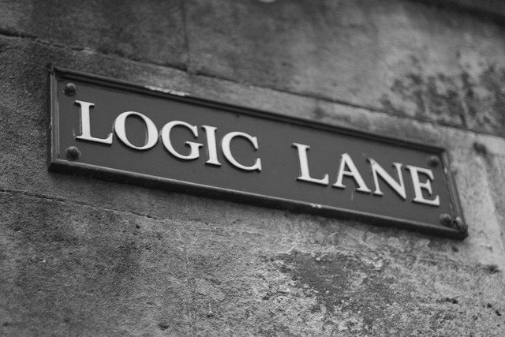
Logic Programming
Or Implies And Not?

Slide 2
Logical Programming
Prolog is a declarative language
Don't describe procedures for obtaining answers
Rather, describe (declare) facts and knowledge
Information can then be deduced from these facts
Prolog is the predominant logic language. Mathematica is another good example.
isLogicalLanguage(prolog).
IsLogicalLanguage[Mathematica] := True;
Prolog possess two features
Nondeterminism: numerous solutions to a problem may be returned
Backtracking: built-in searching of solution space

Slide 3
Propositional Logic : Review
A proposition is defined using terms and connectives.
Term: a single-letter variable that denotes a logical value
Connectives: the logical operators
Define proposition as follows:
Each of the following is a proposition
a term is a proposition
true is a proposition
false is a proposition
If P and Q are propositions then so are
¬P : negation
P∧Q : conjunction
P∨Q : disjunction
P⊃Q : implication
P≡Q : equivalence

Slide 4
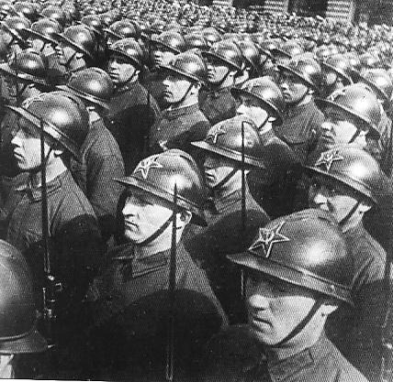
First Order Logic : Review
Predicate logic expands on propositional logic by adding predicates and variables.
A predicate is a boolean-valued relation
isPrime(x) : true if x is a prime number
speaks(x, y) : true if person x speaks language y
0 ≤x+y : true if the sum of x and y is non-negative
quantified expressions involve
∃ : there exists
∀ : for all
∃x(speaks(x, Russian))
∀x(speaks(x, Russian))
∀x ∃y(speaks(x, y))

Slide 5

Classification : Review
Propositions that are true for all possible values are known as tautologies
P or not P
Propositions that are false for all possible values are known as contradictions. They are also unsatisfiable.
P and not P
Predicates that are true for some possible values of their values are known as satisfiable
isEven(x)
isOdd(x)

Slide 6
Logic and Prolog
Prolog uses first order logic.
predicates and objects start with lower-case letters
variables start with upper-case letters
A Prolog program is a knowledge base where each statement/rule is a predicate that ends with an implication. Something like

Slide 7
Prolog Data Types
A single data type: “term”
A term is either
Atom: x, y, ‘symbol’, []
Numbers:
Variables: string beginning with upper-case alphabetic character
Compound term: function (functor) with arguments
A “list” is a compound term having special notational support
[] – the empty list
[1,2,3] – a list of 3 elements

Slide 8
Rules (Horn Clauses)
A rule states that a predicate is true if other predicates are true. A rule is written as
P1 := P2, P3, P4.
For example, consider the following knowledge base
a :- b, c, d.
b.
c.
d :- e.
e.
We can infer some things from the knowledge base
We can ask "is 'a' true"?
We can ask "is 'd' true"?

Slide 9

Prolog
A prolog program does not use “functions” but uses “relations”
brother(sam, bill).
brother(sam, bob).
These rules are understood to mean that
sam is 'brother' to bill.
sam is 'brother' to bob.
Or simply that sam and bill are related as brothers.
Brother is not a function since it maps a single “input” to two different outputs (bill AND bob)
There are no variables in the rules above. sam and bill are data.

Slide 10

Rules with Variables
We can use predicates and variables in rules. Variables are upper-case.
speaks(mary, english).
speaks(john, english).
speaks(john, swahili).
speaks(sarah, swahili).
canSpeakWith(P1, P2) :- speaks(P1,L), speaks(P2,L)
Given this knowledgebase, we can ask questions
speaks(mary,L).
canSpeakWith(mary,P).
speaks(P,english).
speaks(john,P).
canSpeakWith(john,P). // note that this returns some odd stuff

Slide 11
Practical Prolog
Identifiers that begin with a capital letter or an underscore character are taken as variables; all other identifiers are treated as constants.
There must be no space between the name of the predicate and the left parenthesis that opens its argument list.
All facts, rules, and queries must end with a period.
Any code file to be consulted MUST END WITH A CARRIAGE RETURN! Consulting a file that does not have a final carriage return causes Prolog to die.

Slide 12
Example
Assume that the following file is named “teachers.pl”
Load the file by “>consult(teachers)”
Query the file by “>teaches(X, cs, 120)”
X = hunt ;
X = zheng ;
No
teaches(hunt, cs, 120).
teaches(riley, cs, 220).
teaches(periyasami, cs, 341).
teaches(hunt, cs, 421).
teaches(zheng, cs, 120).
teaches(gendreau, cs, 364).
teaches(kelly, math, 120).

Slide 13
Example
Query the file by “>teaches(Prof, Dept, 120)”
Prof = hunt
Dept = cs ;
Prof = zheng
Dept = cs ;
Prof = kelly
Dept = math ;
No
teaches(hunt, cs, 120).
teaches(riley, cs, 220).
teaches(periyasami, cs, 341).
teaches(hunt, cs, 421).
teaches(zheng, cs, 120).
teaches(gendreau, cs, 364).
teaches(kelly, math, 120).

Slide 14
Practical Prolog
Write a query that will return all computer science teachers
Query the file by “>teaches(Prof, cs, Course)”
teaches(hunt, cs, 120).
teaches(riley, cs, 220).
teaches(periyasami, cs, 341).
teaches(hunt, cs, 421).
teaches(zheng, cs, 120).
teaches(gendreau, cs, 364).
teaches(kelly, math, 120).

Slide 15
Geneaology
Given
man / woman relationships
parent : parent – child
father : father – child
mother : mother - child
Write the following relations
son : child – parent
daughter : child – parent
sibling : child1 – child2
uncle : person – uncle
aunt : person – aunt
grandparent : person – grandparent
person :
descendant : person - person
ancestor : person - person
man(adam).
man(peter).
man(paul).
woman(mary).
woman(eve).
parent(adam,peter).
parent(eve,peter).
parent(adam,paul).
parent(mary,paul).
father(F, C) :- parent(F, C), man(F).
mother(M, C) :- parent(M, C), woman(M).

Slide 16
Prolog Lists
Lists are a fundamental prolog data type
Comma separated values in square brackets: [1, 2, 3, 4]
Empty list: []
A vertical bar:
Indicates the HEAD – TAIL division
[X | Y] indicates a list with head X and tail Y
Can write list-processing predicates
first
last
member-of
head of length N

Slide 17

Examples
First
first([X|Y], X).
Last
last([X], X).
last([X|Y], Z) :- last(Y, Z).
Member
member([X|Y],X).
member([X|Y],Z) :- member(Y,Z).
Head of length N
head([X|Y], 1, [X]).
head([X|Y], N, [X|Z]) :- NM is N – 1, head(Y, NM, Z).

Slide 18
Prolog Lists
Write a relation to remove the first occurrence of an item from a list
takeout(X,[X|Y], Y).
takeout(A,[B|C],[B|D]) :- takeout(A,C,D).
> takeout(2,[1,2,3,4],Y).
Y=[1,3,4]
no
> takeout(X,[1,2,3,4],Y).
X=1, Y=[2,3,4]
X=2, Y=[1,3,4]
X=3, Y=[1,2,4]
X=4, Y=[1,2,3]
no

Slide 19
Arithmetic and Evaluation
Logical and arithmetic operators can be used with either prefix or infix notation
3<6.
Yes
<(3,6)
Yes
Be careful about evaluation of these things!
=(5+2,3+4).
No!!!!
The patterns 5+2 and 3+4 are not the same. They are not evaluated. Try the following:
=(3+4, X).

Slide 20
Arithmetic and Evaluation
The “is” predicate forces evaluation
X is 4+3
X takes on the value 7
The “is” predicate requires all right-hand symbols to be known (instantiated).
X is 4+Y.
results in an error if Y is not known.
Example: Write a list-length relation:
listLength([], 0).
listLength([X|Y], Z) :- listLength(Y,Q), Z is Q+1.

Slide 21
Unification
Associates values to variables using unification
Variables are instantiated to actual values
In unification
A constant (atomic term) unifies only with itself
Two structures unify only if they have the same head, the same number of arguments, and each of the arguments unify
A variable unifies with anything
For each pair below, do they unify?
f( a, g(b,a) ) and f( X, g( Y, X ) )
f( g(Y), h(c,d) ) and f( X, h( W, d ) )
The variable assignments are known as the unifiers.

Slide 22
Equality Testing
Equality testing means "do they unify".
Examples:
?- kenny = kenny
Yes
?- kenny = hunt
No
?- likes(Person, fries) = likes(kenny, Food)
Person = kenny
Food = fries;
No
?- likes(Person, Food) = likes(kenny, Food)
Person = kenny
Food = _G138

Slide 23
Searching/Backward Chaining
Prolog follows a depth-first search
rainy(seattle).
rainy(madison).
cold(madison).
snowy(City) := rainy(City), cold(City).
Consider the query
?- snowy(X).

Slide 24
Backward Chaining
snowy(X)
rainy(seattle).
rainy(madison).
cold(madison).
snowy(City) := rainy(City), cold(City).
X=City
snowy(City)
rainy(City)
cold(City)
City=seattle
cold(seattle) fails
City=madison
rainy(seattle)
rainy(madison)
cold(madison)

Slide 25
Infinite Regression
The search for a resolution is ordered and depth-first
Ordering is fundamental in recursion
Inappropriate ordering of the terms may result in non-terminating resolutions (infinite regression)
For example: Graph
edge(a,b). edge(b, c). edge(c, d).
edge(d,e). edge(b, e). edge(d, f).
path(X, X).
path(X, Y) :- edge(Z, Y), path(X, Z).
path(a,a)
path(a,d)

Slide 26
Infinite Regression
For example: Graph
edge(a,b). edge(b, c). edge(c, d).
edge(d,e). edge(b, e). edge(d, f).
path(X, Y) :- path(X, Z), edge(Z, Y).
path(X, X).
path(a,a)
path(a,d)

Slide 27
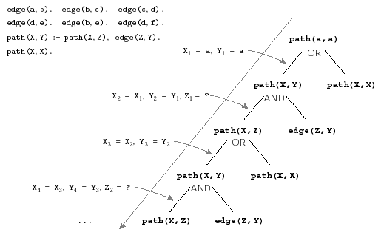
Infinite Regression
Goal

Slide 28
Symbolic Computation
Write a program to manipulate mathematical formula.
Must support numbers and variable
Must support addition, subtraction, multiplication, division
Must support differentiation
Write a differentiate function which takes an expression and variable as input

Slide 29
Symbolic Differentiation
Rules for differentiation are indicated to the left
Separate rules apply for
Constants
Variables
Algebraic combinations

Slide 30
Symbolic Differentiation
d(X, U+V, DU+DV) :- d(X, U, DU), d(X, V, DV).
d(X, U-V, DU-DV) :- d(X, U, DU), d(X, V, DV).
d(X, U*V, U*DV + V*DU) :- d(X, U, DU), d(X, V, DV).
d(X, U/V, (V*DU – U*DV)/(V*V)) :- d(X, U, DU), d(X, V, DV).
d(X, C, 0) :- atomic(C), C\=X.
d(X, X, 1).
Example: Differentiate 2*x + 1 with respect to x

