Slide 1

CSS
http://www.flickr.com/photos/baylorbear78/3406180116/
Cascading style sheets

Slide 2
Overview of CSS
HTML is about content and structure (semantics)
What is the content?
How is the content related to other content?
CSS is all about style (format/appearance)
How large is it?
Where is it?
What is it’s color/font/background?
Does it have a border?
…

Slide 3
CSS Syntax
CSS works by writing directives. Each directive (rule)
Selects certain elements in a document
Defines styling properties on the selected elements
Directives are collected into a 'stylesheet'.
Syntax of a CSS directive (rule)
selector {property: value}
Specific example
body { color: black; font-size: 50%; }

Slide 4
How to Identify elements
<!DOCTYPE html>
<html >
<head>
<title><span class="aaron">Aaron Rodgers</span> Fan Page</title>
</head>
<body>
<p class="intro"><span class="aaron">Aaron Rodgers<span> is the quarterback for
the <a href="www.nfl.com">Green Bay Packers</a>. His arch enemies are the <a href="www.nfl.com">Chicago Bears</a>.</p>
<p>He is really cool</p>
<p id="footer"> Copyright Kenny</p>
</body>
</html>
All links to www.nfl.com should be specially formatted
The footer paragraph should be specially formatted
The paragraph with class intro should be specially formatted
The spans classified as aaron should be specially formatted
The first paragraph of the body should be specially formatted
The body should be specially formatted (yellow background with green text of course).

Slide 5
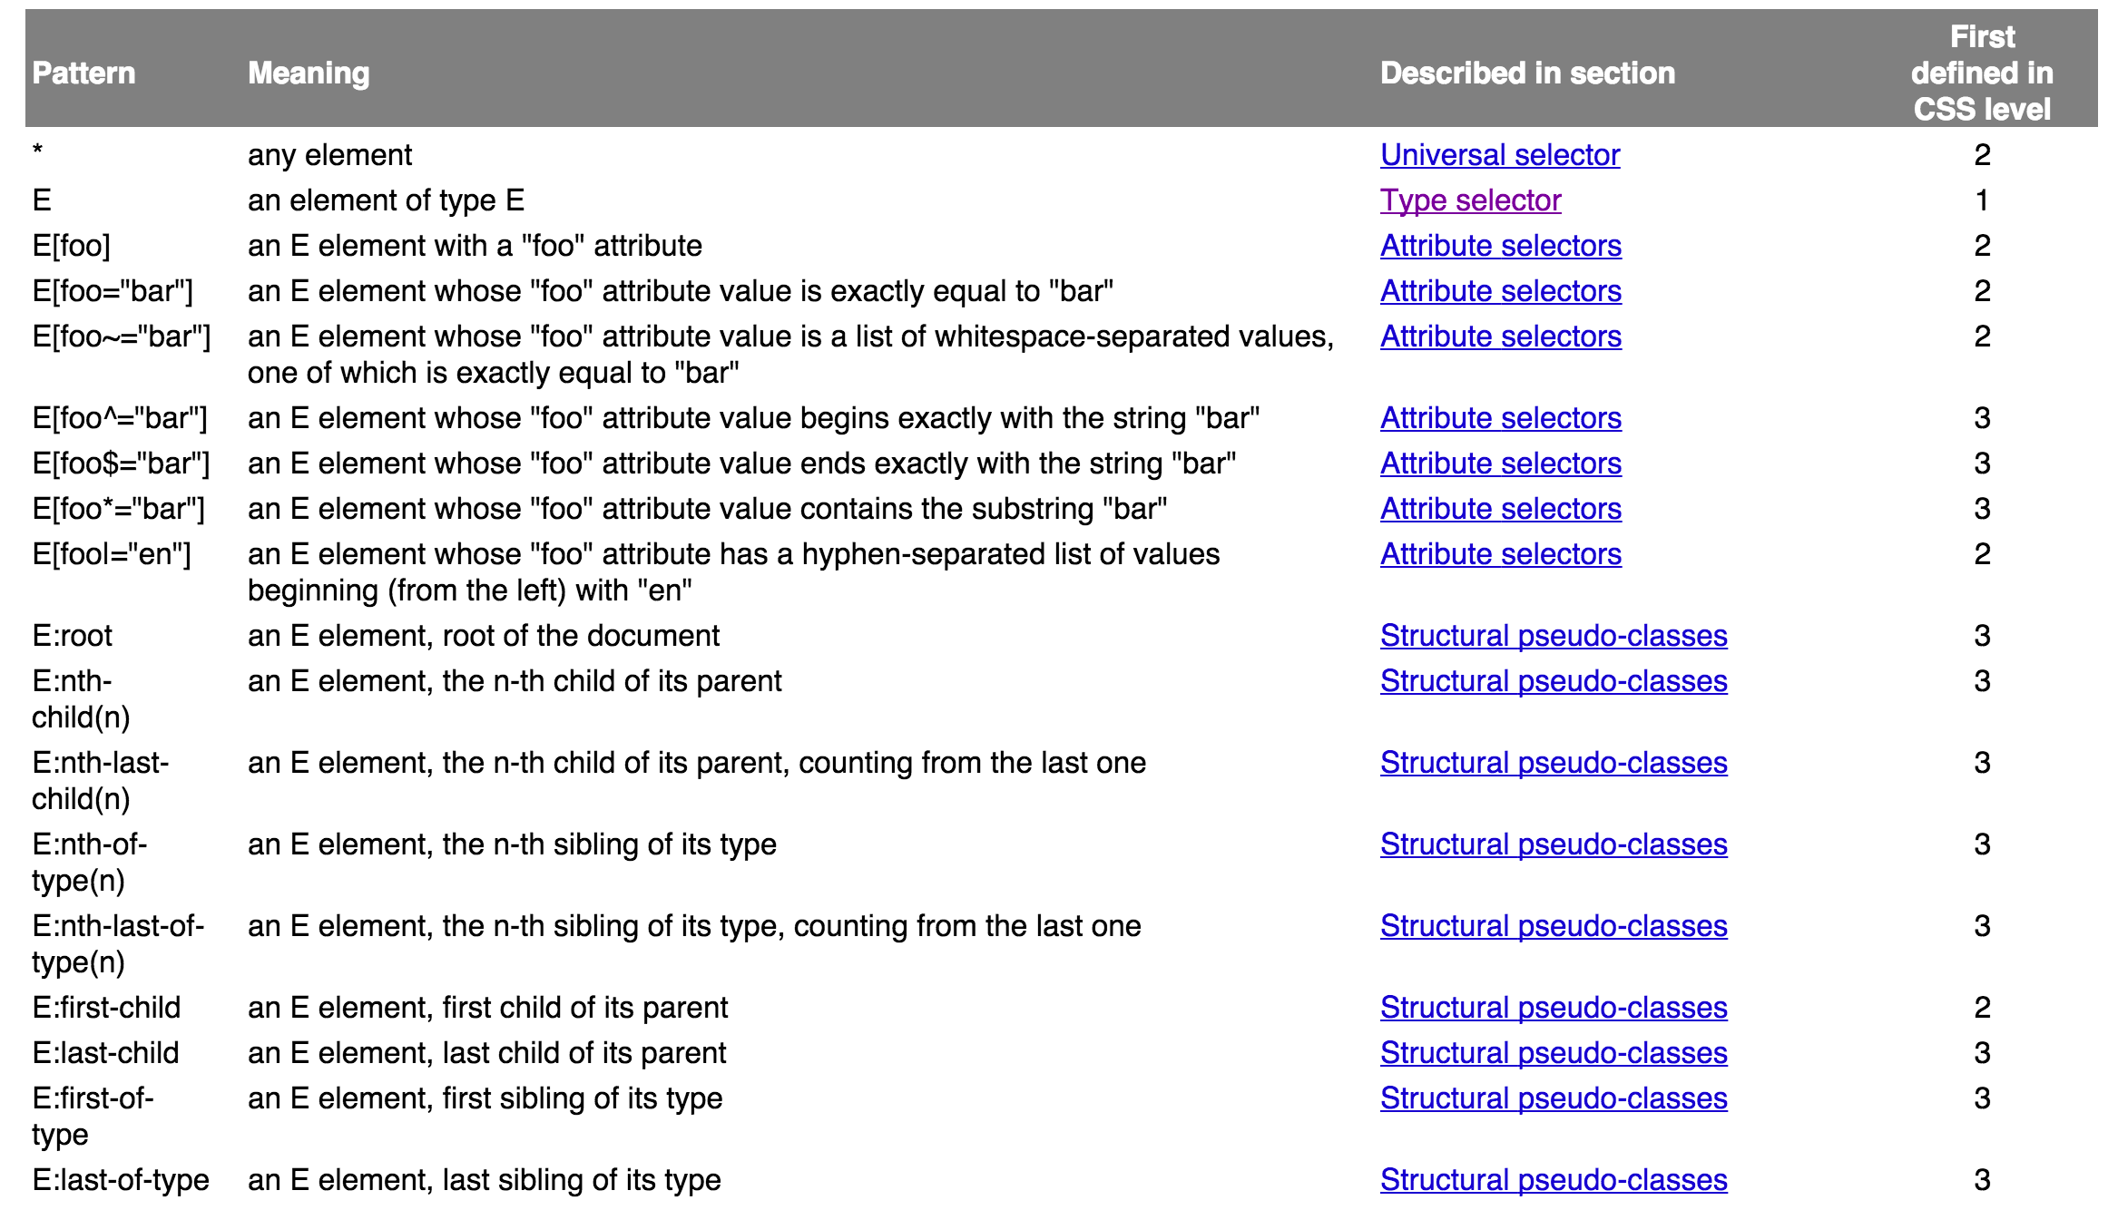
Table of all Selectors

Slide 6
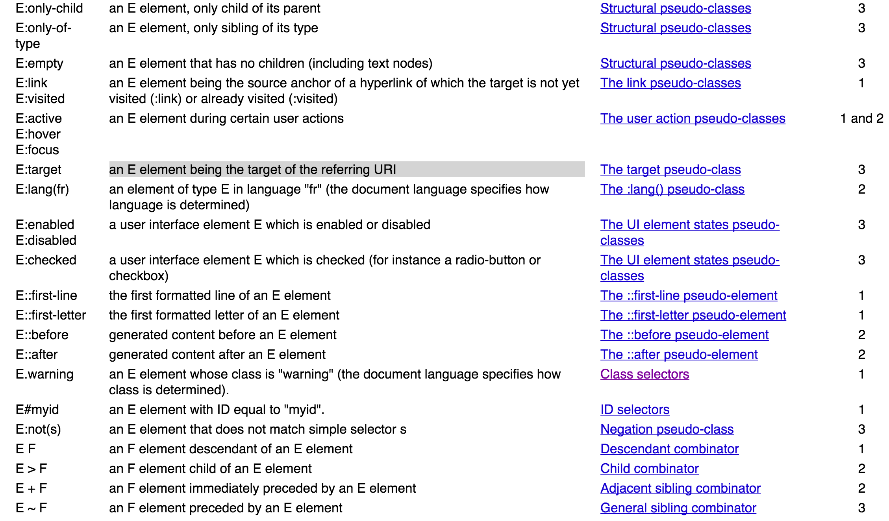
Table of all Selectors

Slide 7
Universal Selector
* is the universal selector. It matches all elements.
Syntax: * { … }
Example:
* { color: green; }
Example: The Global White Space Reset is a common use of the universal selector.
* { margin:0; padding:0; }

Slide 8
Type Selectors
A type selector matches tags by name.
General syntax: tagname { … }
Examples:
p { color : green; }
h1 { color : blue; }

Slide 9
Class Selectors
A period (.) is a class selector. Elements are matched by the class attribute.
The class attribute is a space-separated list of identifiers
Selects all elements that contain the specified class.
General syntax: .classname { … }
Examples:
.info { background-color : green }
*.info { background-color : green }
.green { color : green }
h1.green { color : green }
<body>
<div class="info tagline">Introduction to CSS</div>
<h1 class="tagline green">New things are happening</h1>
<p>This is the <span class="info green">main</span> content of the document.</p>
</body>

Slide 10
ID Selector
A hash (#) selects elements by their id.
General syntax: #id { … }
Examples:
#info { color : green }
p#info { color : green }
Recall that an id value must be unique within a document. Therefore an ID selector can only apply to a single element in a document.

Slide 11
Attribute Selectors
Square brackets ([]) select elements by attribute values.
[att] : Matches elements that have an att attribute.
[att="val"] : Matches elements whose att is val
[att~="val"] : Matches elements whose att attribute value is a space-separated list that contains “val”. In this case “val” cannot contain spaces.
[att|="val"] : Matches elements whose att attribute value is a hyphen-separated list that begins with “val”. Not often used.
Examples
[class] { color: green; }
div[class="ok"] { color : green; }
span[class~="ok"] { color : green; }
p[lang|="en"] { color : green; }
blockquote[class="quote"][cite] { color : green; }

Slide 12
Attribute Selectors
Continued….
[att^="val"] : Matches elements whose value begins with 'val'.
[att$="val"] : Matches elements whose value ends with 'val'.
[att*="val"] : Matches elements whose value contains 'val' as a substring
Examples
a[href$=".html"] { color: green; }
p[title*="hello"] { color : green; }
a[href$="images/"] { color : green; }

Slide 13
Pseudo-class Selectors
The pseudo-classes permit selection based on information that lies outside of the document tree or that cannot be expressed using the other selectors.
A pseudo-class selector always uses a colon followed by the name of the psuedo-class
Link and visited
:link – applies to any link that has not been visited
:visited – applies to any link that has been visited
a:visited { text-decoration: none }
a:link { text-decoration: underline }

Slide 14
Pseudo-class Selectors
:hover – selects the element under the mouse
:active – applies to the element that is being activated by the user. This occurs between a mouse-press and mouse-release action.
:focus – applies to the element having focus
Examples:
div:hover { background-color: black; }
input:focus { border: 1px solid blue; }
div:active { background-color: black; }

Slide 15
Pseudo Class Selectors
URL's are allowed to have a target; a portion of the document. The target is denoted by the text following a hash (#) in the address of the web browser. The selector matches the element having the targeted id.
http://uwl.edu/web/hello.html#section1
Examples
*:target { color : red }

Slide 16
Pseudo Class Selectors
UI elements can be enabled or disabled. The :enabled and :disabled selectors choose the corresponding elements.
input:enabled { background-color : blue; }
input:disabled { background-color: lightgray; }
Radio and checkboxes can be either checked or indeterminate.
input:checked { background-color: blue; }
input:indeterminate { background-color: blue; }
Note that this is not yet standardized

Slide 17
Pseudo Class Selectors
:nth-child(an+b) – represents an element that has (an+b-1) siblings before it, for any positive integer or zero value of n, and has a parent element. In addition, the selector can take 'odd' and 'even' as arguments instead.
odd is equivalent to (2n+1)
even is equivalent to (2n+0) or (2n)
Examples
li:nth-child(3n+1) // items 1, 4, 7, etc…
li:nth-child(3n+2) // items 2, 5, 8, etc…
li:nth-child(3n+3) // items 3, 6, 9, etc…

Slide 18
Pseudo Class Selectors
:nth-of-type(an+b) – represents an element that has (an+b-1) siblings before it with the same name for any zero or positive integer value of n, and that has a parent. Siblings of different name are ignored. Also accepts 'odd' and 'even'.
p:nth-of-type(3n+1) // items 1, 4, 7, etc…
p:nth-of-type(3n+2) // items 2, 5, 8, etc…
p:nth-of-type(3n+3) // items 3, 6, 9, etc…
:nth-last-of-type(an+b) – represents an element that has (an+b-1) siblings after it. Just the reverse of nth-of-type.

Slide 19
Pseudo Class Selectors
:first-child – selects an element if it is the first child
:last-child – selects an element if it is the last child
:first-of-type – selects an element if it is the first child of its type
:last-of-type – selects and element if it is the last child of its type
:only-child – selects an element if it is the only child
:only-of-type – selects an element if it is the only child of its type
:empty – selects an element if it contains no content

Slide 20
Pseudo-elements
Pseudo-elements create abstractions about the document tree beyond those specified by the document language. For example, there is no mechanism to access the first letter or the first of a document (there are no such tags).
Pseudo-elements are expressed with a two-colon (::) notation to distinguish between the pseudo-classes.

Slide 21
Pseudo-elements
::first-line corresponds to the contents of the first formatted line of an element. Note that the length of the first formatted line depends on several factors including the width of the page, the font size and surrounding elements.
::first-letter corresponds to the first letter of an element. If the element contains, as its first child, non-textual content (images, tables), this pseudo-element selects nothing.

Slide 22
Pseudo-Elements
Examples
p::first-line { color : red }
p::first-letter { color : blue }
Note that first-letter also applies if the first-letter is a digit. It may also include punctuation symbols or letter groupings that are language dependent.

Slide 23
NOT NOT
The negation pseudo-class, :not(x), is a functional notation taking a simple selector (excepting the negation pseudo-class itself) as an argument.
Examples:
*:not(p)
All element that are not paragraphs
*:not(:hover)
All elements that are not being hovered over
div:not(:first-child)
All divs that are not the first-child.

Slide 24
Combinators
A simple selector is either a type selector or universal selector followed immediately by zero or more attribute selectors, ID selectors, or pseudo-classes, in any order. The simple selector matches if all of its components match.
In general, a selector is a chain of one or more simple selectors separated by combinators.
A chain of selectors imposes additional constraints on the preceding selector. It is a filtering pipeline of sorts.
Notation | Meaning | Example
White space | Descendent of | body p
> | Child of | body > p
+ | Adjacent Sibling of | div.intro + div
~ | General Sibling of | div.intro ~ section

Slide 25
Combinator: Descendent
Combines two selectors such that an element is matched by the second selector only if it has an ancestor matched by the first.
Examples:
div p { color: green; }
div#myid li p.info { color : green; }
To target only those list items and links that are contained within the navigation list you could use the following CSS:
#nav1 li { color : red; }
nav a { color : red; }
<nav id="nav1">
<ul >
<li><a href="#">Link 1</a></li>
<li><a href="#">Link 2</a></li>
<li><a href="#">Link 3</a></li>
</ul>
</nav>

Slide 26
Combinator: Child Selectors
Combines two selectors such that an element is matched by the second selector only if it is a child of an element matched by the first.
Examples of child selectors:
nav > a { color : green;}
nav > ul { color : green; }
nav > ul > li > a { color : green; }
<nav id="nav1">
<ul>
<li><a href="#">Link 1</a></li>
<li><a href="#">Link 2</a></li>
<li><a href="#">Link 3</a></li>
</ul>
</nav>

Slide 27
Combinator: Adjacent Siblings
Combines two selectors such that an element is matched by the second selector only if it immediately follows an element matched by the first
Example: sibling
li + li { color : green; }
a + a { color : green; }
<nav id="nav1">
<ul>
<li><a href="#">Link 1</a></li>
<li><a href="#">Link 2</a></li>
<li><a href="#">Link 3</a></li>
</ul>
</nav>

Slide 28
Combinator: Sibling Of
Combines two selectors such that an element is matched by the second selector only if it follows (as a sibling) an element matched by the first
Example: sibling
li ~ li { color : green; }
<nav id="nav1">
<ul>
<li><a href="#">Link 1</a></li>
<li><a href="#">Link 2</a></li>
<li><a href="#">Link 3</a></li>
</ul>
</nav>

Slide 29
Grouping
When several selectors share the same declarations, they may be grouped into a comma-separated list.
In this example, we condense three rules with identical declarations into one.
h1 { font-family: sans-serif }
h2 { font-family: sans-serif }
h3 { font-family: sans-serif }
is equivalent to:
h1, h2, h3 { font-family: sans-serif }

Slide 30
How to include CSS in HTML
Every HTML document is styled with a collection of styling rules. There are three levels at which a style can be applied.
External
<link type="text/css" rel="STYLESHEET" href="/pubs.css">
Document level
<style type="text/css"> h2 {text-align: center; color: red} </style>
Inline/Element level
<h2 style="text-align:center;color:red">My heading</h2>

Slide 31
How to include CSS in HTML
external
<head>
...
<link rel="stylesheet" type="text/css" href="myStyles.css" />
<style type="text/css">
body {
font-family: Tahoma, Arial, sans-serif;
}
</style>
</head>
<body>
<div style="color:white;background-color:black;">
</body>
document-level
inline

Slide 32
CSS Rule Origin
Each rule has an origin
Author :
linked
embedded
style attribute
User :
User selected stylesheet (rare)
User Agent :
Default browser settings
Transitions :
Animations where css properties change rapidly/dynamically
Rules can be declared ‘important’.
body { background-color : white !important; }

Slide 33
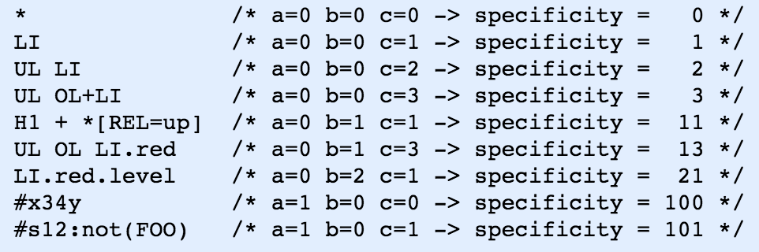
CSS Rule Specificity
A selector's specificity is calculated as follows:
count the ID selectors in the selector (let a be this count)
count the class selectors, attributes selectors, and pseudo-classes in the selector (let b be this count)
count the type selectors and pseudo-elements in the selector ignoring the universal selector and :not. (let c be this count)
Form a number using digits a, b, and c in some large-valued base

Slide 34
Cascading CSS
Great example of what you can do with CSS
www.csszengarden.com
Cascading
Since an elements style can be specified using different selectors, it is possible for conflicting styles to be specified in those different places.
A cascade takes an unordered list of declared values for an elements css-property and sorts them to determine the cascaded value. (The cascade is used to pick the rule that applies).
Sorting is based on
origin and importance
scope
specificity
order

Slide 35
Cascade
The cascade sorts using the following ’keys’ in order of precedence
Transition declarations
Important user agent declarations
Important user declarations
Important override declarations
Important author declarations
Animation declarations
Normal override declarations
Normal author declarations
Normal user declarations
Normal user agent declarations
Scope (this is a detail related to the ‘important’ declaration)
Specificity
Order of appearance (last declaration wins)

