Slide 1
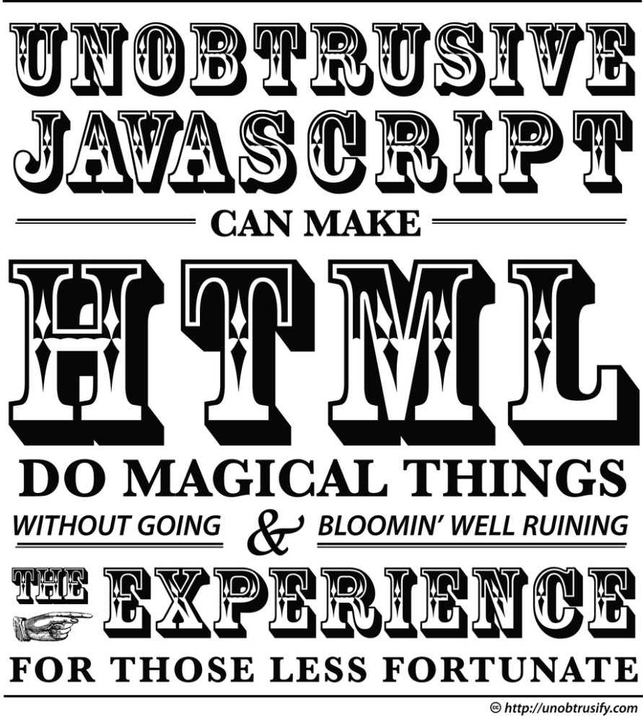
JavaScript
The script that is not Java

Slide 2
Overview
JavaScript is Standardized as ECMA-262 Edition 7
JavaScript is not Java
There is no relationship between the two
JavaScript is 1) dynamically typed and 2) uses a very different OO mechanism than the class-object distinction.
JavaScript is used on the client-side for anything dynamic
Getting data from a server and updating a page
Computing local data
Validating user input prior to sending to a server
JavaScript is delivered as source code (not compiled)
The most used programming language in the world!

Slide 3
Overview
Browser
Server
Document
Database
JavaScript
.net/jsp/node

Slide 4
JavaScript Dynamic Data
http://www.nfl.com/teams.html
<!DOCTYPE html>
<html>
<head>
<title>NFL</title>
<link href=“nfl.js”>
</head>
<body>
<table id=“teams”></table>
</body>
</html>
function( ) {
// make a request for the nfl teams
// execute a function when the data is received
// update the HTML document
}
[ { ’team’ : ‘Bears’, ‘W’ : 3’, ‘L’ : 10},
{ ‘team’ : ‘Vikings’, ‘w’ : 13, ‘L’ : 0 }, … ]
Browser
nfl web server

Slide 5
Language
Identifiers
Begin with letter, '$', or '_' and be followed by zero or more letters, '$', '_', or digits
Are case sensitive
Must not be a reserved word
Examples:
x = 3;
number_of_columns = 3;
_33 = 3;
$$$ = $ + $$;
Comments are identical to Java
//
/* … */

Slide 6
Variable Declarations
Variable declarations
Optional
Do not specify type
Use the ‘var’ keyword to declare a scoped variable
var x;
function foo( n ) { var y; y = n *n; return y; }
Generally want to use ‘var’ for declaration
non-declared variables are global
var-declared variables are function scoped

Slide 7
Language
Supported Types
Number
String
Symbol
Boolean
Undefined
Null
Object
Function
A type defines
A set of values included in the type
A set of operations that can be applied on values of the type.

Slide 8
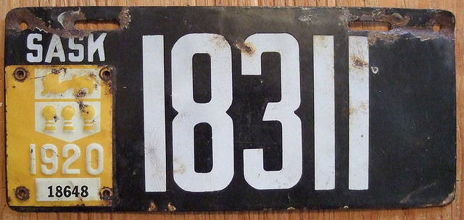
Numbers
Numeric literals are like Java (syntactically)
Numeric values are stored as double-precision fp
There are no integers. All numbers are 64-bit floating point IEEE values.
Three special values:
NaN (Not a Number): This is the result of any undefined or erroneous operation. Also, any arithmetic operation with NaN as an input will have NaN as a result. NaN is not equal to anything, not even NaN.
Infinity: This is positive infinity. A positive infinity is returned whenever a math overflow occurs in a JavaScript application
-Infinity: This is negative infinity. A negative infinity is returned when a number occurs that is smaller than the minimum value supported in
Constructor:
Number(x) : Returns x as a Number. Returns NaN if it can't convert.
var x = Number("Bugs Bunny");
var y = Number("332.123");
var s1 = NaN;
var s2 = Infinity;

Slide 9

Strings
Strings:
A sequence of 0 or more 2-byte chars
No separate char type.
Strings are immutable
Have a length property
Strings can be compared via '=='
String literals are indicated by ' or " enclosed text.
Constructor:
String(x): converts x into a string
Examples:
var a = "Bugs Bunny";
var b = 'Road Runner';
var c = String(28.55)
var x = a.length;
var y = a == b;

Slide 10
String Indexing
The characters are indexed from 0 to length-1.
In certain contexts, negative indices are also used
Index | 0 | 1 | 2 | 3 | 4
Character | H | e | l | l | o
Index | -5 | -4 | -3 | -2 | -1
Character | H | e | l | l | o

Slide 11
String methods
String Method | Description
charAt | Returns the character at the specified index
charCodeAt | Returns the Unicode of the character at the specified index
concat | Joins two or more strings, and returns a copy of the joined strings
fromCharCode | Converts Unicode values to characters
indexOf | Returns the position of the first found occurrence of a specified value in a string
lastIndexOf | Returns the position of the last found occurrence of a specified value in a string
match | Searches for a match between a regular expression and a string, and returns the matches
replace | Searches for a match between a regular expression and a string, and replaces the matched substring with a new substring
search | Searches for a match between a regular expression and a string, and returns the position of the match
slice | Extracts a part of a string and returns a new string
split | Splits a string into an array of substrings
substr | Extracts the characters from a string, beginning at a specified start position, and through the specified number of character
substring | Extracts the characters from a string, between two specified indices
toLowerCase | Converts a string to lowercase letters
toUpperCase | Converts a string to uppercase letters
valueOf | Returns the primitive value of a String object

Slide 12
String examples
var x = "Can a leopard change its spots?";
var y = x.indexOf('a');
y = x.indexOf('leo');
y = x.lastIndexOf('a');
y = x.length; // not a function!
y = x.substr(6,7);
y = x.substring(6,7);
y = x.toLowerCase();
y = x.toUpperCase();

Slide 13

SPLITS
split(delimiter, maximum): this method takes a delimiter and an optional constraint on the number of tokens to return. This method returns an array of tokens.
Consider the following split examples.
var output = "The pony on the left of the pond was gray toned.";
var tokens = output.split(" ");
var tokens = output.split("");
var tokens = output.split("on");
var tokens = output.split("T");
var tokens = output.split(".");

Slide 14
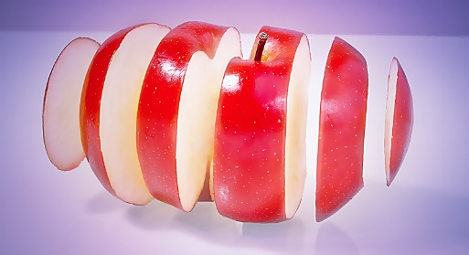
SLICES
slice(from, to): this method takes two indices and returns the indicated substring (indices [from, to-1])
The "to" index is optional. If omitted, it defaults to the last character.
Negative indices are allowed. The string is assumed to wrap around onto itself so that -1 refers to the last character.
Consider the following examples:
var output = "I love computer science."
var sub = output.slice(2,6);
var sub = output.slice(7);
var sub = output.slice(-3);
var sub = output.slice(-5,-3);

Slide 15
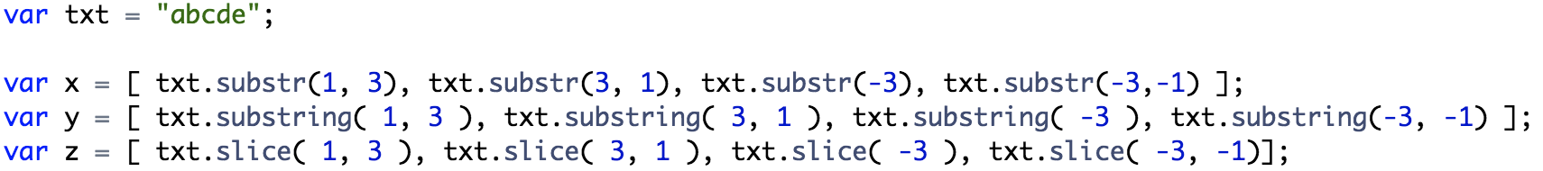
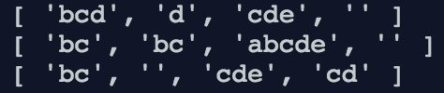
slice/substr/substring
substr( start, length )
if start < 0 then start = start + length
if length is omitted then length = length – start – 1
substring( start, end )
if start > end then swap start and end
if start < 0 then start = 0
if end < 0 then end = 0
if end is omitted then end = length
slice( start, end )
if start > end then do nothing
if start < 0 then start = start
if end < 0 then end = end
if end is omitted then end = length
Notes:
Use substr if you key on the length
Use slice otherwise
substring seems unlovable.
Notes:
var txt = "abcde";var x = [ txt.substr(1, 3), txt.substr(3, 1), txt.substr(-3), txt.substr(-3,-1) ];var y = [ txt.substring( 1, 3 ), txt.substring( 3, 1 ), txt.substring( -3 ), txt.substring(-3, -1) ];var z = [ txt.slice( 1, 3 ), txt.slice( 3, 1 ), txt.slice( -3 ), txt.slice( -3, -1)];

Slide 16
Null and Undefined
Null:
One value: null.
A value that isn't anything
Undefined:
One value: undefined
The default value for variables.
The 'missing value' value.

Slide 17
Booleans
Two boolean values
true
false
Constructor:
Boolean(x).
Returns true if x is truthy
Returns false if x is falsey
All values have a truthiness!
falsey values: false, null, undefined, '', 0, NaN
truthy values: everything not in the above list
Examples
var a = Boolean( "0" );
var b = Boolean( "false" );
var c = Boolean( null );

Slide 18
Operators
Arithmetic
+ - * / %
Comparison
== != < > <= >=
Logical
&& || !
Bitwise
& | ^ >> >>> <<
Ternary
?:
var x = 3;
var y = 12
var z = 12 + 3 * 2;
var z = x < y;
var z = true && false;
var z = x < y ? x : y;

Slide 19
Type Conversions
Types are coerced in order to make the operator do something.
Booleans are converted to numbers
true->1
false->0
Numbers are converted to Strings.
Strings are converted to numbers (unless the operation is addition)
var z = "3" * 2;
var z = true * 5;
var z = "3" + 2;

Slide 20
Operator Notes
+ Operator:
If both operands are numbers then add them else convert them both to strings and concatenate them
var x = '$' + 3 + 4;
Unary prefix operator converts strings to numbers
var x = +"42";
/ Operator:
Numeric floating point division
== and !=
These operators do type coercion and then compare
=== and !===
These do not do type coercion. Typically better to use.
Comparisons:
Object comparisons reduce to address comparisons

Slide 21
Operator Notes
Local And: &&
If the first operand is truthy then the result is the second operand otherwise the result is the first operand.
Logical Or: ||
If the first operand is truthy then the result is the first operand otherwise the result is the second operand.
Examples
var a = true || false;
var b = false || true;
var c = 3 || 12;
var d = "hello" && "world";
var e = undefined && 21;

Slide 22
Relational Coercions
Evaluation rules for the relational operators
If any operand is an object instead of a primitive convert it to a string.
If both arguments are Strings, compare them according to their lexicographical ordering.
Otherwise, convert each primitive to a number and compare numerically with the caveat that any comparison involving NaN evaluates to false.
Examples:
true > null
"1000" > 999
" 100" < 101
"3" < "1"

Slide 23
Math
Math object is modeled on Java's Math class / IEEE spec.
abs | absolute value
floor | integer
log | logarithm
max | maximum
pow | raise to a power
random | random number
round | nearest integer
sin | sine
cos | cosine
sqrt | square root
Examples:
var x = Math.floor(32.115);
var y = Math.sin(2.1);
var z = Math.sqrt(19.0);

Slide 24
Arrays
An array is a zero-indexed sequence of elements. An array is an object : mostly like all others.
Constructing arrays
bracket notation: [1,2,3]
constructor : new Array(3)
The elements in an array can be of any type.
var list1= [1,2,3];
var list2 = [true,38,"UWL",[3]];
var x = list2.length;
var y = list2[2].length;
list[0] = list2[1] + list2[3][0];

Slide 25
Array Access
Array elements (and string characters) are accessed via indexing
First element is at index 0
Last element is at index ( length – 1 )
Accessing with an invalid index results in the value undefined.
Example
var list2 = [true, 38, "UWL", [3]];
var a = list2[2];
var b = list2[5];
var c = list2[-12];
var d = list2[3][1];
var e = list2[2][1];

Slide 26
Array Methods
Arrays support the following pre-defined methods
join(“delim”) – creates a string using a delimiter string
reverse – reverses the elements of the array
sort – sorts the array alphabetically and returns it
concat – concatenates arrays into one array
slice – produces a subset of the array (just like strings)
toString – produces a comma-separated list of elements as a string
push – adds an element to the end of the array
pop – removes an element from the end
shift – removes the first element and returns it
unshift – adds an element as the first and returns the array

Slide 27
Array Join
Creates a string by 'splicing' together the elements; separating with a delimiter.
var a = [1,2,3,4];
var b = a.join('+');
var c = a.join(',');
var x = 'Packers Win'.split('').join(')(');

Slide 28
Array Sort
Sort rearranges the array elements such that they are ordered in ascending fashion. The sort function sorts alphabetically by default.
var x = [38, 15, 1, 150, 3, 8, 33];
x.sort();
var y = ['cat', 'hat', 'bat', 'rat', 'fat'];
y.sort();

Slide 29

Array Methods (TAIL)
push(x1,x2,…): pushes the items onto the end of the array and returns the new length.
pop(): removes and returns the last item of an array.
var data = ["a", "b", "c"];
val = data.push("d")
val = data.push("f", "e");
val = data.pop();
val = data.pop();
val = data.join("-");

Slide 30
Array Methods (HEAD)
unshift(x1,x2,…): shifts the items onto the start of the array and returns the new length.
shift(): removes and returns the first item of an array.
var data = ["a", "b", "c"];
val = data.unshift("d")
val = data.unshift("f", "e");
val = data.shift();
val = data.shift();
val = data.join("-");

Slide 31
Objects
An object is a collection of named values.
Constructing an object
literal notation : { name1 : value1, name2 : value2, …. }
constructor functions : explained later
Examples:
{ x : 3, y : 12 }
{ first : 'Kenny', last : 'Hunt' }
{ name : 'Packers', city : 'Green Bay', win : 5, loss : 0 }
{ username : 'superman', profile : { status : 'flying', age : 32 } }
{ "x" : 3, "y" : 12 }

Slide 32

Dot & Array Notation
Use dot notation to access an objects named value
var x = { ccard:'123456789', expiry:'12/1/2031' };
var num = x.ccard;
var date = x.expiry;
Use array notation to access an objects named value
var num = x['ccard'];
var date = x['expiry'];
Array notation is flexible
var field = 'ccard';
var num = x[field];
field = 'expiry';
var date = x[field];

Slide 33
Dynamic Type Information
typeof: a unary prefix operator that obtains the type-name of any value as a string
returns "number", "string", "boolean" for the obvious types
returns "function" for all functions
returns "object" for objects and NULL
returns "undefined" for the undefined value
Examples:
var t = typeof 3;
var t = typeof [3];
var t = typeof Math.sin;
Note
var x = [1,2,3];
typeof x => object
Array.isArray( x ) => true

Slide 34
Control Statements
JavaScript has all of the control statements that Java has. These statements are similar to Java but with some differences
if
switch
while
do
for
break
continue
return
try/throw

Slide 35
Control Statements
If statement
if ( <condition1> ) { … } else if( <condition2> ) { … } else {…}
The conditions are evaluated in order until one is true
var x = Math.random();
var y = Math.random();
var z = Math.random();
var max = undefined;
if( x >= y && x >= z ) {
max = x;
} else if( y >= x && y >= z ) {
max = y;
} else {
max = z;
}

Slide 36
Control Statements
for( <init> ; <condition> ; <increment> ) { <body> }
<init> : usually assign an initialize value to a variable. This is done once.
<condition> : a boolean that when true means "execute the body again" and when false means "the loop is done"
<increment> : usually add a value to a variable
var sum = 0;
for(var x = 0; x < 5; x += 1 ) {
sum = sum + x;
}

Slide 37
Control Statements
while( <condition> ) { <body> }
<condition> : a boolean that when true means "execute the body again" and when false means "the loop is done"
sum = 0;
var i = 5;
while ( i > 0 ) {
sum = sum + i;
i = i – 1;
}

Slide 38
Control Statements
Specialized version of the 'for'
An object is a collection of properties.
Can iterate through the properties.
for (var propertyName in objectValue) {
var value = objectValue[ propertyName ];
// this iterators over the name:value properties of an object
}

Slide 39
Functions
To define a function you type in
function <function-name>(<formals>) { … }
<function-name> : the name of the function. The function name is optional.
<formals> : a comma separated list of variable names.
The body of the function may have a return statement.
The value of the function is the value of the expression in the return.
If the function ends without a ‘return’ or if no value is specified by the return, the value ‘undefined’ is returned

Slide 40
Creating Functions
Compute the maximum of two numbers
Compute the maximum of three numbers
function max(a, b) {
if(a > b) {
return a;
} else {
return b;
}
}
function max(a, b, c) {
if(a >= b && a >= c) {
return a;
} else if(b >= a && b >= c) {
return b;
} else {
return c;
}
}

Slide 41
Using/Creating Functions
Compute the maximum of two numbers
Lets use the max function above
function max(a, b) {
if(a > b) {
return a;
} else {
return b;
}
}
var z = max(3, 12);
var z = max( 6, max( 3, 12 ) );

Slide 42
Function Scope
Functions can be defined inside of other functions.
These are known as inner-functions
An inner-function has access to all variables in the enclosing function.
Closure: the scope of the inner functions continues even after the enclosing functions have returned.
function sumSquares(a,b) {
function square(x) {
return x * x;
}
return square(a) + square(b);
}

Slide 43
Examples
Write a function that accepts two strings and a number. This function returns a canonical email address.
The first string is the first-name of a user
The second string is the last-name of a user
The third string is the number of users that share the same first and last name.
Return an email that is first-4 of last name followed by first-4 of first name followed by number-of users '@acme.email.org'.
Write a function that computes the shipping cost for an online purchase. The shipping cost is $3 if the total purchase price is less than $10, otherwise the shipping cost is $6 if the purchase price is less than $30, otherwise the shipping cost is 12% of the purchase price.
Write a function that takes in an email and returns the username and domain as an object.

Slide 44
Examples
Write a function to find both the min and max numbers of an array. Return them as an object.
Write a function that accepts an array of strings and a string known as the key. Return all strings that contain key as a substring.
Write a function that accepts a string and returns true if the string is a zip code. A zip code is either a string of exactly 5 digits or a string of 5 digits followed by a dash followed by 4 digits.
Write a function that accepts a string and returns a 'histogram' of the letters in the string.
Write a function that accepts a list of elements and returns a histogram of the elements.

Slide 45
Function Invocation
Function invocation:
If a function is called with too many arguments, the extra arguments are ignored.
If a function is called with too few arguments, the missing values will be undefined.
Examples
var x = max(3, 12, 55);
x = max( 3 );
x = max( 9, 19 );
x = max( "Whats", "Up?" );
x = max( true, false );
function max(a, b) {
if(a > b) {
return a;
} else {
return b;
}
}

Slide 46
Function Invocation : Arguments
Function invocation:
An implicitly defined array named "arguments" is available within each method.
Examples:
var x = max(1, 2, 3);
x = max( 7, 15, 2, 1);
x = max( [ 1, 2, 3, 4, 5] );
function max() {
val result = arguments[0];
for( val i = 1; i < arguments.length; i += 1) {
if( arguments[i] > result ) {
result = arguments[i];
}
}
return result;
}

Slide 47
Function Invocation : This
Function invocation
An implicitly defined variable named "this" is defined. Typically used as an object constructor.
The value cannot be re-assigned. It is 'read only'
The value of 'this' depends on how the function is called.
If called in a non-object function style, it is null.
if called in an object-function style, it is the caller.
If called as a constructor, it is an empty object.
Note, there are other options here…
Examples
x = Car('GM', 'Viper', 2015);
x = new Car('GM', 'Viper', 2015);
function Car( make, model, year ) {
this.make = make;
this.model = model;
this.year = year;
}

Slide 48
Function Invocation
There are different ways to call a function f. Note that f is a function object – not just the name of a function.
Function:
f( args )
Typical usage
Constructor:
new f( args )
Use when making 'instances' of some 'class'
Apply:
f.apply(thisObject, [args])
Use when the arguments are packed into an array
Call :
f.call( thisObject, arg1, arg2, …, argN)
An alternative to 'apply' as the arguments are unpacked

Slide 49
Examples of Function Invocation
Write a function that wraps a function F into a function G. Function G prints the number of times that F has been called (through G) and returns the results as applied to F
Math.max = track( Math.max );
var track = function( f ) {
var count = 0;
return function( ) {
console.log( ++count );
return f.apply( this || null, arguments );
}
}

Slide 50
Using/Creating Functions
Functions are "things" just like other "things".
The two code fragments above are identical. In both cases, max is a function of two inputs.
function max(a, b) {
if(a < b) {
return a;
} else {
return b;
}
}
var max = function(a, b) {
if(a < b) {
return a;
} else {
return b;
}
}

Slide 51
First-class Functions
Functions are objects.
passed to functions
returned from functions
created from other data
have properties
function flarb( a ) {
return function( b ) { return a + b; }
}
c = flarb( 12 );
d = flarb( 12 )( 9 );
e = glurp( flarb( 12), 9 );
f = compose( Math.abs, flarb( 12 ) );
f = compose( Math.abs, flarb( 12 ) )( -20 );
function glurp( a, b ) {
return a( b );
}
function compose( a, b ) {
return function(c) { return a(b(c)); };
}

Slide 52
Functions
function filter(array, predicate) {
var result = [];
for(var i=0; i<array.length; i++) {
if(predicate(array[i])) {
result.push(array[i]);
}
}
return result;
}
Write a method to iterate over an array and select only those elements that satisfy some criteria:
For example:
Get the even number from [1,2,3,4,5,6];
Get numbers larger than 3 from [1,2,3,4,5,6];
Get the numbers from ["one", "two", 3, true, 4, 5];
function evens(array) {
var result = []
for(var i=0; i<array.length; i++) {
if(isEven(array[i])) {
result.push(array[i]);
}
}
return result;
}
function large(array) {
var result = []
for(var i=0; i<array.length; i++) {
if(largerThan3(array[i])) {
result.push(array[i]);
}
}
return result;
}
function numbers(array) {
var result = [];
for(var i=0; i<array.length; i++) {
if(isNumber(array[i])) {
result.push(array[i]);
}
}
return result;
}

Slide 53
Filter
Filter is an array function. It is part of JavaScript.
INPUT: a single input of function type.
The function is expected to take a single input.
The returned value is treated as a boolean.
The function is known as the ‘predicate’.
OUTPUT: an array of all elements satisfying the predicate
Examples:
var x = [1,2,3,4,5];
var y = x.filter( function(x) { return x > 2; } );
x = [ "cat", "dog", "turtle", "chicken", "rabbit" ];
y = x.filter( function(x) { return x[0] == 'c'; } );

Slide 54
Functions
function map(array, f) {
var result = [];
for(var i=0; i<array.length; i++) {
result.push( f(array[i] );
}
return result;
}
Write a method that applies a function to every array element and returns the results.
For example:
Double each element of [1,2,3]
Take the square root of each element of [9,16,25]
Apply isNumber to [1,2,"four",true]
function doubler(array) {
var result = [];
for(var i=0; i<array.length; i++) {
result.push( times2(array[i]) );
}
return push;
}
function root(array) {
var result = [];
for(var i=0; i<array.length; i++) {
result.push( Math.sqrt(array[i]) );
}
return result;
}
function numbers(array) {
var result = [];
for(var i=0; i<array.length; i++) {
result.push( isNumber(array[i]) );
}
return result;
}

Slide 55
Map
Map is an array function. It is part of JavaScript.
INPUT: a single input of function type.
The function is expected to accept a single input
The function, of course, returns a result
OUTPUT: an array of elements where each element is the result of applying function F to each input element.
Examples:
var x = [1,2,3,4,5];
var y = x.map( Math.sqrt );
x = [ "cat", "dog", "turtle", "chicken", "rabbit" ];
y = x.map( function( x ) { return x.length; } );

Slide 56
forEach
The forEach function is an array function. It is part of JavaScript.
INPUT : a single input of function type
The function accepts three inputs
value : the current element value being processed
index : the index of the current element
array : the array that is being processed
The function returns a result; the result is ignored
OUTPUT : undefined (the value of Undefined type)
Examples
[1,2,3].forEach( console.log );
[{a:1,b:2},{a:3:b:10}].forEach(function(v) { v.a *= 2; } );

Slide 57
Arrow Functions
Arrow functions are functions written in a special way
Arrow functions do not have a ‘this’
Arrow functions do not have an ‘arguments’
Arrow functions are always anonymous
Syntax
( listOfParameters ) => { statements }
( listOfParameters ) => expression
singleParameter => { statements }
singleParameter => expression
Details
If using the syntax with a single expression on the right, and that expression is an object literal, it must be surrounded in parenthesis.
( listOfParameters ) => ( { x : 1, y : 3} )

Slide 58
Arrow Function Examples
var x = [1,2,3];
var a = x.map( (v) => { return v*v; } );
var b = x.map( (v) => v*v );
var c = x.map( v => { return v*v; } );
var d = x.map( v => v*v );
var e = x.forEach( (v,i,a) => a[i] = v*v )
var f = x.filter( x => x > 1 );
x = ["Green", "Bay", "Packers"];
var g = x.map( s => s.length );
var h = x.map( s => s.toUpperCase() );

Slide 59
Examples
Write a function that accepts a list of values and returns the even values.
Write a function that accepts a list of strings and a number N. This function returns all strings longer than N.
Write a function that accepts an object and returns a list of it’s property names.
Write a function that takes a list of strings. Each string is a first-name followed by a comma, followed by a last-name. Names are space-separated. Return a list of person objects; each having a first and last property.
toPeople( [“Aaron Rogers”, “Randall Cobb”] )
Write a function that takes a list of strings Ps and a list of values Vs. Lists Ps and Vs must have the same length. The function creates and returns an object having one property for every P with the corresponding value V.
toObject( [“a”, “b”, “c”], [1, true, “Hello”])
Write a function that accepts two objects X and Y and a list of strings Ps. This function returns true if X and Y have the same values for those properties listed in Ps.
Write a function that returns a function F. The first call to F returns 0. Each subsequent call returns an integer that is greater by 1.

Slide 60
Functions as Properties
Since functions are 'things', they can be object-level properties
Car has three properties
make : a string
model : a string
year : a number
Add a function-type property
toString : a function
function Car( make, model, year ) {
this.make = make;
this.model = model;
this.year = year;
}
function Car( make, model, year ) {
this.make = make;
this.model = model;
this.year = year;
this.toString = function() {
return this.make + "," +
this.model + "," +
this.year;
}
}

Slide 61
Example Code
Write two 'constructors'
Point : having x and y attributes. Default values are random values.
Circle: having center and radius. Default values are random values.
Write functions named
scale( circle )
move( circle, pt )
area( circle )
intersects( c1, c2 )
randomCircles( n )
intersectsWith( circles, c )
scaleAll( circles, sf )
moveAll( circles, pt )
sort( circles )

Slide 62
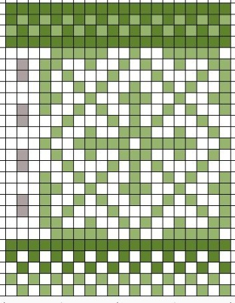
Pattern matching
A pattern denotes a set of strings
A string is either a member of the set or it is not a member of the set.
We will say that a string 'matches' the pattern if it is in the set. Otherwise a string does not match the pattern.
We often informally label sets. For example: credit-card-numbers, phone-numbers, radio-stations, UWL department prefixes, state abbreviations.
A pattern is denoted by forward slashes /PATTERN/
A pattern is really a RegExp object.
Image from http://www.flickr.com/photos/mararie/2332118951/

Slide 63
Patterns
A single character is a pattern. The character represents itself unless it is special.
A period (.) is special. It represents 'any single character'
For any two patterns A and B, the following are patterns
AB
Sequencing : A followed by B
A|B
Alternation: either A or B. Alternation associates with the smallest possible pattern on both the left and the right. The vertical bar is special
(A)
Grouping: A is a group. The parens are special
Examples?
XOXO
(X|O)
(X|O)|(X|O)
.X.

Slide 64
Pattern matching
Quantifiers denote repetitions of patterns and apply to the pattern immediately preceding
{n} denotes exactly n repetitions
{m,} denotes at least m repetitions
{m, n} denotes at least m and not more than n repetitions
* denotes zero or more repetitions
+ denotes one or more repetitions
? denotes zero or one repetition

Slide 65
Patterns
Do the following match the regex '(c|h)a?rt*'
hart
cat
car
chart
chaarrtt
hrtttt
Do the following match the regex '(x|y)*'
x
xy
xxyxyyx
Write a pattern for social security numbers.

Slide 66
Pattern Matching
Character classes
A sequence of character placed in brackets defines a ‘class’ or set of characters, any one of which matches. Special characters loose their 'specialness' in the context of a character class.
Dashes indicate spans or ranges
A ‘caret’ is logical negation
[abcd] is matched by ‘a’ or ‘b’ or ‘c’ or ‘d’
[a-z] is matched by ‘a’ or ‘b’ or … or ‘z’
[^0-9] is matched by anything not a ‘0’ or ‘1’ etc…
[a+] is matched by 'a' or '+'

Slide 67
Pattern Matching
Character classes
Some character classes are so common that they have been predefined and given special names.
\d is [0-9]
\D is [^0-9]
\w is [A-Za-z_0-9]
\W is [^A-Za-z_0-9]
\s is [ \r\t\n\f]
\S is [^ \r\t\n\f]

Slide 68
Positional Matches
There are two 'positional' matches
^ : matches the start of a string or right after a newline
$ : matches the end of a string or matches before a newline
Example
^$
^\w*$
^From:$

Slide 69
Examples
Write a pattern for positive binary integers
Write a pattern for even-valued positive binary integers
Write a pattern for positive binary integers such that the integers do not have leading zeros
Write a pattern for positive binary integers with at least three ones in a row

Slide 70
Examples
A valid US phone number must have:
A 3 digit area code with optional surrounding ()
A 3 digit exchange with optional separator (-,/,., )
A 4 digit number with optional separator (-,/,. )
Examples of valid phone numbers:
(195) 355-3511
180.000.5539
555/035/3599
Construct a regular expression
area code: /\(?\d{3}\)?/
exchange: /[-\/\.\s]?\d{3}/
number: /[-\/\.\s]?\d{4}/

Slide 71
Pattern Modifiers
Patterns can be modified by using
i to denote ‘ignore case’
x to denote ‘ignore whitespace’
g to denote global matching (find all matches)
m to denote ‘multiline mode’
var p1=/[a-z]+/i;
var p2=/\d+/x;

Slide 72
RegExp methods
RegExp objects support the following methods:
exec(string): applies the regexp to the string and returns the match (the first match)
var match = /p.?/ig.exec("javascript is super hip.");
test(string): returns true if the string matches the expression (the string contains the expression)
var match = /\ws/.test("This is a test of expressions.");
Matches return information about groups as well
var match=/p(.?).?/ig.exec("javascript is super hip.");
match is an array containing ["pt ", "t"]

Slide 73
Pattern Matching
Strings support pattern matching operations also
replace(pattern, string) returns the active string having replaced the pattern with the given string
match(pattern) returns the elements of the active string that match the pattern
split(pattern) returns an array of strings split on the patterned delimiter
search(pattern): returns an array of indices that indicate the matches to the pattern
“123-45-6789”.replace(/-/g,””)
“please reply to jim@google.com and to lisa@yahoo.com when you receive this message”.match(/\w+@\w+.\w+/g);

Slide 74
Examples
var m = "CS 402 has MTH 225 as a pre-req. It is fun for the whole family.".match(/(CS|MTH)\s+(\d{2,3})/);
for(var i in m) {
document.write(m[i]);
}
"Jemimah and Puddleduck are two kids names.".replace(/([A-Z])([a-z]+)/g, "<span style='color:red'>$1</span>$2");
var names = "Fred Barney; Micky Minnie; Eleanor Rigby ;Cain Abel ; Jill Jack";
var pattern = /\s*;\s*/;
var nameList = names.split(pattern);
pattern = /(\w+)\s+(\w+)/;
var surnameList = []
for(var i=0; i<names.length; i++) {
surnameList.push(nameList[i].replace(pattern, "$2, $1"));
}

Slide 75
Create your Own Iterator
Write a 'class' that iterates over an array
The iterator should have next and hasNext methods
For example:
var iterator = new iterator([1,2,3,4,5]);
while(iterator.hasNext()) {
document.write(iterator.next());
}
function iterator(array) {
this.index = 0;
this.hasNext = function() { return this.index < array.length; }
this.next = function() {
if(this.hasNext()) {
var result = array[this.index];
this.index = this.index + 1;
return result;
} else { return undefined; }
}
}

Slide 76
Object Inheritance
Some languages have classes and objects. In these languages:
Classes inherit from other classes
Objects don't inherit from other objects
JavaScript uses Prototypal inheritance
Objects can be linked to other objects.
Every object has a __proto__ property that refers to it's parent
Functions have a prototype property that refer to their 'class-like' object
The object inherits all properties of the object linked to
Writing a property value alters only the object itself (not the linked objects)
Reading a property will climb the chain
Single linkage (inheritance) only.
At the root is Object
This has just a couple properties: hasOwnProperty for example.

Slide 77
Exapmle
var obj1 = {name:"Aaron Rodgers", rating:129, position:"qb" }
var obj2 = { __proto__ : obj1 }
obj2.gamesPlayed = 5;
obj2.team="Rams";
obj2.rating += 3;
obj2
gamesPlayed | 5
rating | 131
team | "Rams"
__proto__
obj1
name | "Aaron Rodgers:
rating | 129
position | "qb"
__proto__

Slide 78
The Object function is not standard
This function comes from Douglas Crockford.
The function expresses a common idiom to making a linkage between two objects.
The linkage uses the 'prototype' member
Should simply define this function and then use it.
function object(o) {
function F() {}
F.prototype = o;
return new F();
}

Slide 79
Dates
JavaScript has a Date object that supports calendar operations.
Create a date object by passing in
nothing : the current date and time
A string : "<m> <d>, <y> <hr>:<min>:<sec>"
integers : year, month, day, hour, minute, second
month : 0 to 11
day : 1 to 31
hour : 0 to 23
Examples
var d1 = new Date()
var d2 = new Date("January 1, 2014 08:00:00");
var d3 = new Date(2014, 0, 1, 0, 0, 0);

Slide 80
Dates
A 'date' object is represented internally as a number that denotes the number of milliseconds since January 1st, 1970, 00:00:00 in GMT. Dates can be created by passing in this number.
var d3 = new Date(0);
var d4 = new Date(235200025);
This number is obtained via getTime
var time = d3.getTime();
Dates can be compared by using this number
d3.getTime() < d4.getTime()

