Slide 1
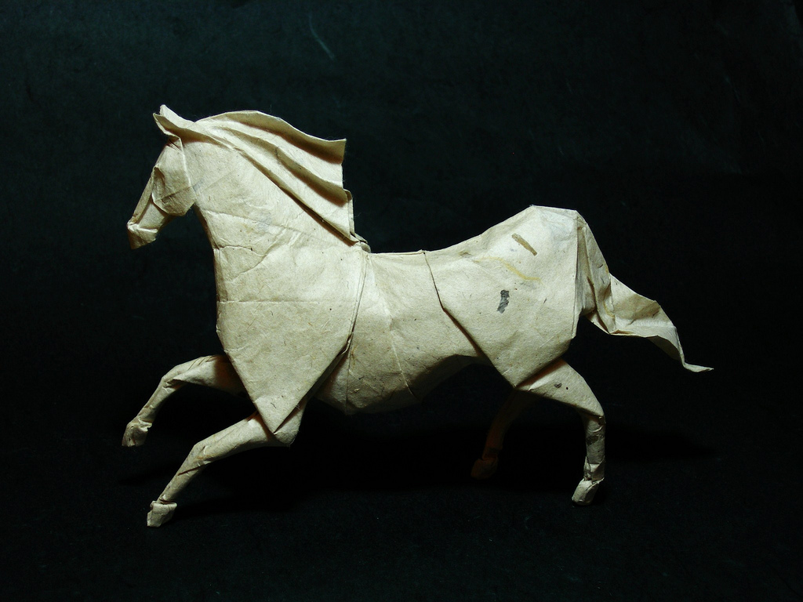
DOM
Photo from http://www.flickr.com/photos/emraya/2861149369/
Documents as Objects

Slide 2
DOM
When a browser reads an HTML file, it must interpret the file and render it onscreen. This process is sophisticated.
The HTML file is turned into a "tree" object. This object is named 'document' and it is a DOM instance.
graphics from Yahoos Douglas Crockford.

Slide 3
DOM
The DOM is a model of the HTML document.
Standardized by w3c
A document-processing library of objects and function. In other words, an API
Standards
DOM 0 is supported by all JavaScript enabled browsers but has no specification.
DOM 1 was released in 1998
DOM 2 was released in 2000
DOM 3 was released in 2004
DOM 4 is the latest approved standard

Slide 4
DOM
Why the DOM?
Since the HTML file is an 'object', it can be processed and changed by JavaScript functions. This supports user interaction with a web page.
"Dynamic HTML" is a term used by some vendors to describe the combination of HTML, style sheets and scripts that allows documents to be animated.
graphics from Yahoos Douglas Crockford.

Slide 5
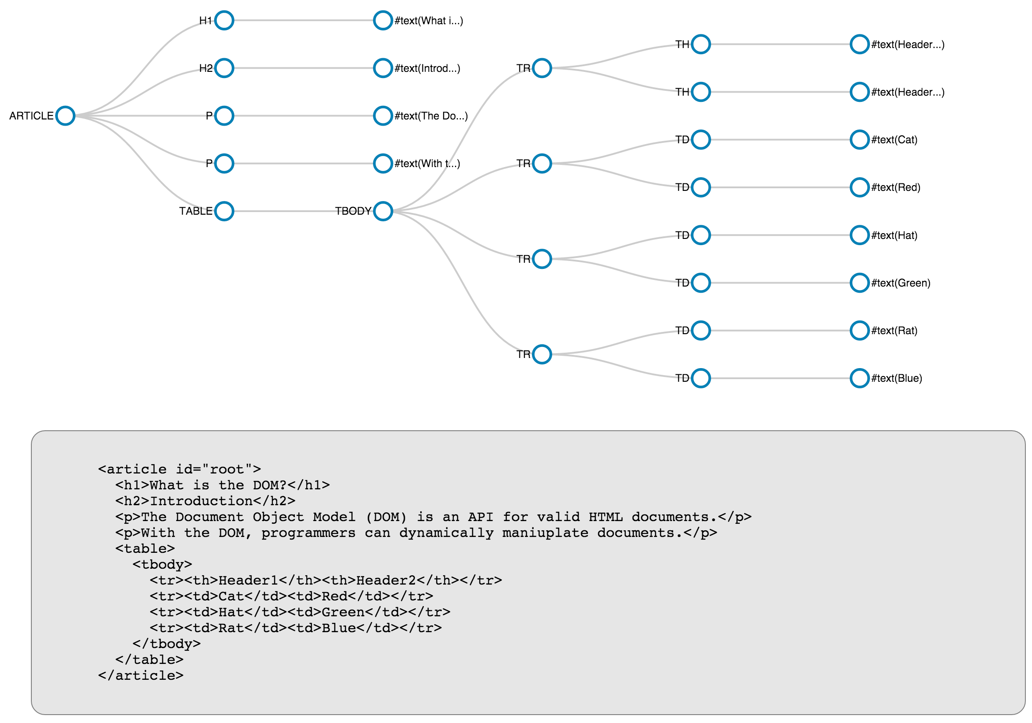

Slide 6
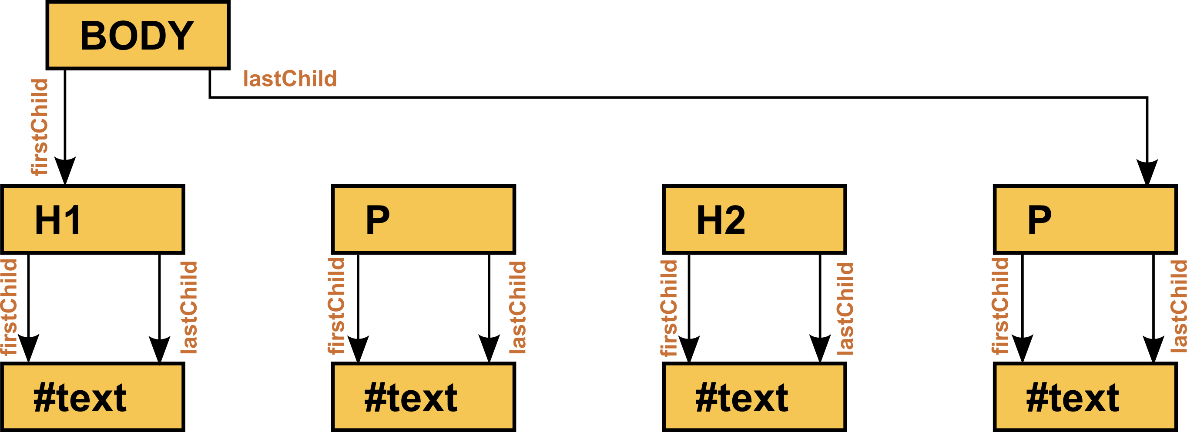
Trees and Nodes

Slide 7
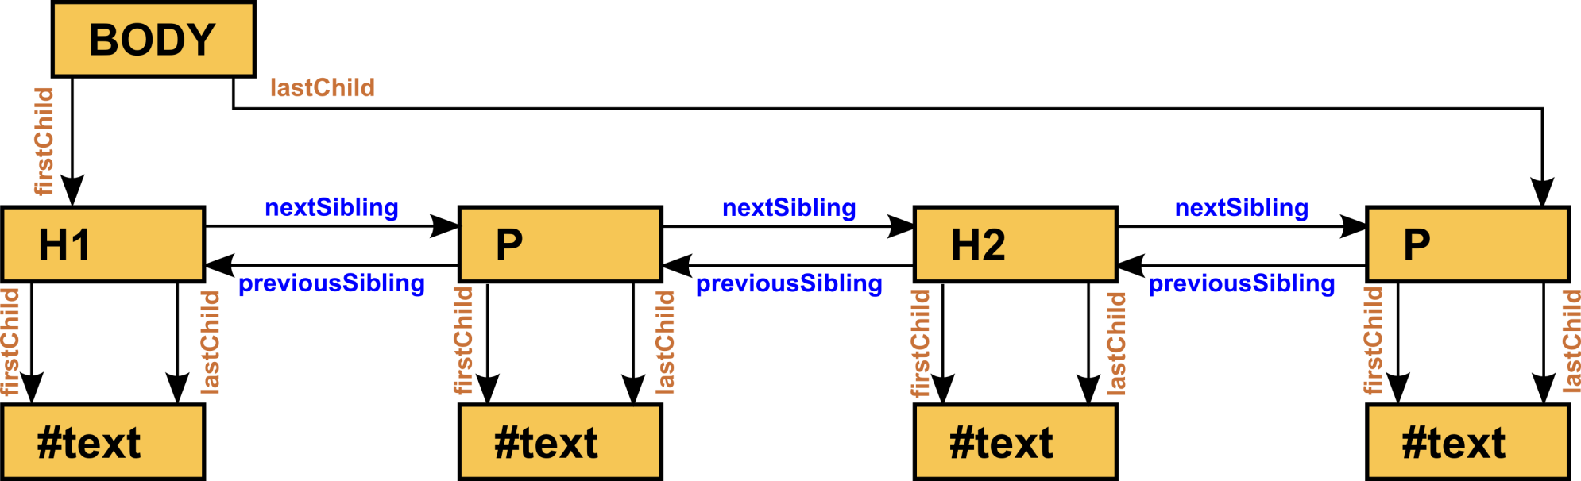
Trees and Nodes

Slide 8
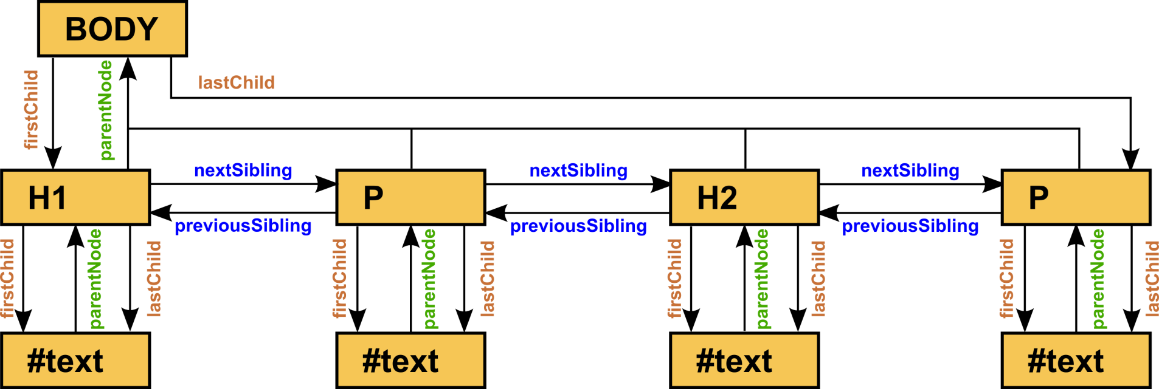
Trees and Nodes

Slide 9
Dom
The DOM specification defines a set of classes that all browsers are expected to support.
The browsers implement the specification in JavaScript
The DOM classes and methods are JavaScript objects and methods
These objects and methods are used to programmatically control an HTML document.
There are several globally defined variables in a browser-based JavaScript environment along with numerous globally defined methods.
document
window

Slide 10
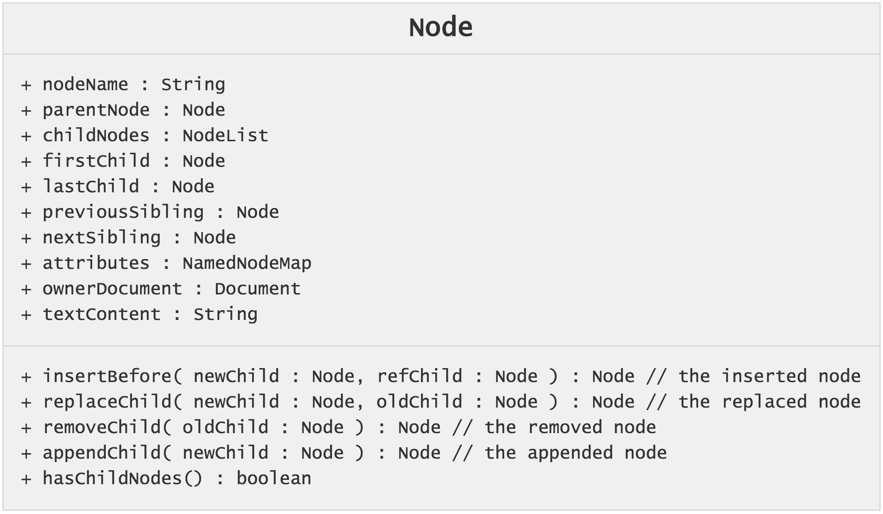
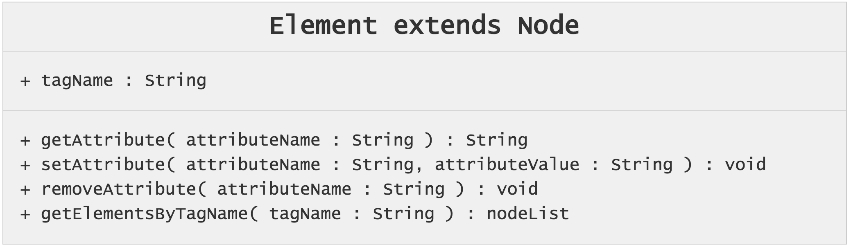
Dom Summary

Slide 11
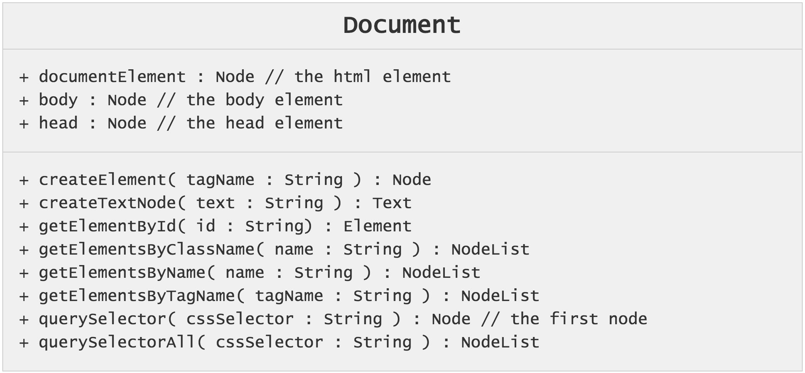
Dom Summary
Every JS environment in a browser defines a global variable named “document”. This variable is of Document type.

Slide 12
Finding an Element
You can write code to retrieve element(s) in the document
By id
var node = document.getElementById('x13');
By class
var nodes = document.getElementsByClassName('well');
By tag
var nodes = document.getElementsByTagName('div');
By name (the attribute)
var nodes = document.getElementsByName('movies');
By CSS selector
var node = document.querySelector( ’.btn’ ); // the first
var nodes = document.querySelectorAll( ‘.btn’ ); // all

Slide 13
Reading/Writing Attributes
Elements have attributes that can be read and changed.
node.getAttribute( propName )
node.setAttribute(propName, propValue);
Examples
var node = document.getElementById( ‘x13’ );
var id = node.getAttribute( ‘id’ );
node.setAttribute( 'style', 'background-color:red;');
node.setAttribute( 'id', id + ‘3’ );

Slide 14
Creating Nodes in the DOM
You can create nodes and insert them into the document. Note that there is a difference between an HTML element and a text-node.
document.createElement( tagName )
document.createTextNode( text )
Example:
var node = document.createElement( ‘tr’ );
var cell= document.createElement( ‘td ’ );
var cellValue = document.createTextNode( ‘13’ );

Slide 15
Adding Nodes to the Document
The new nodes are not part of the document. They have simply been created. Insert them using one of the following methods.
node.appendChild( newNode )
node.insertBefore(newNode, newNodesSibling )
Example:
var node = document.createElement( ‘tr’ );
var cell= document.createElement( ‘td ’ );
var cellValue = document.createTextNode( ‘13’ );
cell.appendChild( cellValue );
node.appendChild( cell );
…
node.insertBefore( otherRow, cell )

Slide 16
Deleting Nodes from a Document
Node replacement is possible via
node.replaceChild( newNode, oldChild )
Example
var node = document.getElementById( ‘x13’ );
var newNode = document.createElement( ‘div’ );
node.parentNode.replaceChild( newNode, node );
How to delete a node in the DOM
node.removeNode(childNodeToRemove)
It is often helpful to take a chunk of HTML and replace it by some other chunk of HTML. This can be done by
node.innerHTML = newHTMLtext.

Slide 17
Name differences with Styling
CSS
background-color
border-radius
font-size
list-style-type
word-spacing
z-index
JavaScript
backgroundColor
borderRadius
fontSize
listStyleType
wordSpacing
zIndex

Slide 18
DOM Examples
Write a function to return all the siblings that follow an element
Write a function to return all of the children of an element
Write a function to return all of the ancestors of an element.
Write a function that accepts a UL element and a list of strings. Insert the strings into the list.
Write a function to create and return a multiplication table covering the rows [1, M] and the columns [1,N]. M and N are parameters.

Slide 19
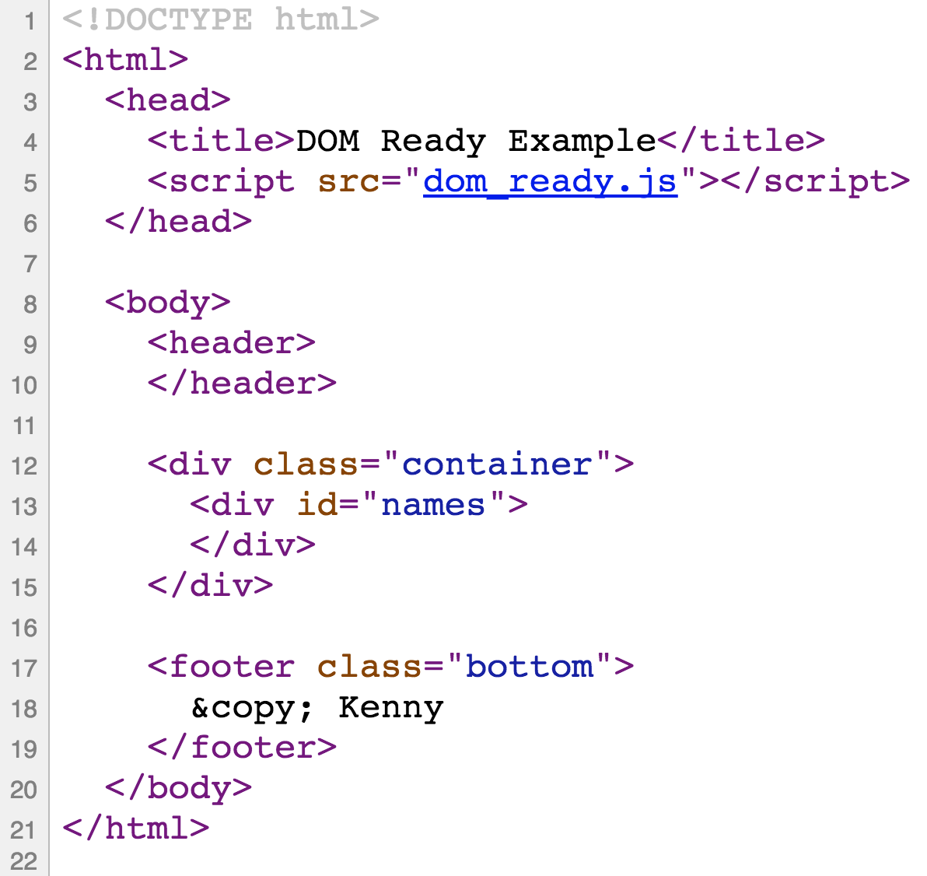
Example
Write a page that uses JS to create a page having a single ordered-list of several NFL team names.

Slide 20
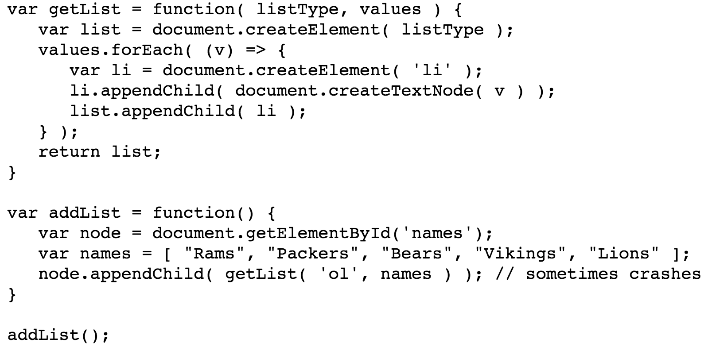
The JS Code

Slide 21
Document Ready
The JS file executes as soon as the code is loaded.
This may occur before the containing HTML is fully loaded
This may occur before the HTML is parsed
This means that the “names” element is not present when the line document.getElementById( ‘names’ ) is executed.
Most pages register a handler to execute on page-load.
document.addEventListener(‘DOMContentLoaded’, f );
$(document).ready( f ); // if using jQuery.
Function ‘f’ is then executed only after the HTML page has been loaded AND parsed.
Can also move the script to the bottom of the page
This is not a guarantee that the doc is parsed
This assumes synchronous loads (not always the case)

Slide 22
Events and Handling
An event is a user-or-browser generated action.
Events are of specific types.
Events are typically associated with an HTML element
When an event occurs, one-or-more JavaScript functions will be called
Event categories
Mouse events
Keyboard events
HTML frame/object events
HTML form events
User interface events
Mutation events (changes to the structure of a document)

Slide 23
Event Handlers
Elements may generate events when they are acted upon.
clicking on a button
pressing a key in an input field
hovering over an element
entering an element with the mouse
many others ….
Handlers are associated with events in one of two ways
Using HTML :
<div onclick="divClicked(event)">I'm a button!</div>
Using JS:
node["on" + type] = handlerFunction;
node.addEventListener(<event-type>, <func>, <capture>);
<event-type> is a string
<func> is the event handler
<capture> is a boolean indicating capture phase (true) or bubble

Slide 24
Event Handling Process
Target node: the node that generates/creates the event
Capturing phase :
Events begin at the root and move toward the target node
Registered and enabled event handlers at nodes on the path from root-to-target are executed when encountered
Target phase:
Registered handlers at the target are executed
Bubbling phase:
The tree is traversed from target to root.
Registered and enabled handlers at nodes on the path are executed when encountered.
Default phase :
Default handlers are invoked

Slide 25
Event Phases
Capture
(Phase 1)
Bubble
(Phase 3)
E1
E2
E3
Target (Phase 2)
When the target element (E3) is clicked
Any E1 Capture-enabled click-handlers are executed
Any E2 Capture-enabled click-handlers are executed
Any E3 Capture-enabled click-handlers are executed
Any E3 bubble-enabled click-handlers are executed
Any E2 bubble-enabled click-handlers are executed
Any E1 bubble-enabled click-handlers are executed
Any default click-handlers are executed

Slide 26
Event Objects
An event object has the following read-only properties
bubbles : a boolean
cancelable : a boolean
target : the target node
currentTarget : the element whose handler is executing
defaultPrevented : a boolean
eventPhase : a string denoting processing phase
timeStamp : the time the event was created
Event objects also support the following methods
preventDefault() : cancels the event
stopPropagation() : prevents further handler invocation

Slide 27
Events
Type (JS) | Attribute (HTML) | Description | Bubbles | Cancelable
click | onclick | Fires when the pointing device button is clicked over an element. A click is defined as a mousedown and mouseup over the same screen location. The sequence of these events is: mousedown, mouseup, click | Yes | Yes
dblclick | ondblclick | Fires when the pointing device button is double clicked over an element | Yes | Yes
mousedown | onmousedown | Fires when the pointing device button is pressed over an element | Yes | Yes
mouseup | onmouseup | Fires when the pointing device button is released over an element | Yes | Yes
mouseover | onmouseover | Fires when the pointing device is moved onto an element | Yes | Yes
mousemove | onmousemove | Fires when the pointing device is moved while it is over an element | Yes | No
mouseout | onmouseout | Fires when the pointing device is moved away from an element | Yes | Yes
Type | Attribute | Description | Bubbles | Cancelable
select | onselect | Fires when a user selects some text in a text field, including input and textarea | Yes | No
change | onchange | Fires when a control loses the input focus and its value has been modified since gaining focus | Yes | No
submit | onsubmit | Fires when a form is submitted | Yes | Yes
reset | onreset | Fires when a form is reset | Yes | No
focus | onfocus | Fires when an element receives focus either via the pointing device or by tab navigation | No | No
blur | onblur | Fires when an element loses focus either via the pointing device or by tabbing navigation | No | No
http://en.wikipedia.org/wiki/DOM_events

Slide 28
Example : toggle Switch
Write code (HTML/CSS/JS) to support a toggle-switch component
A toggle switch
Has two states: on and off
Is a picture of those states. red = off, blue = on.
clicking anywhere on the toggle-switch changes the state.
Start with the HTML
<div class=“toggle-switch”></div>

Slide 29
Getting Input Values
Recall that input elements gather user input. How to obtain the value of an input element?
text type: x.value
checkbox type: x.checked
radio type: x.checked
color type: x.value (A string of form #RRGGBB)
date type : x.value (A string of form YYYY-MM-DD)
Examples:
var x = document.getElementById('a').value;
var y = document.getElementById('b').checked;

Slide 30
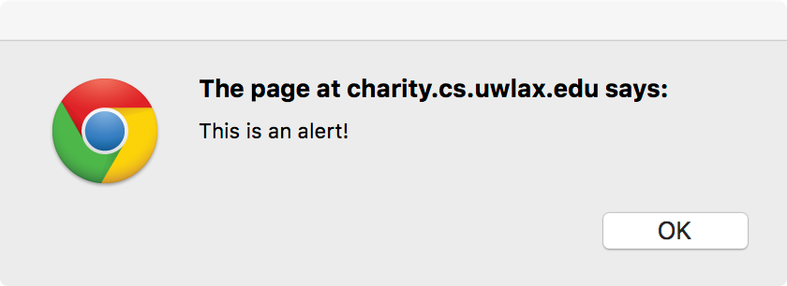
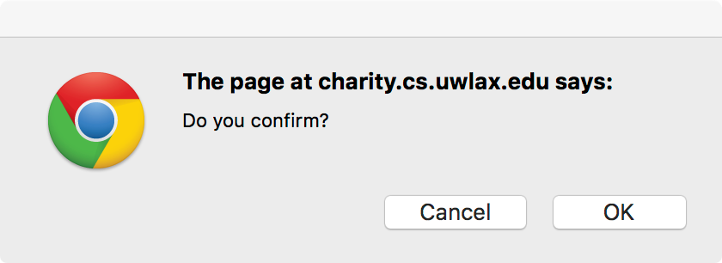
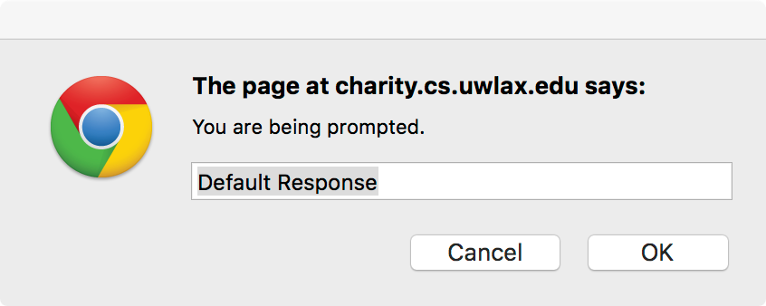
JavaScript Dom Methods
Several JavaScript methods support modal dialogs.
alert(text) : no return value
confirm(text) : return a boolean
prompt(text, default) : returns the value entered or null.

Slide 31
JavaScript Dom Methods
Asynchronous function execution
setTimeout( f, t ) : execute f after t milliseconds. Returns a handle that can be used to stop the function.
setInterval( f, t ) : execute f every t milliseconds. Returns a handle that can be used to stop the function.
clearInterval( handle )
clearTimeout( handle );
Examples
var p = function() { print('Hello'); }
var x = setInterval( p, 2500);
clearInterval( x );
var x = setTimeout( p, 2500 );
clearTimeout( x );

Slide 32
Creating a page
Write a web page that turns a JavaScript array of NFL teams into an ordered list of HTML strings on the page.
An NFL team has properties
name : a string
city : a string
conference : NFC, AFC
division : EAST, WEST, CENTRAL
Modify to order by conference
Modify to order by division

Slide 33
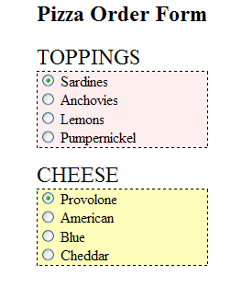
DOM Events Example
Develop an HTML page that allows users to order a pizza. Use ‘onclick’ handling for the radio buttons
Users must select one topping
Sardines
Anchovies
Lemons
Pumpernickel
Users must select one cheese
Provolone
American
Blue
Cheddar
Some combinations of topping/cheese are so repugnant that it would be unethical to sell them. Users receive a warning if selecting unethical combinations. The selection is nonetheless allowed on the page.
Sardines and Cheddar
Pumpernickel and Blue
Lemons and Blue
Alternately, warn and disallow unethical combinations
Notes:
<?xml version = "1.0" encoding = "utf-8" ?>
<!DOCTYPE html PUBLIC "-//W3C//DTD XHTML 1.0 Strict//EN"
"http://www.w3.org/TR/xhtml1/DTD/xhtml1-strict.dtd">
<!-- radio_click.hmtl
A document for radio_click.js
-->
<html xmlns = "http://www.w3.org/1999/xhtml">
<head>
<title> radio_click.html </title>
<script type = "text/javascript" src = "pizza_toppings2.js" >
</script>
</head>
<body>
<h2>Pizza Order Form</h2>
<form name="pizzaForm" action = "">
<span style="font-size:1.5em;">TOPPINGS</span>
<div style="border-width:1px;border-style:dashed;background-color:#ffeeee;width:50%;">
<label> <input type = "radio" name = "toppings" checked="true"
value = "Sardines"
onclick = "checkChoices()" />
Sardines </label>
<br />
<label> <input type = "radio" name = "toppings"
value = "Anchovies"
onclick = "checkChoices()" />
Anchovies </label>
<br />
<label> <input type = "radio" name = "toppings"
value = "Lemons"
onclick = "checkChoices()" />
Lemons </label>
<br />
<label> <input type = "radio" name = "toppings"
value = "Pumpernickel"
onclick = "checkChoices()" />
Pumpernickel </label>
</div>
<p></p>
<span style="font-size:1.5em;">CHEESE</span><br/>
<div style="border-width:1px;border-style:dashed;background-color:#ffffbb;width:50%;">
<label> <input type = "radio" name = "cheeses" checked="true"
value = "Provolone"
onclick = "checkChoices()" />
Provolone </label> <br />
<label> <input type = "radio" name = "cheeses"
value = "American"
onclick = "checkChoices()" />
American </label> <br />
<label> <input type = "radio" name = "cheeses"
value = "Blue"
onclick = "checkChoices()" />
Blue </label> <br />
<label> <input type = "radio" name = "cheeses"
value = "Cheddar"
onclick = "checkChoices()" />
Cheddar </label>
</div>
</form>
</body>
</html>
// some pizza combinations are so repugnant as to not be unethical
// to actually sell. Those combinations generate an error message but are allowed.
// Unethical combinations:
// sardines on cheddar
// pumpernickel and blue
// lemons and blue
function getTopping() {
for(i=0; i<document.pizzaForm.toppings.length; i++){
if(document.pizzaForm.toppings[i].checked) {
return document.pizzaForm.toppings[i].value;
}
}
}
function getCheese() {
for(i=0; i<document.pizzaForm.cheeses.length; i++){
if(document.pizzaForm.cheeses[i].checked) {
return document.pizzaForm.cheeses[i].value;
}
}
}
function checkChoices() {
var topping = getTopping();
var cheese = getCheese();
if(topping == 'Sardines' && cheese == 'Cheddar' ||
topping == 'Pumpernickel' && cheese == 'Blue' ||
topping == 'Lemons' && cheese == 'Blue') {
alert("This is an unethical combination. Please reselect.");
}
}
// some pizza combinations are so repugnant as to not be unethical
// to actually sell. Those combinations generate an error message and are disallowed.
// Unethical combinations:
// sardines on cheddar
// pumpernickel and blue
// lemons and blue
var lastTopping;
var lastCheese;
function getTopping() {
for(i=0; i<document.pizzaForm.toppings.length; i++){
if(document.pizzaForm.toppings[i].checked) {
return document.pizzaForm.toppings[i];
}
}
}
function getCheese() {
for(i=0; i<document.pizzaForm.cheeses.length; i++){
if(document.pizzaForm.cheeses[i].checked) {
return document.pizzaForm.cheeses[i];
}
}
}
function checkChoices() {
checkCount++;
var topping = getTopping().value;
var cheese = getCheese().value;
if(topping == 'Sardines' && cheese == 'Cheddar' ||
topping == 'Pumpernickel' && cheese == 'Blue' ||
topping == 'Lemons' && cheese == 'Blue') {
alert("This is an unethical combination. Please reselect.");
getTopping().checked="false";
getCheese().checked="false";
lastCheese.checked="true";
lastTopping.checked="true";
} else {
lastTopping = getTopping();
lastCheese = getCheese();
}
}

