Slide 1
Academic Program Workshop: Microchip PyKit Explorer Troubleshooting

Slide 2
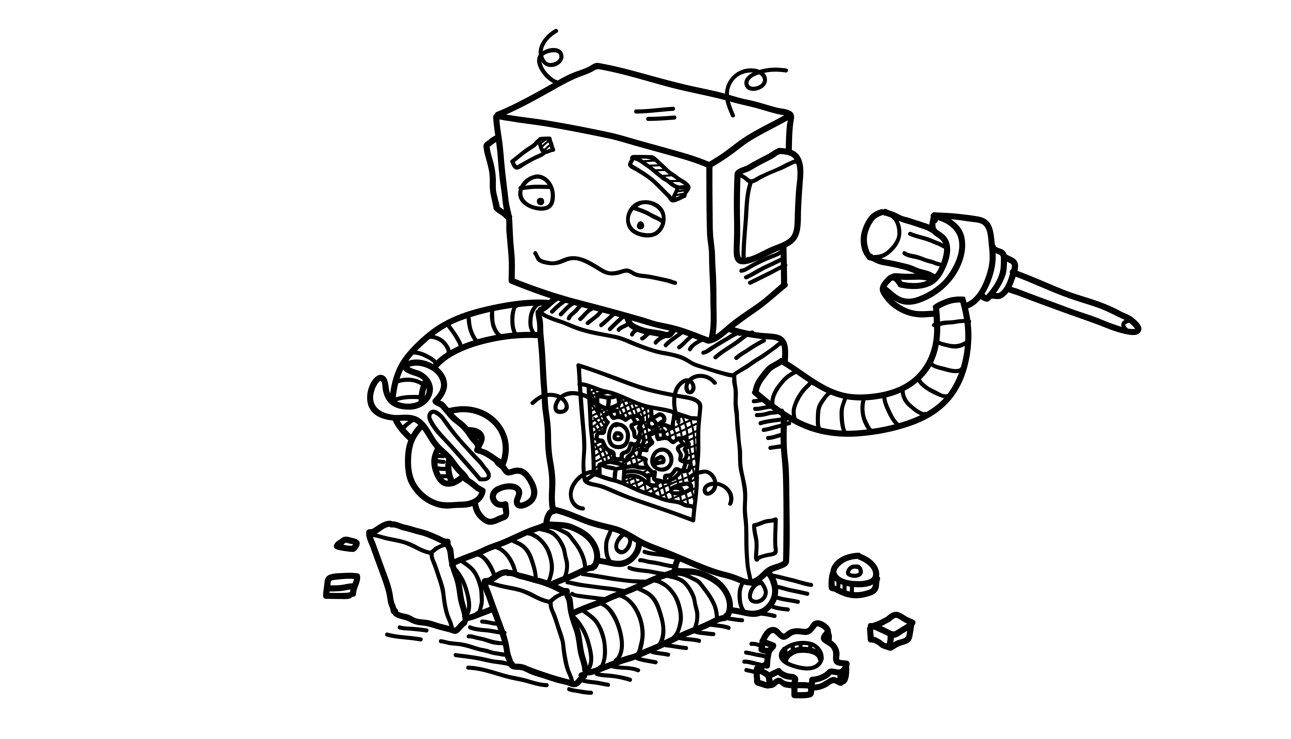
Troubleshooting!
Read Only File System Error When Saving
If student cannot save file and board gives Read Only File System error:
First: Try Ejecting the drive, then press Reset button, then try saving file again
If that fails:
Filesystem may be corrupted!
Most likely source:
Board has been reset/disconnected while performing write operations
Before starting solution – save files from CIRCUITPY to
host computer!!
Solution:
Enter REPL
Type:
import storage
storage.erase_filesystem()
Then copy saved files back to D:\CIRCUITPY
Notes:
To enter REPL:
Open Serial Monitor tab in lower pane
Connect to USB Serial Device (you may need to use Device Manager to find which COM port)
Send CTRL+C
Click on message field, press enter.
You should see prompt >>>
After implementing erase_filesystem solution, copy the files back to the CIRCUITPY drive.

Slide 3
Troubleshooting!
My CIRCUITPY drive disappeared!
If the user was previously successfully writing to D:\CIRCUITPY
But now the drive has disappeared:
Check you can access the CPYNANOBOOT drive
Double click the RESET button (near the USB connector)
You should see the Red LED fading in and out
In Windows Explorer you should see D:\CPYNANOBOOT
This means the board is likely OK!
(continued on next slide)
Notes:
For more troubleshooting issues and solutions, go to:
https://learn.adafruit.com/welcome-to-circuitpython/troubleshooting

Slide 4
Troubleshooting!
CIRCUITPY drive disappeared!
Enter Safe Mode:
Press RESET button on Curiosity CircuitPython board
Immediately you will see 4 Yellow flashes in one second
During this time press the RESET button again
You will then see 2 yellow flashes and the CIRCUITPY drive will appear!
Now you can enter the REPL and erase the filesystem
Enter REPL, then at prompt >>>
Type:
import storage
storage.erase_filesystem()
CIRCUITPY drive should reappear!
Notes:
To enter REPL:
Open Serial Monitor tab in lower pane
Connect to USB Serial Device (you may need to use Device Manager to find which COM port)
Send CTRL+C
Click on message field, press enter.
You should see prompt >>>

Slide 5
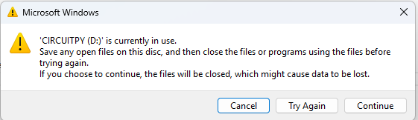
How To Eject The CIRCUITPY Drive
Always Eject before disconnecting cable or pressing reset button
Before Ejecting D:\CIRCUITPY
Close VS Code first!
Failure to close VS Code will give this popup:
Click Cancel, then close VS Code
Notes:
To enter REPL:
Open Serial Monitor tab in lower pane
Connect to USB Serial Device (you may need to use Device Manager to find which COM port)
Send CTRL+C
Click on message field, press enter.
You should see prompt >>>
After implementing erase_filesystem solution, copy the files back to the CIRCUITPY drive.

Slide 6
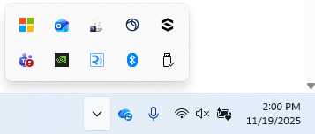
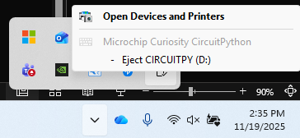
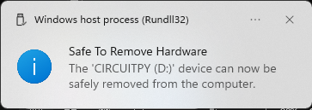
How To Eject The CIRCUITPY Drive
Always Eject before disconnecting cable or pressing reset button
Click Safely Remove Hardware and Eject Media button
Bottom right corner of Windows
Click Eject CIRCUITPY (D:)
Notes:
To enter REPL:
Open Serial Monitor tab in lower pane
Connect to USB Serial Device (you may need to use Device Manager to find which COM port)
Send CTRL+C
Click on message field, press enter.
You should see prompt >>>
After implementing erase_filesystem solution, copy the files back to the CIRCUITPY drive.

