Slide 1
Academic Program Workshop: Microchip PyKit Explorer Games

Slide 2
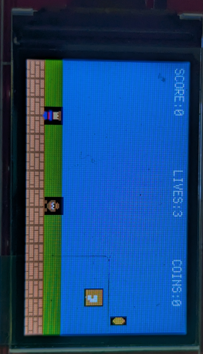
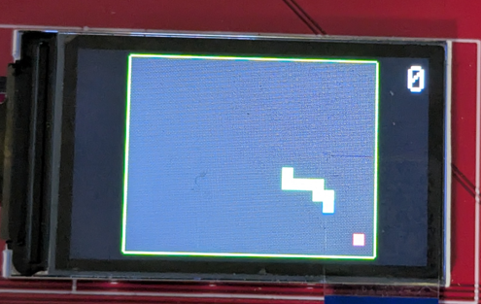
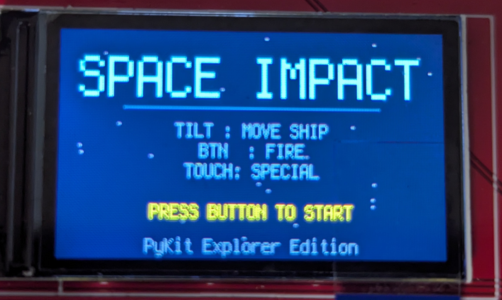
PyKit Explorer Games
Snake • Super Mario Bros • Space Impact

Slide 3
The PyKit Explorer Games
Three full games — controlled by tilting the board
Snake
Classic grid game — eat food, grow longer, avoid yourself
IMU tilt steers the snake in real time
High score persisted in on-chip NVM across power cycles
Super Mario Bros
Side-scrolling platformer with enemies, coins and audio
Tilt left/right to run; tilt forward to jump
Sprite pooling, WAV audio and 8.5-screen level
Space Impact
Vertical shoot-em-up inspired by the Nokia classic
Tilt to aim; touch pad to fire
Enemies, projectiles, lives and scrolling starfield
All three use the same MVC software architecture

Slide 4
Software Architecture: MVC
Model – View – Controller
Why use MVC on a microcontroller?
Separation of concerns — each file has one job
Game logic can be tested on a PC without any hardware
Swapping the display or adding BLE requires zero game-logic changes
MODEL (snake_model.py)
The brain — all game state and rules, no hardware
VIEW (snake_view.py)
All output — LCD, audio, LEDs — no knowledge of game rules
CONTROLLER (code.py)
The glue — reads inputs, ticks the Model, routes events to the View
Rule: the Model never calls the View. The View never reads inputs.
All communication flows through the Controller

Slide 5
The Model — snake_model.py
All game state and rules. Zero hardware.
What it stores
snake — list of (x, y) cell positions; index 0 is the head
direction — current movement vector (UP / DOWN / LEFT / RIGHT)
food — (x, y) position of the pellet
score and high_score — persisted to NVM flash across reboots
What it does each tick (step())
Moves the head, checks wall and self-collision
Returns an event string: None, "ate_food", or "died"
Never resets itself — leaves that decision to the Controller
Demo / AI mode
_ai_step() — greedy pathfinding, tries food-preferring directions in order
Touch-pad tap toggles demo_mode; AI score never overwrites the player score

Slide 6
The View — snake_view.py
All output. No game rules.
displayio layer stack (back to front)
_game_layer — 24x18 Bitmap scaled 7x to fill the 240x135 LCD
border_group — 4 thin green rectangles (vectorio)
_ui — score label (top-right) and game-over overlay (centred)
render(model) — called every tick
Clears bitmap, paints food (red-pink), body (green), head (cyan)
The only place the View touches the Model — read-only
Events triggered by the Controller
update_score() — updates the score label text
flash_red() — swaps palette BG to red, waits 150 ms
show_game_over() — overlay with score + high score for 3 s
play_food_sfx() / play_gameover_sfx() — non-blocking DAC audio
set_mode_pixel() — NeoPixel: blue = manual, green = demo

Slide 7
The Controller — code.py
Glue between hardware, Model and View
Initialisation
Instantiates all hardware via API modules (LCD, IMU, NeoPixels, audio, touch)
Creates SnakeModel() then SnakeView(lcd, px, led, audio)
Main loop — runs every ~5 ms
poll_inputs() — reads IMU tilt and cap-touch pad every iteration
IMU tilt applies a low-pass filter (alpha=0.25) to remove vibration noise
Dominant-axis tilt above threshold (2.2 m/s²) sets direction via model.set_direction()
Game tick — fires every 120 ms
Calls model.step() and reads the event string
"ate_food" → view.update_score(), view.play_food_sfx()
"died" → view.flash_red(), view.show_game_over(), model.reset()
None → view.render(model) only

Slide 8
Snake — MVC Data Flow
How the three files talk to each other
Every ~5 ms (poll_inputs)
IMU → ax, ay (raw m/s²) → low-pass filter → tilt direction → model.set_direction()
CapTouch pad → just_touched edge → model.toggle_demo() → view.set_mode_pixel()
Every 120 ms (game tick)
Controller calls model.step()
Model moves snake, checks collisions, returns event string
Controller reads event → calls matching view methods
Controller calls view.render(model) every tick regardless
Key design constraints
Model only imports struct + microcontroller (no displayio, no audio)
View only imports displayio, audio, and constants from snake_model
Controller is the only file that imports everything

Slide 9
Embedded Systems Concepts in the Games
Real engineering skills — wrapped in a game
Hardware abstraction
API modules hide pin numbers, SPI buses and I2C addresses — swap hardware without touching game code
Sensor fusion and filtering
Exponential moving average LPF on IMU ax/ay reduces vibration noise in tilt control
Non-volatile memory (NVM)
High score packed into 6 bytes (magic marker + uint16) and written to on-chip flash
Non-blocking audio
AudioOut.play() fires in the background; the game loop never stalls waiting for sound
displayio layer compositing
Bitmap game layer + vectorio border + UI group stacked at the driver level for zero-copy rendering
Fixed-rate tick loop
Input sampled at ~200 Hz; game logic at 8.3 Hz — decoupled timing prevents input lag

Slide 10
Super Mario Bros
MVC deep-dive — side-scrolling platformer on the PyKit Explorer

Slide 11
SMB — The Model (mario_model.py)
All game state and rules. Zero hardware.
Entities
Mario — position, velocity, on_ground, sprite_frame, facing_right, invincible, jump_triggered, is_running
Platform — world x/y, width, height, block_type (brick/question/pipe); static — no update() needed
Enemy (Goomba) — walks left, gravity, AABB bounce off walls, sprite_frame for walk animation
Coin — world x/y, collected flag; 8x14 AABB hitbox used for pickup detection
Level — builds 2200 px wide world 1-1
Ground row, question blocks, brick platforms, pipes, staircase, enemies (x7), coins (x8)
All positions in world coordinates; Camera offset applied by the View during draw()
Camera — smooth-follow scrolling
Target = mario.x - 80 px; lerps at 20% per tick toward target (smoothing = 0.2)
Clamped to [0, 2200 - 240] so the world edge is never overscrolled
update(InputState) returns a list of event strings
Physics: gravity 0.6 px/tick^2, jump strength -10, walk 2.5/run 4.5 px/tick
Nearby-only collision check (< 150 px) to skip distant platforms each tick
Stomp detection: mario.vel_y > 0 AND mario.y < enemy.y on the same tick

Slide 12
SMB — The View (mario_view.py)
Sprites, audio, HUD and overlays. No game rules.
displayio layer stack (back to front)
Static 240x135 sky bitmap (0x5C94FC blue) -- rendered once, never redrawn
Static ground strip bitmap (0x00AA00 green) at GROUND_Y
_sprite_group -- pre-allocated pools: 75 platforms, 10 enemies, 20 coins, 1 Mario TileGrid
_hud -- SCORE / LIVES / COINS labels with dirty-flag caching (string only created on change)
Overlay groups: _victory_screen, _gameover_screen (hidden until triggered by Controller)
draw(model) -- called every tick at 30 FPS
Camera window culling: only sprites within cam_x +-64 px are shown, rest hidden
Platform tile index set from _TILE_MAP dict: brick=0, question=1, pipe=2
Mario blinks every 10 ticks during invincibility; flip_x set from mario.facing_right
Sprite properties (x, y, tile, flip) only written when value has actually changed
NeoPixel mapping (5 pixels)
Pixel 0: amber while run (CAP1) is held | Pixels 1-3: green per remaining life | Pixel 4: blue while airborne
All gold on level complete; all red on game over (flash_neopixels_gameover)

Slide 13
SMB — The Controller (code.py)
Hardware owner, input normaliser, and event router
IMUController class
X-axis only tilt for horizontal movement (left/right) -- Y axis not used in Mario
Calibrates X bias at startup: 30 samples averaged after 1 s settle time
Dead-zone 0.8 g (wider than Space Impact's 0.4 g -- prevents drift while running)
Full range 6.0 g normalised to [-1.0, 1.0] -- larger range suits slower platformer input
Jump buffering (D3 button, active-LOW)
poll_button() called at frame top -- catches taps during draw() and sleep()
3-frame buffer: press stored for ~100 ms so quick taps are never swallowed
CAP1 run touch -- debounced
Latch True immediately on touch; only release after 3 consecutive False readings
Passed as InputState.run -- MarioModel uses it to switch MOVE_SPEED (2.5) vs RUN_SPEED (4.5)
Game-over hold screen
Model emits "gameover"; Controller runs a 150-frame (~5 s) countdown loop
After hold: model.reset() + view.hide_overlays() -- clean handoff back to Model

Slide 14
SMB — Events and Embedded Concepts
How the three layers communicate, and what students learn
Event vocabulary from model.update()
"jumped" -> view.play_sfx("jump")
"coin" -> view.play_sfx("coin") (+200 score, coin counter++)
"stomp" -> +100 score, mario vel_y = -6 (bounce), enemy.alive = False
"enemy_hit" -> lives--, invincible = 120 ticks (~4 s)
"level_complete" -> view.show_victory(), victory_timer = 180 ticks (6 s)
"gameover" -> view.show_game_over(), 150-frame hold in Controller, then model.reset()
Key embedded concepts showcased
World vs screen coordinates -- level is 2200 px wide; Camera.x offsets every draw call
Viewport culling -- only sprites within cam_x +/- 64 px sent to displayio each frame
flip_x sprite mirroring -- single 16x16 Mario sprite sheet covers both directions
Static backgrounds -- sky and ground bitmaps rendered once; never redrawn to avoid flicker
Nearby-only AABB -- platform list filtered by |dx|, |dy| < 150 px before collision test
Dirty-flag HUD -- label.text string only allocated when score/lives/coins actually change

Slide 15
Space Impact
MVC deep-dive — Nokia-inspired shoot-em-up on the PyKit Explorer

Slide 16
Space Impact — The Model (space_model.py)
All game state and rules. Zero hardware.
Entities
Ship — position, velocity, sprite_frame, fire_cooldown, has_shield, rapid_fire, special_ammo
Enemy — 4 types: Scout (straight), Weaver (sine wave), Diver (tracks player Y), Boss (oscillates + fires spread)
Bullet / EnemyBullet / PowerUp / Explosion / Star — pre-allocated pools to avoid heap fragmentation
WaveManager
Reads wave definitions per level (1-3) and spawns enemies by delay_ticks offset
After all waves: spawns a Boss with scaled HP (5 / 8 / 12 per level)
Sets all_done = True when boss dies, triggering level_complete flow
update(InputState) returns a list of event strings
IMU tilt_x / tilt_y applied directly to ship vel_x / vel_y each tick
AABB collision: bullet-enemy, enemy bullet-ship, enemy-ship body
Power-ups: 20% drop on enemy kill — shield, rapid-fire (300 ticks), or +1 life
No random module used — LCG pseudo-random for star Y and power-up drops

Slide 17
Space Impact — The View (space_view.py)
Sprites, audio, HUD and overlays. No game rules.
displayio layer stack (back to front)
Static 240x135 black background bitmap
_star_group — 30 TileGrids (12 bright fast + 18 dim slow) for parallax scrolling
_sprite_group — pre-built pools: 8 bullets, 6 enemy bullets, 12 enemies, 3 power-ups, 5 explosions, 1 ship
_hud — SCORE / HP / LV / SP labels with dirty-flag updates (only redraws on change)
Overlay groups: _victory_screen, _gameover_screen, _start_menu (shown/hidden by Controller)
draw(model) — called every tick at 30 FPS
Iterates model lists, positions sprites; hides unused pool slots
Ship blinks during invincibility (visible when invincible % 8 < 4)
AudioManager (_AudioManager)
Opens WAV file per play, closes after — keeps heap usage low
Rate-limited to 80 ms minimum between plays; reinitialises AudioOut every 50 plays
NeoPixel mapping: pixel 0 = shield/special | 1-3 = lives | 4 = firing flash

Slide 18
Space Impact — The Controller (code.py)
Hardware owner, state machine, and event router
IMUController class
Calibrates X and Y axes at startup: averages 30 samples to find resting bias
Dead-zone (0.4 g) + range normalisation to [-1.0, 1.0] — same interface as Snake
Fire button (D3, active-LOW) with 3-frame buffer to catch fast taps during draw()
Special weapon (CAP1 touch) with 3-tick debounce and edge detection — fires on rising edge only
Game state machine (4 states)
STATE_MENU — shows title screen, blinks prompt, waits for fire button
STATE_PLAYING — calls model.update(inp), routes events, calls view.draw(model)
STATE_GAMEOVER — holds game-over screen for 2 s then returns to menu
STATE_VICTORY — holds all-clear screen until fire button is pressed
Compared to Snake controller
Two-axis IMU input (X + Y) vs. Snake's single dominant-axis tilt
Event list per tick (multiple events possible) vs. Snake's single event string
Explicit state machine vs. Snake's simpler linear loop

Slide 19
Space Impact — Events, Audio and Embedded Concepts
How the three layers communicate
Full event vocabulary from model.update()
"fired" / "special_fired" → view.play_sfx("shoot")
"enemy_destroyed" → view.play_sfx("explosion")
"boss_hit" / "boss_destroyed" → view.play_sfx("hit") or "boss_explode"
"player_hit" / "shield_hit" → view.play_sfx("hit")
"powerup_collected" → view.play_sfx("powerup")
"level_complete" / "all_clear" / "gameover" → overlay + state transition
Audio synthesis (generate_audio.py)
7 WAV files generated on-PC using NumPy (sine sweeps, noise bursts, ADSR envelopes)
Mono 16-bit PCM 22050 Hz -- exact format required by CircuitPython audiocore.WaveFile
Key embedded concepts showcased
Sprite sheet pooling -- TileGrids pre-built; tile index set per frame (no GC pressure)
Dirty-flag HUD updates -- label.text only written when value changes
Forgiving AABB hitbox -- ship hit area (10x8) smaller than sprite (16x16)
Periodic GC every 90 frames (~3 s) to prevent fragmentation without stalling gameplay

