Slide 1
Name: Yun-Chen Tsai
Advisor: Prof. Yu-Jung (Yuri) Lu^{1,2}
¹Research Center for Applied Sciences, Academia Sinica, Taipei 11529, Taiwan
²Department of Physics, National Taiwan University, Taipei 10617, Taiwan
Date: 2024.xx.xx

Slide 2
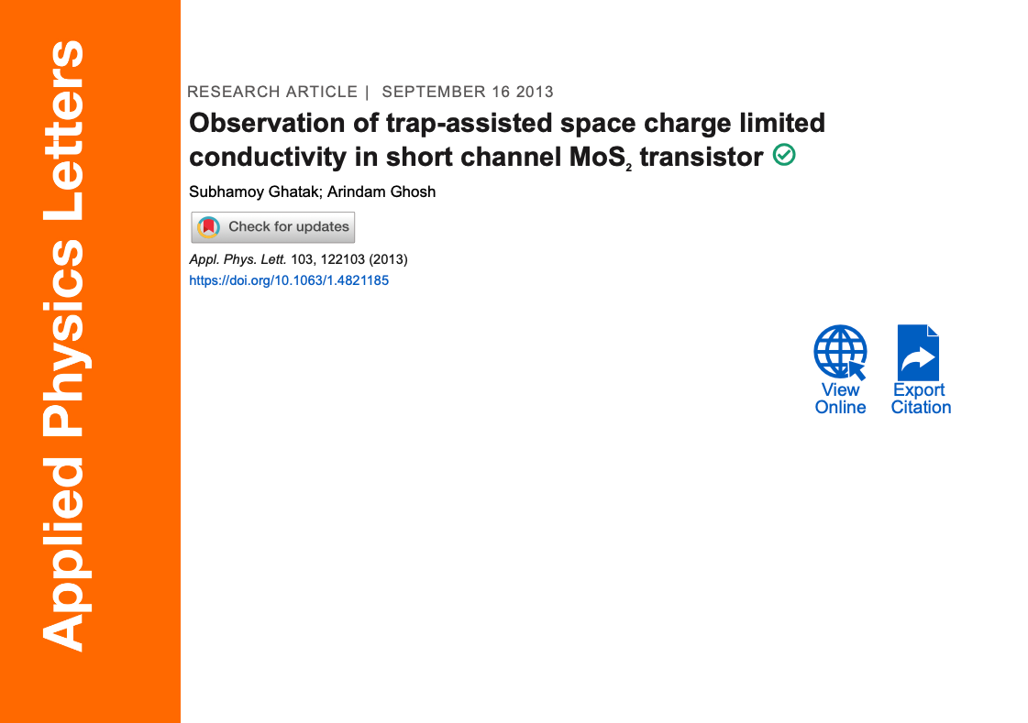

Slide 3
Key findings
At low V_{DS}, conduction is ohmic; at higher V_{DS}, it becomes SCLC
The current follows I ∝ V^{m}, with m ≈ 2 at room T, increasing as temperature decreases, consistent with exponential trap distribution
A temperature-independent critical voltage V_{c} is observed, where I–V curves at different T intersect.
From V_{c}, trap densities were quantified: Nt∼1.5 – 2.3×10¹⁷ cm⁻³
Increasing gate voltage lowers V_{c}, showing that gate-induced carriers pre-fill traps.
The trap states likely originate from bulk MoS₂ disorder (sulfur vacancies, oxidation, structural inhomogeneity) rather than just substrate effects.

Slide 4
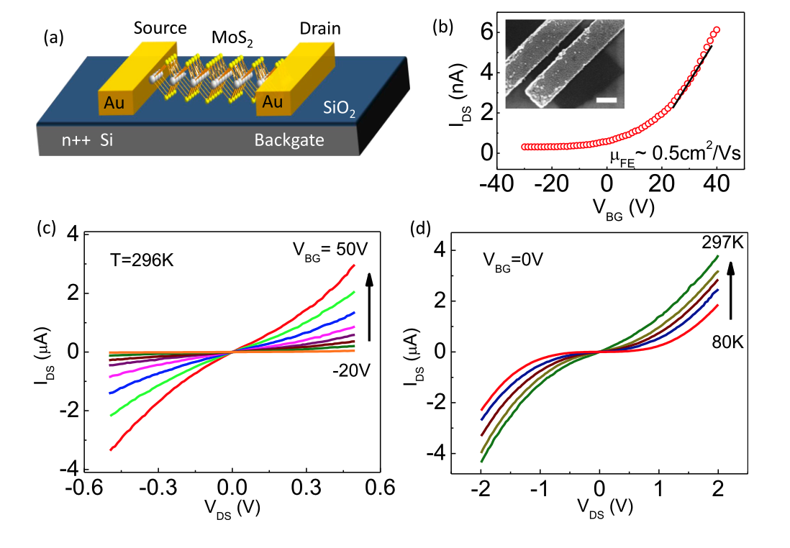
Figure 1
Inset: SEM image
I–V curves at V_{BG} = 0 V across different T
Nonlinearity increases as T decreases, excluding Schottky/tunneling effects.
(nonlinearity arises from SCLC)
Work function:
MoS2: 5.1 eV
Au: 4.5 eV
I–V curves at room T for different V_{BG}
Linear and symmetric at low V_{DS},
showing quasi-ohmic contacts

Slide 5
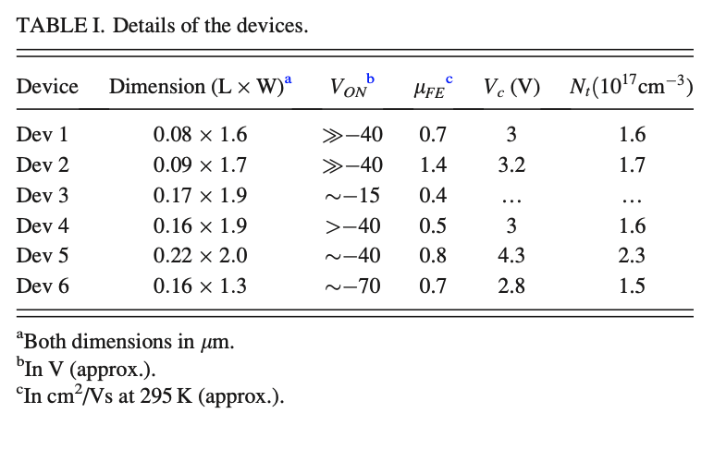
channel length ~80–200 nm

Slide 6
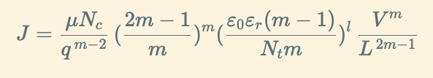
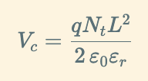
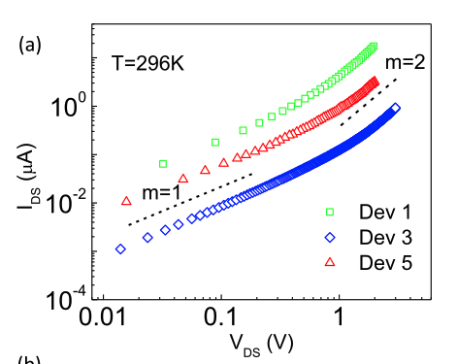
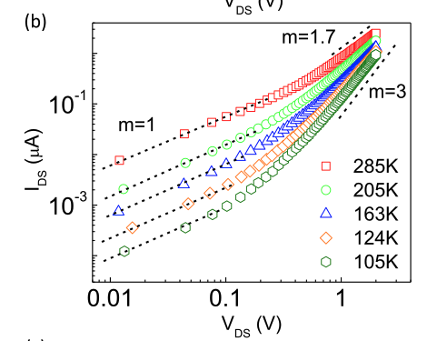
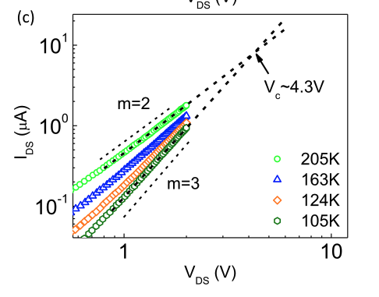
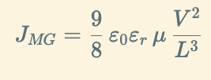
Figure 2
Dev 5
Extrapolation of I–V curves at low T yields a T-independent critical voltage ≈4.3 V, giving trap density 2.3×10¹⁷ cm⁻³
Log–log I–V curves (room T, VBG=0).
At low VDS slope = 1 (ohmic)
At higher VDS slope → 2 (SCLC).
Temperature dependence:
slope increases from
1.7 (285 K) → 2 (205 K) → 3 (105 K)
At RT > Tc, m = 1.7 < 2
At Tc, m = 2
At T < Tc, m increases
Confirms exponential trap distribution and provides a method to quantify trap density

Slide 7
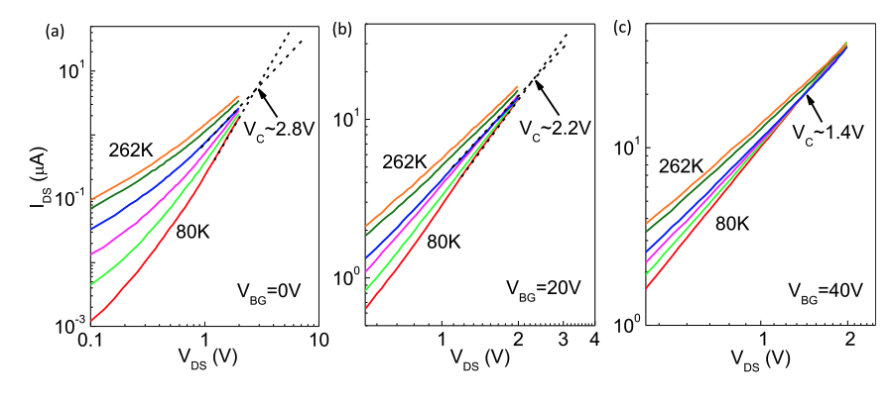
Figure 3
I–V curves at VBG = 0, 20, 40 V for multiple T.
Intersection points (critical voltage) decrease with gate bias
High gate voltage fills more traps at equilibrium
reducing effective trap density and lowering Vc​

Slide 9


ACKNOWLEDGEMENT
Lu Lab 2024

